Slide 1
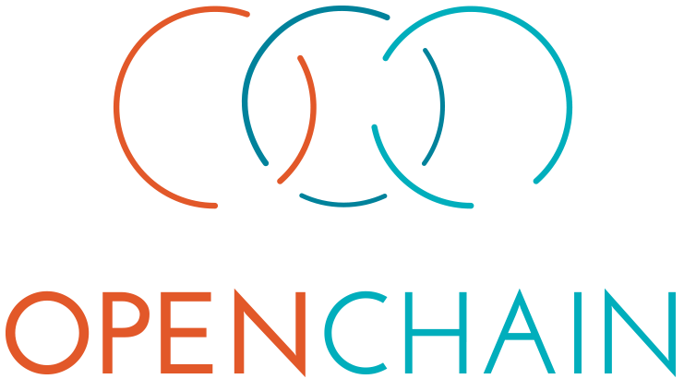


The OpenChain Projects builds standards to define the key requirements of quality open source license compliance and security assurance programs
upstream
downstream
downstream
inbound
inbound
Training
Policy
Process
outbound
These are simple, effective standards for organizations of all sizes in all markets. They are openly developed and freely available to all.
The OpenChain Project supports these standards with extensive reference material, free self-certification and a vibrant community:
https://www.openchainproject.org/get-started
OpenChain Platinum Members

