Slide 1
OpenChain Project
Understanding How We Build A More Trusted Open Source Supply Chain

Slide 2
OpenChain Vision + Mission
Our vision is a trusted supply chain
Our mission is to make that happen
This makes a cheaper, faster, more efficient supply chain… for everyone
Project Charter:
https://github.com/OpenChain-Project/Project-Charter-And-Agreements/blob/master/Project-Charter/OpenChain-Charter-March2020.pdf

Slide 3
Our standards are the international baseline for quality in open source license compliance and security assurance programs.
Our guides and reference material helps people solve compliance challenges.
Our community provides a space to share knowledge.

Slide 4

Platinum Members (Governing Board)
Members Represent Trillions In USD Market Value

Slide 5

























































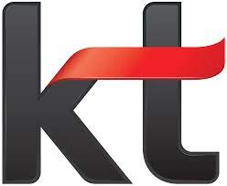













Example Verticals Impacted by OpenChain
Automotive | Banking | Cloud | Consumer | Industrial | SaaS | Service | Silicon | Telco
This is a snapshot based on membership and select conformant organizations currently listed on our website. Total conformant numbers are far higher.
Example: PwC Survey shows 20% of companies in Germany with over 2,000 employees already used ISO/IEC 5230.

Slide 6







































Trillions More In Market Value Touched
(Chris @ Lockheed chairs our spec development)
This is a non-exhaustive list of participants on some of our community lists

Slide 7
Project Overview

Slide 8
Our Mental Model Of The Supply Chain

Slide 9

The Actual Supply Chain

Slide 10
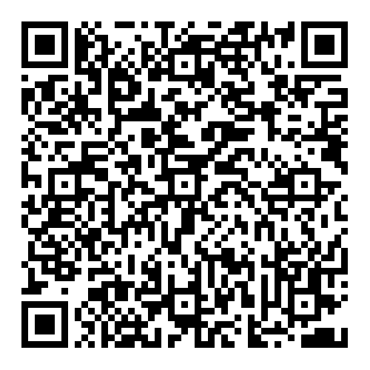

The Value of Open Source Software
The supply-side value of widely-used OSS is $4.15 billion
The demand-side value is $8.8 trillion.
Companies would need to spend 3.5 times more on software if OSS did not exist.

Slide 11
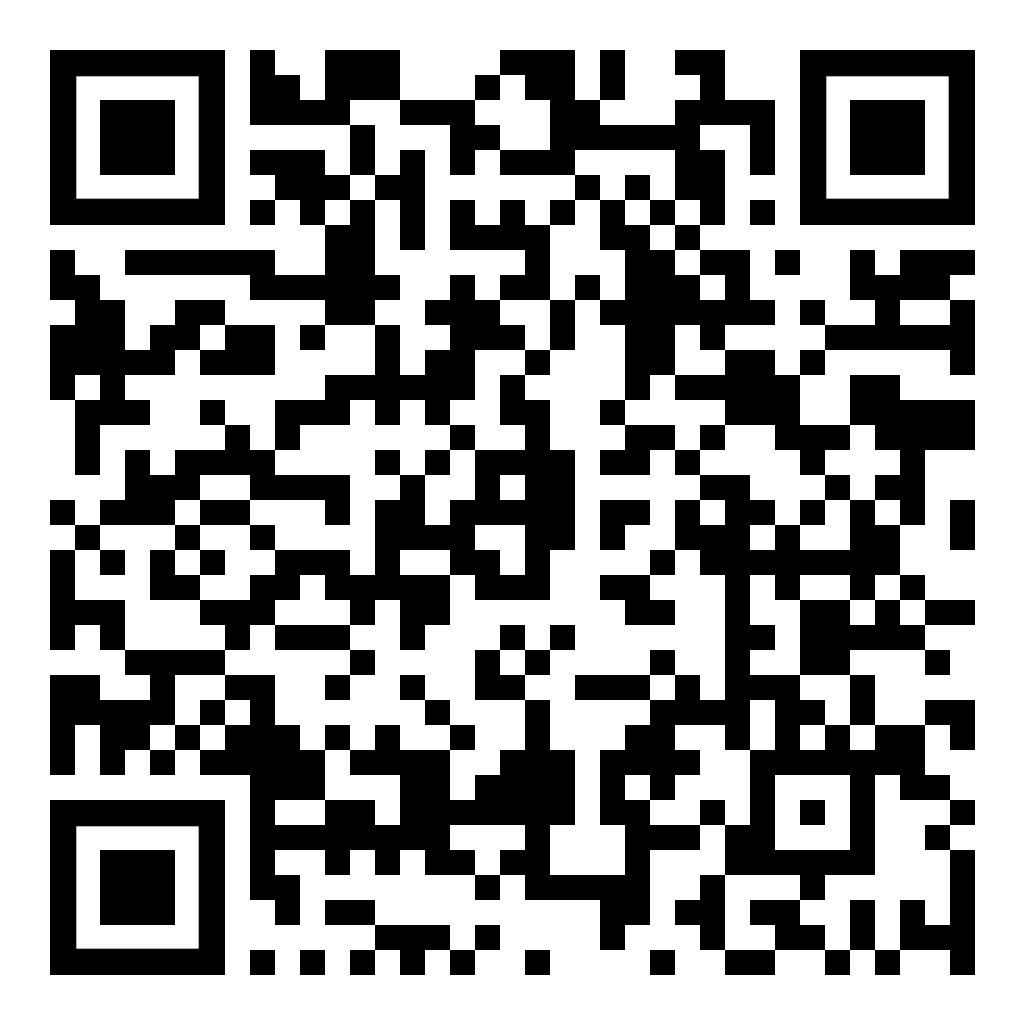
Global Codebase Statistics
98% use open source
68% have license compliance issues
87% have security issues
Black Duck OSSRA Report 2026
Notes:
Black Duck Open Source Security and Risk Analysis Report

Slide 12
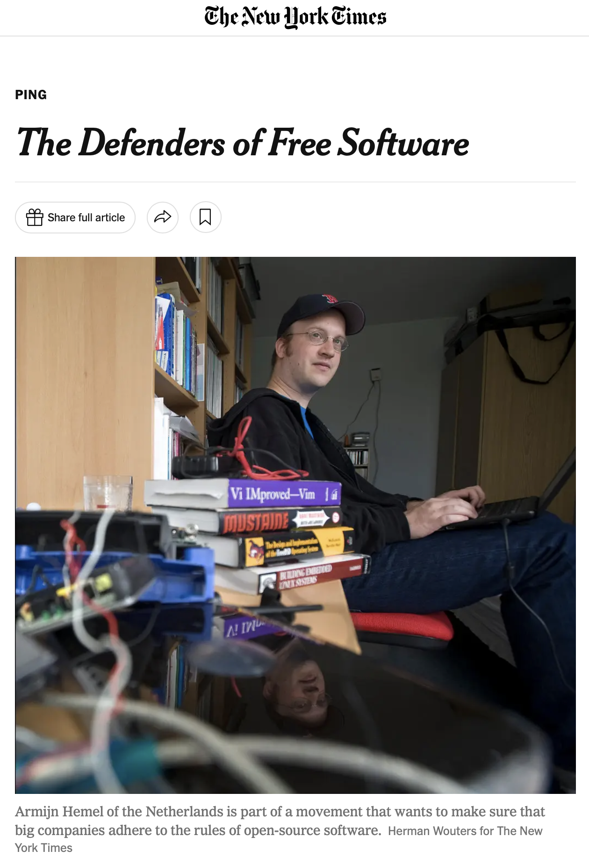
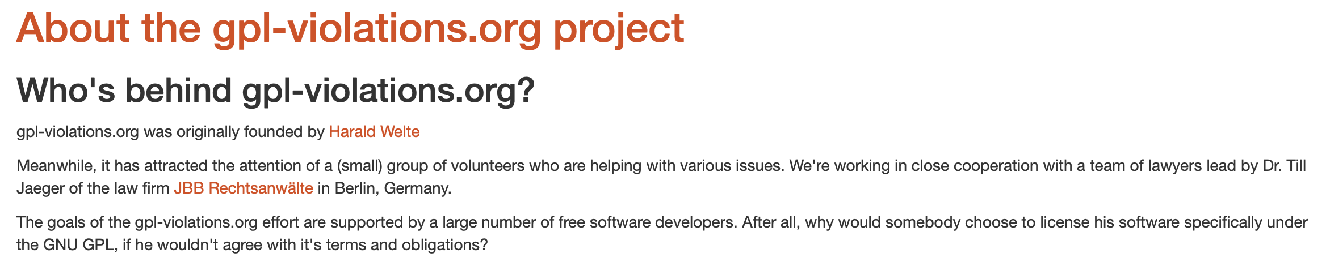
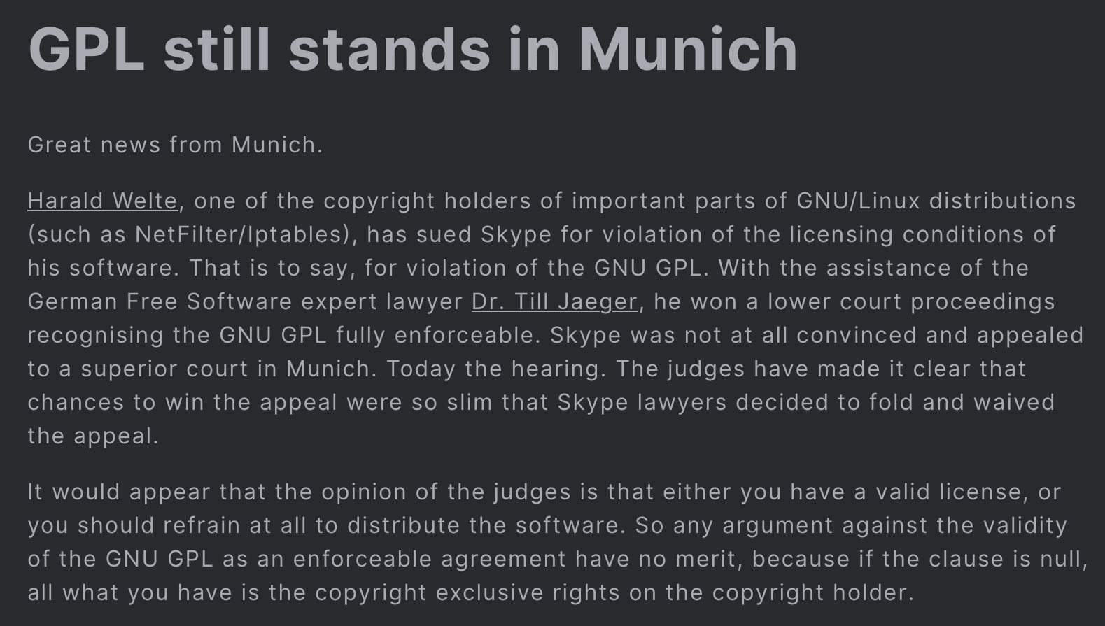
So, Inevitably…

Slide 13
We Needed To Improve Trust In The Supply Chain

Slide 14

Projects Working On This Emerged…
2010 onward…
2015 onward…

Slide 15
What is the
Supply Chain?

Slide 21
The Supply Chain is Internal + External

Slide 22
OpenChain Makes Guides, Specs, Standards… +
We Study
We Brainstorm
We Make a Guide (if useful)
We Make a Specification (if useful)
We Make a Standard (if useful)
And supporting reference material!

Slide 23



We Provide A High Level Process Solution
Process Management Standards, Guides and Reference Material
Implementation Standards
Implementation Guides, Reference Material and Metrics

Slide 24
Trust Built By Process Management
OpenChain ISO/IEC 5230:2020
International Standard for open source license compliance.
OpenChain ISO/IEC 18974:2023
International Standard for open source security assurance.
High level process standards
Simple, effective and suitable for companies of all sizes in all markets
Openly developed by a vibrant user community and freely available to all

Slide 25
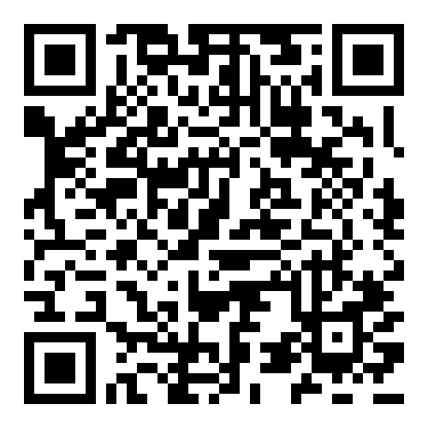
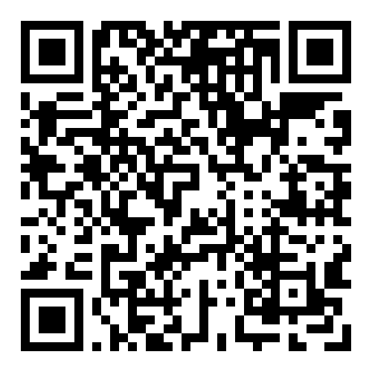
Sister Standards - Processes for Programs
ISO/IEC 5230 (License Compliance)
ISO/IEC 18974 (Security Assurance)
Flexible program size
Covering:
Inbound processes
Internal processes
Outbound processes
Standards about process points
Not about process content

Slide 26
The OpenChain standards are the international baseline for quality in open source license compliance or security assurance programs.

Slide 27
Recent Progress

Slide 28












1H 2025 Overview
Proposed updates to ISO/IEC 5230 and ISO/IEC 18974 finished public comments and freeze periods, moved to Steering Committee.
Maturity models released.
“Explainers” for company departments released.
Open source policy template updated.
Telco SBOM Quality Guide updated.
AI BOM Compliance Guide complete, board approval pending.
Cross-industry SBOM quality guide early drafting.
Reorganized reference library of 1,500~ resources.
Better discoverability of processes
Improved integration with other LF Project activities (e.g. OpenSSF).
New Platinum Member:
ISO/IEC 5230 Co-Announcements:
Recertification Co-Announcements:
ISO/IEC 18974 Co-Announcements:

Slide 29
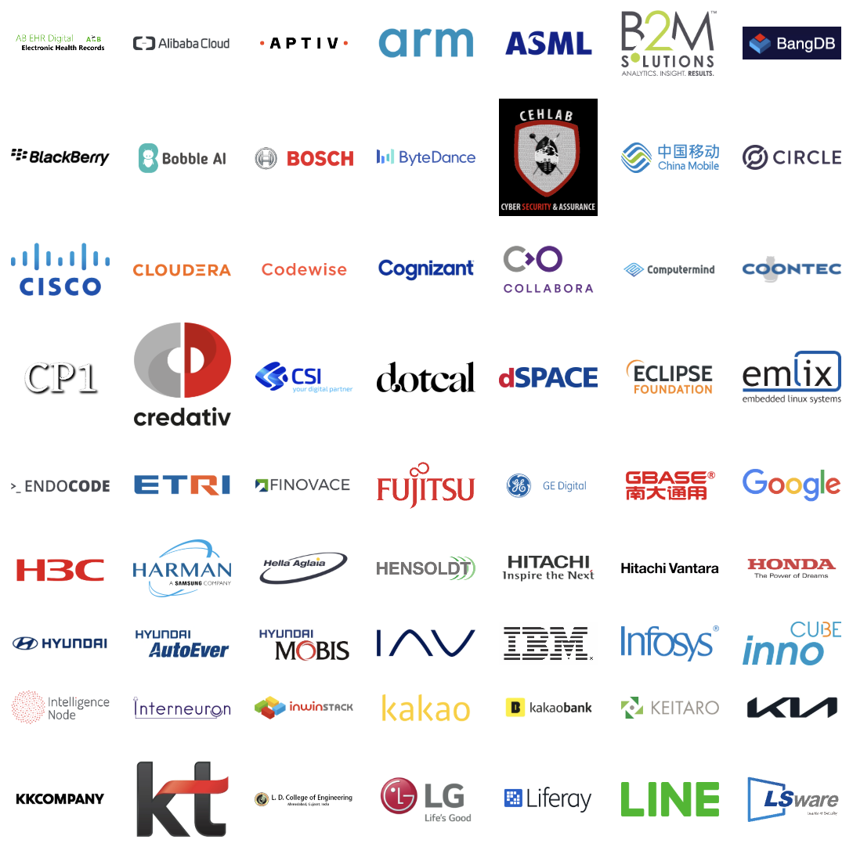
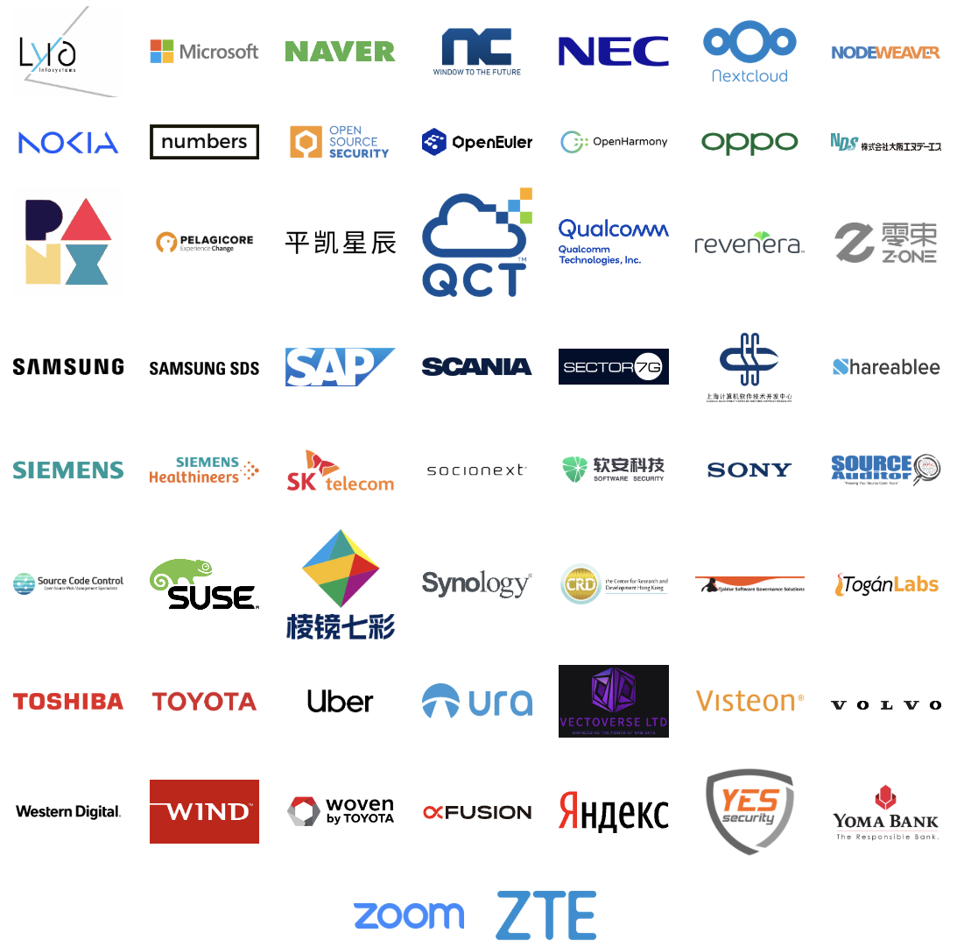
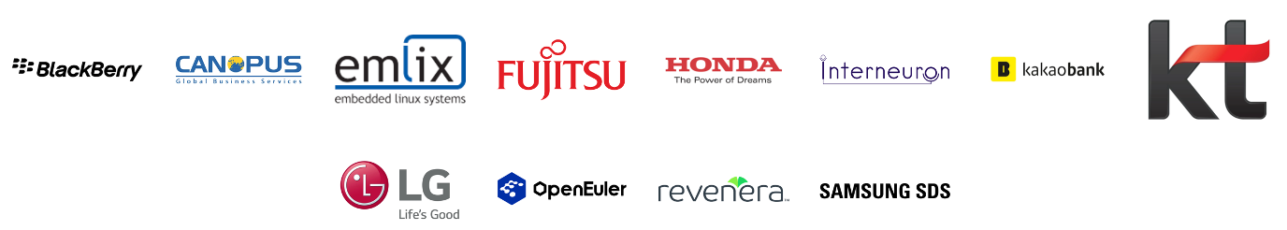
A Continual Heartbeat Of Adoption
ISO/IEC 5230:2020
OpenChain standards are built, used
and supported by all industries
Recent adoption announcements:
ISO/IEC 18974:2023
Reminder: ISO standards can be adopted and used by any party,
so we only get informed and do PR on a discretionary basis.

Slide 30
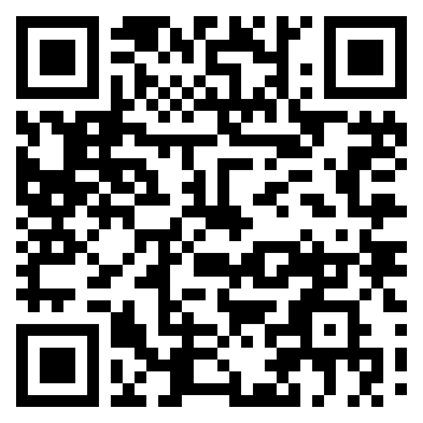
31%
Data Point
of large German companies already use or plan to adopt OpenChain ISO/IEC 5230
Source PwC: https://tinyurl.com/openchain-germany-31

Slide 31
Supporting Regulation

Slide 32
Addressing US Executive Order / NIST / CISA
OpenChain ISO/IEC 5230 and ISO/IEC 18974 require the use of SBOMs.
They are flexible enough to meet any specific requirements the US develops around SBOM use, structure or format.

Slide 33
Addressing the CRA
OpenChain ISO/IEC 5230 and ISO/IEC 18974 asked for record-keeping before Cyber Resiliency Act (CRA) made it into a requirement.
OpenChain ISO/IEC 5230 and ISO/IEC 18974 require companies to create and archive verification materials around open source license compliance and security assurance.

Slide 34
Relationship with Other Standards

Slide 35
Wide Compatibility
OpenChain standards are compatible with all compliance standards, security standards and SBOM formats that we are aware of.
In general, OpenChain standards are designed to work with all other standards related to open source process management or solution implementation.
The goal is to be practical and useful for companies of all sizes and in all markets.

Slide 36
Adoption Methods

Slide 37
Self-Certification
Self-certification to an OpenChain standard (and any other standard) involves an entity reviewing material, deciding that they meet the requirements it describes, and then advertising that fact.
OpenChain provides extensive resources to help with this, such as self-certification checklists.
The OpenChain standards are explicitly designed to work effectively with self-certification because:
  They require a company to keep records of how they certified and details of each point (verification materials)
  They are designed for supply chain procurement, with an expectation that customer companies can and will audit supplier company verification materials at the time of their choosing
This has proven effective, and no purposeful attempts to “cheat” have been reported to us since our public launch in 2016.

Slide 38
Third-Party Certification
Third-party certification to an OpenChain standard (and any other standard) one legal entity with appropriate permission in the local jurisdiction to certify that another legal entity meets the requirements of the relevant standard.
This is a common approach in regulation-heavy industries such as automotive around standards such as ISO 26262 (functional safety).
Because OpenChain produces ISO standards, it supports and follows the same type of third-party certification processes used by other ISO standards.
Third-party certifiers such as Bureau Veritas, Deloitte and PwC support OpenChain standards.

Slide 39
Support Network

Slide 40
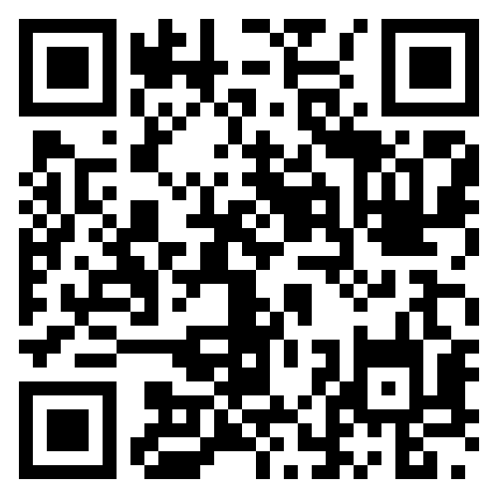
Our Community Work Groups
Core Work Groups
Education (Autumn 2020~)
Specification (Spring 2016~)
Community Work Groups
AI (January 2024~)
Automation (Summer 2019~)
SBOM (July 2024~)
Industry-Specific Work Groups
Automotive (Summer 2019~)
Telco (Spring 2021~)
Regional User Groups
China (Sept 2019~)
Germany (Jan 2020~)
India (Sept 2019~)
Japan (Dec 2017~)
Korea (Jan 2019~)
Meridian 22 (Sept 2025~)
Taiwan (Sept 2019~)
UK (June 2020~)

Slide 41
Our Current Community Chairs
Global Work Groups:
  AI Dave Marr, Qualcomm and Matthew Crawford, Arm
  Automotive Masato Endo, Toyota
  Education Martin Yagi, First Light Fusion
  SBOM Norio Kobota, Sony
  Specification Chris Wood, Lockheed Martin
  Tooling Oliver Fendt, Siemens
  Telco Marc-Etienne Vargenau, Nokia
Regional Work Groups:
  China Zhenhua Sun, ByteDance
  Germany Pending Chair Election
  Japan Ayumi Watanabe, Hitachi Solutions
  Korea Haksung Jang, SK Telecom
  India Buji K. Nair
  Taiwan Pending Chair Election

Slide 42
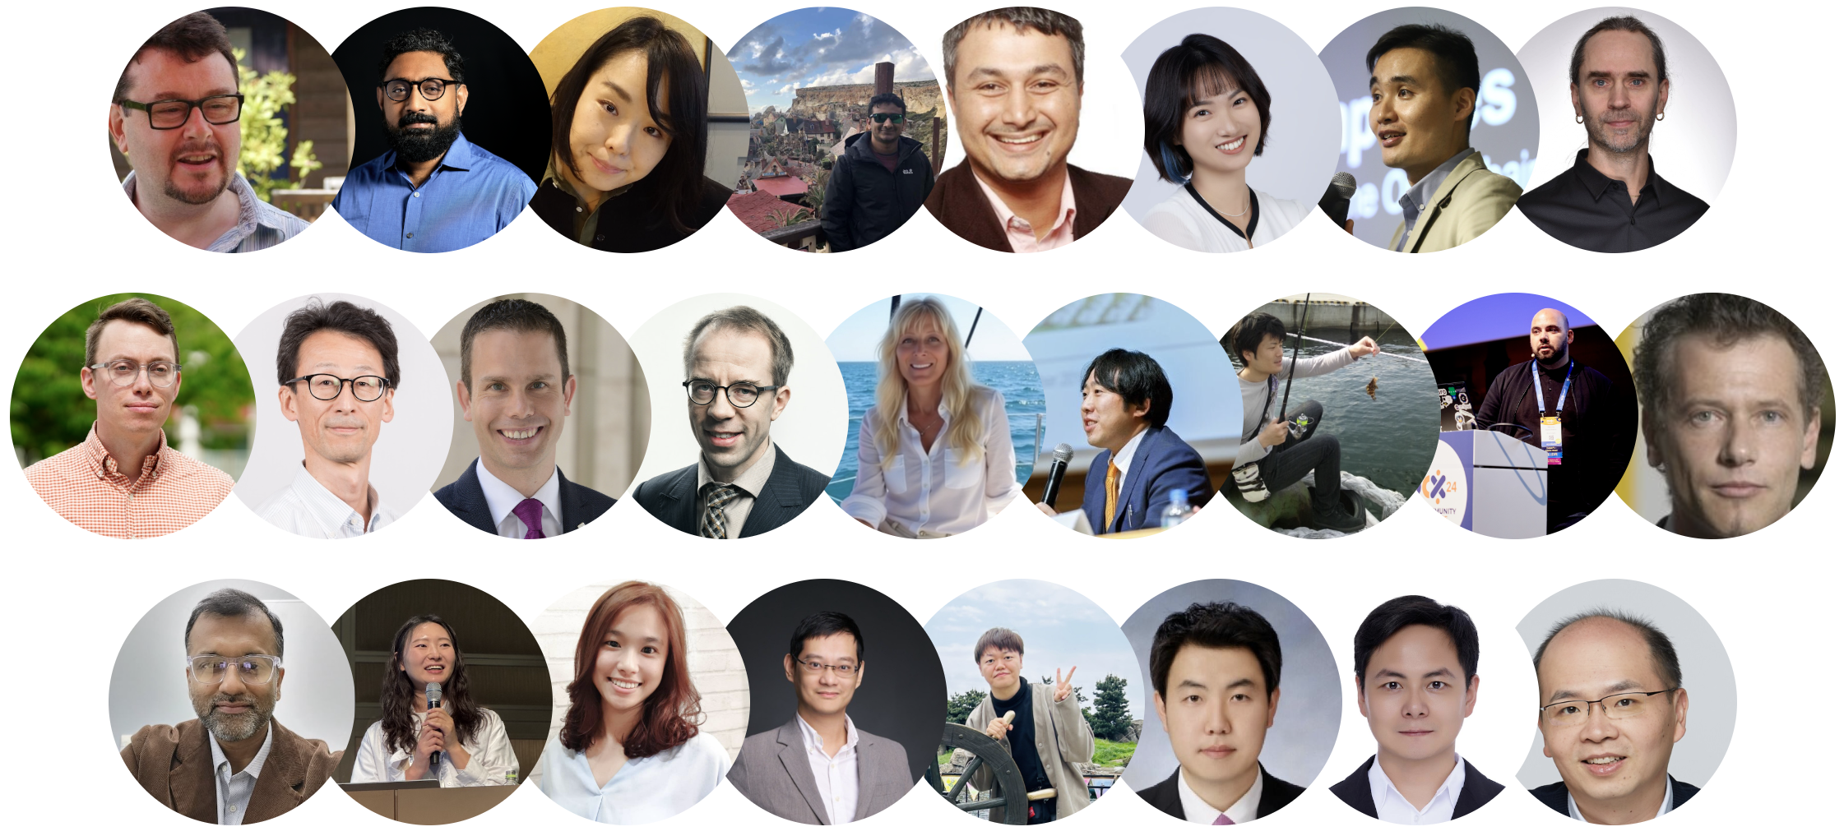
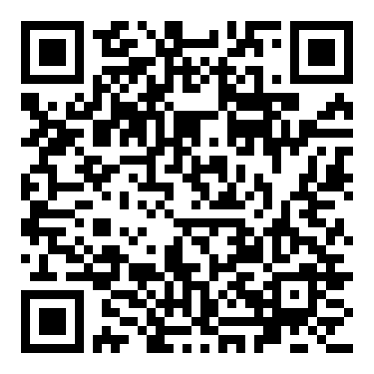
25 Global Ambassadors Supporting Our Work

Slide 43

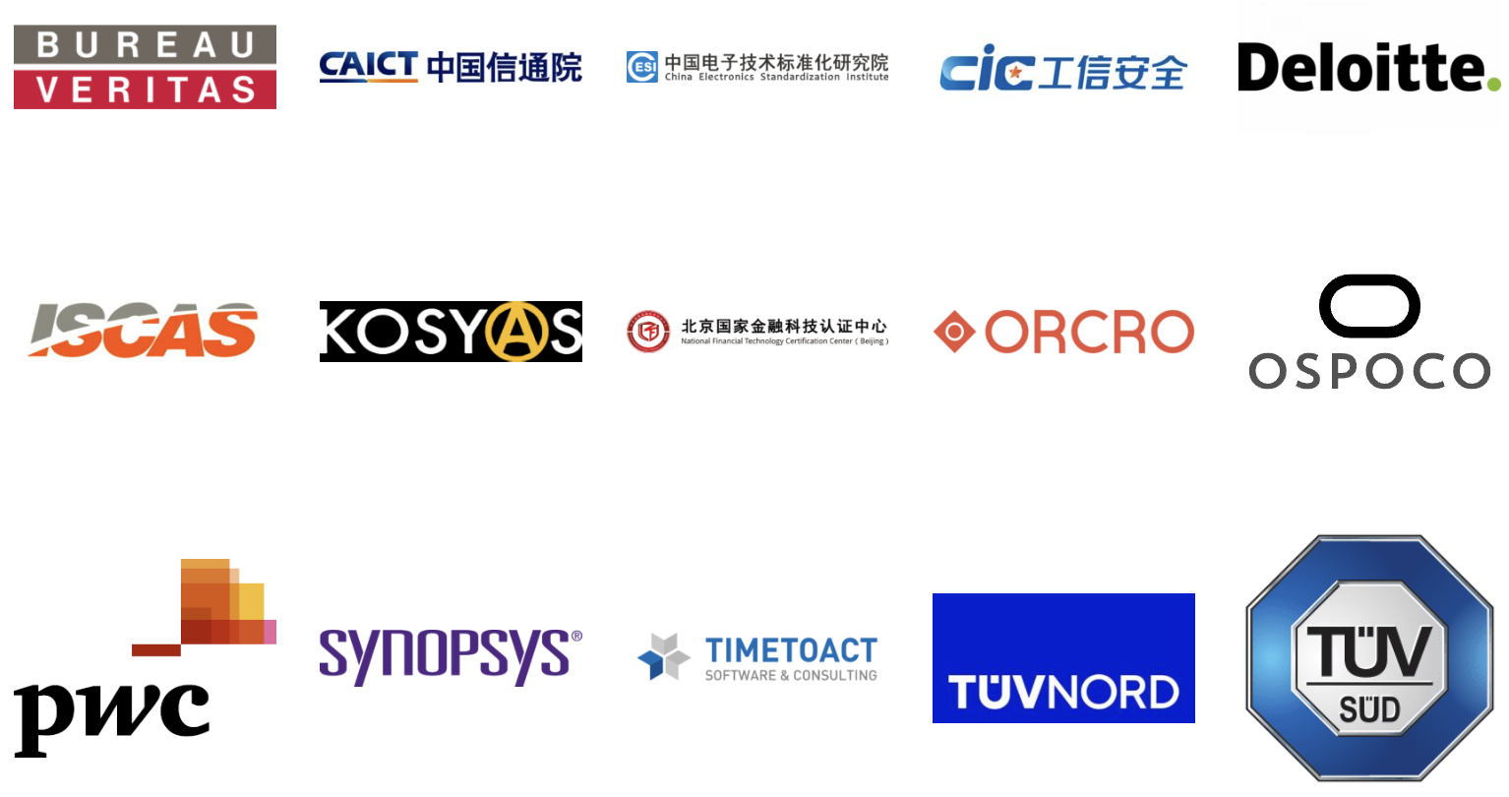
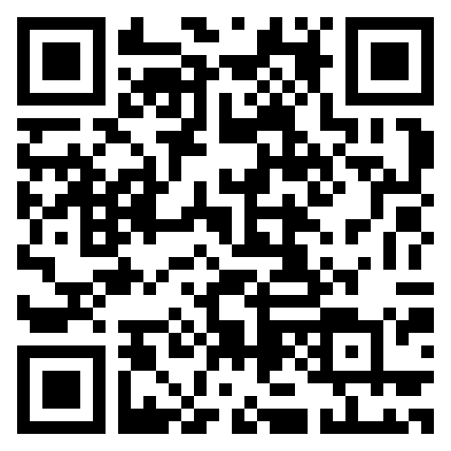
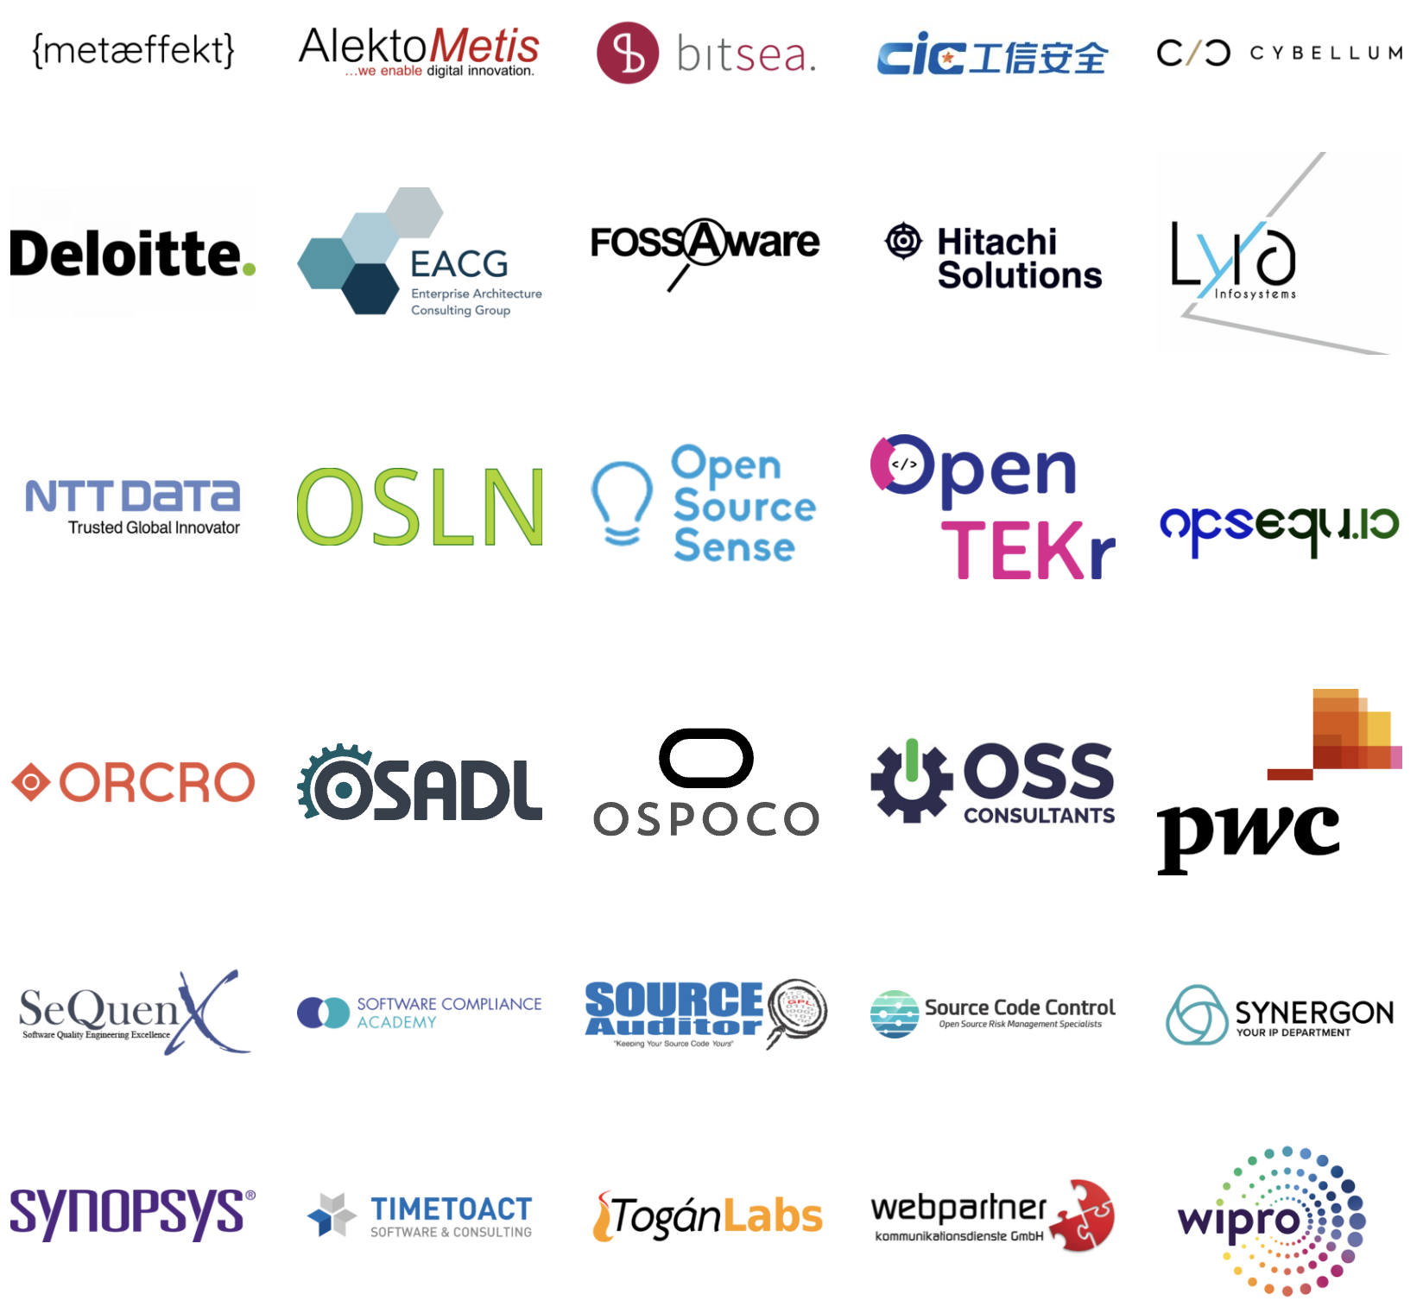
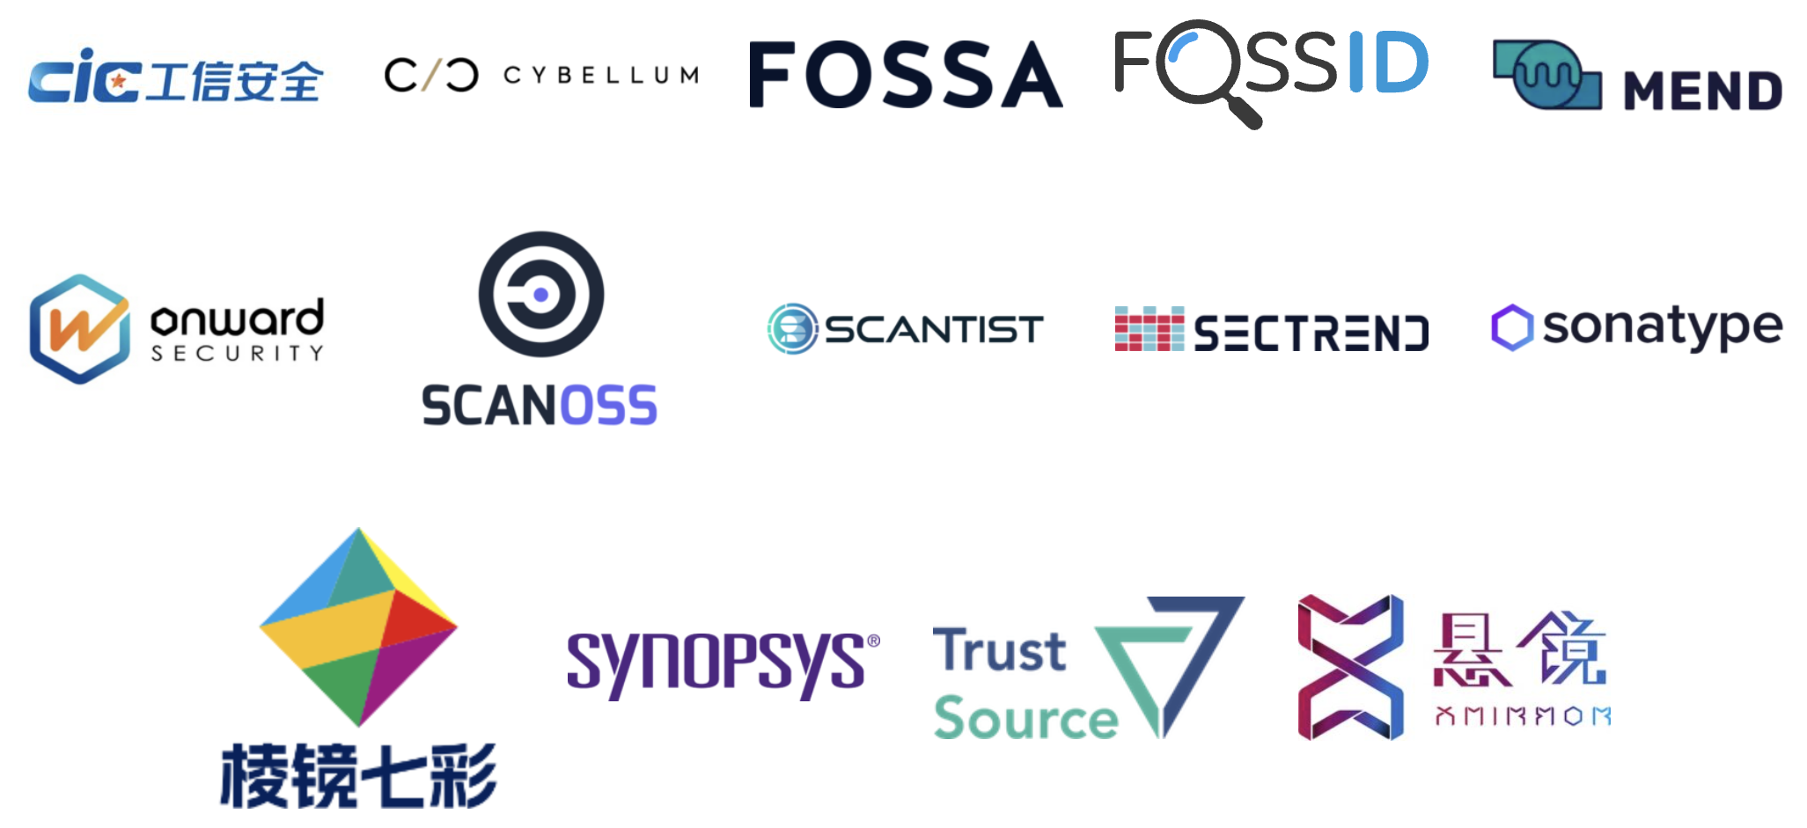
We Have Commercial Support
Legal Providers
Third-Party Certification
Consultancies
Tooling / Automation

Slide 44
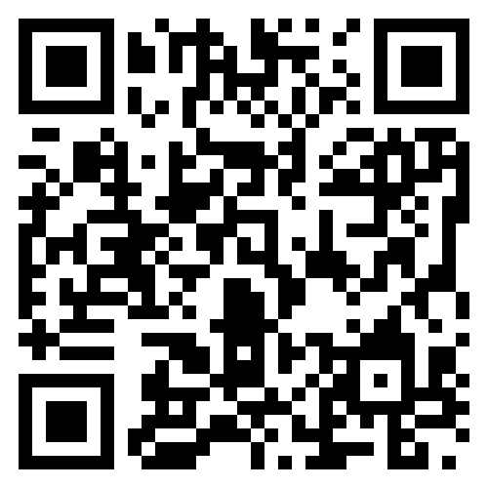
We Have Free Reference Material
Reference training material
Policy template material
Capability modeling
Supplier education material
Self-certification checklists
Over 100 webinars
Over 1,000 other documents in multiple languages

Slide 45
Example Reference Material

Slide 46
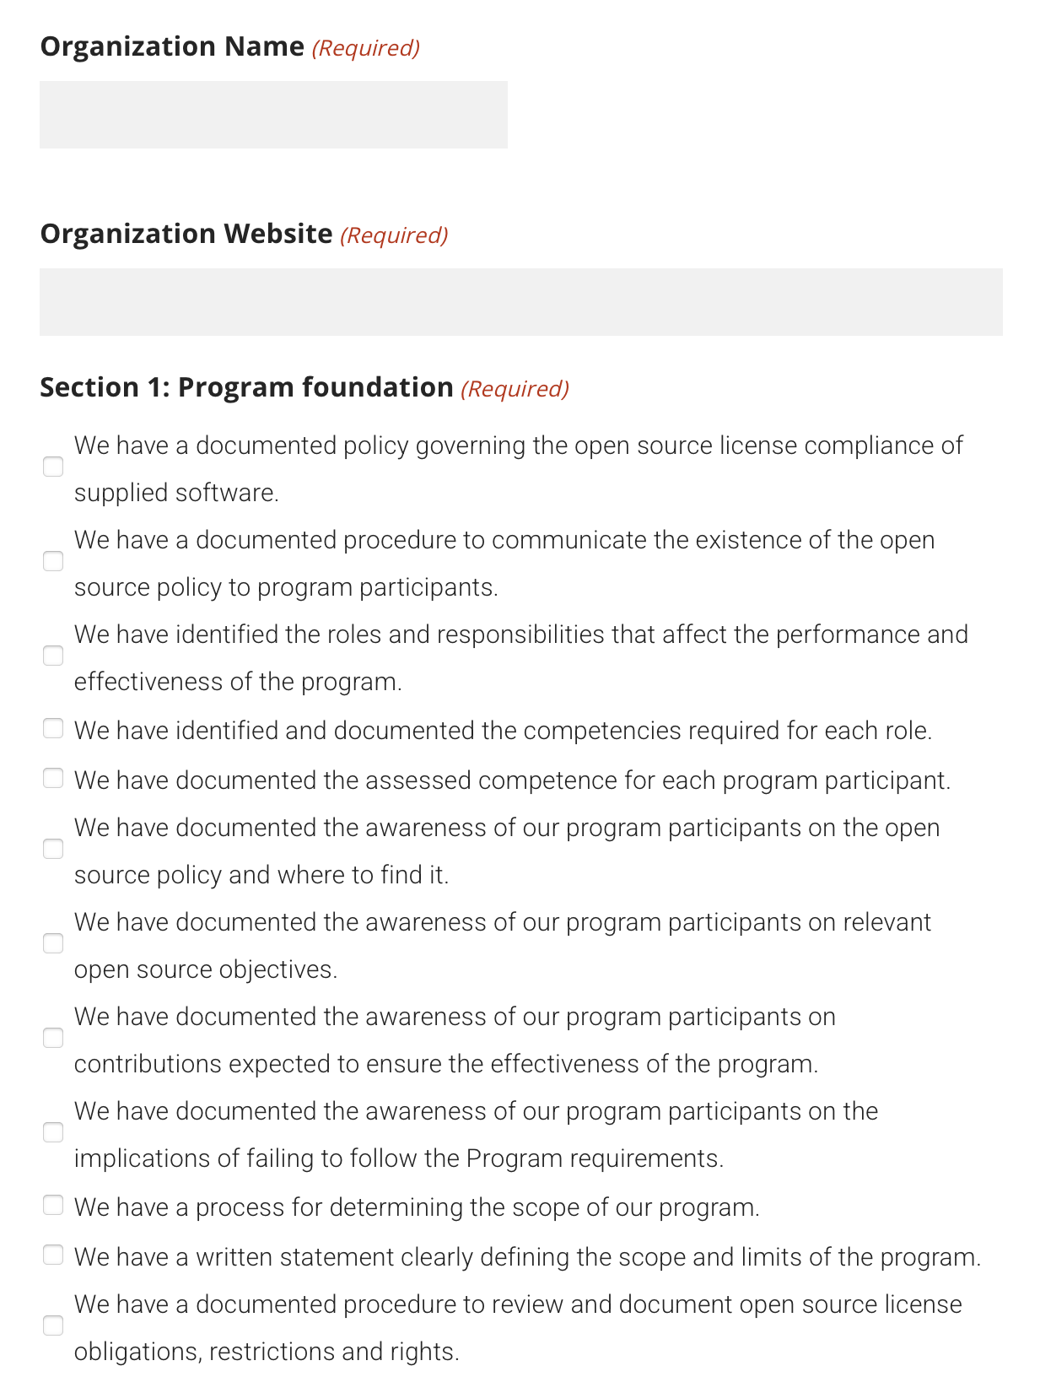
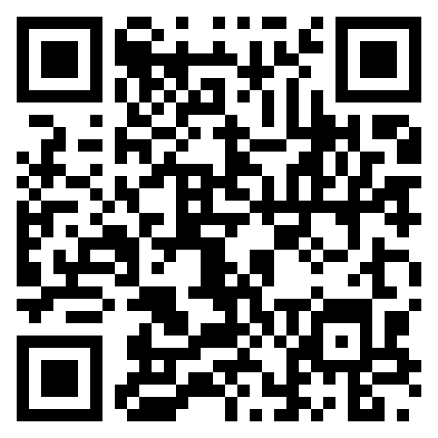
Self-Certification Checklists

Slide 47
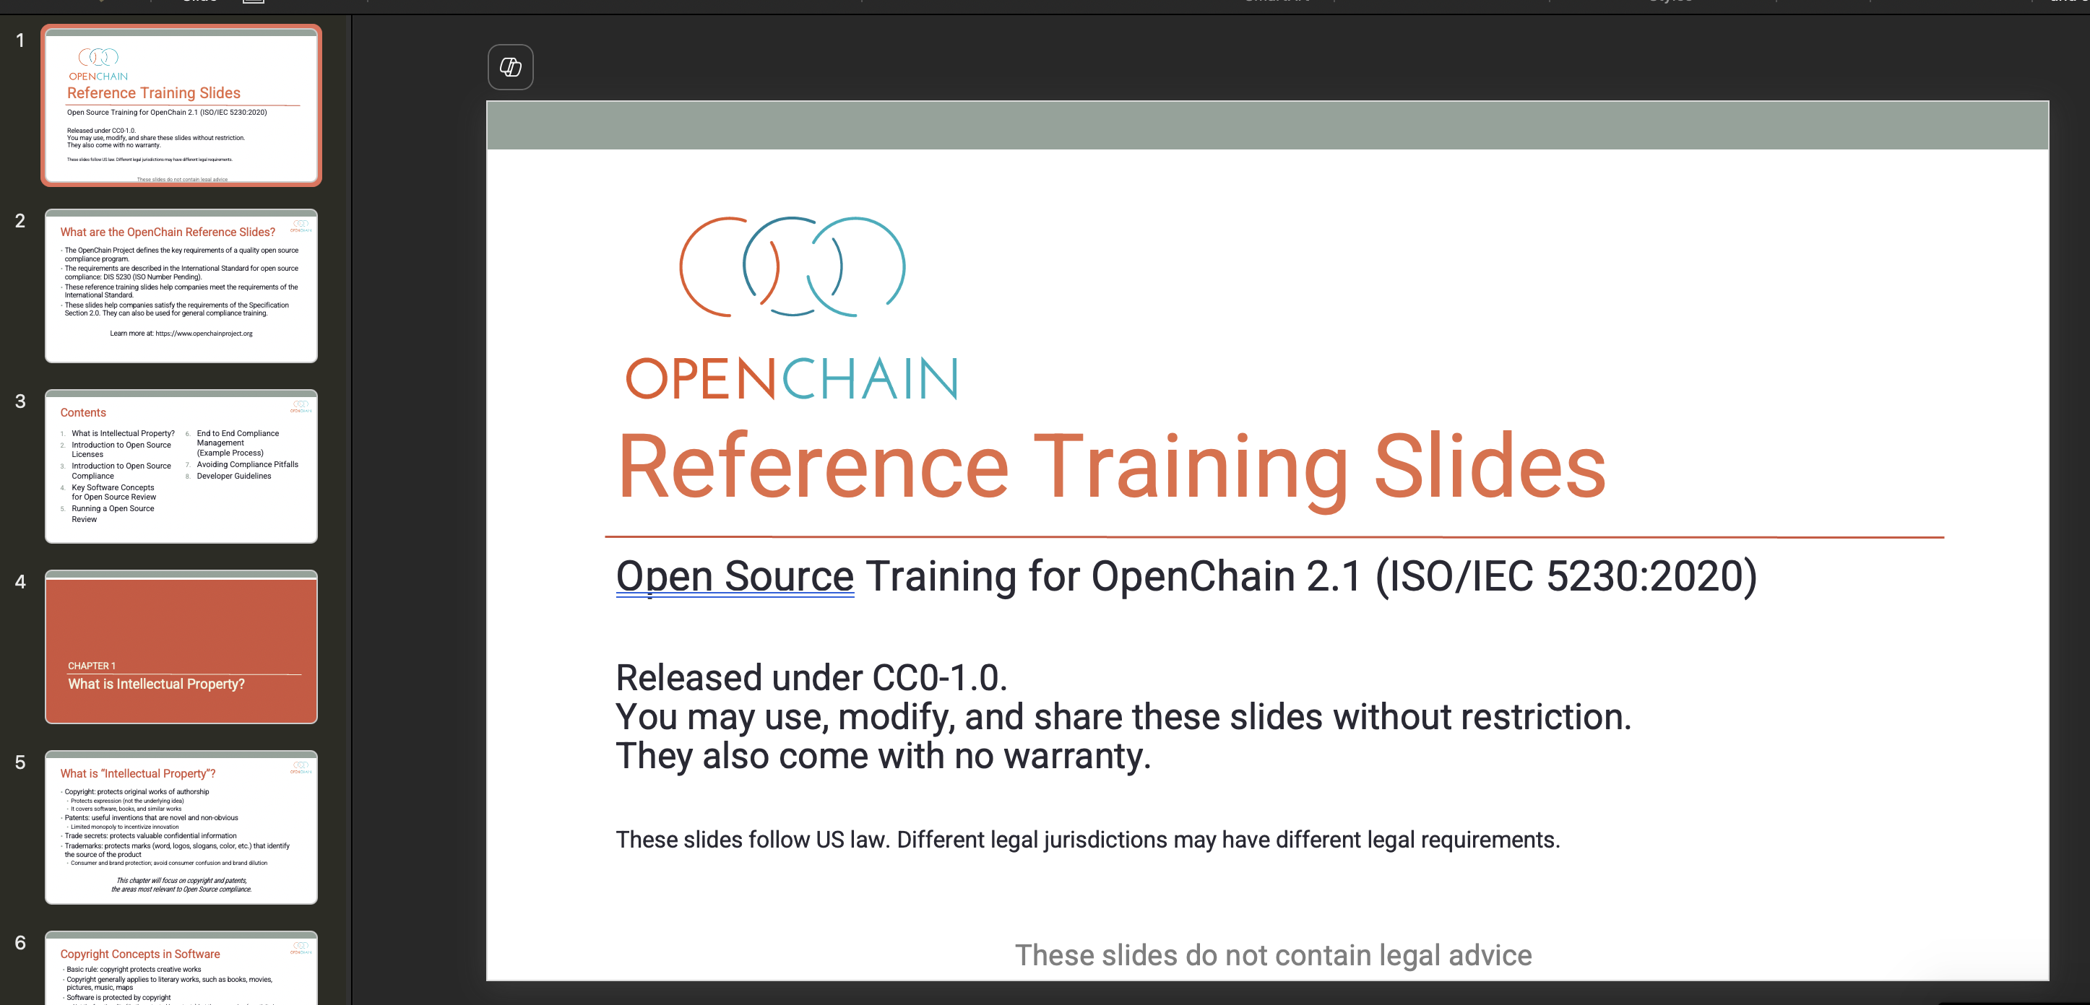
Reference Compliance Training Slides

Slide 48
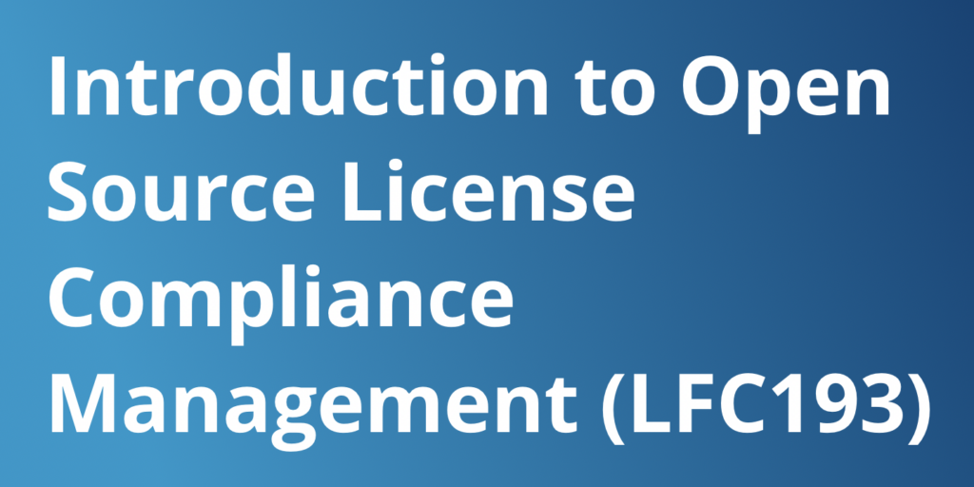
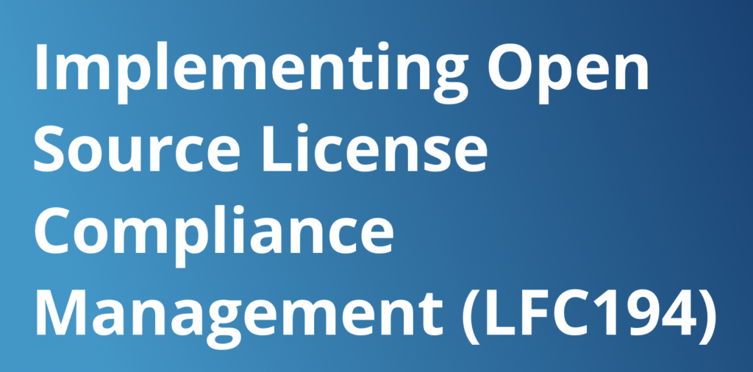
Free Online Compliance Management Training
4.5 out of 5 star rating!
4.6 out of 5 star rating!

Slide 49
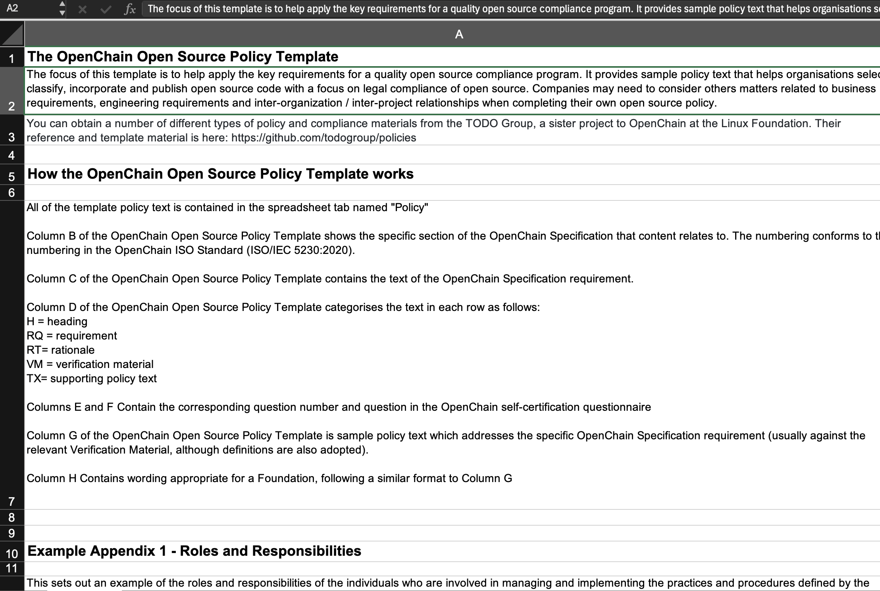
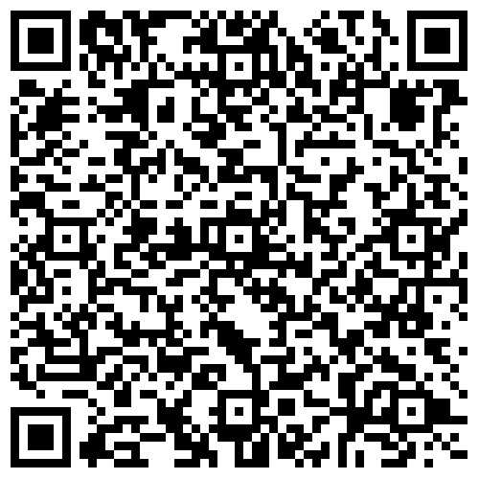
Open Source Policy Template

Slide 50
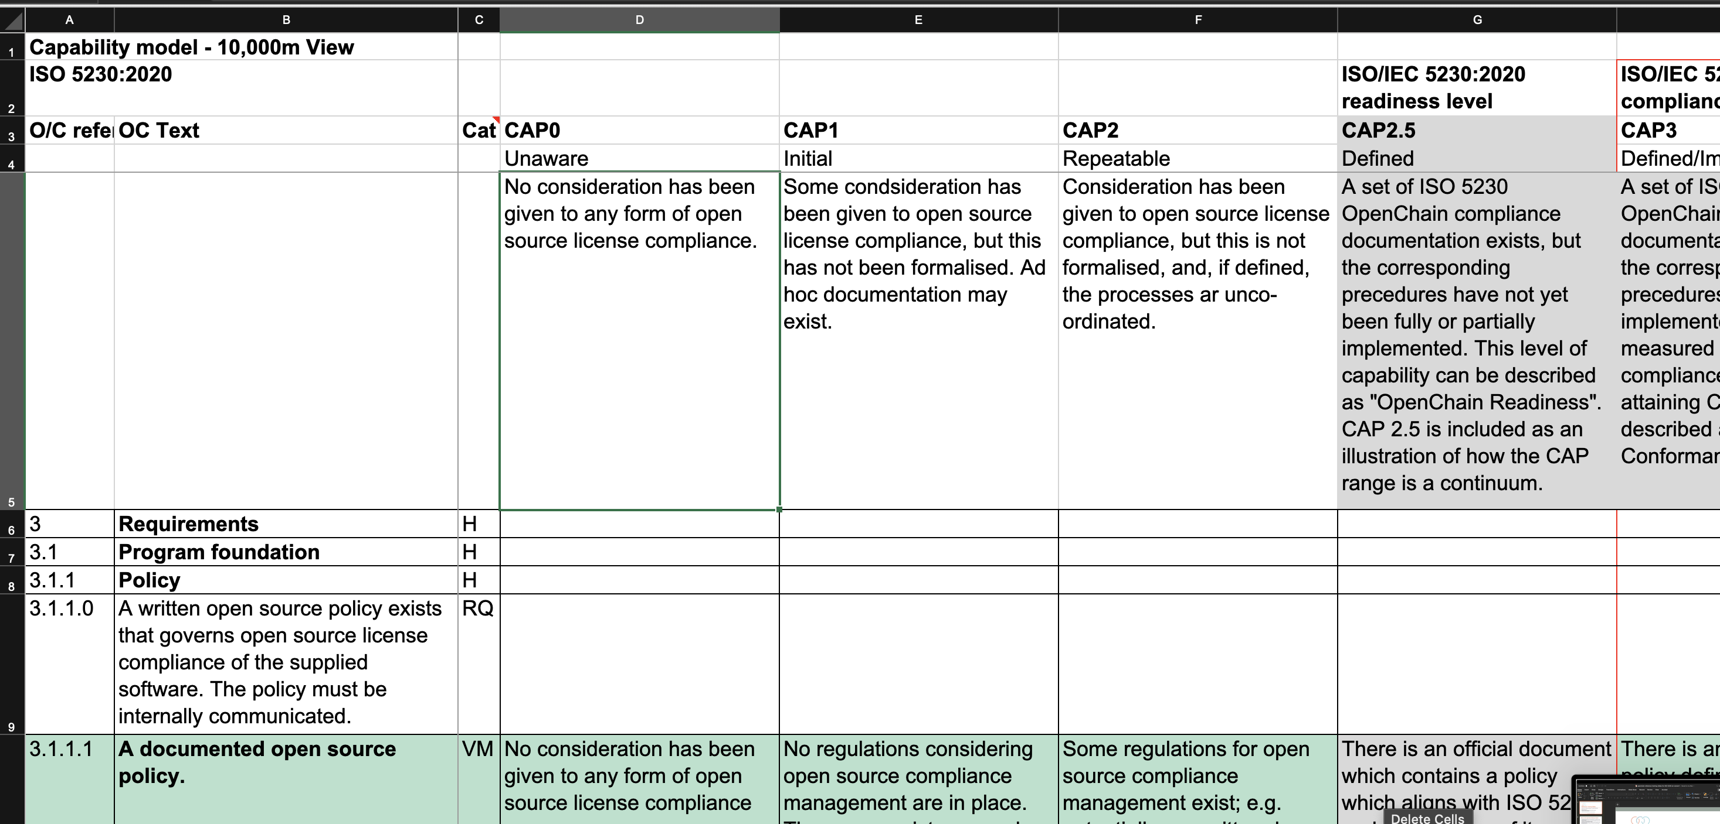
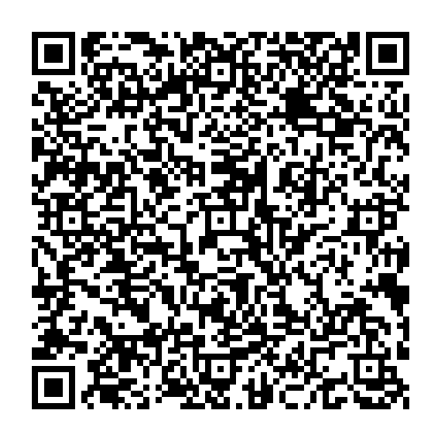
Compliance Program Maturity / Capability Model

Slide 51
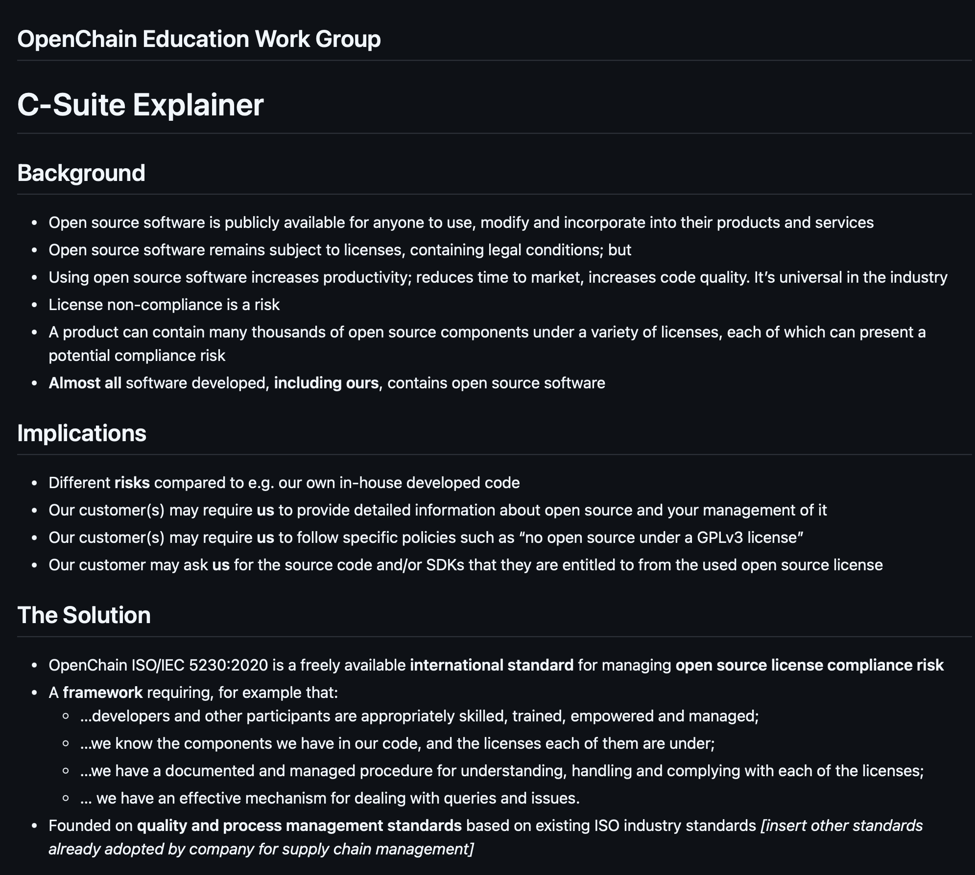
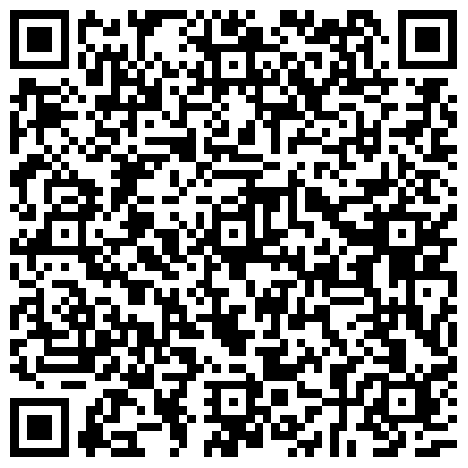
Explainers

Slide 52
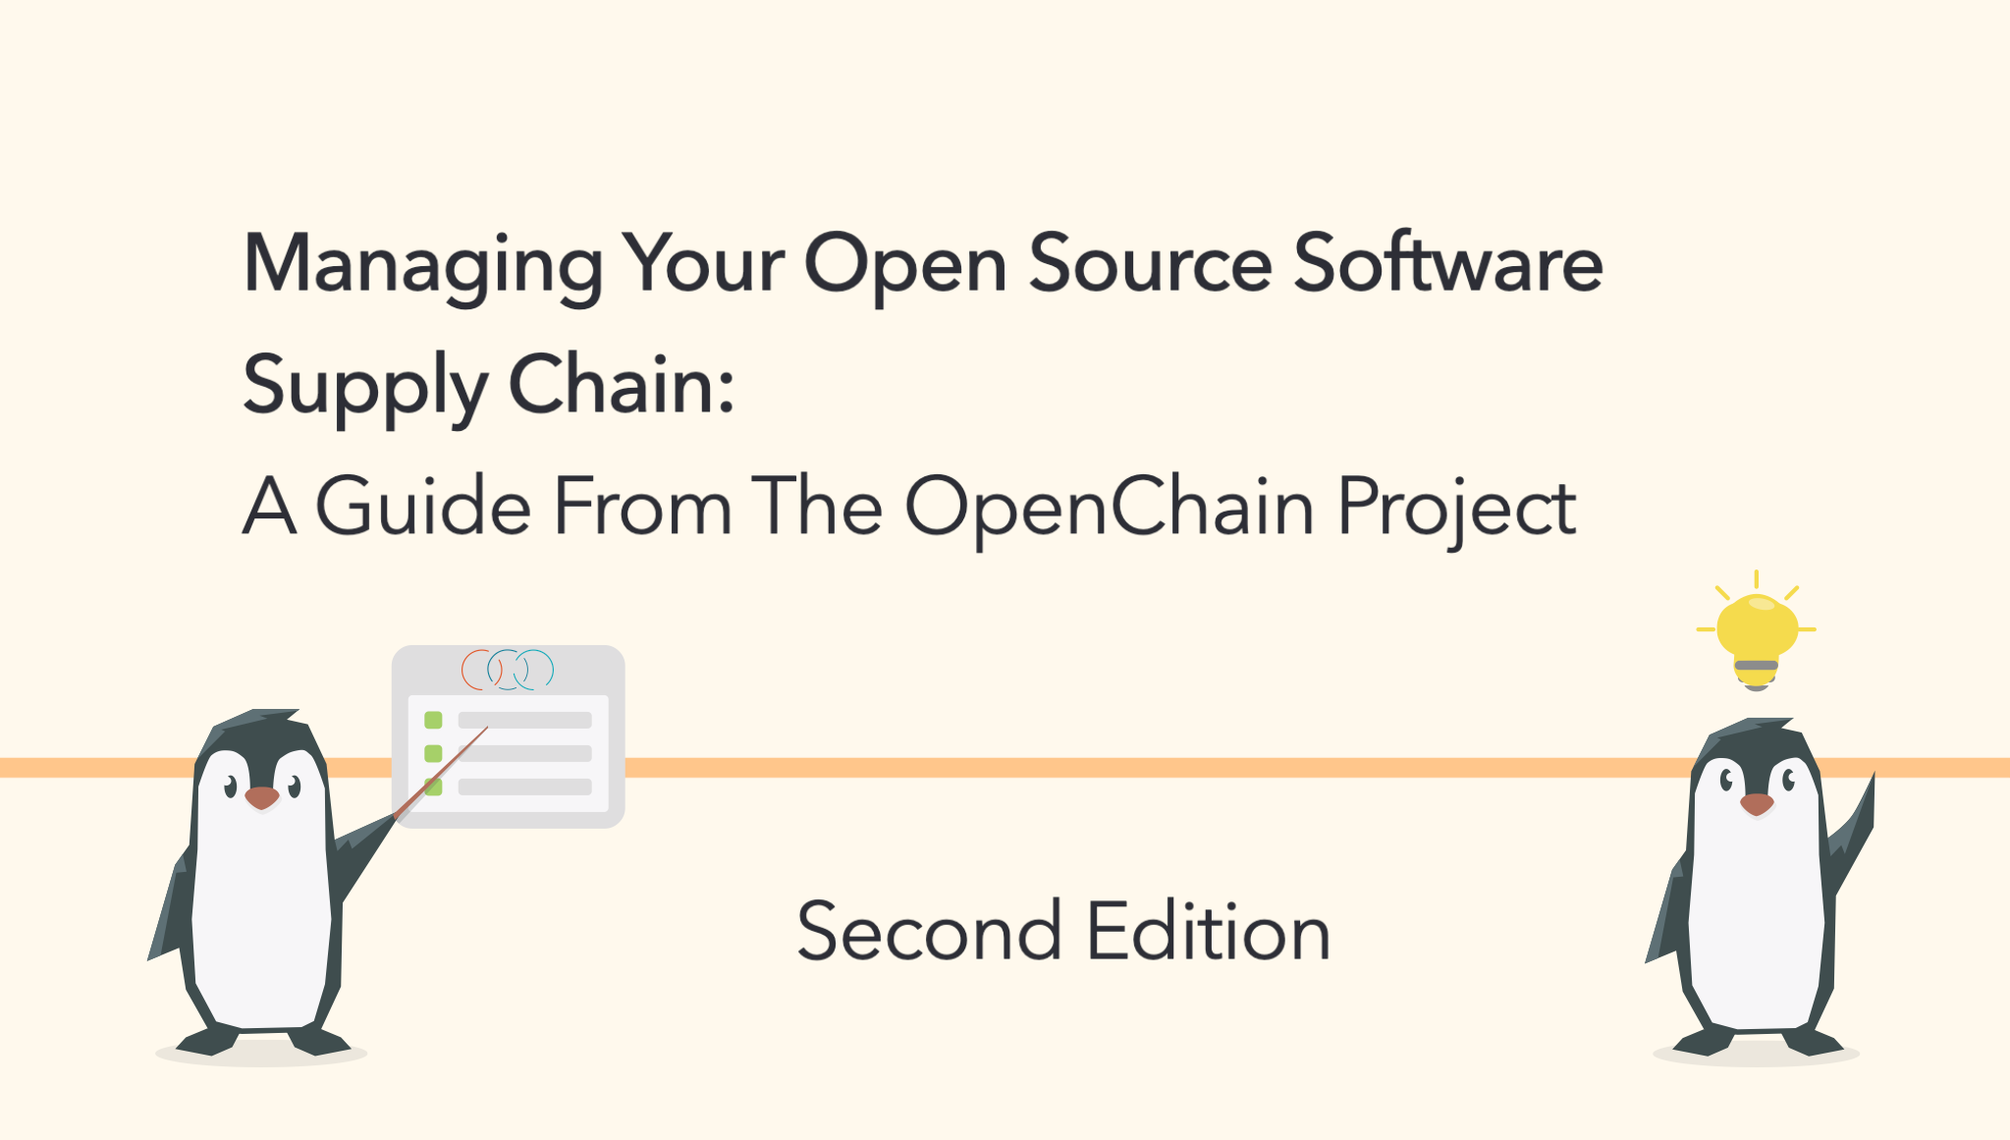
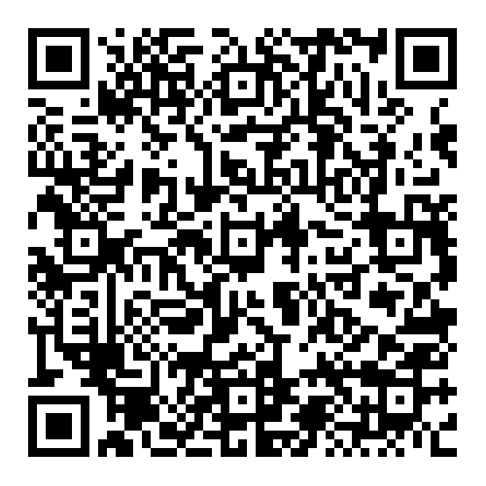
Supplier Education Leaflet (One Email Solution)

Slide 53


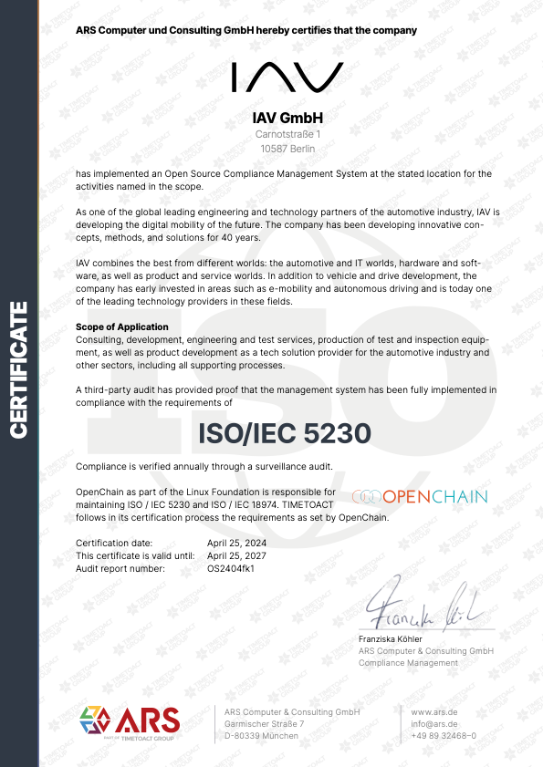


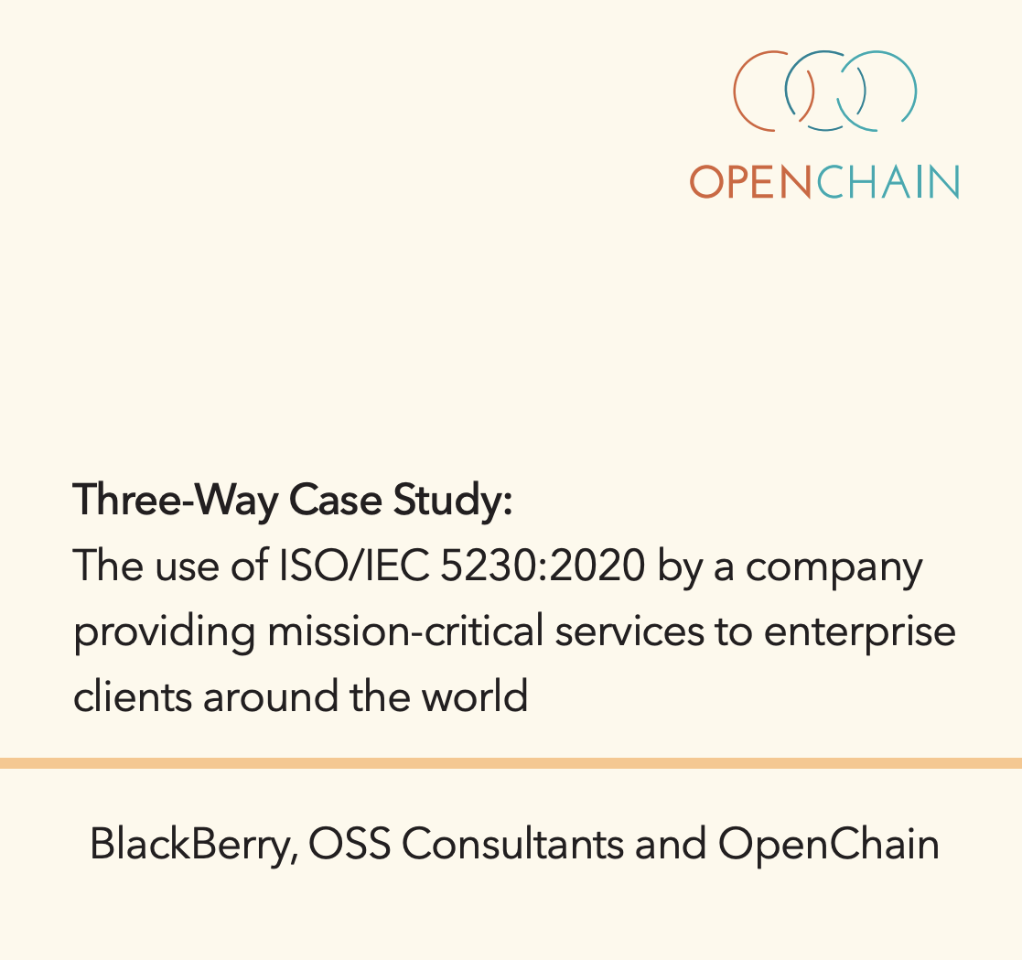
Case Studies

Slide 54
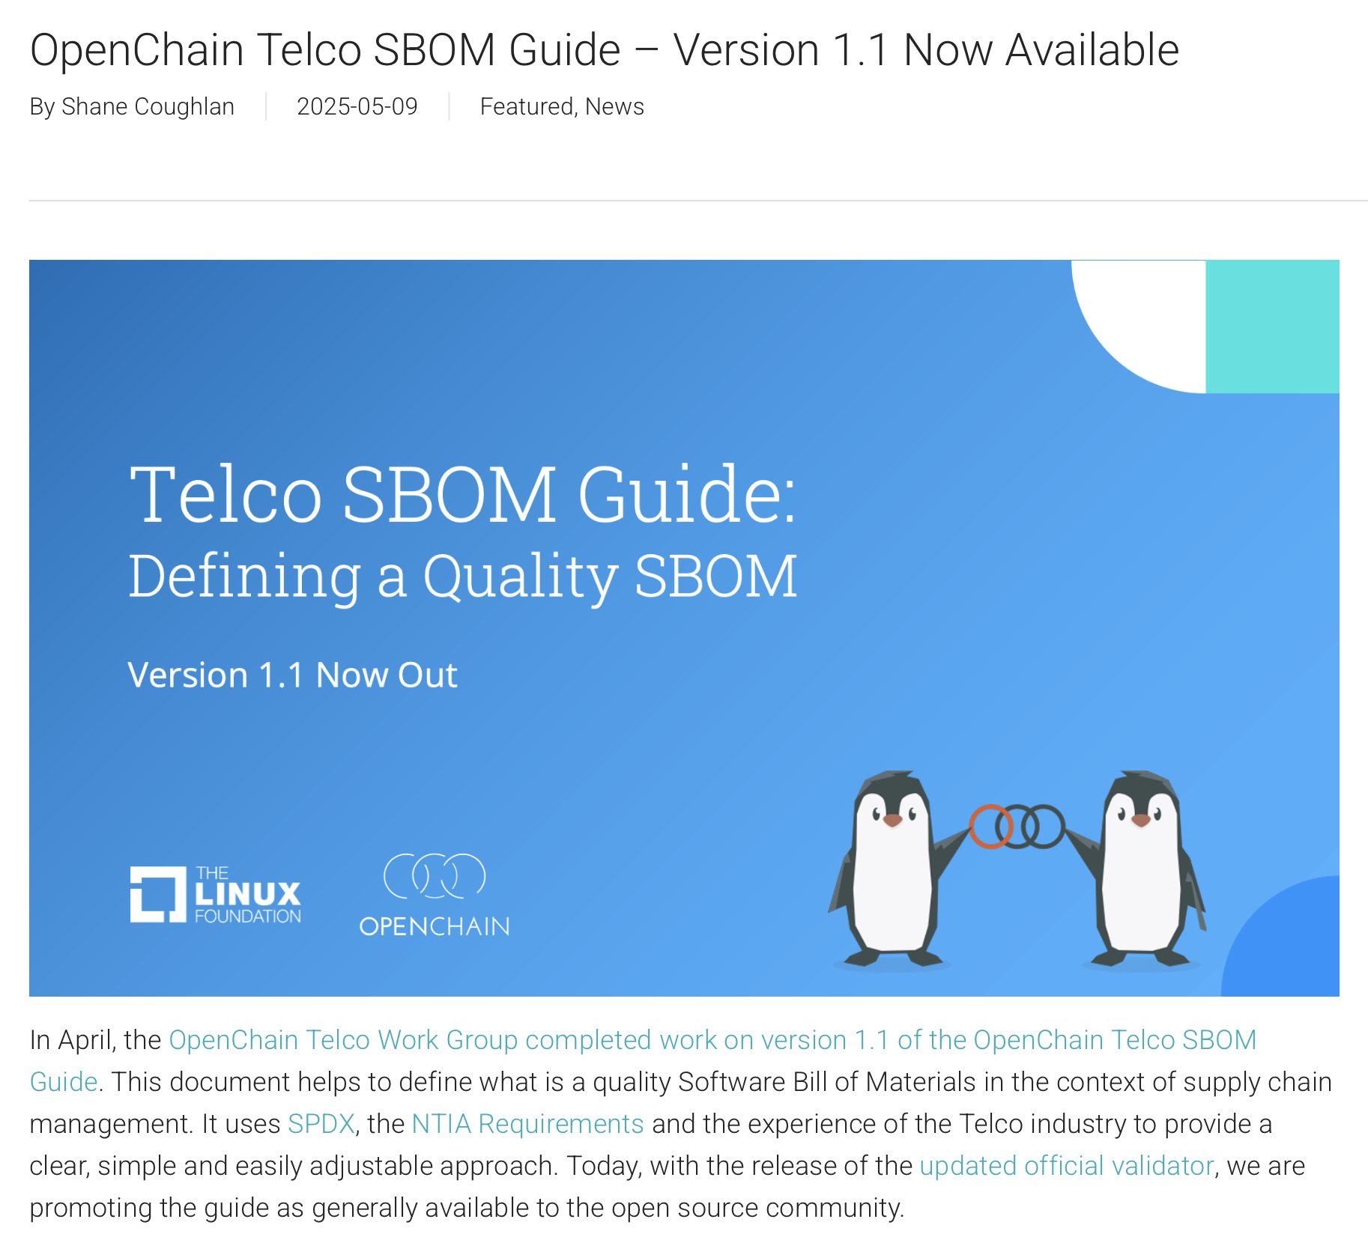
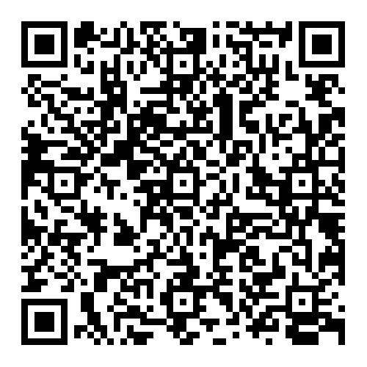
Telco SBOM Quality Guide

Slide 55
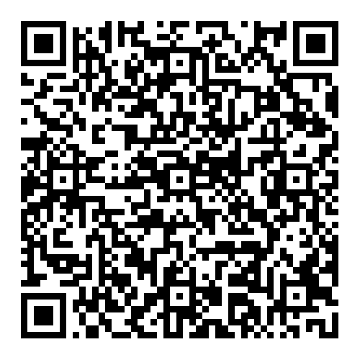
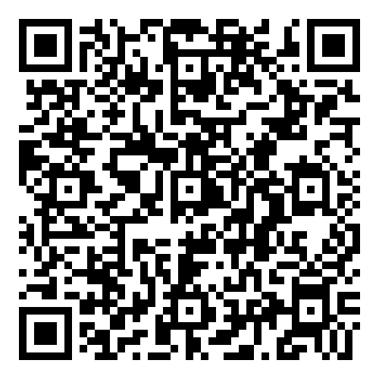
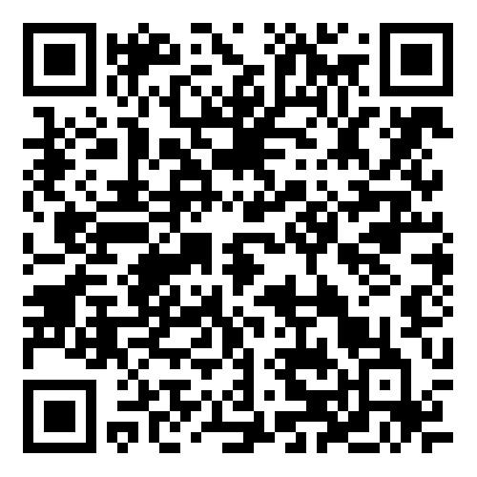
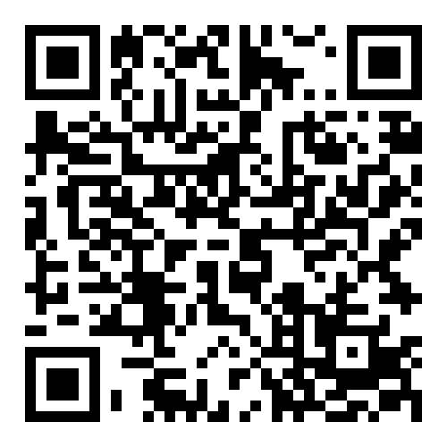
Telco SBOM Quality Work … EXPANDED
Official
Validator
Third-Party
Tooling
ByteDance
Case Study
ByteDance
Schemas

Slide 56
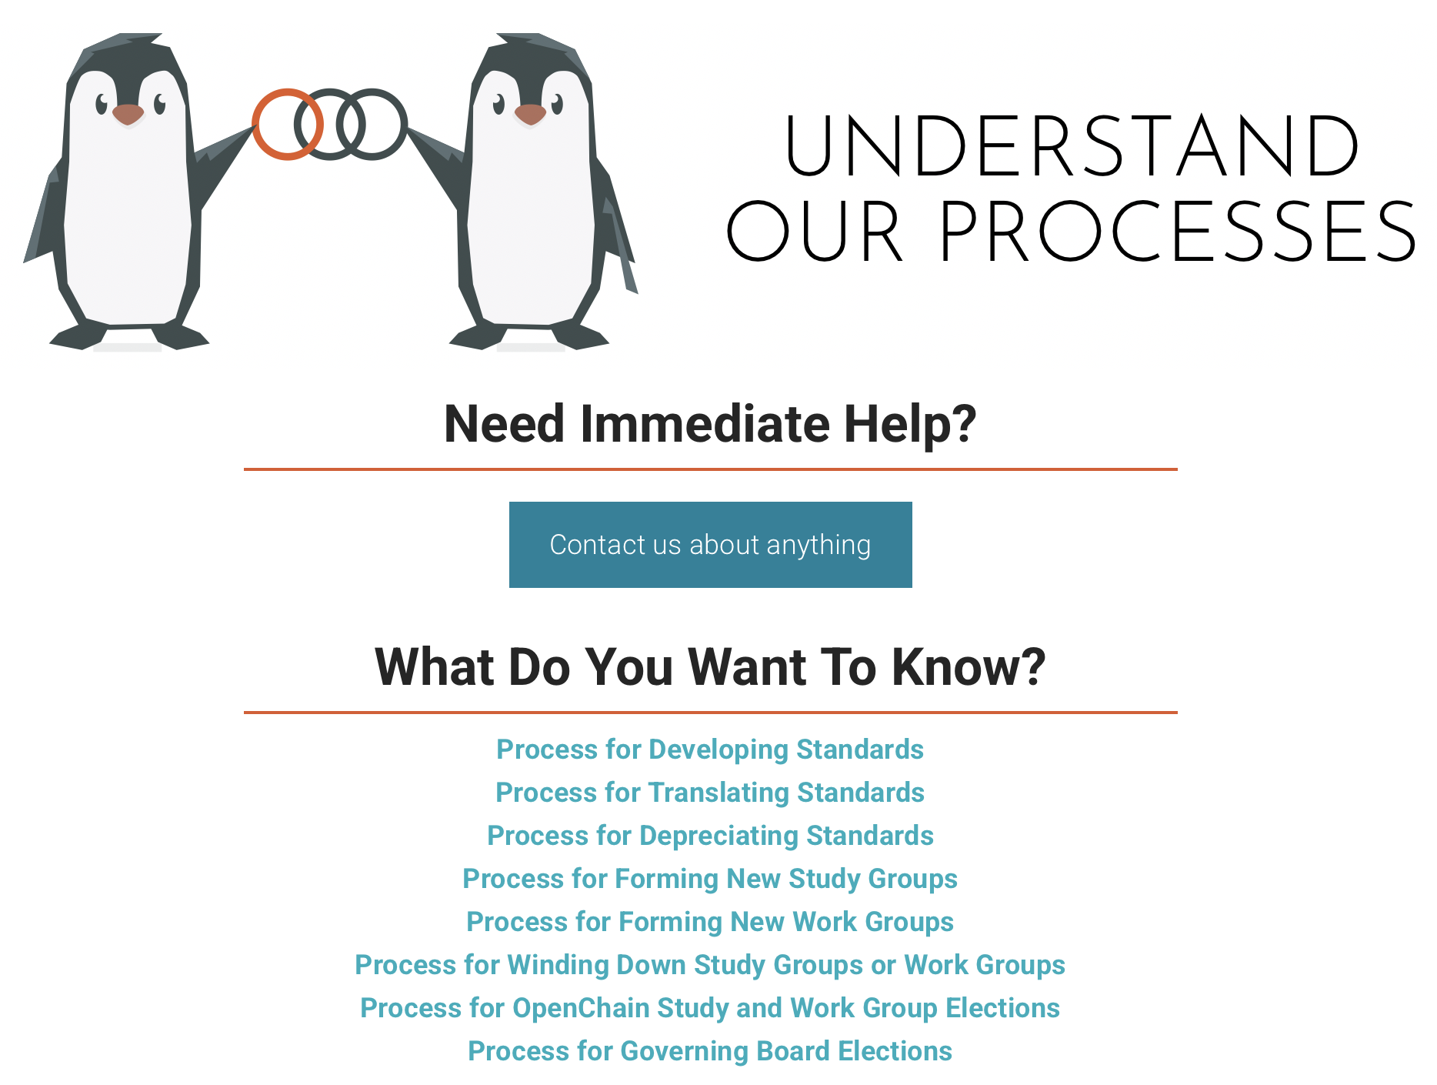
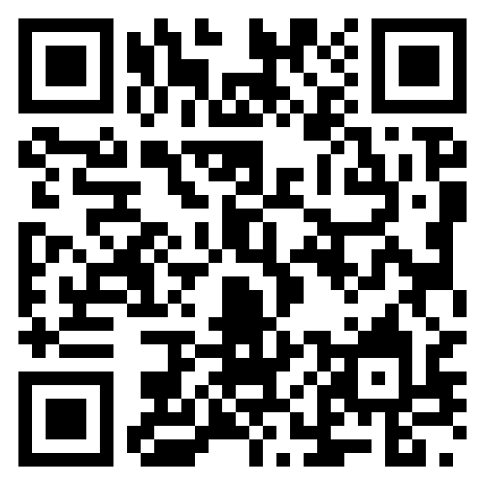
Our Processes – Easy to Find and Understand

Slide 57
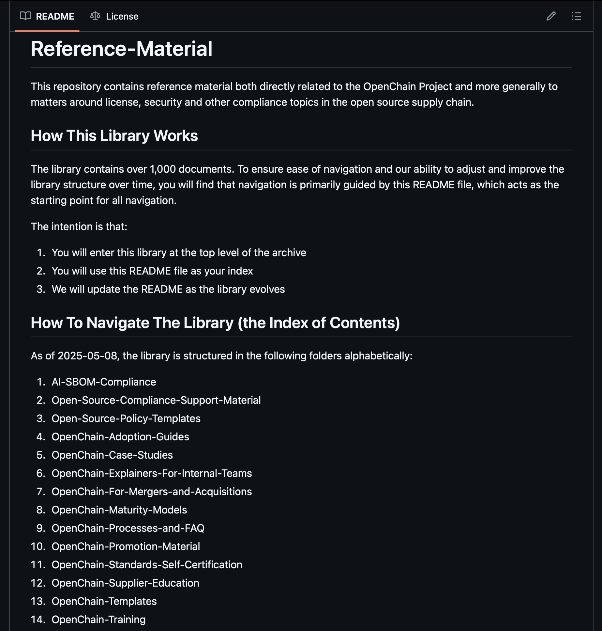
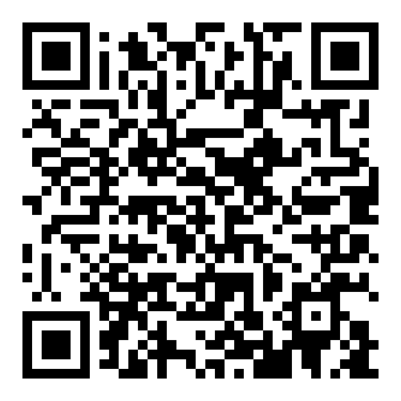
A Reference Library
Of 1,500+ Documents

Slide 58
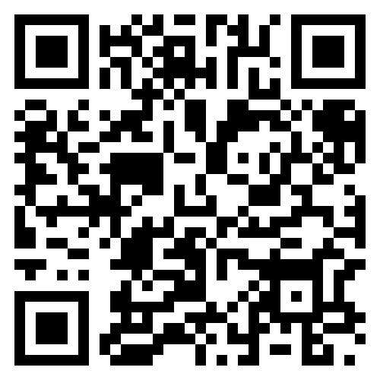
100+
OpenChain has
Webinars about open source
management and governance

Slide 59
Evolution

Slide 60
Open Source Management
OpenChain thought ahead of the curve on management requirements.
The community can develop international standards of high quality.
We have built institutional knowledge on how to do this.

Slide 61
Open Source Regulation
Open source – as with all software – is increasingly subject to regulation.
Some of our current standards help address their requirements.
Some of the forthcoming standards (e.g. CEN-CENELEC) will impact our work.

Slide 62
Biggest Market Challenges
Prepare the foundation for future management requirements.
Remember we don’t know what we don’t know.
Have patience to wait until requirements and regulations are clear.

Slide 63
Biggest Operational Challenges
Keep evolving to address emerging market concerns.
But do not reinvent the wheel.
And keep it simple.

Slide 64
A Simple Workflow
We Study
We Brainstorm
We Make a Guide (if useful)
We Make a Specification (if useful)
We Make a Standard (if useful)
And supporting reference material!

Slide 65
Evolution in Practice

Slide 66
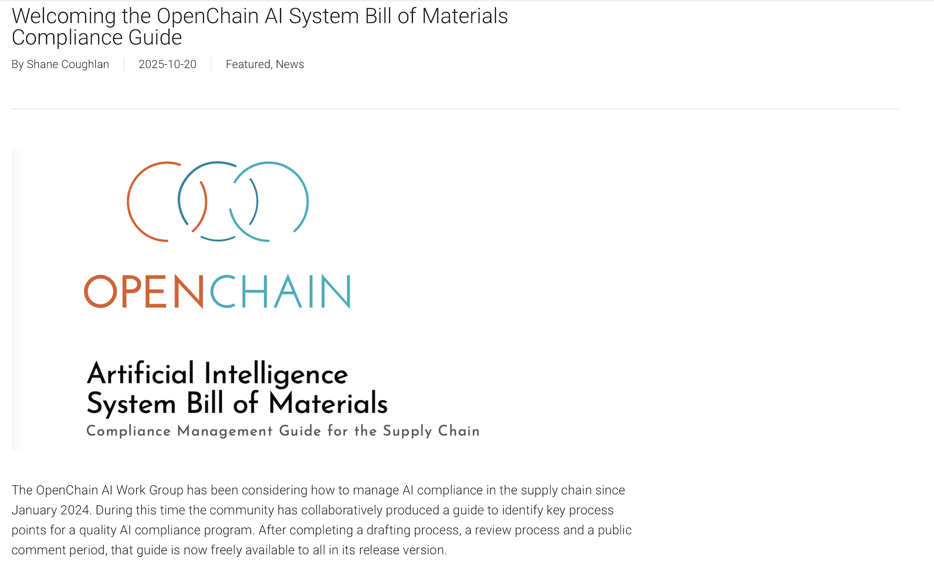
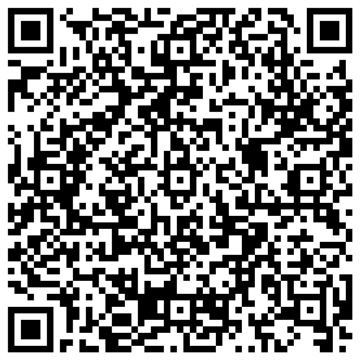

Slide 67
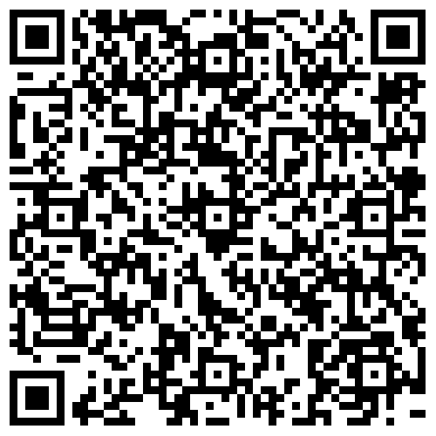
Cross-Industry SBOM Quality Guide Concept

Slide 68
In Conclusion

Slide 69
What Is Happening Right Now?
An increase in the use of formal standards around open source
An increase in the use of OpenChain standards for licensing and security
Improved trust in the supply chain because of this
In 2025 the OpenChain Project expects awareness and capability around open source standards to become critical for companies.

Slide 70
What Is Coming Next For The Market?
There is a steady trend:
Open source is becoming more professional
Open source is becoming more accountable
Open source is becoming more sustainable
In 2025 the OpenChain Project expects this trend to bring open source closer to traditional Software Asset Management (SAM).

Slide 71
What Will The OpenChain Project Do?
We will continue to assist in the professionalization of the supply chain, with specific impact in procurement, M&A and supply chain management
We will continue to grow our reference library of material to assist companies adopting and using our standards.
We will also support process management discussions in new domains like AI Compliance

Slide 72
We Are Guided By Three Ideas…
Be curious
Be kind
Aim for the stars

Slide 73
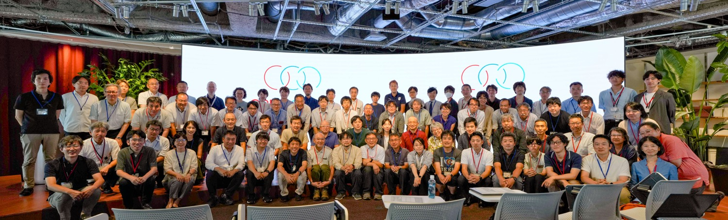
You Are The Community

Slide 74

We Know About Cultural Challenges
Linguistic Distance: A Quantitative Measure of the Distance Between English and Other Languages
Barry R. Chiswick
Paul W. Miller
Table 1
Index of Difficulty of Learning a Foreign Language (Language Scores) and Codes for Languages Reported in the U.S. Census
Language | Language Score
Japanese | 1.0 (Most Different from English)
Diversity in Open Source, an Asian Perspective - Masae Shida
https://sched.co/1OGgS
https://sched.co/1nb0O
https://www.iza.org/publications/dp/1246/linguistic-distance-a-quantitative-measure-of-the-distance-between-english-and-other-languages
Slide credit: Kobota San and Shima San from Sony Group Corporation

Slide 75

Everyone Is Always Welcome!
New in Korea: Makkoli Study Group

Slide 76
Follow and Participate
Our calls are open and publicly listed.
We publish a recording of every meeting not under Chatham House Rule.
We provide access to work groups, special interest groups and local work groups via mailing list.
We also use Slack and WeChat.

Slide 77
Let’s Talk More

