Slide 1
SEPIA> SBOM Exchange Procedures, Interfaces and Architecture
Hans Malte Kern, Robert Bosch GmbH
Head of Bosch Center of Competence Open Source
2024-09-12

Slide 2

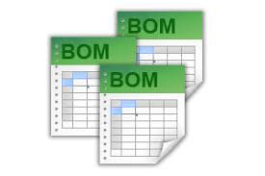
Problem 1: SBOM Formats
SEPIA – SBOM Exchange Procedures, Interfaces and Architecture
OpenChain V2.0/ISO 5230 §3.1 – “A process exists for creating and managing a bill of materials that includes each Open Source component (and its Identified Licenses) from which the Supplied Software is comprised.”
  No further definition or other requirements…
  So “dead SBOMs” are totally valid
2 competing machine-processable Standards:
  SPDX
  CycloneDX
  OpenChain Telco SBOM Guide Version 1.0
  released April 2024 aiming to outline certain
  requirements
    SPDX 2.3 + ISO/IEC 5962 (SPDX 2.2.1)
    Defines a set of REQUIRED elements of SPDX
re/texlive/texmf-dist/fonts/type1/urw/times/utmri8a.pfb>
Output written on sbom.pdf (58544 pages, 98893885 bytes).
Transcript written on sbom.log.
Draper Laboratory; restored by Adam Cuerden InfoFieldSee file page for creator info. (https://commons.wikimedia.org/wiki/File:Margaret_Hamilton_-_restoration.jpg), „Margaret Hamilton - restoration“, als gemeinfrei gekennzeichnet, Details auf Wikimedia Commons: https://commons.wikimedia.org/wiki/Template:PD-US

Slide 3
Problem 2: External Requirements
SEPIA – SBOM Exchange Procedures, Interfaces and Architecture
Customers have their own SBOM formats
  B2B
    Custom XLS, Word with embedded XLS
    Upload tool that digests different formats with different outcome
    SPDX 1.x, 2.1, CycloneDX 1.4, …
    …
  B2C
    Published/Printed SBOM according to OSS License and target market requirements
Authorities
  Cyber Resilience Act – Proposal for a regulation on horizontal cybersecurity requirements for products with digital elements
  BIS and NSA for export controls with Open Source
  BSI TR-3183 (Technische Richtlinie TR-03183: Cyber-Resilienz-Anforderungen an Hersteller und Produkte)
  …

Slide 4
Problem 3: “Standardized” SBOMs
SEPIA – SBOM Exchange Procedures, Interfaces and Architecture
Apples and Bananas
  Main focus of SPDX is license compliance
  Main focus of CycloneDX is security and vulnerability tracking
Problem 3.1: Too many versions with changes that are not backward compatible
  Both formats started to also cover other focuses in their latest development
Problem 3.2: Mapping
  Both have unique attributes (mainly amplifying their main focus)
  Both have common attributes with common content
  But some common attributes are not so common There is no automatic conversion that can be used without gambling with compliance!
Problem 3.3: SW Architecture
  It is difficult and time-consuming to build a SBOM that reflects the SW Architecture and Dependencies
  This information is often lost/altered when converting, merging, modifying it
Problem 3.4: Merging SBOMs
  How to deal with duplicated entries is a science for itself. There is no automatic conversion that can be used without gambling with compliance!

Slide 5
Our Approach: SBOM-Validation and Conversion
SEPIA – SBOM Exchange Procedures, Interfaces and Architecture
The existing schemas were not sufficient <all assert> and allows ambiguities;
  Syntax Checks: possible
  Semantic Checks: impossible
We mapped SPDX and CycloneDX attributes to be able to define a clear semantic
We defined a semantic schema that reflects our requirements on a machine processable SBOM
We utilized existing validators to validate SBOMs against our schema
We implemented yet another converter that is facilitating the schema for better results
Benefits
  Ensure machine processable SBOM exchange with semantic relevance
  Providing validator to suppliers would ensure SBOM quality
  Purchase could use validator for first check of deliveries to us

Slide 6
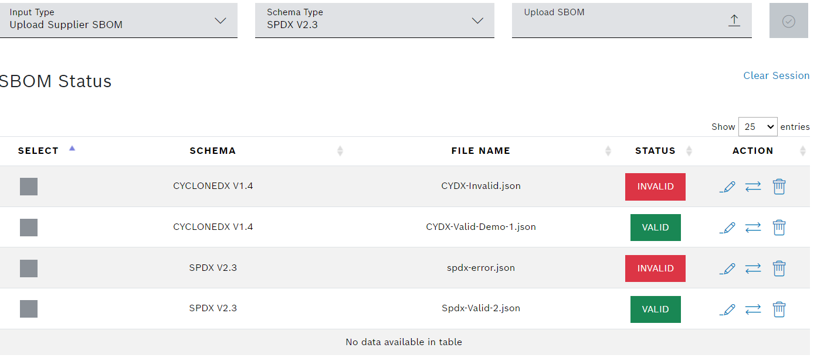
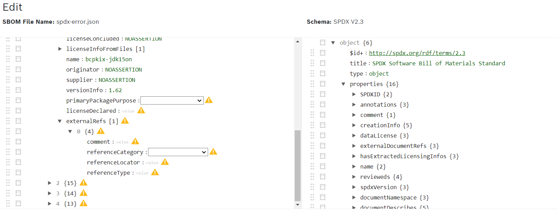
SBOM Validator Screenshots
SEPIA – SBOM Exchange Procedures, Interfaces and Architecture

Slide 7
Supply Chain SBOM Maturity
SEPIA – SBOM Exchange Procedures, Interfaces and Architecture
Before OpenChain
With OpenChain
With OpenChain + SEPIA

Slide 8
Our Approach: Make it Open Source
SEPIA – SBOM Exchange Procedures, Interfaces and Architecture
We started an Open Source project
  We will provide our evaluation and mapping of SPDX and CycloneDX with semantic definition of important properties
  We will provide our SBOM tooling and will continue its development in the Open
  We will provide our semantic schema (currently SPDX only)
  We will curate an Open SBOM Schema Library that can be used for automation
We encourage you to participate in this activity
  Providing your semantic schema to build an Open SBOM Schema Library
  Share your insights and experience to build an SBOM ecosystem that allows an automatic processing of SBOMs independent of the tool used to generate and the format used.
https://github.com/OpenChain-Project/SBOM-sg-SEPIA
We will use our experience and assets in the OpenChain activities to define a “common SBOM” – maybe in OpenChain’s SBOM Study Group

Slide 9

see you here: https://github.com/OpenChain-Project/SBOM-sg-SEPIA
Thank you!
Hans Malte Kern
Head of Bosch Center of Competence Open Source

