Slide 1

EV charging station – ISO15118 (DC)

Slide 2
Contents
Introduction
System Overview
Hardware
OSI communication layer
High Level Communication (ISO15118)
Synchronization with IEC 61851-1 (Control Pilot state)
Datalink handling
Middle layer
V2G message sequence
Timing
Error handling (between HLE, Datalink and CP states)

Slide 3
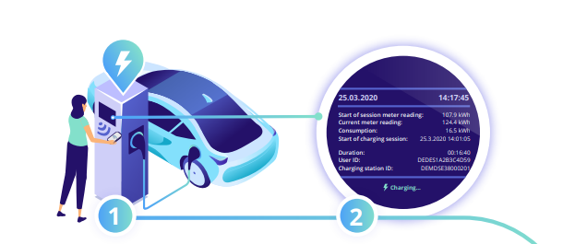
Introductions
ISO 15118 is an international standard that outlines the digital communication protocol that an electric vehicle (EV) and charging station should use to recharge the EV’s high-voltage battery. As part of the Combined Charging System (CCS), ISO 15118 covers all charging-related use cases includes wired (AC and DC) and wireless charging applications.
Notes:
whereby an EV can arrive at a charging station, plug in, and communicate directly with the charging station. In this communication the vehicle automatically identifies and authorizes itself to receive energy and then charging automatically commences. (Not supported by VINFAST CS yet).
The driver will not need to do anything else, such as use an RFID card or mobile application, to start charging. It also enables bi-directional charging and discharging of energy to the battery and back to the grid. To ensure privacy and security, communications between the vehicle and charger take place through digital certificates secured through a Public Key Infrastructure (PKI).
The standard only covers communication between vehicle and charger, not with other Charging Point Operator (CPO) or E-Mobility Service Provider (MSP) backend systems.
The physical and data link layer specify how the EV and charging station can exchange messages using either a charging cable (powerline communication via a HomePlug Green PHY modem as described in ISO 15118-3)
When the EV is plugged into a charging station, the communication controller of the EV (called the EVCC) and the charging station’s communication controller (the SECC) establish a communication network

Slide 4
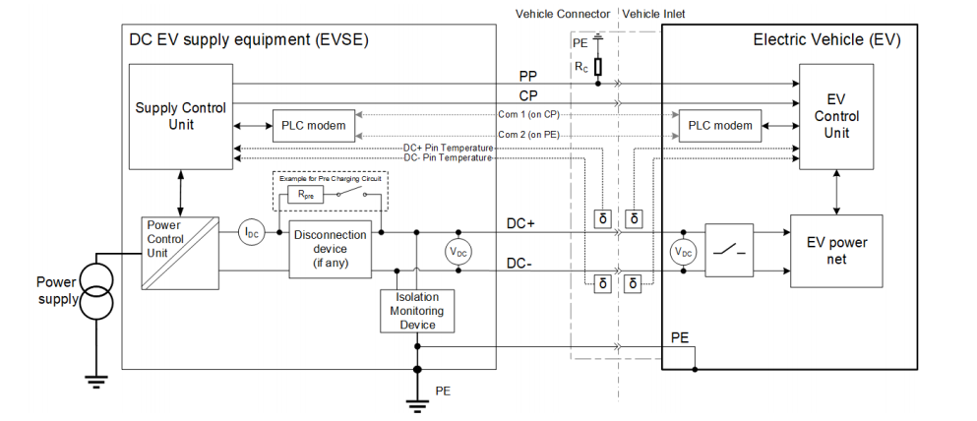
System overview – Hardware schematic
Notes:
V_DC : Voltage Measurement at output of DC EV supply equipment I_DC : Current Measurement (on DC+ or DC- or both) Power Conversion Unit : Isolated power stage for converting AC supply network into regulated DC power for EV supplying (charger module) Disconnection device : Device to connect and disconnect DC output of DC EV supply equipment to Power conversion unit (RELAY – control by HV,main) PLC Modem : Supply communication interface between PLC and internal communication (PLC board – qca7000(HLC) on CP, XMC – PWM on CP(basic signaling)) Supply Control Unit : Unit for control of supply process within DC EV supply equipment and communicating with EV (EVSE – main, hv)
R_pre : Resistor for pre charging circuit, Switch and resistor are recommended for implementation of mandatory PRE CHARGING function. IMD : Insulation Monitoring Device – CABLE CHECK
EV Control Unit : Unit for communicating from EV to the DC EV supply equipment and verifying safety procedure EV Power Net : Subsystem within the EV related to be supplied with energy from the DC EV supply equipment. PP (Proximity)
CP (Control Pilot) :

Slide 5
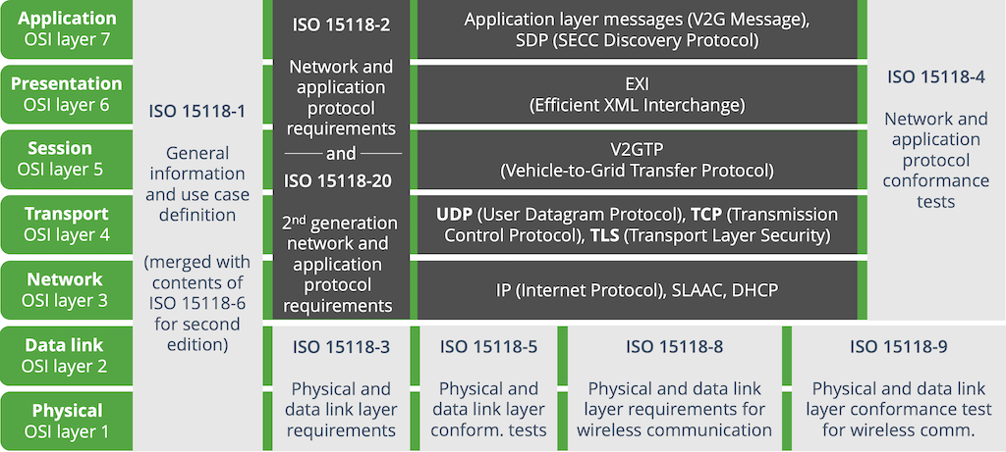

System overview – software osi layer

Slide 6
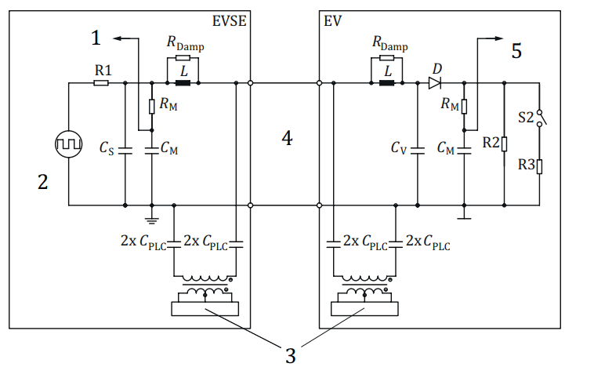
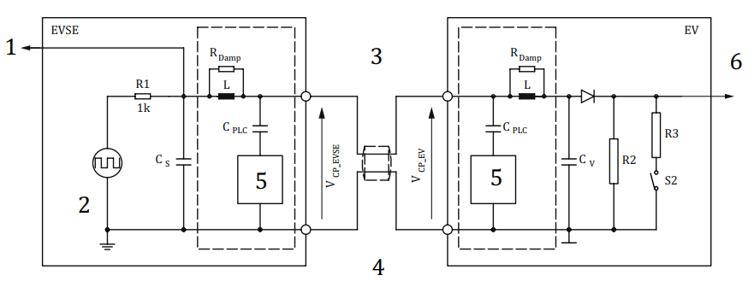
Iso15118 – synchronization with iec61851-1
Basic signaling : for any charging process (with or without present of HLC), use of bidirectional signaling (as IEC61851-1) always available. [V2G3-M06-01]
EV indicate information through the control pilot states (i.e. pull resistor value on EV side circuit -> change the CP positive voltage level -> change state of Control Pilot: Ax(12V), Bx(9V), Cx(6V), Dx(3V)).
EVSE indicate information through the duty cycle of the control pilot signal (PWM signal [-12:12]V) (i.e. change the PWM duty -> change state of Control Pilot: x1 (duty = 100%) , x2 (duty != 0%, 100%), F(duty = 0%) ). State E: power outage and if the EV supply equipment or short circuit between CP and PE.
High-level communication : main bidirectional communication in case of DC charging, which is a digital communication protocol, HLC data is injected on control pilot line by under layer HomePlug Green PHY(Ethernet II) As define in ISO15118-2, HLC can be split into 3 main phase:
Datalink setup
V2G setup
V2G charging loop
Notes:
For more information on HLC under layer data link and physical (how its operate and integrate directly on CP line), check ISO15118-3 and HomePlug Green PHY Spec.
[V2G3] 6.2 Definition of high-level communication and basic signalling
Any charging process, no matter the presence of high-level communication, uses the bidirectional signalling according to [IEC-1], indicating EV related information through control pilot states and EVSE related information through the duty cycle of the control pilot signal .
In case basic charging is used as back-up of HLC-C (e.g. when HLC-C has failed), the duty cycle is allowed to change due to dynamically changed grid information, according [IEC-1] requirements [V2G3] A.11 Signal coupling (information on injected HomePlug Green Phy digital communication signal onto control pilot line) [V2G3-A11-05] HomePlug Green PHY shall work with any valid control pilot duty cycle or state as defined in [IEC-1]. [V2G3-A11-07] The control pilot line and the PE wires shall be considered as a transmission line for the HomePlug Green PHY signal [V2G3-A11-06] A proper voltage level and duty cycle of the control pilot raw signal shall be implemented on EVSE side, to ensure [IEC-1] compliancy in presence of an additionalHomePlug Green PHY signal. The [ISO-3] highly recommends to apply at least a first order low pass filter with a cut-off frequency of 100 kHz to 200 kHz for measurements on the control pilot signal (e.g. duty cycle or amplitude), not to disturb the measurement by high frequency HomePlug Green PHY signals.

Slide 7
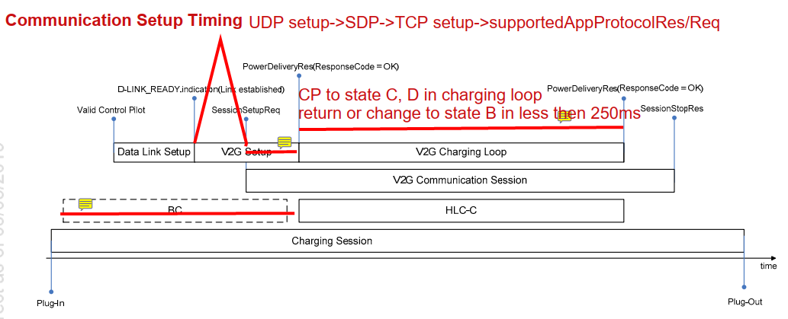
Iso15118 – synchronization with iec61851-1
BC: basic charging (in case of AC, power transfer could be occur before HLC establish between EV-CS by using
basic signaling on Control Pilot line).
HLC-C: high level communication charging (ISO15118 – V2G)
Notes:
[V2G2] 7.4 V2G communication states and data link handling
Data Link Setup: V2G messaging on application layer requires the establishment of the lower layer protocols to enable V2G message exchange between EVCC and SECC [V2G2] 8.7.4 V2G message synchronization with IEC 61851-1 signalling [V2G2-912] After receiving a ChargeParameterDiscoveryRes message and before sending a CableCheckReq message, the EVCC shall change to CP State C or D as defined in IEC 61851-1. [V2G2-913] After sending a PowerDeliveryReq message with ChargeProgress equal to “STOP” and receiving the corresponding PowerDeliveryRes message, the EVCC shall change to CP State B as defined in IEC 61851-1 before sending the next Request Message. [V2G2-915] The EVSE shall apply a CP duty cycle of 5 % from start of Data Link Setup until end of V2G Communication Session.
[V2G3-M06-01] Any charging process, no matter the presence of high-level communication, uses the bidirectional signalling according to [IEC-1], indicating EV related information through control pilot states and EVSE related information through the duty cycle of the control pilot signal .
[V2G3-M06-03] In case basic charging is used as back-up of HLC-C (e.g. when HLC-C has failed), the duty cycle is allowed to change due to dynamically changed grid information, according [IEC-1] requirements
[V2G3-M06-14] The EV shall always charge in the HLC-C mode, as soon as V2G charging loop is started.Within the V2G charging loop, the EV is not allowed to charge in the basic charging mode. Before the V2G charging loop and after the V2G communication session, the EV is allowed to charge in the basic charging mode in case of nominal control pilot duty cycle. In case of AC-charging, an EV should be capable to switch from a HLC-C mode to a basic charging mode, if an error occurs on the high-level communication, even if a HLC-C mode is already launched.

Slide 8
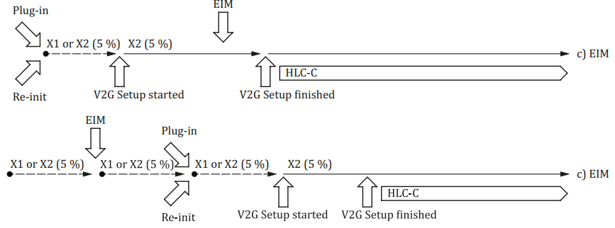
Iso15118 – Datalink handling
Data link setup
EIM: External Identification Mean (RFID, phone app)
Plug-in, Re-init: a change from state A/E/F to Bx/Cx/Dx
Notes:
[V2G3-M06-11] The matching process shall be launched by a transition from state A, E, or F to state Bx, Cx, or Dx. [V2G3-M06-15] During a matching process, a change in the duty cycle shall not terminate/interrupt the matching process on EV side. [V2G3-M07-01] After successful detection of the plug-in of a cable assembly, the low-layer communication module shall be ready for communication in less than T_conn_max_comm. [V2G3-M07-02] The EVSE shall only apply 5 % control pilot duty cycle if the low-layer communica tion module is ready for communication (receive first SLAC message).
According to the initialization process, an EVSE should be prepared to receive EIM identification, if offered, at any time. [V2G3-A11-05] HomePlug Green PHY shall work with any valid control pilot duty cycle or state as defined in [IEC-1].
[V2G3-A11-06] A proper voltage level and duty cycle of the control pilot raw signal shall be imple mented on EVSE side, to ensure [IEC-1] compliancy in presence of an additionalHomePlug Green PHY signal. The [ISO-3] highly recommends to apply at least a first order low pass filter with a cut-off frequency of 100 kHz to 200 kHz for measurements on the control pilot signal (e.g. duty cycle or amplitude), not to disturb the measurement by high frequency HomePlug Green PHY signals.
A.11.3 Signal requirements for HomePlug Green PHY injection Table A.11 gives requirements that physical signals shall comply with, in order to enable HomePlug Green PHY injection into the control pilot line, according to previous requirements. NOTE The HomePlug Green PHY signal has to be added to control pilot signal on the control pilot line. The resulting signal should be the algebraic sum of PWM control pilot signal and of the HomePlug Green PHY signals.

Slide 9
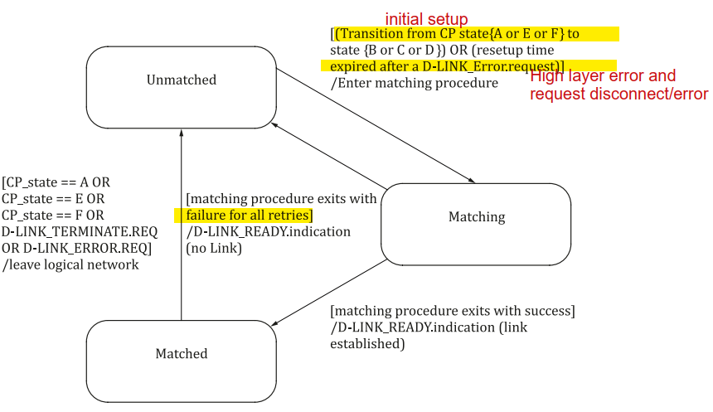
Iso15118 – Datalink handling
Data link setup
D-LINK_TERMINATE:called by
higher layer (after SessionStop). D-LINK_ERROR: called by
higher layer when error occur. After matching detected, HLE(app) will move to logical
network setup (binding UDP, TCP)
Notes:
[V2G3] 7.5 Loss of communication
7.5.1.1 Error handling with a Control Pilot duty cycle of 5 %
[V2G3-M07-05] With receiving a D-LINK_ERROR.request in X2 state from HLE, the EVSE’s communication node shall perform a state X2 to X1 to state E/F to state X1 or X2 transition.
With reaching the state “Unmatched”, the EVSE shall switch to state E/F, The state E/F shall be applied at least T_step_EF, After applying state E/F, the EVSE shall switch to contol pilot state X1 or X2 as soon as the EVSE is ready for incoming matching requests.
[V2G3-M07-13] EV side: With receiving a D-LINK_ERROR.request from HLE, the EV’s communication node shall change to Bx state, leave the logical network and change the matching state to “Unmatched” within TP_match_leave and wait for a new incoming matching trigger (control pilot X1 or X2 state). [V2G3-A09-123] In any case the matching process is considered as FAILED, the matching process shall be restarted as long as the timer TT_matching_repetition is not expired and a control pilot is detected in state Bx, Cx, or Dx

Slide 10
ISO15118 – MIDDLE LAYER (IP, SLAAC, TCP, UDP)
Link local IP address of EVCC
Global IP address of EVCC, if router is present in local link IP address of SECC
Because all interfaces has its own local link address, to ensure unique addresses and to support global addresses the neighbour discovery protocol is used.
IPV6: V2G Entities support IPV6 [V2G2-037]
SLAAC:
V2G Entity shall support the configuration of a link-local IPv6 unicast address [V2G2-050]
The interface ID of the Link-Local address of a V2G Entity shall be generated from its 48 bit MAC identifier [V2G2-051]
Notes:
[V2G2] 7.6 Network Layer – page 34

Slide 11
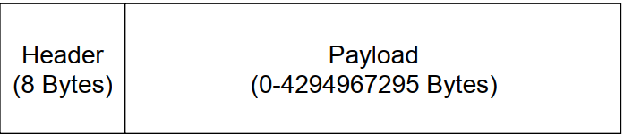
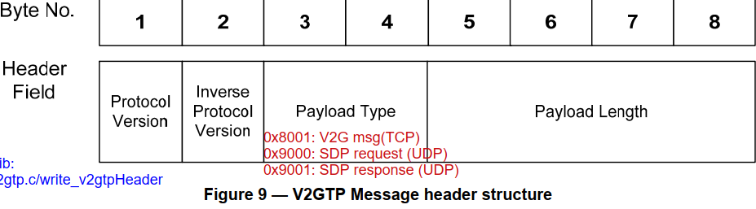
ISO15118 – MIDDLE LAYER (V2GTP)
Operate on TCP(only supported one currently), required source/destination port number in the range of Dynamic Ports (49152-65535)
PDU
EXI encoded V2G messages (payload 0x8001)
a V2GTP entity shall use a separate V2GTP message for each V2G message.
I.E. only 1 V2G AppMsg in this payload section
Notes:
[V2G2] 7.8 V2G Transfer Protocol – page 40 Receive V2GTP shall verify header (check protocol version, type of payload(to deserialize data with corresponding EXI on upper layer-> parse to msg data)
[V2G2-088] For EXI encoded V2G messages (payload 0x8001) a V2GTP entity shall use a separate V2GTP message for each V2G message. NOTE messagRequirement [V2G2-088] implies that the payload field can include neither a part of a message nor multiple

Slide 12
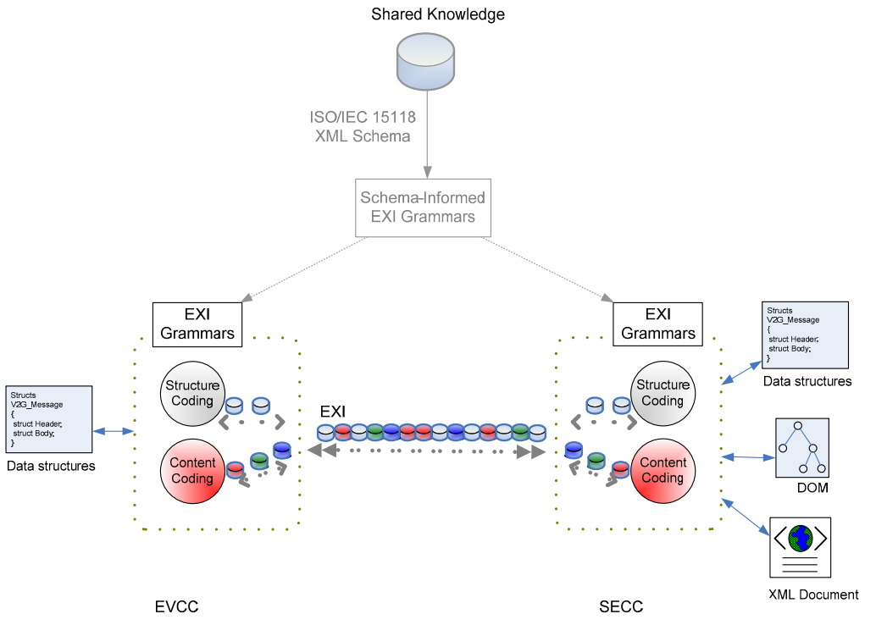
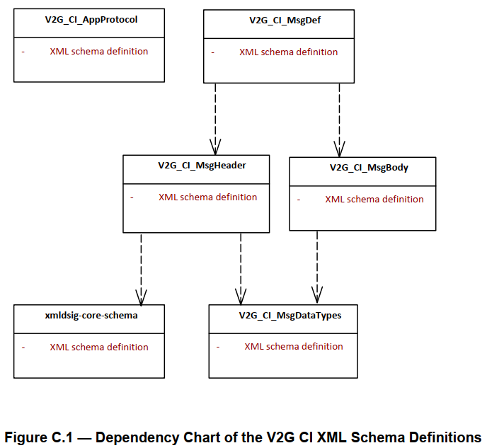
ISO15118 – MIDDLE LAYER (Presentation layer - exi)
XML and Efficient XML Interchange basic concept (message structure base on xml schema)
Notes:
[V2G2] 7.9 Presentation Layer For the purpose of describing the V2G Message Set the presentation layer uses the widely adopted XML data representation accordingly the document defines messages (i.e. data structures and data types) based on XML Schema which allows the type aware use of XML and enables simplified validity evaluation of exchanged messages
EVCC may only be able to handle the XML-based data using a corresponding data structure representation. Such data structures can be used to serialize or deserialize ISO 15118 application messages. Meanwhile, the SECC may be able to handle the data as data structure and/or the more resource intensive Document Object Model (DOM) or in a traditional plain-text XML variant.
V2G communication consists of two different Message Sets:  V2G application layer protocol handshake messages (refer to 8.2)  V2G application layer messages (refer to 8.3)

Slide 13
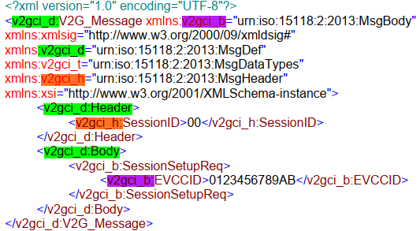
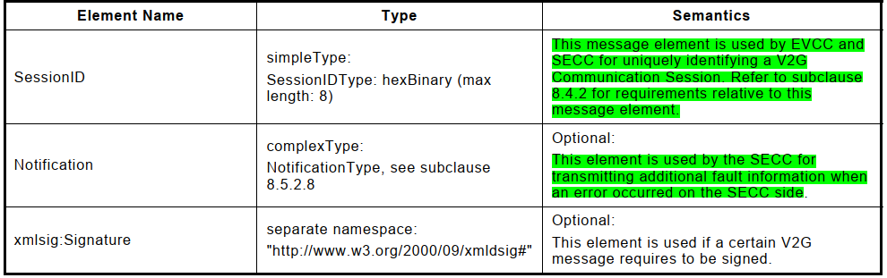
ISO15118 – MIDDLE LAYER (Presentation layer - exi)
V2G message example 5 - Example for a SessionSetupReq message
Ref: Annex C (normative) Schema definition – ISO15118-2
Notes:
EVCC may only be able to handle the XML-based data using a corresponding data structure representation. Such data structures can be used to serialize or deserialize ISO 15118 application messages. Meanwhile, the SECC may be able to handle the data as data structure and/or the more resource intensive Document Object Model (DOM) or in a traditional plain-text XML variant.

Slide 14
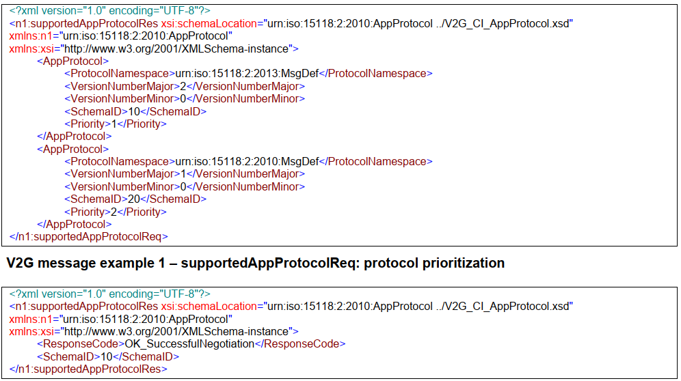
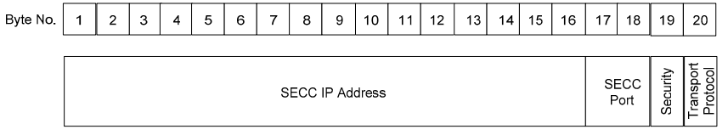
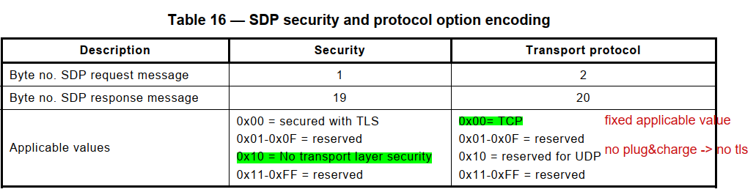
Iso15118 – v2g message SEQUENCE
EVCC act as client send request message to SECC as server(provide response)
General message sequence shall follow message list in table
Phase | Message | Description
Data-link (B1, B2) | SLAC (Signal Level Attenuation Characterization) messages | D-LINK_READY.indication(no link, link established) D-LINK_TERMINATE.request (called after SessionStop(terminate) D-LINK_ERROR.request (called with error from HLE) D-LINK_PAUSE.request (called after SessionStop(pause))
Initialization (B2) | SDP(SECC Discovery Protocol) Request SDP Response [V2G2-7.10.1] | SDP client sends out SECC Discovery Request messages to the local link (multicast) expecting any SDP server to answer its request. This msg base on UDP: EVCC send SDP request with request security and transport to local link multicast FF02::01 and target port 15118 SECC shall listen for multicast msg on port 15118 and response with its IPV6, port, which shall be used for TCP binding (only supported transport currently) - All application msgs after this shall be send on TCP
 | supportedAppProtocolReq [V2G2-175] supportedAppProtocolRes [V2G2-176] | EVCC provide a list of supported protocol namespace(with id, version info), SECC response with status and additional selected schema ID of protocol namespace it agree to use.
Notes:
[V2G2]
7.10.1 SECC Discovery Protocol 7.10.1.1 General Information An EVCC uses the SECC Discover Protocol (SDP) to get the IP address and port number of the SECC. The SDP client sends out SECC Discovery Request messages to the local link (multicast) expecting any SDP server to answer its request with a SECC Discovery Response message containing this information. After the EVCC received the IP address and the port number of the SECC, it can establish a transport layer connection to the SECC (refer to subclause 7.3.4). [V2G2-123] An SDP server shall be accessible in the local link.
7.10.1.2 Supported ports
SDP is a UDP based protocol. The ports listed in Table 15 are used by SDP (SOURCE port = (49152-65535), DESTINATION port = 15118 ) [V2G2-623] An SDP client shall use the encoding for the requested security option and the requested transport protocol as defined in Table 16. [V2G2-143] The SDP server shall be able to extract the source IP address and source port of a received UDP packet (client IP address and port number) and send a UDP packet to the identified IP address and port number. [V2G2-149] An SDP server shall send an SDP response with source port V2G_UDP_SDP_SERVER(15118) as defined in Table 15
7.10.1.6 Timing and Error Handling page-58 for SDP
This element is used by the SECC for transmitting additional fault information when an error occurred on the SECC side.

Slide 15
Iso15118 – v2g message SEQUENCE
Phase | Message | Description
Initialization (B2) | SessionSetupReq[V2G2-189] SessionSetupRes[V2G2-191] | Setup communication to start new session or resume old one. SessionID which was communicated in the header of messages (all following msgs shall has same SessionID in header part). Req send ID = 0: start new session. Res shall send back a ID different from 0 and list of stored pause SessionID, to be used in current session. Req send ID = value of previous session: check if value in stored list, then resume old session(pop id out from stored list) else start new session.
 | ServiceDiscoveryReq[V2G2-194] ServiceDiscoveryRes[V2G2-196] | EVCC request SECC to send back list of available services and payment option. EVCC can filter service by provide service scope or category.
 | ServiceDetailReq[V2G2-198](loop) ServiceDetailRes[V2G2-200] | EVCC select a service(with provided serviceID from previous msg) and request SECC to provide service’s parameter list (parameter set = id and parameter name + type + value – could be primitive or physical)
 | PaymentServiceSelectionReq[V2G2-202] PaymentServiceSelectionRes[V2G2-203] | EVCC select PaymentOption, Services and related ParameterSets (information receive from previous ServiceDiscovery/ServiceDetail msg).
 | CertificateUpdateReq/Res CertificateInstallationReq/Res PaymentDetailsReq/Res | T.B.D (current charging station doesn’t support Plug&Charge -> these msg pair is not used)
Notes:
8.4.3.5.1 Payment and Service Selection Handling Based on the provided services and the corresponding payment options by the SECC this message pair allows the transmission of the selected PaymentOption, SelectedServices and related ParameterSets. Depending on the selected payment additional messages (PaymentDetails message pair) are exchanged.
[V2G2-494] After receiving the ServiceDetailRes, the EVCC shall send an additional ServiceDetailReq while V2G_EVCC_Sequence_Timer is smaller than V2G_EVCC_Sequence_Performance_Time, if further ServiceDetailReq are necessary to retrieve the detailed information from the SECC.

Slide 16
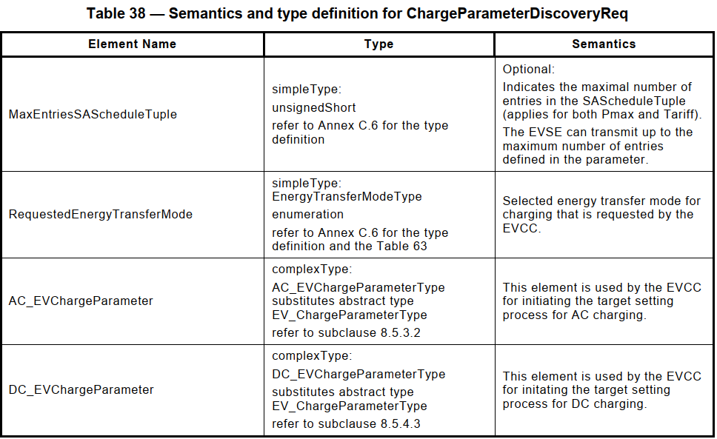
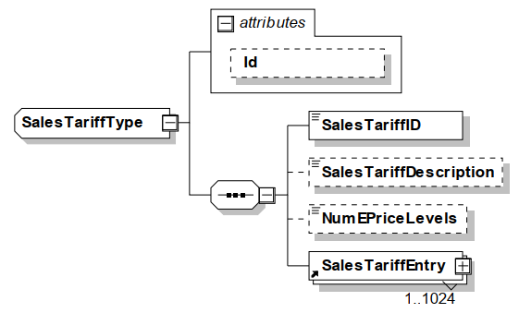
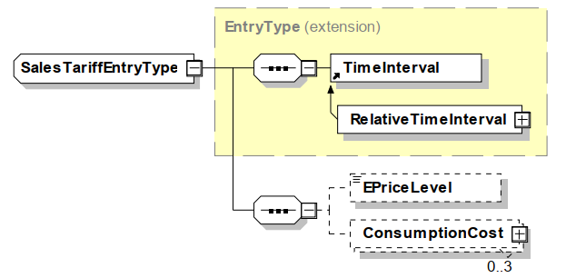
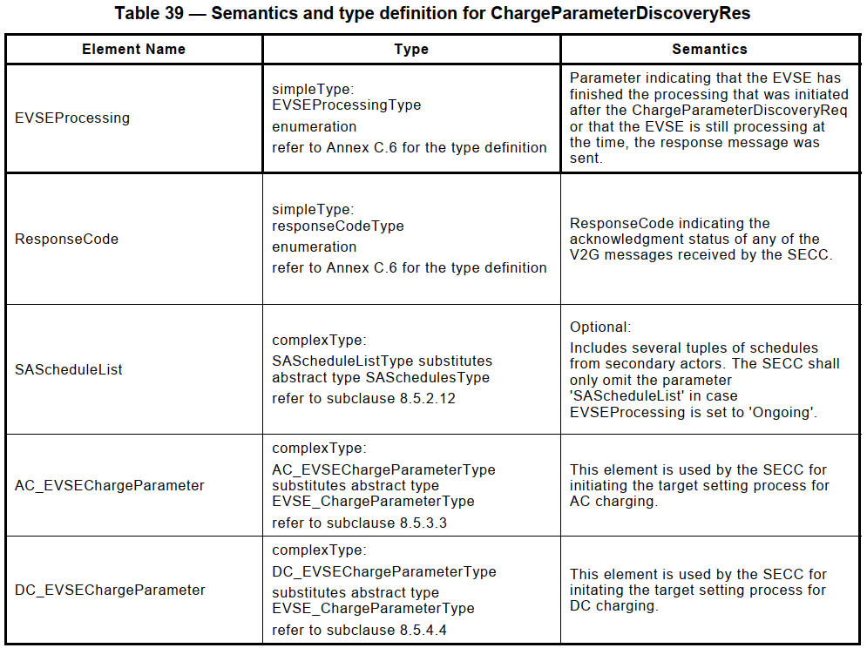
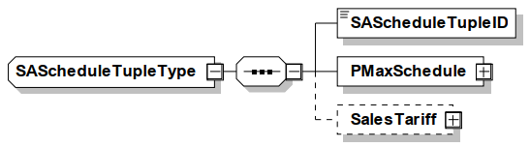
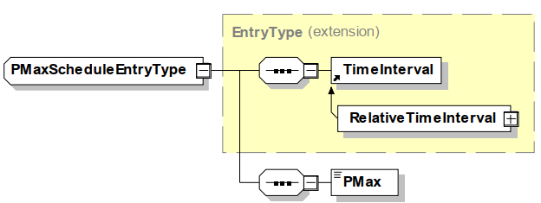
Iso15118 – v2g message SEQUENCE
Phase | Message | Description
Initialization (B2) | AuthorizationReq AuthorizationRes[V2G2-213] (loop) | EVCC request authorization(empty msg in case EIM). SECC shall return status Ongoing_WaitingForCustomerInteraction when customer hasn’t provide EIM authorized info (RFID, phone app interact).
 | ChargeParameterDiscoveryReq[V2G2-216] ChargeParameterDiscoveryRes[V2G2-220] (loop) | Negotiate charging parameters that precede the energy delivery or can be engaged during energy delivery phase. EV shall indirectly negotiate with CSO to ensure that the client will be satisfied while at the same time ensuring that the energy will effectively be available and fall within the capacity of power supply grid at the local level (private network) and at the regional level (public network) EV: estimated energy amounts for recharging the vehicle, capabilities of the EV charging system and the point in time the vehicle operator intends to leave the EVSE CS: applicable charge parameters from the grid’s perspective, optionally includes further information on cost over time, cost over demand, cost over consumption or a combination of these.
Notes:
[V2G2-684] After receiving the AuthorizationRes, the EVCC shall send an empty AuthorizationReq while V2G_EVCC_Sequence_Timer is smaller than V2G_EVCC_Sequence_Performance_Time as long as the parameter EVSEProcessing is equal to 'Ongoing'.
8.4.3.8.1 ChargeParameterDiscoveryReq/Res Handling
After being authorized for charging at the EVSE (SECC) the EVCC and the SECC negotiate the charging parameters with the ChargeParameterDiscoveryReq/Res message pair. The charging parameters negotiation that precedes the delivery of energy or may be engaged during the energy delivery phase is destined to ensure that the client will be satisfied while at the same time ensuring that the energy will effectively be available and fall within the capacity of power supply grid at the local level (private network) and at the regional level (public network) Initially, before the onset of the energy supply, the EV will negotiate with EVSE operator, and third party actors indirectly, to fit to the known or predicted available electric power. The available energy may evolve once the charging has started due to sudden lack of power source, or increase in demand of other consumptions (e.g. other EV arrival). New negotiation shall be allowed to cope with difficulties encountered, locally or regionally. Such re-negotiation shall be included within the communication protocol between EVSE and EV during the charging period
Request msg list out EV side constrain: (DC)
- max number of schedule, required energy transfer type
- Departure time(not used -> charge right away)
- Current,Voltage, Power max limit
- EV Status
- Energy capacity
- Energy request
- Full SOC, Bulk SOC (percent value consider to be full or done fast charge)
DC
- EVSE status
- EVSE max,min current, voltage
- EVSE max power
- EVSE current regulation tolerance
- EVSE current peak ripple
- EVSEEnergyToBeDelivered

Slide 17
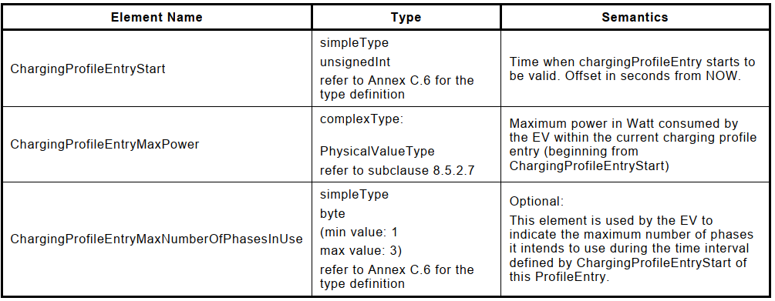
Iso15118 – v2g message SEQUENCE
Phase | Message | Description
Insulation Check & Pre-Charge (C2|D2) | CableCheckReq[V2G2-250] CableCheckRes[V2G2-252] (loop) | - EVCC asks for the cable check status of the EVSE and e.g. tells the EVSE if the connector is locked on EV side and if the EV is ready to charge - SECC sends the CableCheckRes informing the EVCC about result of cable check and EVSE status - Insulation check process request by EV to CS, CS execute check on system and report status.
 | PreChargeReq[V2G2-254] PreChargeRes[V2G2-256] (loop) | - EVCC start the Pre Charge process from EV side - SECC informing the EV about the EVSE status and the present EVSE output voltage. - EV request CS provide target Voltage level, current value(2A) to measure the responsive time and verify current/voltage ripple/slew rate
Energy Transfer(C2|D2) | PowerDeliveryReq[V2G2-222] PowerDeliveryRes[V2G2-223] | Msg exchange marks the point in time when the EVSE provides voltage to its output power outlet and the EV can start to recharge its battery. EVCC select ScheduleID, ChargeProgess status(start/stop/renegotiate), Charging Profile of EV SECC back status of EVSE and response code if ChargeProfile is valid with Schedule(PMaxSchedule)
Notes:
IEC61851-23
CC.4 Safety measures - CC.4.1 IT (isolated terra) system requirements
DC supply (with insulation monitoring device (IMD)) shall perform insulation monitoring between DC+ and PE and DCand PE during the supply process and communicate the current state (Invalid, Valid, Warning, Fault) of the system periodically to the EV.
Prior to each supply cycle the following tests shall be performed. During these tests the d.c. output voltage shall not exceed 500 V at vehicle connector. a) A self test of the insulation monitoring function of the d.c. supply shall be done by applying a defined fault resistor between d.c. output rail and equipotential bonding (e.g. PE). At least one of the following three possibilities for time management of self test shall be applied: 1) directly prior to supply cycle with vehicle connector plugged into vehicle inlet; 2) at regular intervals with maximum period of 1 h; 3) after self test has successfully been performed the station may stay in Valid state for a maximum time of 1 h and during supply session under normal conditions. b) An insulation check of the system according to 6.4.3.106, e.g. by IMD shall be performed: 1) vehicle connector not plugged into vehicle inlet: system comprises station, cable and vehicle connector, or 2) vehicle connector plugged into vehicle inlet: system comprises station, charging cable, vehicle connector, vehicle inlet and vehicle cables. The insulation states of the system are defined as follows. a) Invalid state: Self test has not been carried out yet. Charging is not allowed. b) Valid state: After self test has successfully been performed the station shall go into Valid state. After each termination of energy transfer the station shall go back into Invalid state. c) Warning state: If the actual total physical insulation resistance between DC+/DC- to PE falls below a value calculated by 500 Ω/V multiplied by the maximum output voltage rating of the d.c. EV charging station (without negative tolerance) the d.c. supply shall send a Warning message and store the Warning. d) Fault state: If self test has failed or the actual total physical insulation resistance between DC+/DC- to PE falls below a value calculated by 100 Ω/V multiplied by the maximum output voltage rating of the d.c. EV charging station (without negative tolerance) an optical and/or acoustical signal shall be issued by the d.c. supply to the user and the d.c. supply shall terminate the supply process. While the DC charging station is charging a vehicle, the DC charging station shall detect the Fault state and indicate the Invalid State ≤ 2 consecutive minutes of the insulation resistance ≤ 100 Ω/V. If Warning or Fault state during energy transfer occurs, the station shall perform a self test after disconnecting the vehicle connector from the vehicle. If self test is successfully passed, the station shall go into Valid state; otherwise it shall go into Invalid state and stay there until serviced.
CC.5.1 Pre charging While executing the pre-charge sequence, the EVSE shall comply with the pre-charge request process as stated in the communication protocol but the current request of the EV shall be ignored and the output current shall be limited to 2 A During pre-charge, the EVSE shall: be able to pre-charge the circuit defined in Figure CC.12 with the values according to Table CC.13 for its entire operating range within 3 s; and subsequently follow the voltage request from the EV according to 101.2.1.2.2 and 101.2.1.6(voltage ripple, slew rate) within 1 s
During pre-charge, the EV shall limit its current draw to an equivalent of the circuit defined in Figure CC.12 and Table CC.13. According to ISO 17409, the EV shall close its disconnection device only after verifying that the absolute voltage difference between the EV inlet and the EV battery is less than 20 V. The EV should be protected against the case that the polarity of the DC output is reversed and shall not close its disconnection device. The EV shall measure the DC bus voltage at its inlet and could use the measured voltage as feedback for the pre-charge request adjustments. The EV shall not solely use the voltage measurements communicated by the EVSE to check if the EVSE output and battery voltages are within this limit. As the voltage across the EV contactors are leading for closing the EV contactors. The EV could consider to do pre-charge voltage request adjustment to compensate for tolerances and steady state errors to get the inlet voltage within the +/- 20 V of the battery voltage.
• Pre-charge starts when the EV sends PreChargeReq <5a>, which contains the requested DC current ≤ 2 A (maximum inrush current acc. to CC.6.2) and the requested DC voltage. See Pre charge (CC.5.1).

Slide 18
Iso15118 – v2g message SEQUENCE
Phase | Message | Description
Energy Transfer(C2|D2) | CurrentDemandReq[V2G2-258] CurrentDemandRes[V2G2-260] (loop) | Cyclic exchange of the requested current from EV side is necessary. Also the target voltage and the difference in current and voltages is transferred. EV: request target voltage and current value, status of EV and battery SoC CS: send back present voltage, current value, EVSE status, Limit(A,V,P) flag and additional info such as meter info and receipt.
Welded Check & Unlocking (B1, B2) | WeldingDetectionReq[V2G2-261] WeldingDetectionRes[V2G2-263] (loop) | Start welding check operation on EV and EVSE side.
 | SessionStopReq[V2G2-239] SessionStopRes[V2G2-241] | EV request to terminate or pause charging session EVSE acknowledge by return status and store current session id if request is pause.
Notes:
During energy transfer, EV could send PowerDeliveryReq when it want to renegotiate charging parameters.
FF.5.6 Diagnostic check of mechanical disconnection device in the DC output system The multi-outlet DC EV supply equipment shall perform the diagnostic check of the mechanical disconnection device installed in the DC output system to prevent unexpected
power flow from a vehicle to the DC EV supply equipment, or between the two or more
vehicles simultaneously connected to the DC EV supply equipment in case the mechanical
disconnection device is welded (ON stuck) , and to prevent hazardous voltage at the unmated
vehicle connector.
As the minimum requirement, the diagnostic shall check the welding (ON stuck) of the
mechanical disconnection device. Diagnostic checks of other failures such as OFF stuck and
erratic actuation are not mandatory but still recommended.
If the diagnostic check is performed before the start of charging and the ON stuck failure is
detected, the charging process shall be terminated and the system shall transfer to shutdown
sequence
If the diagnostic check is performed after the completion of a single charging event and the
ON stuck failure is detected, the DC EV supply equipment shall prohibit further charging
events until the mechanical disconnection device is properly replaced or repaired.

Slide 19
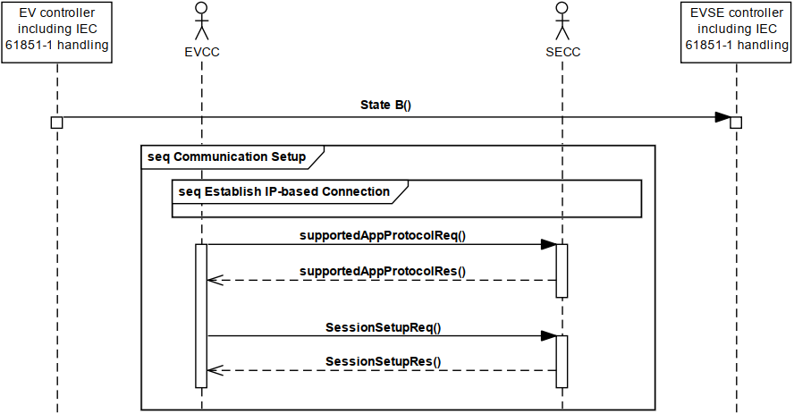
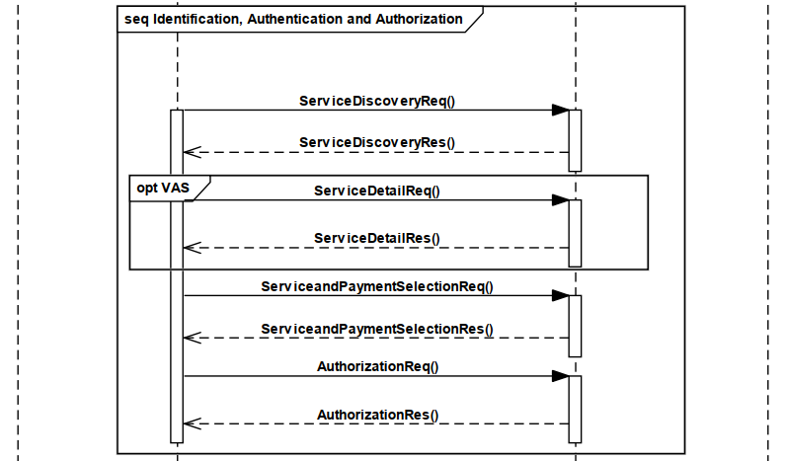
Iso15118 – v2g message SEQUENCE (normal)

Slide 20
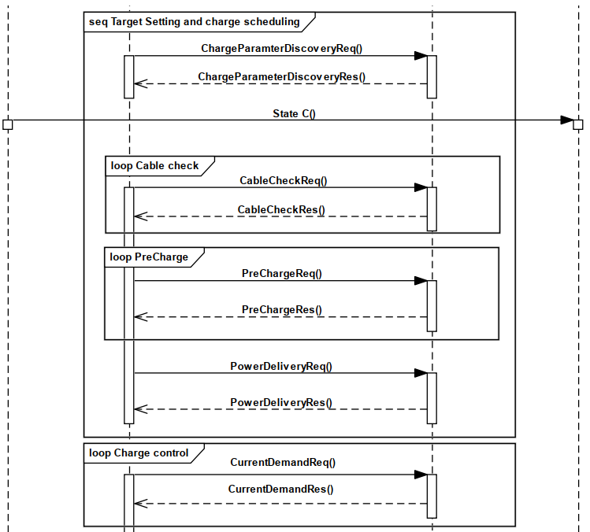
Iso15118 – v2g message SEQUENCE (normal)
Start charging loop with EVCC send PowerDeliveryReq(start)
Normal charging loop: EVCC: CurrentDemandReq SECC: CurrentDemandRes
Notes:
[V2G2-880] All DC_EVSEStatusCodes in Table 98 for which there are no explicit requirements in this document are for information purpose only. They shall not influence the EVSE charging process. NOTE 1 EVSE_EmergencyShutdown” may be used by the SECC to inform the EVCC that the EVSE is in the process of, or has just executed, an emergency shutdown. However, to force the EV to participate in the emergency shutdown, the SECC does not use this value, but instead uses the CPL in accordance with IEC 61851-1. In all other cases, the expected value for DC_EVSEStatusCode is “EVSE_Ready” or “EVSE_IsolationMonitoringActive”, even though they do not influence the EV charging process.

Slide 21
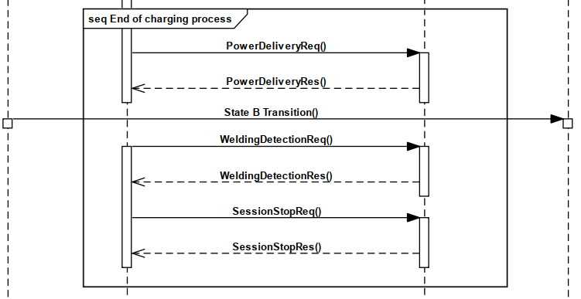
Iso15118 – v2g message SEQUENCE (normal)
End charging process: EVCC send PowerDeliveryReq(stop) SECC send CurrentDemandRes( parameter EVSENotification in EVSEStatus is equal to StopCharging)
SessionStopReq(terminate)

Slide 22
Iso15118 – v2g message SEQUENCE (renegotiation)
To initiate a renegotiation by the SECC, the SECC has to set EVSENotification in EVSEStatus to 'ReNegotiation'. If so, the EVCC shall initiate a renegotiation in a limited time
To initiate a renegotiation by the EVCC, the EVCC can decide to perform a renegotiation by sending PowerDeliveryReq with parameter ChargeProgress set to ‘Renegotiate’
Notes:
renegotiation messaging for updating the agreement on the charging schedule between EV and EVSE during a V2G Communication Session by retransmitting the parameters SASchedule and ChargingProfile
[V2G2] Annex I (informative) Message sequencing for renegotiation
[V2G2-839] The EVCC shall use the message PowerDeliveryReq with parameter ChargeProgress set to “Stop” to stop HLC-C based charging. [V2G2-840] The EVCC shall use the message PowerDeliveryReq with parameter ChargeProgress set to “Renegotiation” to initiate a renegotiation messaging [V2G2-841] The EVCC shall not send the message PowerDeliveryReq with parameter ChargeProgress set to “Renegotiation” before sending PowerDeliveryReq with parameter ChargeProgress set to “Start. V2G2-842] If [V2G2-841] applies the EVCC shall set the parameter ChargeProgress to “Start” in the next following message PowerDeliveryReq to apply the negotiated charging limits after a renegotiation.

Slide 23
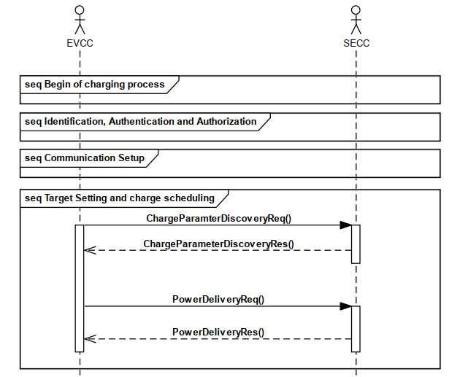
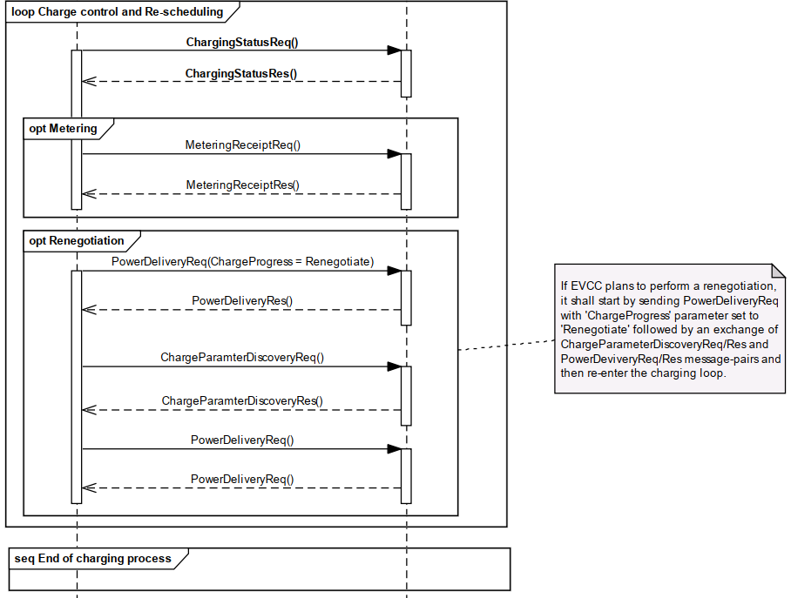
Iso15118 – v2g message SEQUENCE (renegotiation) - EVCC

Slide 24
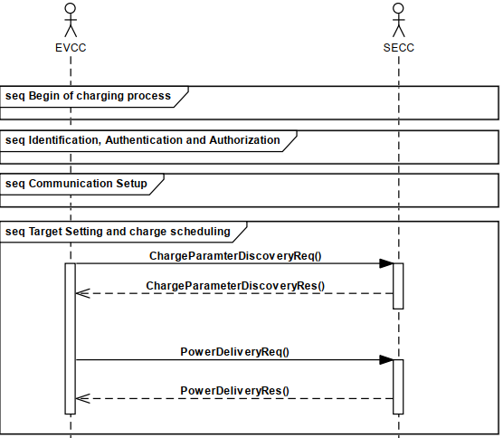
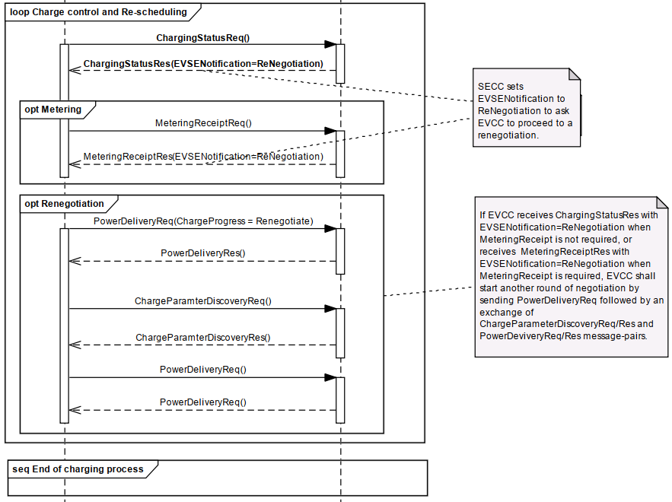
Iso15118 – v2g message SEQUENCE (renegotiation) - SECC

Slide 25
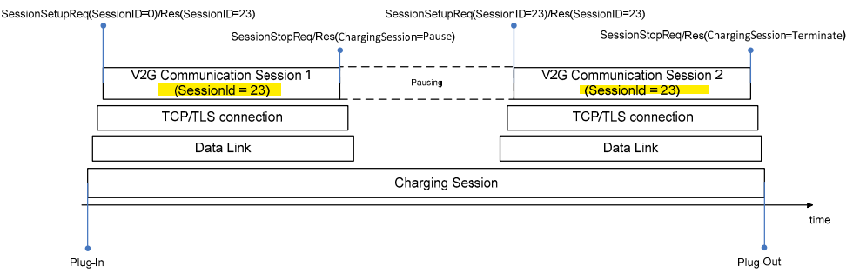
Iso15118 – v2g message SEQUENCE (pausing and resume)
Notes:
EVCC
[V2G2-740] If an EVCC resumes a previously paused V2G Communication Session, the following parameter values provided by the EVCC in the previous V2G Communication Session shall be provided again for the resumed V2G Communication Session: - SessionID which was communicated in the header of the SessionSetupRes message in the previous V2G Communication Session (for all request messages starting from SessionSetupReq). - SelectedPaymentOption (PaymentServiceSelectionReq) - RequestedEnergyTransferMode (ChargeParameterDiscoveryReq) [V2G2-742] If an EVCC wants to resume a previously paused V2G Communication Session, it shall send the parameter DepartureTime in ChargeParameterDiscoveryReq reduced by the elapsed time. [V2G2-743] If an EVCC wants to resume a previously paused V2G Communication Session, it shall send the parameter EAmount in ChargeParameterDiscoveryReq reduced by the energy that was already charged. [V2G2-744] If [V2G2-739] applies, the EVCC shall take care that [V2G2-740] is fulfilled as long as no CP State A, E, or F was detected in the EVCC as defined in IEC 61851-1.
SECC
[V2G2-741] If an EVCC resumes a previously paused V2G Communication Session, the following parameter values provided by the SECC in the previous V2G Communication Session shall be provided again for the resumed V2G Communication Session: - SessionID which was communicated in the header of the SessionSetupRes message in the previous V2G Communication Session if the SessionID communicated in the header of SessionSetupReq matches the stored value (for all request messages starting from SessionSetupReq) - PaymentOptionList (ServiceDiscoveryRes). Only the payment option previously selected by the EVCC shall be provided. - ChargeService (ServiceDiscoveryRes) - SAScheduleTuple (ChargeParameterDiscoveryRes). At least the SAScheduleTuple (including the related PMaxSchedule and SalesTariff data) whose ID was selected by the EVCC in its ChargingProfile in the previous V2G Communication Session shall be provided. This tuple ID must not change during a V2G Communication Session. The period of time this SAScheduleTuple applies for shall be reduced by the time already elapsed [V2G2-745] If [V2G2-739] applies, the SECC shall take care that [V2G2-741] is fulfilled as long as no CP State A, E, or F was detected in the SECC as defined in IEC 61851-1. [V2G2-750] When receiving the SessionSetupReq with the parameter SessionID equal to zero (0), the SECC shall generate a new (not stored) SessionID value different from zero (0) and return this value in the SessionSetupRes message header. [V2G2-751] The SessionID value returned by the SECC in the SessionSetupRes message shall not change as long as the V2G Communication Session is not terminated (i.e. value of parameter ChargingSession of SessionStopReq has not been set to ‘Terminate’ at any time)

Slide 26
ISO15118 – V2G TIMING
On application level, error(on application) detect by expected condition timeout, V2G Entity to manage any processing error and communication error on application level after waiting for the expected behaviour until a specified timeout.
A terminated TCP connection before a SessionStopRes is always interpreted as an error by the EVCC or the SECC.
EVCC can establish a new V2G Communication Session after an error.
Timer list in application level:
Message pair timer: monitor the exchange of request and corresponding response message.
Sequence timer: monitor the time after response a message and the next expected request msg.
Ongoing msg timer: monitor the repeated message pair base on parameter EVSEProcessing equal to "Ongoing.
Communication Setup timer: Monitors the time from the moment of an established data link until the Session Setup message.
CableCheck, PreCharge Timing: carry out by EV to verify EVSE fulfill timing for requested operation.
Notes:
[V2G2] 8.7 V2G communication timing [V2G2-438] The EVCC shall stop waiting for the response message and stop monitoring the V2G_EVCC_Msg_Timer when V2G_EVCC_Msg_Timer is equal or larger than V2G_EVCC_Msg_Timeout(MessageType) and no response message was received. It shall then apply the error handling as defined in subclause 8.8. [V2G2-443] The SECC shall stop waiting for a request message and stop monitoring the V2G_SECC_Sequence_Timer when V2G_SECC_Sequence_Timer is equal or larger than V2G_SECC_Sequence_Timeout and no request message was received. It shall then stop the V2G Communication Session..
[V2G2-440] The EVCC shall ignore any message that is not a valid response message. [V2G2-445] The SECC shall ignore any message that is not a valid request message
NOTE While exceeding a timeout always causes an error handling, the performance time does not necessarily cause error handling if not defined differently by requirements. Depending on the system behaviour (e.g. transmission time) no error may occur if the corresponding communication partner does not detect a timeout but the probability for causing a timeout is high.

Slide 27
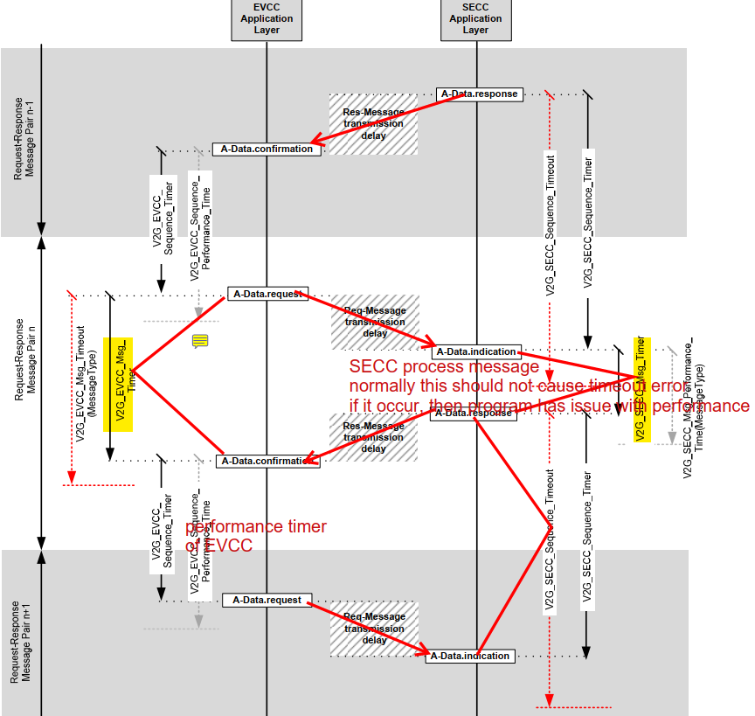
ISO15118 – V2G TIMING
Timeout: If the specified time is exceeded the related error handling is initiated.
Performance Time: If the specified time is exceeded the performance requirement is not fulfilled.
Timeout: when the target communication entity does not response in time
Performance: when specific internal operation (processing action) of the entity take too long and cause performance timeout.
Notes:
[V2G2-448] The EVCC shall stop waiting for the SessionSetupRes message and stop monitoring the V2G_EVCC_CommunicationSetup_Timer when V2G_EVCC_CommunicationSetup_Timer is equal or larger than V2G_EVCC_CommunicationSetup_Timeout and no SessionSetupRes message was received. It shall then stop the V2G Communication Session. [V2G2-716] The SECC shall stop waiting for SessionSetupReq and stop monitoring the V2G_SECC_CommunicationSetup_Timer when V2G_SECC_CommunicationSetup_Timer is equal or larger than V2G_SECC_CommunicationSetup_Performance_Time and no SessionSetupRes message was sent. It shall then apply [V2G2-034].
[V2G2-711] If [V2G2-710] applies, the EVCC shall stop the V2G Communication Session when V2G_EVCC_Ongoing_Timer is equal or larger than V2G_EVCC_Ongoing_Timeout and no parameter EVSEProcessing equal to 'Finished' has been received. [V2G2-713] If [V2G2-712] applies, the SECC shall try to send ResponseCode equal to "FAILED" when V2G_SECC_Ongoing_Timer is equal or larger than V2G_SECC_Ongoing_Performance_Time and no parameter EVSEProcessing equal to 'Finished' has been sent. The SECC shall stop the V2G Communication Session

Slide 28
ISO15118 – V2g error handling (between HLE, Datalink and CP states)
On application level, error handling is based on timers of request-response message sequences.
In case there is no error in the communication layers below the application layer, the application has the option to terminate the TCP communication in case of application error. A terminated TCP connection before a SessionStopRes is always interpreted as an error by the EVCC or the SECC.
Beside the timeout error on application level, basic error handling for a Request-Response-Message Pair is based on the ResponseCode included in the Response Message of the SECC. Value starting with “FAILED” or “FAILED_” indicates a negative response. Detailed information may be provided by FAILED_<additional info>. This information may be used to differentiate the reaction on the negative response.
=> Application: timeout then terminate communication session, ResponseCode = FAILED then EVCC shall has different reaction.
Notes:
[V2G2-914] If [V2G2-912] applies and no error has been identified, the EV shall not change the CP State until [V2G2-913] applies. Within a Charging Session, an EVCC can establish a new V2G Communication Session after an error by applying the V2G communication state processing as described in subclause 7.4. In this case, the EVCC and the SECC start the communication in the same way as for the first V2G session setup.
[V2G2-728] After the EVCC stopped the V2G Communication Session with an error it shall terminate the communication by applying [V2G2-025]. [V2G2-737] If the EVCC measures CP State E or F it shall stop the V2G Communication Session and continue with [V2G2-728]. [V2G2-731] If [V2G2-508] or [V2G2-728] applies, the EVCC can establishing a new or resumed V2G Communication Session by applying [V2G2-014]

Slide 29
ISO15118 – V2g error handling (between HLE, Datalink and CP states)
Any error on Application level shall terminate underlying TCP request D-LINK_ERROR.request to under datalink layer to request error handling.
Datalink shall terminate, leave logical network.
EVSE shall perform transition from X2 to X1 to state E/F to state X1 or X2 (after returning to X1/X2, EVSE shall ready for incoming match request).
Incase of lost logical connection, datalink shall notify upper layer (i.e. TCP), and this error shall be process on application level as lost communication.
Notes:
[V2G2-025] The EVCC shall terminate the TLS or TCP connection after stopping the V2G Communication Session.
[V2G2-720] If the EVCC identifies any error it shall indicate an Data-Link error (D-LINK_ERROR.request()) and continue with [V2G2-014]. [V2G2-034] The SECC shall terminate the TLS or TCP connection after stopping the V2G Communication Session. [V2G2-727] If the SECC identifies any error it shall indicate an Data-Link error (D-LINK_ERROR.request()) and continue with [V2G2-721]. [V2G3-M07-05] With receiving a D-LINK_ERROR.request in X2 state from HLE, the EVSE’s communication node shall perform a state X2 to X1 to state E/F to state X1 or X2 transition.
NOTE 1 EVSE_EmergencyShutdown” may be used by the SECC to inform the EVCC that the EVSE is in the process of, or has just executed, an emergency shutdown. However, to force the EV to participate in the emergency shutdown, the SECC does not use this value, but instead uses the CPL in accordance with IEC 61851-1. In all other cases, the expected value for DC_EVSEStatusCode is “EVSE_Ready” or “EVSE_IsolationMonitoringActive”, even though they do not influence the EV charging process.
9.7 Error handling [V2G3-M09-19] In the following cases, the communication node shall leave the logical network within TP_match_leave. All parameters related to the current link shall be set to the default value and shall change to the status “Unmatched”. — The state A is detected on EVSE side — The state E is detected on EV side
[V2G3-A09-123] In any case the matching process is considered as FAILED, the matching process shall be restarted as long as the timer TT_matching_repetition is not expired and a control pilot is detected in state Bx, Cx, or Dx.

Slide 30
ISO15118 – Testing
https://serverfault.com/questions/362529/how-can-i-sniff-the-traffic-of-remote-machine-with-wireshark

