Slide 1
Stay healthy, free flu shots for students!
Thursday, October 27 | 6:30 a.m. to 4:30 p.m. | University Services Building
Tuesday, November 1 | 8.30 a.m. to 11:30 a.m. and 1 p.m. to 4 p.m. | Buchanan D140, Meekison Lounge
Wednesday, November 2 | 8.30 a.m. to 11:30 a.m. and 1 p.m. to 4 p.m. | The Nest
Thursday, November 3 | 8.30 a.m. to 11:30 a.m. and 1 p.m. to 4 p.m. | The Nest
Full schedule and details here

Slide 2
Quiz 1, P3 - A system contains carbon dioxide and water under vapour-liquid equilibrium and there are no chemical reactions involved. How many degrees of freedom does the system have?
~ 63% correct
DF = 2 + c – Π – r
= 2 + 2 components (CO₂, H₂O) – 2 phases (V-L) – 0 reactions = 2 DF

Slide 3
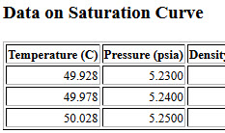
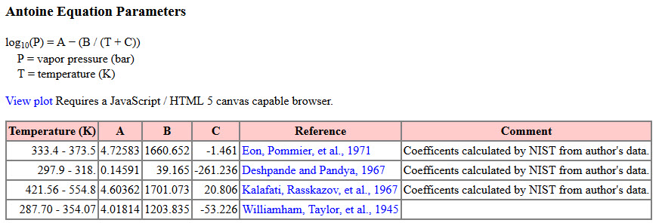
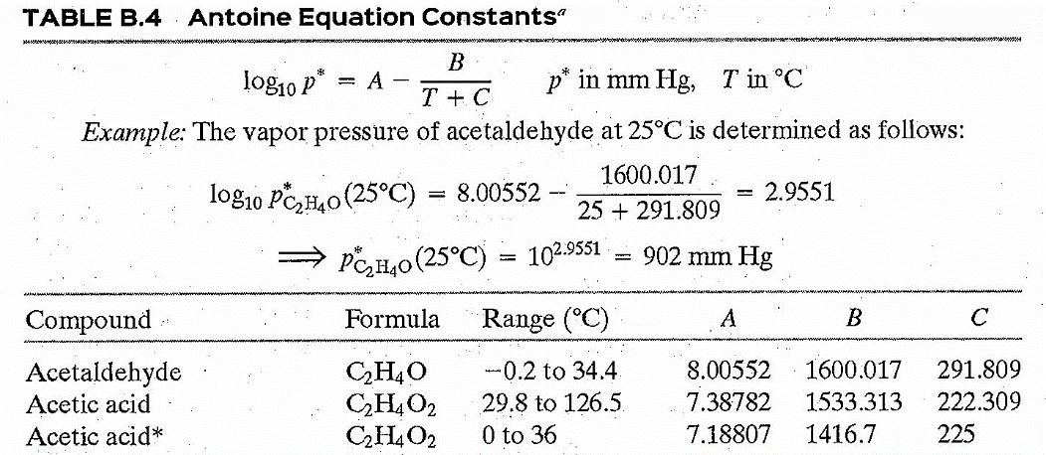
Quiz 1, P4 – What is the dew point temperature in Celsius for benzene at 5.24 psia?
~ 20% correct Multiple methods to solve
NIST – 49.98 (Note +/- 2 C was also accepted)
Antoine Equation - Data from NIST Webbook, also in text Table B4

Slide 4

Practice Problems
Tutorial videos sponsored by UC Boulder and Shell
Online – organized same as the text we use
http://www.learncheme.com/screencasts/mass-energy-balances

Slide 5
Adsorption

Slide 6
Adsorption on solids
Adsorption – molecules of gas, liquid or solid, called the adsorbate, adhere to a solid surface, called the adsorbent
Absorption – molecules of gas, liquid or solid dissolve into another substance known as the absorbent for solids or solvent for liquids
Adsorption Equilibrium data is taken at a particular temperature and known as an adsorption isotherm

Slide 7
Table 6.7-1 Equilibrium data for CCl4 adsorbed on activated carbon at 34°C
P CCl4 (mmHg) | 0 | 0.169 | 3.38 | 6.76 | 8.45 | 11.8 | 20.7 | 32.1 | 40.0 | 84.5 | 104.5 | 123 | 133
X* (g CCl4/g carbon) | 0 | 0.07 | 0.14 | 0.27 | 0.34 | 0.48 | 0.57 | 0.63 | 0.68 | 0.70 | 0.71 | 0.71 | 0.71

Slide 8
Table 6.7-1 Equilibrium data for CCl4 adsorbed on activated carbon at 34°C
P CCl4 (mmHg) | 0 | 0.169 | 3.38 | 6.76 | 8.45 | 11.8 | 20.7 | 32.1 | 40.0 | 84.5 | 104.5 | 123 | 133
X* (g CCl4/g carbon) | 0 | 0.07 | 0.14 | 0.27 | 0.34 | 0.48 | 0.57 | 0.63 | 0.68 | 0.70 | 0.71 | 0.71 | 0.71

Slide 9
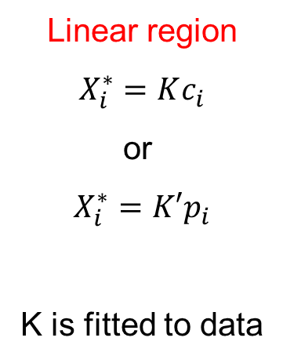
Table 6.7-1 Equilibrium data for CCl4 adsorbed on activated carbon at 34°C
P CCl4 (mmHg) | 0 | 0.169 | 3.38 | 6.76 | 8.45 | 11.8 | 20.7 | 32.1 | 40.0 | 84.5 | 104.5 | 123 | 133
X* (g CCl4/g carbon) | 0 | 0.07 | 0.14 | 0.27 | 0.34 | 0.48 | 0.57 | 0.63 | 0.68 | 0.70 | 0.71 | 0.71 | 0.71
Linear region
$$X_{i}^{∗}=Kc_{i}$$
or
$$X_{i}^{∗}=K′p_{i}$$
K is fitted to data

Slide 10
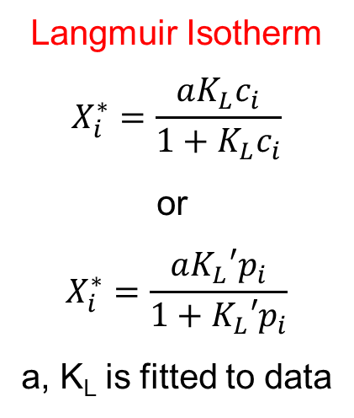
Table 6.7-1 Equilibrium data for CCl4 adsorbed on activated carbon at 34°C
P CCl4 (mmHg) | 0 | 0.169 | 3.38 | 6.76 | 8.45 | 11.8 | 20.7 | 32.1 | 40.0 | 84.5 | 104.5 | 123 | 133
X* (g CCl4/g carbon) | 0 | 0.07 | 0.14 | 0.27 | 0.34 | 0.48 | 0.57 | 0.63 | 0.68 | 0.70 | 0.71 | 0.71 | 0.71
Linear region
$$X_{i}^{∗}=Kc_{i}$$
or
$$X_{i}^{∗}=K′p_{i}$$
K is fitted to data
Langmuir Isotherm
$$X_{i}^{∗}=\frac{aK_{L}c_{i}}{1+K_{L}c_{i}}$$
or
$$X_{i}^{∗}=\frac{aK_{L}′p_{i}}{1+K_{L}′p_{i}}$$
a, K_{L} is fitted to data

Slide 11
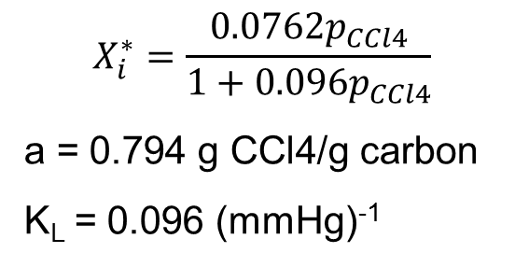
Table 6.7-1 Equilibrium data for CCl4 adsorbed on activated carbon at 34°C
P CCl4 (mmHg) | 0 | 0.169 | 3.38 | 6.76 | 8.45 | 11.8 | 20.7 | 32.1 | 40.0 | 84.5 | 104.5 | 123 | 133
X* (g CCl4/g carbon) | 0 | 0.07 | 0.14 | 0.27 | 0.34 | 0.48 | 0.57 | 0.63 | 0.68 | 0.70 | 0.71 | 0.71 | 0.71
Linear region
$$X_{i}^{∗}=Kc_{i}$$
or
$$X_{i}^{∗}=K′p_{i}$$
K is fitted to data
Langmuir Isotherm
$$X_{i}^{∗}=\frac{aK_{L}c_{i}}{1+K_{L}c_{i}}$$
or
$$X_{i}^{∗}=\frac{aK_{L}′p_{i}}{1+K_{L}′p_{i}}$$
a, K_{L} is fitted to data
$$X_{i}^{∗}=\frac{0.0762p_{CCl4}}{1+0.096p_{CCl4}}$$
a = 0.794 g CCl4/g carbon
K_{L} = 0.096 (mmHg)⁻¹

Slide 12
Ex 6.7-1 from text: A 50.0 L tank contains an air-carbon tetrachloride mixture at 1 atm absolute, 34°C, and 30.0% relative saturation. Activated carbon is placed in the tank to absorb CCl₄. The tank pressure is maintained at 1.00 atm by feeding in pure air and the temperature is kept at 34°C.
Calculate the minimum amount of activated carbon needed to reduce the CCl₄ mole fraction in the gas to 0.001. Neglect the volume of activated carbon and the absorbed CCl₄.
Working backwards, what is the strategy to solve this problem?
V=50 L
T=34°C
P=1atm
V=50 L
T=34°C
P=1atm
Carbon
Carbon + CCl₄
Question text: Elementary Principles of Chemical Processes, 4/E by Richard M. Felder, Ronald W. Rousseau, and Lisa G. Bullard Copyright © 2016 by John Wiley & Sons, Inc.

Slide 13
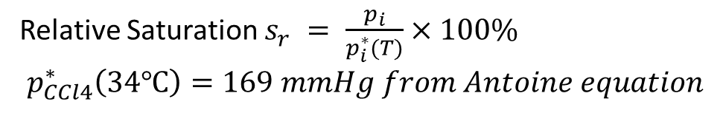
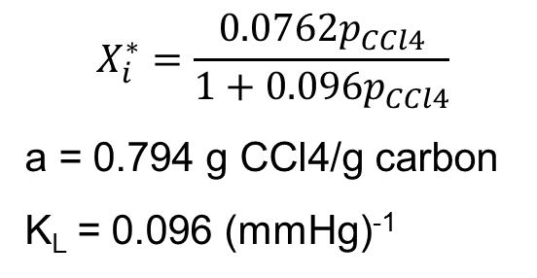
Ex 6.7-1 from text: A 50.0 L tank contains an air-carbon tetrachloride mixture at 1 atm absolute, 34°C, and 30.0% relative saturation. Activated carbon is placed in the tank to absorb CCl₄. The tank pressure is maintained at 1.00 atm by feeding in pure air and the temperature is kept at 34°C.
Calculate the minimum amount of activated carbon needed to reduce the CCl₄ mole fraction in the gas to 0.001. Neglect the volume of activated carbon and the absorbed CCl₄.
V=50 L
T=34°C
P=1atm
V=50 L
T=34°C
P=1atm
$$X_{i}^{∗}=\frac{0.0762p_{CCl4}}{1+0.096p_{CCl4}}$$
a = 0.794 g CCl4/g carbon
K_{L} = 0.096 (mmHg)⁻¹
Carbon
Carbon + CCl₄
Relative Saturation $s_{r} = \frac{p_{i}}{p_{i}^{∗}(T)}×100\%$
$$p_{CCl4}^{∗}\left(34℃\right)=169 mmHg from Antoine equation$$
Question text: Elementary Principles of Chemical Processes, 4/E by Richard M. Felder, Ronald W. Rousseau, and Lisa G. Bullard Copyright © 2016 by John Wiley & Sons, Inc.

Slide 14
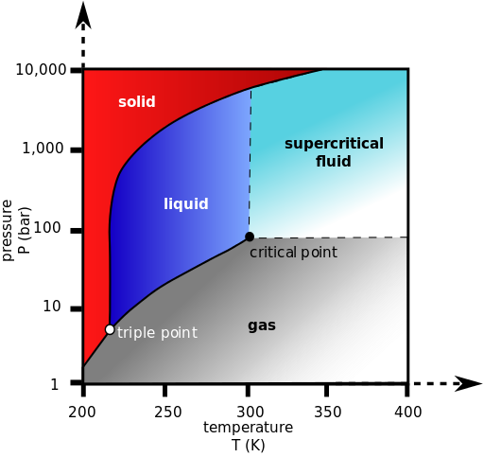
Summary
Intro to phase diagrams

Slide 15
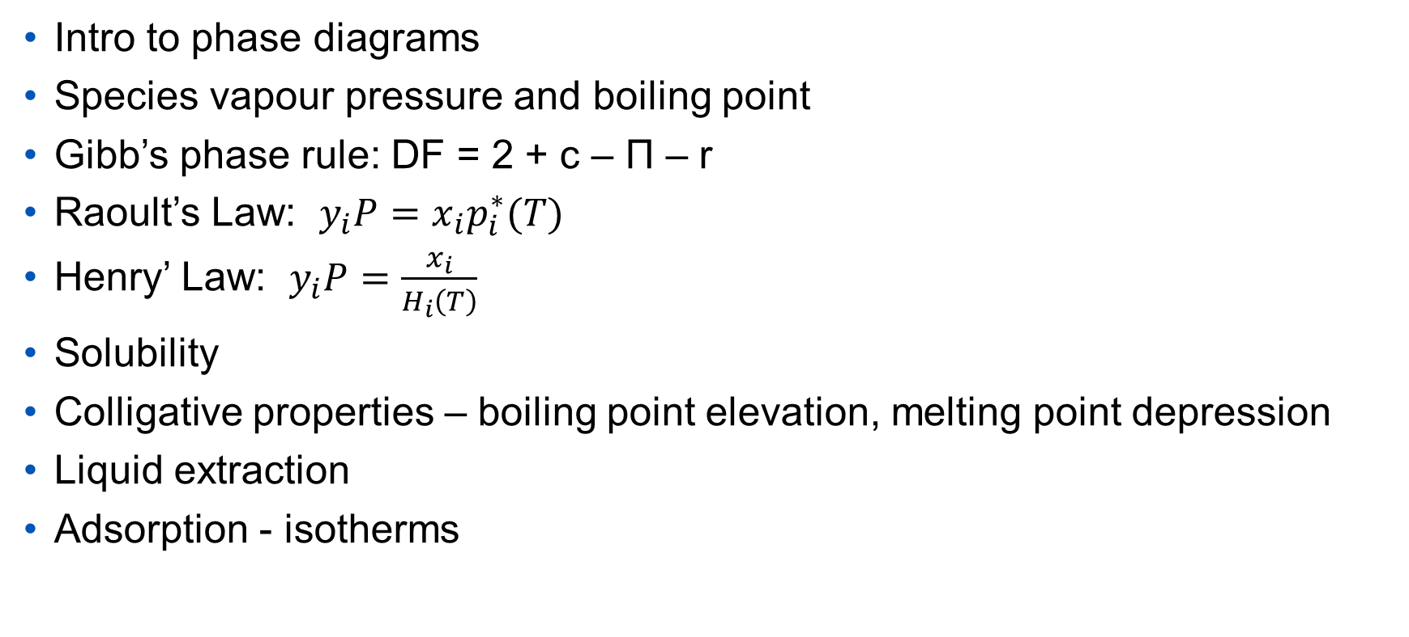
Summary
Intro to phase diagrams
Species vapour pressure and boiling point
Gibb’s phase rule: DF = 2 + c – Π – r
Raoult’s Law: $y_{i}P=x_{i}p_{i}^{∗}(T)$
Henry’ Law: $y_{i}P=\frac{x_{i}}{H_{i}\left(T\right)}$
Solubility
Colligative properties – boiling point elevation, melting point depression
Liquid extraction
Adsorption - isotherms

Slide 16
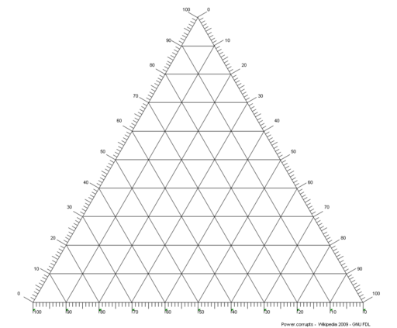
Summary
Intro to phase diagrams
Species vapour pressure and boiling point
Gibb’s phase rule: DF = 2 + c – Π – r
Raoult’s Law: $y_{i}P=x_{i}p_{i}^{∗}(T)$
Henry’ Law: $y_{i}P=\frac{x_{i}}{H_{i}\left(T\right)}$
Solubility
Colligative properties – boiling point elevation, melting point depression
Liquid extraction
Adsorption - isotherms
Image: By Power.corrupts (Own work) CC BY-SA 3.0 via Wikimedia Commons

Slide 17
End of Content covered by midterm 2

Slide 18
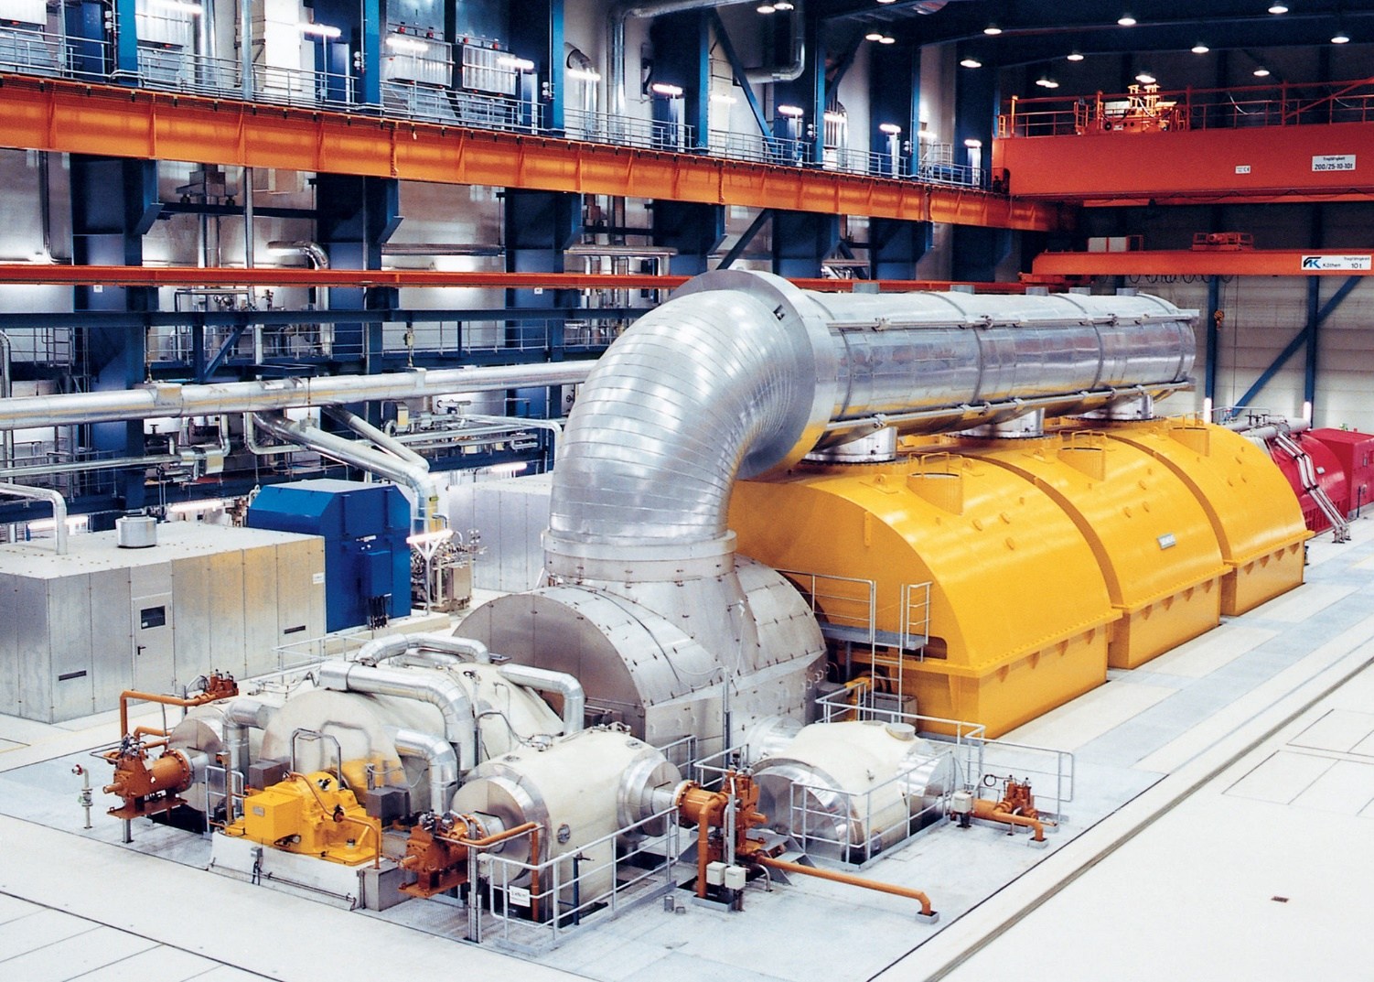
Energy Balances
Image: By Siemens (Siemens website) CC-BY-SA-3.0 via Wikimedia Commons

Slide 19
Learning objectives
By the end of this class you will be able to:
Identify relevant terms for energy balances for open and closed systems
Calculate changes in various forms of energy for a system
Content is Ch 7-7.4

Slide 20

Forms of Energy
Kinetic - $E_{k}$ - Translational or rotational energy
$E_{k }= \frac{1}{2}mu^{2}$ or ${\dot{E}}_{k }= \frac{1}{2}\dot{m}u^{2}$ is for flowing systems
$m$ [=] mass
$u$ [=] velocity relative to a reference (generally earth’s surface)

Slide 21
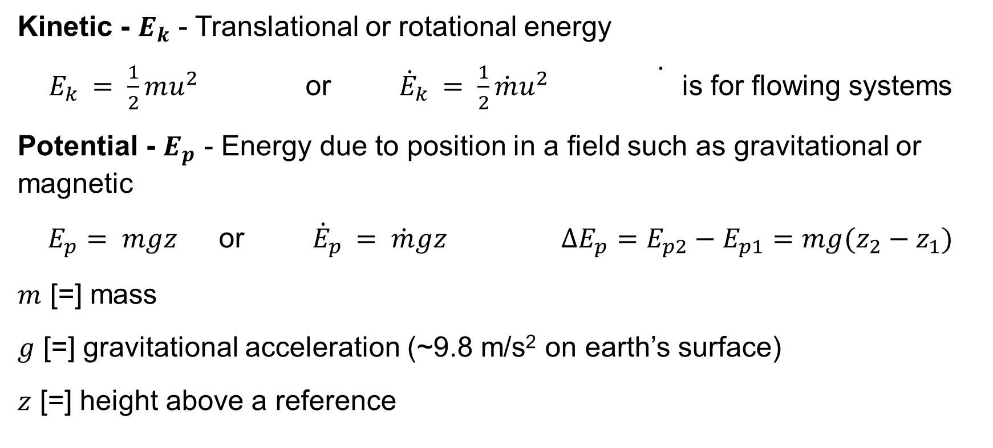
Forms of Energy
Kinetic - $E_{k}$ - Translational or rotational energy
$E_{k }= \frac{1}{2}mu^{2}$ or ${\dot{E}}_{k }= \frac{1}{2}\dot{m}u^{2}$ is for flowing systems
Potential - $E_{p}$ - Energy due to position in a field such as gravitational or magnetic
$E_{p}= mgz$ or ${\dot{E}}_{p }= \dot{m}gz$ $∆E_{p}=E_{p2}−E_{p1}=mg(z_{2}−z_{1})$
$m$ [=] mass
$g$ [=] gravitational acceleration (~9.8 m/s² on earth’s surface)
$z$ [=] height above a reference

Slide 22
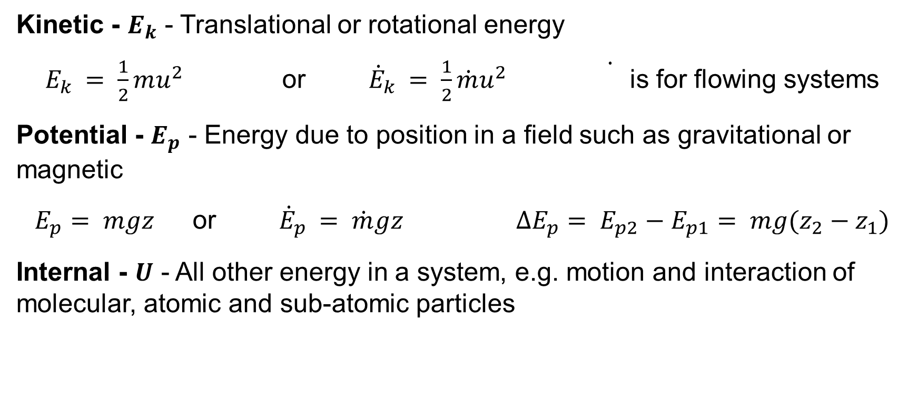
Forms of Energy
Kinetic - $E_{k}$ - Translational or rotational energy
$E_{k }= \frac{1}{2}mu^{2}$ or ${\dot{E}}_{k }= \frac{1}{2}\dot{m}u^{2}$ is for flowing systems
Potential - $E_{p}$ - Energy due to position in a field such as gravitational or magnetic
$E_{p}= mgz$ or ${\dot{E}}_{p }= \dot{m}gz$ $∆E_{p}= E_{p2}−E_{p1}= mg(z_{2}−z_{1})$
Internal - $U$ - All other energy in a system, e.g. motion and interaction of molecular, atomic and sub-atomic particles

Slide 23
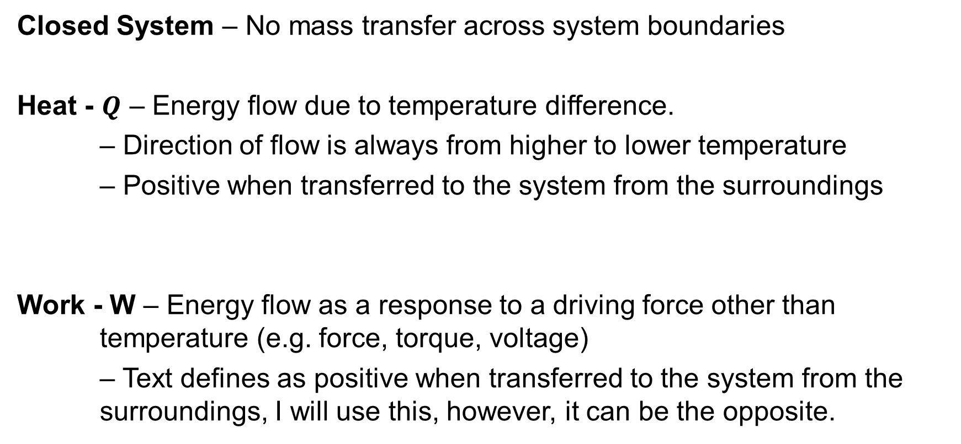
Energy transfer in closed systems
Closed System – No mass transfer across system boundaries
Heat - $Q$ – Energy flow due to temperature difference.
– Direction of flow is always from higher to lower temperature
– Positive when transferred to the system from the surroundings
Work - W – Energy flow as a response to a driving force other than temperature (e.g. force, torque, voltage)
– Text defines as positive when transferred to the system from the surroundings, I will use this, however, it can be the opposite.

Slide 24
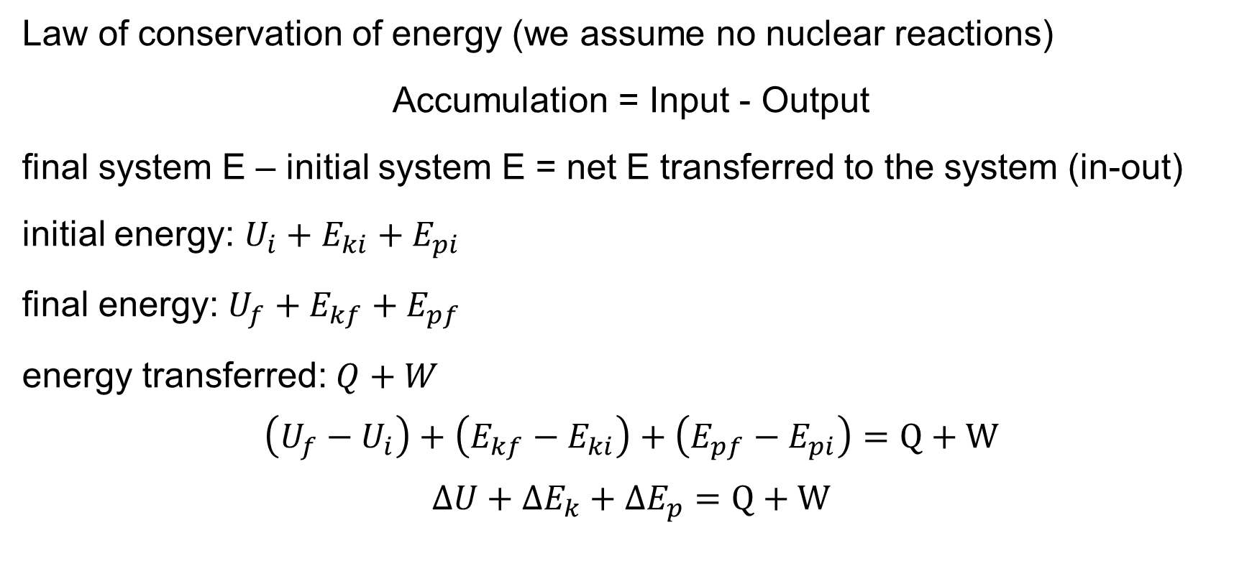
Energy balances on closed systems
Law of conservation of energy (we assume no nuclear reactions)
Accumulation = Input - Output
final system E – initial system E = net E transferred to the system (in-out)
initial energy: $U_{i}+E_{ki}+E_{pi}$
final energy: $U_{f}+E_{kf}+E_{pf}$
energy transferred: $Q+W$
$$\left(U_{f}−U_{i}\right)+\left(E_{kf}−E_{ki}\right)+\left(E_{pf}−E_{pi}\right)=Q+W$$
$$∆U+∆E_{k}+∆E_{p}=Q+W$$

Slide 25
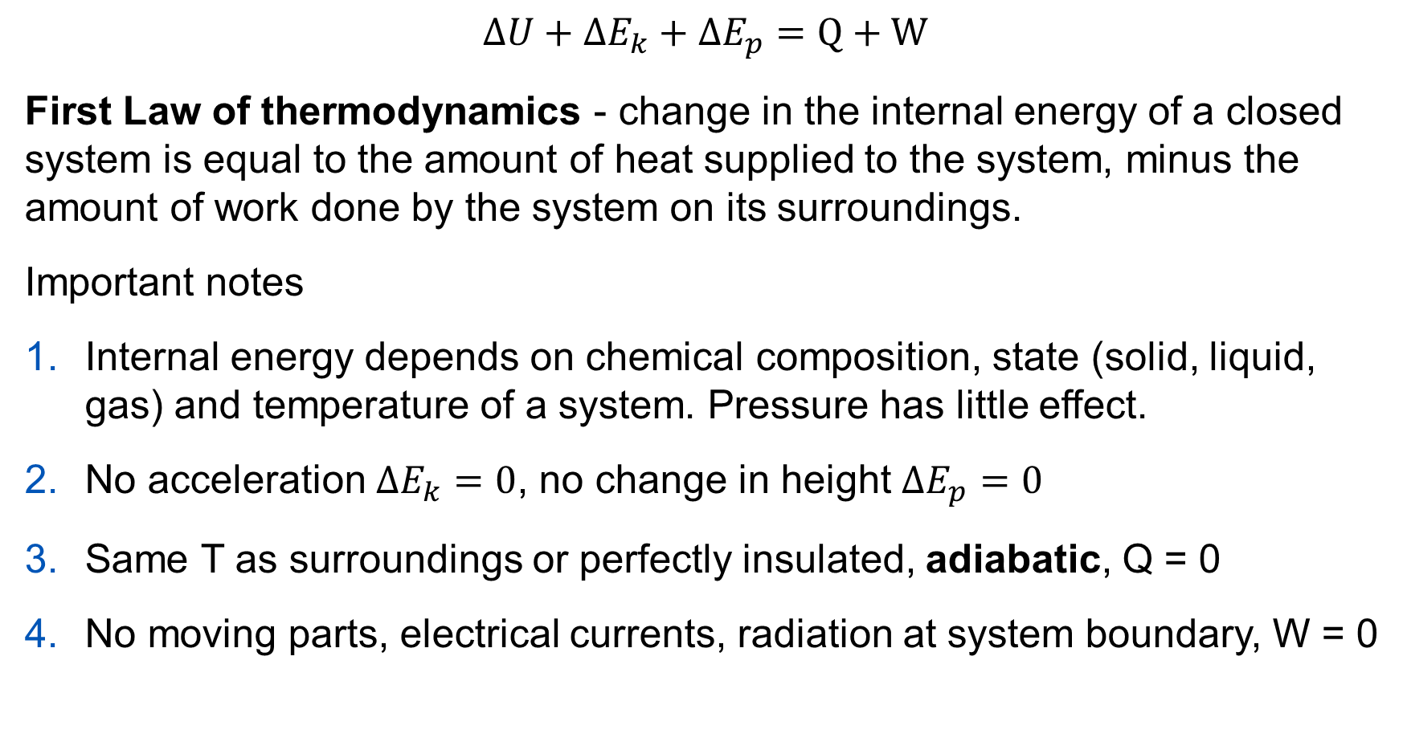
$$∆U+∆E_{k}+∆E_{p}=Q+W$$
First Law of thermodynamics - change in the internal energy of a closed system is equal to the amount of heat supplied to the system, minus the amount of work done by the system on its surroundings.
Important notes
Internal energy depends on chemical composition, state (solid, liquid, gas) and temperature of a system. Pressure has little effect.
No acceleration $∆E_{k}=0$, no change in height $∆E_{p}=0$
Same T as surroundings or perfectly insulated, adiabatic, Q = 0
No moving parts, electrical currents, radiation at system boundary, W = 0

Slide 26
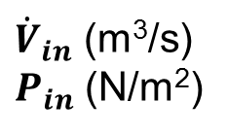
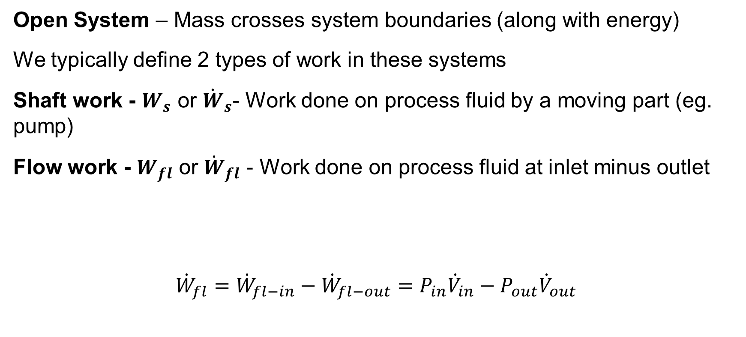
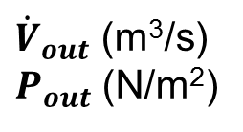
Work in Open Systems
Open System – Mass crosses system boundaries (along with energy)
We typically define 2 types of work in these systems
Shaft work - $W_{s}$ or ${\dot{W}}_{s}$- Work done on process fluid by a moving part (eg. pump)
Flow work - $W_{fl}$ or ${\dot{W}}_{fl}$ - Work done on process fluid at inlet minus outlet
$${\dot{W}}_{fl}={\dot{W}}_{fl−in}−{\dot{W}}_{fl−out}=P_{in}{\dot{V}}_{in}−P_{out}{\dot{V}}_{out}$$
${\dot{V}}_{in}$ (m³/s)
$P_{in}$ (N/m²)
Process Unit
${\dot{V}}_{out}$ (m³/s)
$P_{out}$ (N/m²)

Slide 27

Specific properties
Specific property - – intensive property obtained by dividing extensive property by a total amount (or flow rate)
$\hat{V}=\frac{V}{m}$ or $\hat{U}=\frac{\dot{U}}{\dot{n}}$

Slide 28

Steady-state open-system energy balance
How do we get to:
$$∆\dot{H}+∆{\dot{E}}_{k}+∆{\dot{E}}_{p}=\dot{Q}+{\dot{W}}_{s}$$

Slide 29
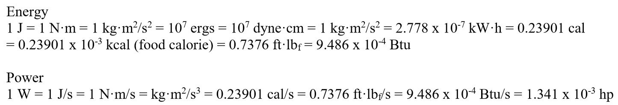
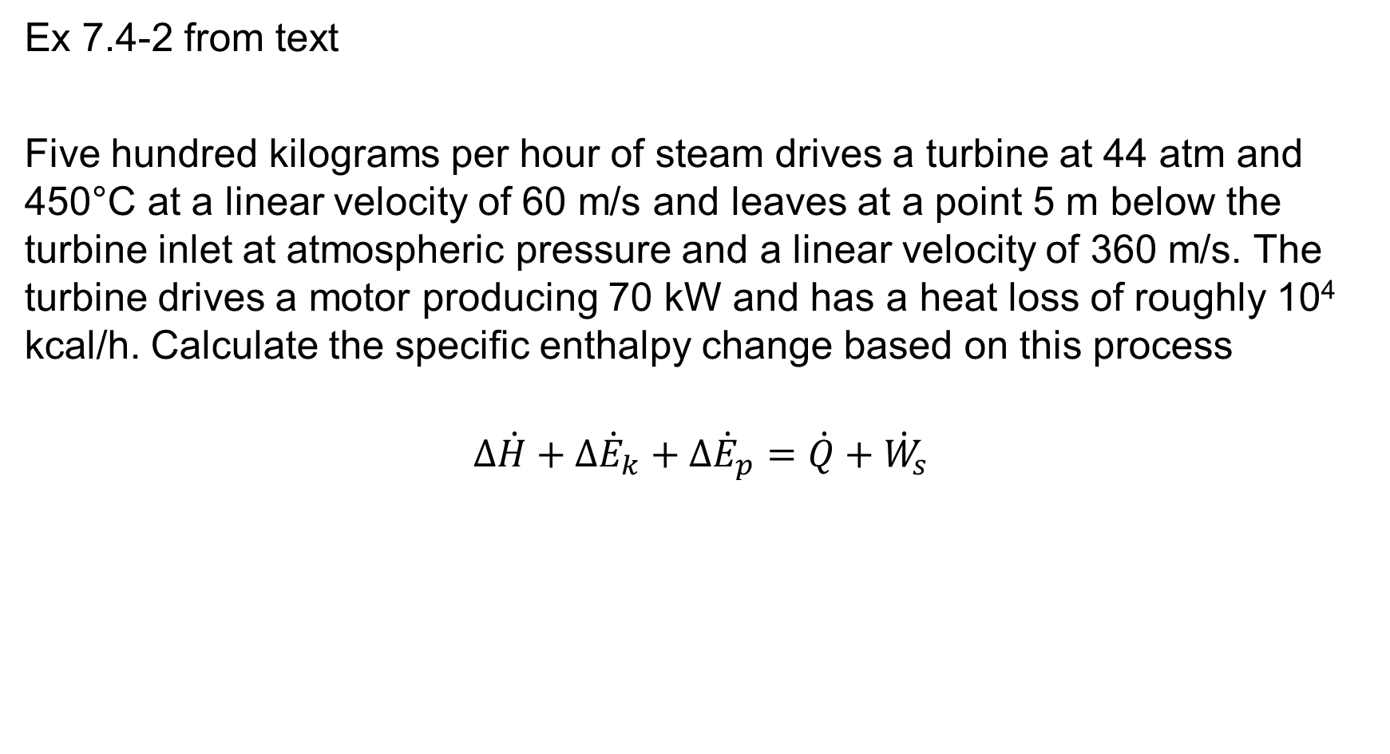
Ex 7.4-2 from text
Five hundred kilograms per hour of steam drives a turbine at 44 atm and 450°C at a linear velocity of 60 m/s and leaves at a point 5 m below the turbine inlet at atmospheric pressure and a linear velocity of 360 m/s. The turbine drives a motor producing 70 kW and has a heat loss of roughly 10⁴ kcal/h. Calculate the specific enthalpy change based on this process
$$∆\dot{H}+∆{\dot{E}}_{k}+∆{\dot{E}}_{p}=\dot{Q}+{\dot{W}}_{s}$$
Question text: Elementary Principles of Chemical Processes, 4/E by Richard M. Felder, Ronald W. Rousseau, and Lisa G. Bullard Copyright © 2016 by John Wiley & Sons, Inc.

