Slide 1
Social Network distribuiti
e opensource

Slide 2

Rete Sociale
“
Una rete sociale (in inglese social network) consiste di un qualsiasi gruppo di persone connesse tra loro da diversi legami sociali, che vanno dalla conoscenza casuale, ai rapporti di lavoro, ai vincoli familiari.
Wikipedia
Notes:
gruppo di persone connesse da legami sociali: parenti, amici, colleghi

Slide 3
Servizi di Social Network
“
Un servizio di rete sociale, o servizio di social network, consiste in una struttura informatica che gestisce nel Web le reti basate su relazioni sociali. La struttura è identificata per mezzo di un sito web di riferimento del social network.
Wikipedia
Notes:
struttura informatica che gestisce nel Web le reti basate su relazioni sociali

Slide 4


Slide 5
Centralizzati
Chiusi
Controllati

Slide 6
centralizzato
alice
faccialibro
casimiro

Slide 7
centralizzato
alice
faccialibro
casimiro

Slide 8
chiuso
alice
faccialibro
miospazio
bruno

Slide 9
chiuso
alice
faccialibro
miospazio
bruno

Slide 10
controllato
Censura
Tracciamento degli utenti
Proprietà intelletuale

Slide 11
Condivisione dei contenuti e delle informazioni
L'utente è il proprietario di tutti i contenuti e le informazioni pubblicate su Facebook e può controllare in che modo possono essere condivise mediante le impostazioni sulla privacy e delle applicazioni. Inoltre:
Per quanto riguarda i contenuti coperti da diritti di proprietà, ad esempio foto e video (Contenuti IP), l'utente concede a Facebook le seguenti autorizzazioni, soggette alle impostazioni sulla privacy e delle applicazioni dell'utente stesso: l'utente fornisce a Facebook una licenza non esclusiva, trasferibile, che può essere concessa come sotto-licenza, libera da royalty e valida in tutto il mondo, che consente l'utilizzo di qualsiasi Contenuto IP pubblicato su Facebook o in connessione con Facebook (Licenza IP). La Licenza IP termina nel momento in cui l'utente elimina i Contenuti IP presenti sul suo account, a meno che tali contenuti non siano stati condivisi con terzi e che questi non li abbiano eliminati.
Quando l'utente elimina Contenuti IP, questi vengono eliminati in modo simile a quando si svuota il cestino del computer. Tuttavia, è possibile che i contenuti rimossi vengano conservati come copie di backup per un determinato periodo di tempo (pur non essendo visibili ad altri).
http://www.facebook.com/terms.php

Slide 12
Servizi di Social Network Distribuiti

Slide 13
Servizi di Social Network Distribuiti
“
Un servizio di rete sociale, o servizio di social network, consiste in una struttura informatica che gestisce nel Web le reti basate su relazioni sociali. La struttura è identificata per mezzo di un sito web di riferimento del social network.
Wikipedia

Slide 14
Servizi di Social Network Distribuiti
“
Un servizio di rete sociale, o servizio di social network, consiste in una struttura informatica che gestisce nel Web le reti basate su relazioni sociali. La struttura è identificata per mezzo di un sito web di riferimento del social network.
Wikipedia

Slide 15
Ognuno si può installare il
software sul proprio server
O puo' scegliere di iscriversi
su un server di cui si fida

Slide 16
I dati caricati rimangono in proprio possesso

Slide 17
Le comunicazioni avvengono anche
tra utenti registrati su server diversi
(come per le email)

Slide 18
alice@server1
bruno@server2

Slide 19
alice@server1
bruno@server2

Slide 20
alice@server1
casimiro@server3
bruno@server2

Slide 21
alice@server1
casimiro@server3
dafne@server3
bruno@server2

Slide 22
Rete Sociale
Notes:
gruppo di persone connesse da legami sociali: parenti, amici, colleghi

Slide 23
Rete aperta
Interoperabile (quasi)
Sicura
Rispetto della privacy

Slide 24
Status.net / Identi.ca
Diaspora*
Appleseed
Jappix
Buddycloud
Friendica
...

Slide 25
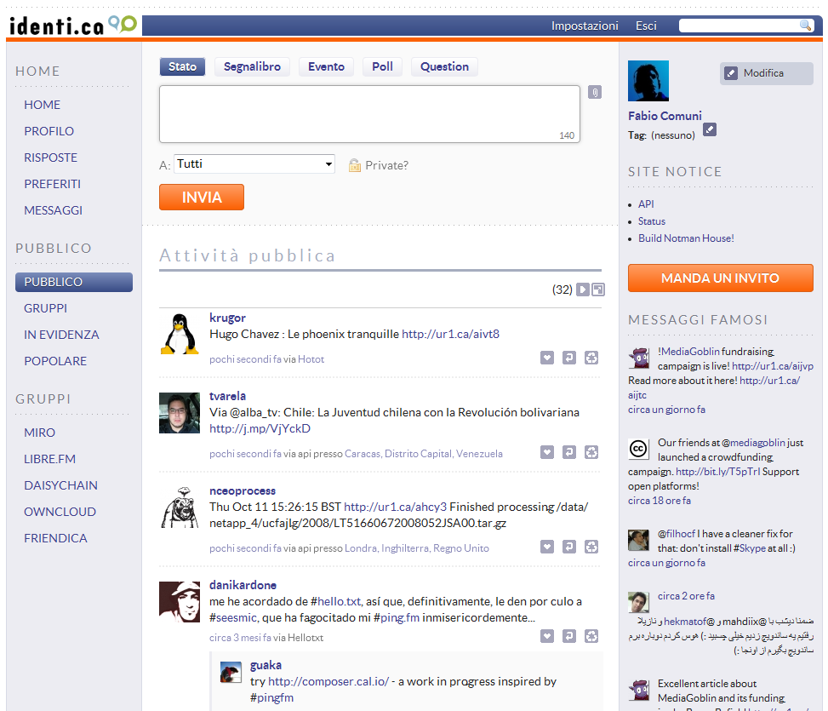
Status.net / Identi.ca
Micro blogging
!Gruppi (solo locale)
#Hashtag
@Menzioni
Tutto pubblico
(messaggi privati solo locale)

Slide 26
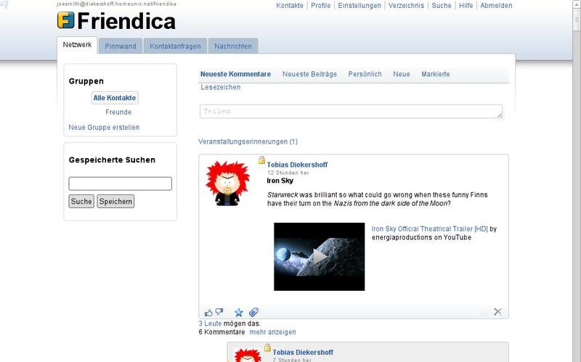
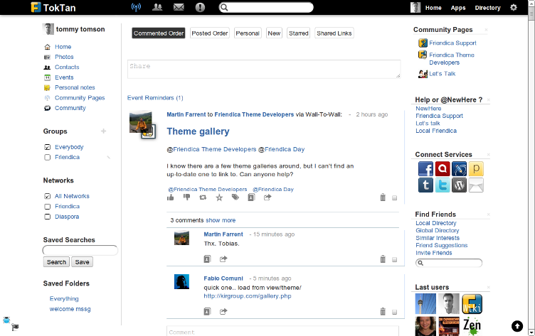
Friendica
Messaggi non limitati
Gruppi/Pagine/Forum
#Hashtag
@Menzioni
Gruppi di contatti
Permessi sui contenuti
Profili multipli
“don't like”

Slide 27
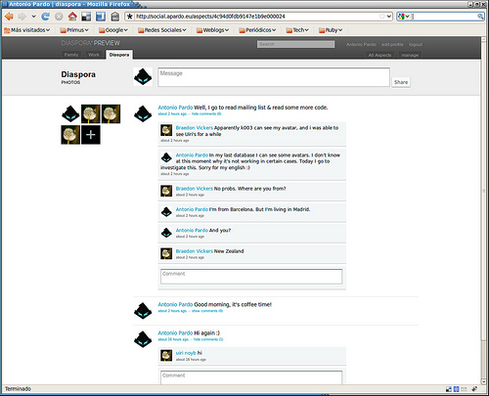
Diaspora*
Messaggi non limitati
#Hashtag 'globali'
@Menzioni
Aspetti
Permessi sui contenuti
Immagine (cc) by-sa Antonio Pardo http://www.flickr.com/photos/apardo/5003809422/

Slide 28
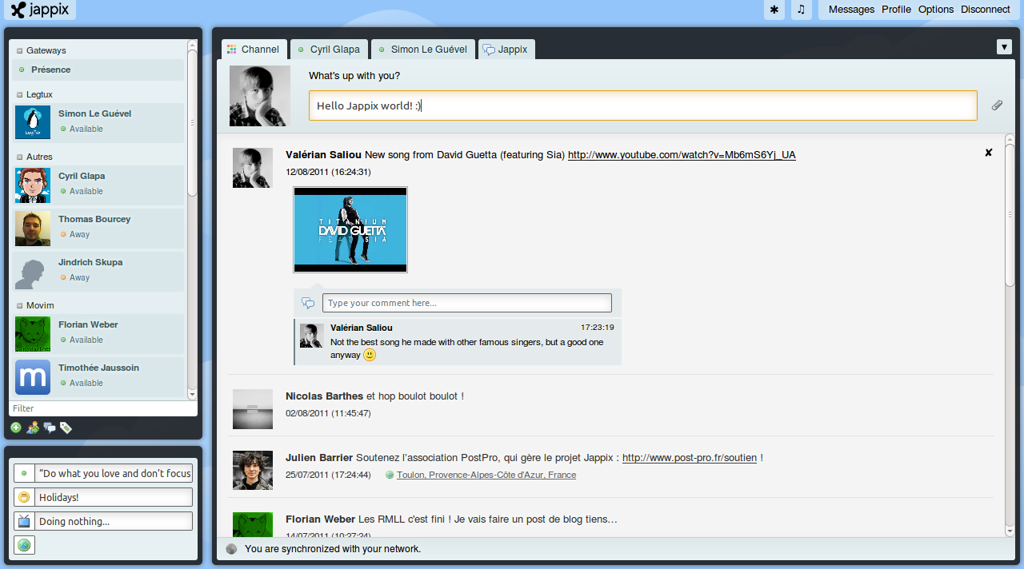
Jappix
Bacheca pubblica
per i contatti
Messaggistica istantanea
“Mood”

Slide 29
HTTP
XMMP
altro

Slide 30
HTTP
Appleseed
(QuickSocial)
Friendica
(DFRN + Ostatus + Diaspora)
Statusnet / identica
(Ostatus)
Diaspora*
(suo)

Slide 31
OStatus
Web Finger
Activty Streams
PushSubHubBub (!)
Salmon
http://www.w3.org/community/ostatus/

Slide 32
Web Finger
bruno@server2
http://code.google.com/p/webfinger/wiki/WebFingerProtocol

Slide 33
Web Finger
bruno@server2
http://server2/.well-known/host-meta
http://code.google.com/p/webfinger/wiki/WebFingerProtocol

Slide 34
Web Finger
bruno@server2
http://server2/.well-known/host-meta
“well-known” uri:
/favicon.ico
/robots.txt
/crossdomain.xml
http://code.google.com/p/webfinger/wiki/WebFingerProtocol

Slide 35
Web Finger
bruno@server2
http://server2/.well-known/host-meta
<XRD>
<hm:Host>server2</hm:Host>
<Link rel="lrdd" template="http://server2/xrd/?uri={uri}"/>
[...]
</XRD>
http://code.google.com/p/webfinger/wiki/WebFingerProtocol

Slide 36
Web Finger
bruno@server2
http://server2/.well-known/host-meta
http://server2/xrd/?uri=acct%3Abruno%40server2
acct:bruno@server2
http://code.google.com/p/webfinger/wiki/WebFingerProtocol

Slide 37
Web Finger
bruno@server2
http://server2/.well-known/host-meta
http://server2/xrd/?uri=acct%3Abruno%40server2
<XRD>
<Subject>bruno@server2</Subject>
<Alias>http://server2/profile/bruno</Alias>
<Link rel="http://webfinger.net/rel/profile-page" type="text/html"
href="http://server2/profile/bruno"/>
<Link rel="http://webfinger.net/rel/avatar" type="image/jpeg"
href="http://server2/photo/profile/1.jpg"/>
<Link rel="salmon" href="http://server2/salmon/bruno"/>
[...]
</XRD>
http://code.google.com/p/webfinger/wiki/WebFingerProtocol

Slide 38
Web Finger
bruno@server2
http://server2/.well-known/host-meta
http://server2/xrd/?uri=acct%3Abruno%40server2
https://identi.ca/.well-known/host-meta
http://code.google.com/p/webfinger/wiki/WebFingerProtocol

Slide 39
Activity Streams
Atom / JSON
“actor, verb, object”
“Alice ha carcato una foto”
“Bruno ha condiviso un video”
http://activitystrea.ms/

Slide 40
Activity Streams
[...]
<entry xmlns="http://www.w3.org/2005/Atom" xmlns:activity="http://activitystrea.ms/spec/1.0/">
<id>tag:photopanic.example.com,2009:activity/4859/4352</id>
<title>Geraldine posted a Photo on PhotoPanic</title>
<published>2009-11-02T15:29:00Z</published>
<link rel="alternate" type="text/html" href="http://example.com/geraldine/activities/4352" />
<activity:verb>post</activity:verb>
<activity:object>
<id>tag:photopanic.example.com,2009:photo/4352</id>
<title>My Cat</title>
<published>2009-11-02T15:29:00Z</published>
<link rel="alternate" type="text/html" href="http://example.com/geraldine/photos/4352" />
<activity:object-type>photo</activity:object-type>
</activity:object>
<content type="html">
&lt;p&gt;Geraldine posted a Photo on PhotoPanic&lt;/p&gt;
&lt;img src="/geraldine/photos/4352.jpg"&gt;
</content>
</entry>
[..-]
http://activitystrea.ms/

Slide 41
Activity Streams
[...]
<entry xmlns="http://www.w3.org/2005/Atom" xmlns:activity="http://activitystrea.ms/spec/1.0/">
<id>tag:photopanic.example.com,2009:activity/4859/4352</id>
<title>Geraldine posted a Photo on PhotoPanic</title>
<published>2009-11-02T15:29:00Z</published>
<link rel="alternate" type="text/html" href="http://example.com/geraldine/activities/4352" />
<activity:verb>post</activity:verb>
<activity:object>
<id>tag:photopanic.example.com,2009:photo/4352</id>
<title>My Cat</title>
<published>2009-11-02T15:29:00Z</published>
<link rel="alternate" type="text/html" href="http://example.com/geraldine/photos/4352" />
<activity:object-type>photo</activity:object-type>
</activity:object>
<content type="html">
&lt;p&gt;Geraldine posted a Photo on PhotoPanic&lt;/p&gt;
&lt;img src="/geraldine/photos/4352.jpg"&gt;
</content>
</entry>
[..-]
http://activitystrea.ms/

Slide 42
Activity Streams
[...]
<entry xmlns="http://www.w3.org/2005/Atom" xmlns:activity="http://activitystrea.ms/spec/1.0/">
<id>tag:photopanic.example.com,2009:activity/4859/4352</id>
<title>Geraldine posted a Photo on PhotoPanic</title>
<published>2009-11-02T15:29:00Z</published>
<link rel="alternate" type="text/html" href="http://example.com/geraldine/activities/4352" />
<activity:verb>post</activity:verb>
<activity:object>
<id>tag:photopanic.example.com,2009:photo/4352</id>
<title>My Cat</title>
<published>2009-11-02T15:29:00Z</published>
<link rel="alternate" type="text/html" href="http://example.com/geraldine/photos/4352" />
<activity:object-type>photo</activity:object-type>
</activity:object>
<content type="html">
&lt;p&gt;Geraldine posted a Photo on PhotoPanic&lt;/p&gt;
&lt;img src="/geraldine/photos/4352.jpg"&gt;
</content>
</entry>
[..-]
http://activitystrea.ms/

Slide 43
Activity Streams
[...]
<entry xmlns="http://www.w3.org/2005/Atom" xmlns:activity="http://activitystrea.ms/spec/1.0/">
<id>tag:photopanic.example.com,2009:activity/4859/4352</id>
<title>Geraldine posted a Photo on PhotoPanic</title>
<published>2009-11-02T15:29:00Z</published>
<link rel="alternate" type="text/html" href="http://example.com/geraldine/activities/4352" />
<activity:verb>post</activity:verb>
<activity:object>
<id>tag:photopanic.example.com,2009:photo/4352</id>
<title>My Cat</title>
<published>2009-11-02T15:29:00Z</published>
<link rel="alternate" type="text/html" href="http://example.com/geraldine/photos/4352" />
<activity:object-type>photo</activity:object-type>
</activity:object>
<content type="html">
&lt;p&gt;Geraldine posted a Photo on PhotoPanic&lt;/p&gt;
&lt;img src="/geraldine/photos/4352.jpg"&gt;
</content>
</entry>
[..-]
http://activitystrea.ms/

Slide 44
Activity Streams
[...]
<entry xmlns="http://www.w3.org/2005/Atom" xmlns:activity="http://activitystrea.ms/spec/1.0/">
<id>tag:photopanic.example.com,2009:activity/4859/4352</id>
<title>Geraldine posted a Photo on PhotoPanic</title>
<published>2009-11-02T15:29:00Z</published>
<link rel="alternate" type="text/html" href="http://example.com/geraldine/activities/4352" />
<activity:verb>post</activity:verb>
<activity:object>
<id>tag:photopanic.example.com,2009:photo/4352</id>
<title>My Cat</title>
<published>2009-11-02T15:29:00Z</published>
<link rel="alternate" type="text/html" href="http://example.com/geraldine/photos/4352" />
<activity:object-type>photo</activity:object-type>
</activity:object>
<content type="html">
&lt;p&gt;Geraldine posted a Photo on PhotoPanic&lt;/p&gt;
&lt;img src="/geraldine/photos/4352.jpg"&gt;
</content>
</entry>
[..-]
http://activitystrea.ms/

Slide 45
PushSubHubBub
server1
https://code.google.com/p/pubsubhubbub/

Slide 46

PushSubHubBub
server1
https://code.google.com/p/pubsubhubbub/

Slide 47
PushSubHubBub
server1
PuSH
https://code.google.com/p/pubsubhubbub/

Slide 48
PushSubHubBub
server1
PuSH
https://code.google.com/p/pubsubhubbub/

Slide 49
PushSubHubBub
server1
PuSH
https://code.google.com/p/pubsubhubbub/

Slide 50
PushSubHubBub
server1
PuSH
https://code.google.com/p/pubsubhubbub/

Slide 51
Salmon
Ho caricato una nuova foto!
PushSubHubBub
server1
server2
Una nuova foto! La condivido subito!
http://www.salmon-protocol.org/

Slide 52
Salmon
Ho commentato la foto!
Salmon
server1
server2
Un commento! Lo pubblico con la foto
http://www.salmon-protocol.org/

Slide 53
Salmon
Ho un nuovo commento!
PushSubHubBub
server1
server n
http://www.salmon-protocol.org/

Slide 54
Salmon
Atom / JSON
Invio via HTTP POST
(url recuperato via web finger)
Identificazione del mittente
(messaggio firmato dal mittente, recupero chiave attraverso web finger)
http://www.salmon-protocol.org/

Slide 55
Salmon
[...]
<link rel="salmon" href="http://example.org/salmon-endpoint"/>
[..-]
POST /salmon-endpoint HTTP/1.1
Host: example.org
Content-Type: application/atom+xml
<?xml version='1.0' encoding='UTF-8'?>
<me:env xmlns:me="http://salmon-protocol.org/ns/magic-env">
<me:data type='application/atom+xml'>
PD94bWwgdmVyc2lvbj0nMS4wJyBlbmNvZGluZz0nVVRGLTgnPz4KPGVudHJ5IHhtbG5zPS
dodHRwOi8vd3d3LnczLm9yZy8yMDA1L0F0b20nPgogIDxpZD50YWc6ZXhhbXBsZS5jb20s
MjAwOTpjbXQtMC40NDc3NTcxODwvaWQ-ICAKICA8YXV0aG9yPjxuYW1lPnRlc3RAZXhhbX
[...]
</me:data>
<me:encoding>base64url</me:encoding> <me:alg>RSA-SHA256</me:alg>
<me:sig>
EvGSD2vi8qYcveHnb-rrlok07qnCXjn8YSeCDDXlbhILSabgvNsPpbe76up8w63i2f
WHvLKJzeGLKfyHg8ZomQ
</me:sig>
</me:env>
http://www.salmon-protocol.org/

Slide 56
nessun controllo
sulla privacy

Slide 57
DSPN
Diaspora
DFRN
Zot!

Slide 58
DSPN
(Distributed Social Networking Protocol)
Comunicazione su SSL
Single sign-on
Messaggi via testo / Base64url
Criptazione con RSA
Demone specifico
http://www.complang.org/dsnp/

Slide 59
Diaspora
Messaggi via HTTP / JSON (?)
Certificati SSL server validi (?)
Rich text via Markdown
Ogni “Pod” cerca di replicare la
parte di rete che conosce
Cancellazione dei contenuti
“hashtag-effect”
https://github.com/diaspora/diaspora/wiki/Diaspora's-federation-protocol

Slide 60
DFRN
(Distributed Friends & Relations Network)
Web Finger
Atom / Activity Stream
Rich text via BBCode
Controllo privacy
Piuttosto complesso
Autenticazione remota non user-friendly
https://macgirvin.com/spec/dfrn2.pdf

Slide 61
DFRN
(Distributed Friends & Relations Network)
+
<XRD xmlns="http://docs.oasis-open.org/ns/xri/xrd-1.0">
<Subject>bruno@server2</Subject>
<Link rel="http://purl.org/macgirvin/dfrn/1.0"
Href="http://server2/profile/bruno"/>
[…]
</XRD>
Alice
bruno@server2
Web Finger
alice@server1
https://macgirvin.com/spec/dfrn2.pdf

Slide 62
DFRN
(Distributed Friends & Relations Network)
+
<XRD xmlns="http://docs.oasis-open.org/ns/xri/xrd-1.0">
<Subject>bruno@server2</Subject>
<Link rel="http://purl.org/macgirvin/dfrn/1.0"
Href="http://server2/profile/bruno"/>
[…]
</XRD>
Alice
bruno@server2
Web Finger
alice@server1
<!DOCTYPE html >
<html>
[…]
<link rel="dfrn-request" href="http://server2/dfrn_request/bruno" />
<link rel="dfrn-confirm" href="http://server2/dfrn_confirm/bruno" />
<link rel="dfrn-notify" href="http://server2/dfrn_notify/bruno" />
<link rel="dfrn-poll" href="http://server2/dfrn_poll/bruno" />
<link rel="dfrn-poco" href="http://server2/poco/bruno" />
[…]
...
https://macgirvin.com/spec/dfrn2.pdf

Slide 63
DFRN
(Distributed Friends & Relations Network)
+
<XRD xmlns="http://docs.oasis-open.org/ns/xri/xrd-1.0">
<Subject>bruno@server2</Subject>
<Link rel="http://purl.org/macgirvin/dfrn/1.0"
Href="http://server2/profile/bruno"/>
[…]
</XRD>
Alice
bruno@server2
Web Finger
alice@server1
<!DOCTYPE html >
<html>
[…]
<link rel="dfrn-request" href="http://server2/dfrn_request/bruno" />
<link rel="dfrn-confirm" href="http://server2/dfrn_confirm/bruno" />
<link rel="dfrn-notify" href="http://server2/dfrn_notify/bruno" />
<link rel="dfrn-poll" href="http://server2/dfrn_poll/bruno" />
<link rel="dfrn-poco" href="http://server2/poco/bruno" />
[…]
...
https://macgirvin.com/spec/dfrn2.pdf

Slide 64
DFRN
(Distributed Friends & Relations Network)
+
<XRD xmlns="http://docs.oasis-open.org/ns/xri/xrd-1.0">
<Subject>bruno@server2</Subject>
<Link rel="http://purl.org/macgirvin/dfrn/1.0"
Href="http://server2/profile/bruno"/>
[…]
</XRD>
Alice
bruno@server2
Web Finger
alice@server1
<!DOCTYPE html >
<html>
[…]
<link rel="dfrn-request" href="http://server2/dfrn_request/bruno" />
<link rel="dfrn-confirm" href="http://server2/dfrn_confirm/bruno" />
<link rel="dfrn-notify" href="http://server2/dfrn_notify/bruno" />
<link rel="dfrn-poll" href="http://server2/dfrn_poll/bruno" />
<link rel="dfrn-poco" href="http://server2/poco/bruno" />
[…]
...
https://macgirvin.com/spec/dfrn2.pdf

Slide 65
DFRN
(Distributed Friends & Relations Network)
+
<XRD xmlns="http://docs.oasis-open.org/ns/xri/xrd-1.0">
<Subject>bruno@server2</Subject>
<Link rel="http://purl.org/macgirvin/dfrn/1.0"
Href="http://server2/profile/bruno"/>
[…]
</XRD>
Alice
bruno@server2
Web Finger
alice@server1
<!DOCTYPE html >
<html>
[…]
<link rel="dfrn-request" href="http://server2/dfrn_request/bruno" />
<link rel="dfrn-confirm" href="http://server2/dfrn_confirm/bruno" />
<link rel="dfrn-notify" href="http://server2/dfrn_notify/bruno" />
<link rel="dfrn-poll" href="http://server2/dfrn_poll/bruno" />
<link rel="dfrn-poco" href="http://server2/poco/bruno" />
[…]
...
https://macgirvin.com/spec/dfrn2.pdf

Slide 66
DFRN
(Distributed Friends & Relations Network)
<!DOCTYPE html >
<html>
[…]
<link rel="dfrn-request" href="http://server2/dfrn_request/bruno" />
<link rel="dfrn-confirm" href="http://server2/dfrn_confirm/bruno" />
<link rel="dfrn-notify" href="http://server2/dfrn_notify/bruno" />
<link rel="dfrn-poll" href="http://server2/dfrn_poll/bruno" />
<link rel="dfrn-poco" href="http://server2/poco/bruno" />
[…]
<img class=”photo” src=”http://server2/bruno.jpg” alt=”Bruno” >
<div class=”adr”>
<span class=”locality”>Cadorago</span>
<span class=”country-name”>Italia</span>
</div>
<div class=”key” style=”display:none;”>
-----BEGIN PUBLIC KEY-----
MIICIjANBgkqhkiG9w0BAQEFAAOCAg8AMIICCgKCAgEAzZeUTuHLYs0/1xdtBs9h
RlGzAfgiHNqZWgd+2ET844qo9FwM7xQzNK5BdYXh5QPSK5UbFIksflx9WQSrSxjr
/rpXJQxhg4+43pDJHztMVKQEs27PY1dQ+m/w8pm2sI31aXiSESvTfUTcb4lZjNIA
JPs4W5u4Upy+hD0e257Gsx1k+1T4u5M3PKGbzbhKxsZRhcphwZdQ6MzEqs1rxRzh
w/fJCh3OnrmcUevi1NokdPOg9fp7xW+0OqBNvuOTmOICUzELBBkE8ibikJY69rUv
oPgmPcIXTmli8MZPnsMD9SPeqMfNZ5hSYfwOLIRLTUDssp4gxbQLqVW54cIdM/D9
uH2wpUdoZ6kca5LrZpiQluuKY47/gmzGxlW5YbwflWle+XwrXFLRZveIvpKDTt4v
iVTxmx82UvBAww5UcKrxQ8/SZAQplXMMeeDducgJ3PCcW1eWa756Jjc0p38hj97r
ye4njXzWwCV6jyrFpAHIFVUkNbgsks+Vq1ttruqr01gchMe/9UaAC5c7Jb9SkZKq
NvJNTjWMSJhlPTTp4Pwb4BkqnimAL4xemQ1Yd9zz52gp0Y2k8KJmKOftKiwc6AUA
q6tNmG9ONh+e5HpGc3D2SoXR5QgEuwDgDyHCAV1pgvF5bIWwRYPVEVX1IrXNVxJD
+YShCCd4j1l7HQx4IxqjkCcCAwEAAQ==
-----END PUBLIC KEY-----
</div>
https://macgirvin.com/spec/dfrn2.pdf

Slide 67
DFRN
(Distributed Friends & Relations Network)
<!DOCTYPE html >
<html>
[…]
<link rel="dfrn-request" href="http://server2/dfrn_request/bruno" />
<link rel="dfrn-confirm" href="http://server2/dfrn_confirm/bruno" />
<link rel="dfrn-notify" href="http://server2/dfrn_notify/bruno" />
<link rel="dfrn-poll" href="http://server2/dfrn_poll/bruno" />
<link rel="dfrn-poco" href="http://server2/poco/bruno" />
[…]
<img class=”photo” src=”http://server2/bruno.jpg” alt=”Bruno” >
<div class=”adr”>
<span class=”locality”>Cadorago</span>
<span class=”country-name”>Italia</span>
</div>
<div class=”key” style=”display:none;”>
-----BEGIN PUBLIC KEY-----
MIICIjANBgkqhkiG9w0BAQEFAAOCAg8AMIICCgKCAgEAzZeUTuHLYs0/1xdtBs9h
RlGzAfgiHNqZWgd+2ET844qo9FwM7xQzNK5BdYXh5QPSK5UbFIksflx9WQSrSxjr
/rpXJQxhg4+43pDJHztMVKQEs27PY1dQ+m/w8pm2sI31aXiSESvTfUTcb4lZjNIA
JPs4W5u4Upy+hD0e257Gsx1k+1T4u5M3PKGbzbhKxsZRhcphwZdQ6MzEqs1rxRzh
w/fJCh3OnrmcUevi1NokdPOg9fp7xW+0OqBNvuOTmOICUzELBBkE8ibikJY69rUv
oPgmPcIXTmli8MZPnsMD9SPeqMfNZ5hSYfwOLIRLTUDssp4gxbQLqVW54cIdM/D9
uH2wpUdoZ6kca5LrZpiQluuKY47/gmzGxlW5YbwflWle+XwrXFLRZveIvpKDTt4v
iVTxmx82UvBAww5UcKrxQ8/SZAQplXMMeeDducgJ3PCcW1eWa756Jjc0p38hj97r
ye4njXzWwCV6jyrFpAHIFVUkNbgsks+Vq1ttruqr01gchMe/9UaAC5c7Jb9SkZKq
NvJNTjWMSJhlPTTp4Pwb4BkqnimAL4xemQ1Yd9zz52gp0Y2k8KJmKOftKiwc6AUA
q6tNmG9ONh+e5HpGc3D2SoXR5QgEuwDgDyHCAV1pgvF5bIWwRYPVEVX1IrXNVxJD
+YShCCd4j1l7HQx4IxqjkCcCAwEAAQ==
-----END PUBLIC KEY-----
</div>
https://macgirvin.com/spec/dfrn2.pdf

Slide 68
DFRN
(Distributed Friends & Relations Network)
<!DOCTYPE html >
<html>
[…]
<link rel="dfrn-request" href="http://server2/dfrn_request/bruno" />
<link rel="dfrn-confirm" href="http://server2/dfrn_confirm/bruno" />
<link rel="dfrn-notify" href="http://server2/dfrn_notify/bruno" />
<link rel="dfrn-poll" href="http://server2/dfrn_poll/bruno" />
<link rel="dfrn-poco" href="http://server2/poco/bruno" />
[…]
<img class=”photo” src=”http://server2/bruno.jpg” alt=”Bruno” >
<div class=”adr”>
<span class=”locality”>Cadorago</span>
<span class=”country-name”>Italia</span>
</div>
<div class=”key” style=”display:none;”>
-----BEGIN PUBLIC KEY-----
MIICIjANBgkqhkiG9w0BAQEFAAOCAg8AMIICCgKCAgEAzZeUTuHLYs0/1xdtBs9h
RlGzAfgiHNqZWgd+2ET844qo9FwM7xQzNK5BdYXh5QPSK5UbFIksflx9WQSrSxjr
/rpXJQxhg4+43pDJHztMVKQEs27PY1dQ+m/w8pm2sI31aXiSESvTfUTcb4lZjNIA
JPs4W5u4Upy+hD0e257Gsx1k+1T4u5M3PKGbzbhKxsZRhcphwZdQ6MzEqs1rxRzh
w/fJCh3OnrmcUevi1NokdPOg9fp7xW+0OqBNvuOTmOICUzELBBkE8ibikJY69rUv
oPgmPcIXTmli8MZPnsMD9SPeqMfNZ5hSYfwOLIRLTUDssp4gxbQLqVW54cIdM/D9
uH2wpUdoZ6kca5LrZpiQluuKY47/gmzGxlW5YbwflWle+XwrXFLRZveIvpKDTt4v
iVTxmx82UvBAww5UcKrxQ8/SZAQplXMMeeDducgJ3PCcW1eWa756Jjc0p38hj97r
ye4njXzWwCV6jyrFpAHIFVUkNbgsks+Vq1ttruqr01gchMe/9UaAC5c7Jb9SkZKq
NvJNTjWMSJhlPTTp4Pwb4BkqnimAL4xemQ1Yd9zz52gp0Y2k8KJmKOftKiwc6AUA
q6tNmG9ONh+e5HpGc3D2SoXR5QgEuwDgDyHCAV1pgvF5bIWwRYPVEVX1IrXNVxJD
+YShCCd4j1l7HQx4IxqjkCcCAwEAAQ==
-----END PUBLIC KEY-----
</div>
https://macgirvin.com/spec/dfrn2.pdf

Slide 69
DFRN
(Distributed Friends & Relations Network)
<!DOCTYPE html >
<html>
[…]
<link rel="dfrn-request" href="http://server2/dfrn_request/bruno" />
<link rel="dfrn-confirm" href="http://server2/dfrn_confirm/bruno" />
<link rel="dfrn-notify" href="http://server2/dfrn_notify/bruno" />
<link rel="dfrn-poll" href="http://server2/dfrn_poll/bruno" />
<link rel="dfrn-poco" href="http://server2/poco/bruno" />
[…]
<img class=”photo” src=”http://server2/bruno.jpg” alt=”Bruno” >
<div class=”adr”>
<span class=”locality”>Cadorago</span>
<span class=”country-name”>Italia</span>
</div>
<div class=”key” style=”display:none;”>
-----BEGIN PUBLIC KEY-----
MIICIjANBgkqhkiG9w0BAQEFAAOCAg8AMIICCgKCAgEAzZeUTuHLYs0/1xdtBs9h
RlGzAfgiHNqZWgd+2ET844qo9FwM7xQzNK5BdYXh5QPSK5UbFIksflx9WQSrSxjr
/rpXJQxhg4+43pDJHztMVKQEs27PY1dQ+m/w8pm2sI31aXiSESvTfUTcb4lZjNIA
JPs4W5u4Upy+hD0e257Gsx1k+1T4u5M3PKGbzbhKxsZRhcphwZdQ6MzEqs1rxRzh
w/fJCh3OnrmcUevi1NokdPOg9fp7xW+0OqBNvuOTmOICUzELBBkE8ibikJY69rUv
oPgmPcIXTmli8MZPnsMD9SPeqMfNZ5hSYfwOLIRLTUDssp4gxbQLqVW54cIdM/D9
uH2wpUdoZ6kca5LrZpiQluuKY47/gmzGxlW5YbwflWle+XwrXFLRZveIvpKDTt4v
iVTxmx82UvBAww5UcKrxQ8/SZAQplXMMeeDducgJ3PCcW1eWa756Jjc0p38hj97r
ye4njXzWwCV6jyrFpAHIFVUkNbgsks+Vq1ttruqr01gchMe/9UaAC5c7Jb9SkZKq
NvJNTjWMSJhlPTTp4Pwb4BkqnimAL4xemQ1Yd9zz52gp0Y2k8KJmKOftKiwc6AUA
q6tNmG9ONh+e5HpGc3D2SoXR5QgEuwDgDyHCAV1pgvF5bIWwRYPVEVX1IrXNVxJD
+YShCCd4j1l7HQx4IxqjkCcCAwEAAQ==
-----END PUBLIC KEY-----
</div>
https://macgirvin.com/spec/dfrn2.pdf

Slide 70
DFRN
(Distributed Friends & Relations Network)
Bruno chiede di entrare in contatto con Alice.
Bruno visita il profilo di Alice, clicca su “Connetti” e inserisce il suo indirizzo
(http://server2/profile/bruno o bruno@server2)
server1 carica il profilo di Bruno e trova il link http://server2/dfrn_request/bruno
Bruno viene indirizzato su
http://server2/dfrn_request/bruno?dfrn_url=[...]&confirm_key=ABC123
Bruno conferma la richiesta
Server2 richiede in GET
http://server1/dfrn_confirm/?confirm_key=ABC123
Server1 notifica Alice della richiesta di contatto
https://macgirvin.com/spec/dfrn2.pdf

Slide 71
DFRN
(Distributed Friends & Relations Network)
Alice conferma il contatto con Bruno
Server1 genera una coppia di chiavi RSA, memorizza la chiave privata
Server1 genera un DFRN-id random
Server1 chiama in POST
http://server2/dfrn_request/bruno?dfrn_url=[...]&confirm_key=ABC123
“public_key” => DFRN-public-key criptata con “aes_key”
“dfrn_id” => DFRN-id criptata con la chiave privata di server1
“source_url” => DFRN-url di server1 criptata con la chiave pubblica di server2
“aes_key” => stringa random criptata con la chiave pubblica di server2
“duplex” => optional. 1 or 0. Default is 0.
“dfrn_version” => 2.2
https://macgirvin.com/spec/dfrn2.pdf

Slide 72
DFRN
(Distributed Friends & Relations Network)
Alice scrive un post privato
alice@server1
bruno@server2
GET http://server2/dfrn_notify/bruno?dfrn_id=...
challenge (criptato con pubkey di alice)
POST http://server2/dfrn_notify/bruno
challege decriptato + Atom
Ritenta in caso di errore
Blocca il contatto dopo n errori
https://macgirvin.com/spec/dfrn2.pdf

Slide 73
DFRN
(Distributed Friends & Relations Network)
Bruno controlla aggiornamenti da Alice
alice@server1
bruno@server2
GET http://server1/dfrn_poll/alice?dfrn_id=...&last_update=...
challenge (criptato con pubkey di bruno)
POST http://server2/dfrn_poll/alice
challege decriptato
Atom (con BBCode)
https://macgirvin.com/spec/dfrn2.pdf

Slide 74
XMPP
(Jappix, Buddycloud)
XEP-0060: Publish-Subscribe
http://xmpp.org/extensions/xep-0060.html
XEP-0313: Message Archive Management
http://xmpp.org/extensions/xep-0313.html

Slide 75
Futuro

