Slide 1
OpenComm Group
September 22, 2011

Slide 2


History
Summer 2009 (1.5)
Founded by Graeme Bailey and Makoto Bentz ’10, M.Eng. ’11
Fall 2009 (1.6, 2.0)
Realized that we needed more than 4 people in the group
Determined possible modifiable SIP stacks
Spring 2010 (2.1)
Successfully completed:
2D sound spatialization algorithm
RTP session negotiation with Jingle
NAT traversal with STUN
RTP audio streams between several of our clients
2009 – 2010
Getting used to mobile application development
+
Prepping different components
Notes:
SIP: session initiation protocol – controls communication sessions such as voice and video calls over IP
-> used to create, modify, and terminate two-party sessions
RTP: real-time transport protocol – defines a standardized packet format for delivering audio and video voer IP networks
NAT: network address translation – modifying IP address info in IP packet headers while in transit across a traffic routing device
STUN: session traversal utilities for NAT: standardized set of methods used in NAT traversal

Slide 3
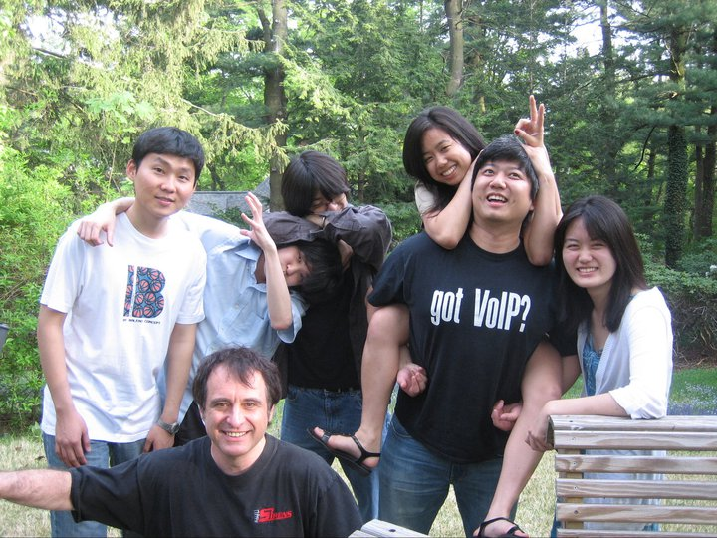
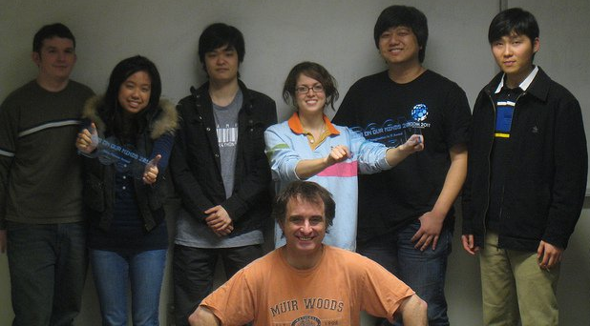
HISTORY
Fall 2010 (2.2)
Transition over to XMPP/Jingle/Jabber
Upgrade to Android 2.2 Platform
Spring 2011 (2.3)
Created demo of Desktop Client for BOOM 2011
Started implementation for Android
Integration issue
2010 – 2011
Preliminary attempt at integration of different parts

Slide 4
Fall 2011
OBJECTIVE:
Release both DESKTOP and ANDROID APPLICATIONS that are FULLY INTEGRATED and OPERABLE on multiple computers and phones.
Prepare PUBLICATION MATERIALS to be used for BOOM 2012, Bailey + company meetings, and publication submissions.
MEMBERS
4 M.Eng.s
8.5 Undergraduates (2, 1, 4, 1.5)
5 Majors, 3 Colleges
2011 – 2012
Shifting from research toy to actual product

Slide 5
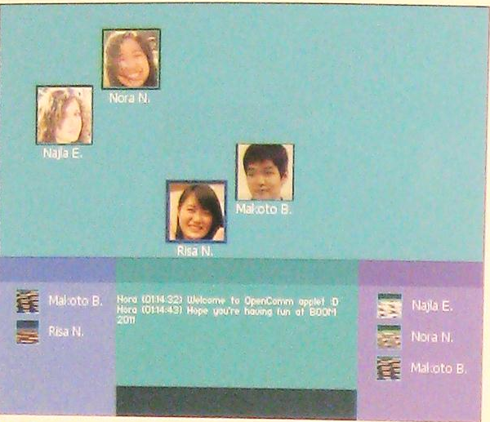
Current situation :: DESKTOP
Front-end
UI written in Processing (http://www.processing.org/)
Private space implemented
Drag/drop + lasso
Back-end
Sound spatialization implemented
Notification of private space NOT implemented
Network: IP address, not JabberIDs
Possible shift to C/C++ Programming for UI

Slide 6
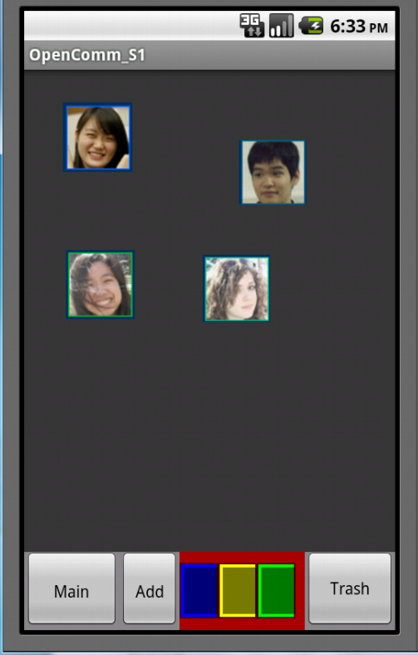
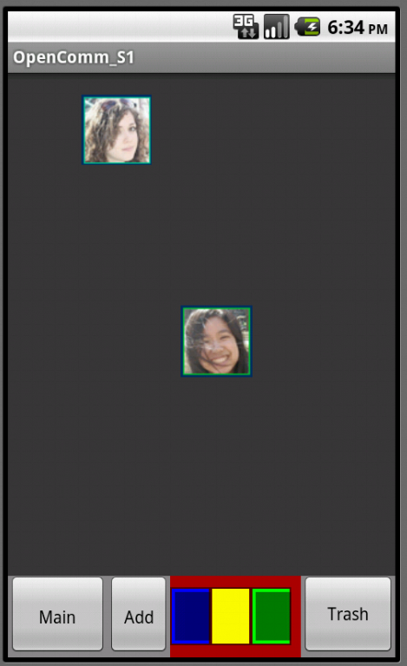
CURRENT SITUATION :: ANDROID
Front-end
Private space implemented
Back-end
Network ready
Sound spatialization ready
Private space notifications not implemented

Slide 7
SEPTEMBER 22 – DECEMBER 16, 2011
Group meeting: 5:30PM, Sundays
Paper critique
Assignment on Basecamp
12 Sundays

Slide 8
GitHub: Getting Started
What is GitHub?
What is Git? http://progit.org/book/ch1-3.html
Set up an account: https://github.com/signup/free
Install Git:

