Slide 1
OpenComm Group
September 22, 2011

Slide 2


History
Summer 2009 (1.5)
Founded by Graeme Bailey and Makoto Bentz ’10, M.Eng. ’11
Fall 2009 (1.6, 2.0)
Realized that we needed more than 4 people in the group
Determined possible modifiable SIP stacks
Spring 2010 (2.1)
Successfully completed:
2D sound spatialization algorithm
RTP session negotiation with Jingle
NAT traversal with STUN
RTP audio streams between several of our clients
2009 – 2010
Getting used to mobile application development
+
Prepping different components
Notes:
SIP: session initiation protocol – controls communication sessions such as voice and video calls over IP
-> used to create, modify, and terminate two-party sessions
RTP: real-time transport protocol – defines a standardized packet format for delivering audio and video voer IP networks
NAT: network address translation – modifying IP address info in IP packet headers while in transit across a traffic routing device
STUN: session traversal utilities for NAT: standardized set of methods used in NAT traversal

Slide 3
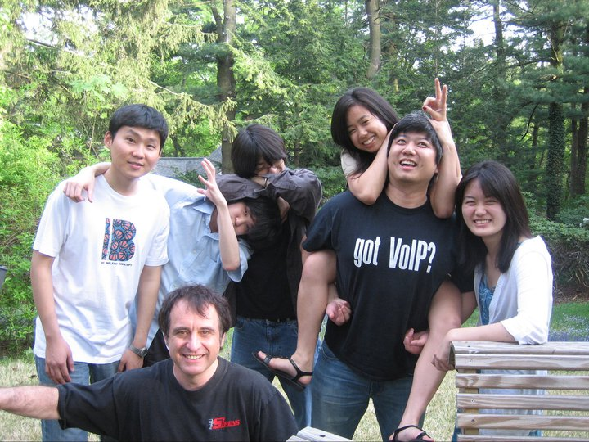
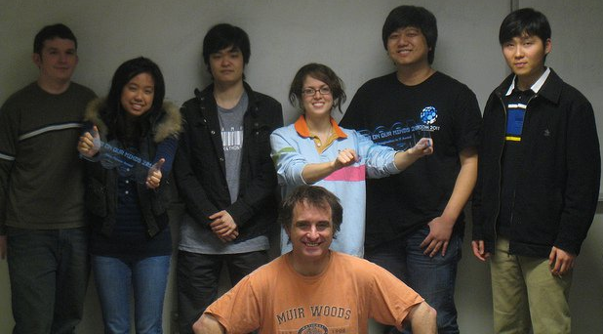
HISTORY
Fall 2010 (2.2)
Transition over to XMPP/Jingle/Jabber
Upgrade to Android 2.2 Platform
Spring 2011 (2.3)
Created demo of Desktop Client for BOOM 2011
Started implementation for Android
Integration issue
2010 – 2011
Preliminary attempt at integration of different parts

Slide 4
Fall 2011
OBJECTIVE:
Release both DESKTOP and ANDROID APPLICATIONS that are FULLY INTEGRATED and OPERABLE on multiple computers and phones.
Prepare PUBLICATION MATERIALS to be used for BOOM 2012, Bailey + company meetings, and publication submissions.
MEMBERS
4 M.Eng.s
8.5 Undergraduates (2, 1, 4, 1.5)
5 Majors, 3 Colleges
2011 – 2012
Shifting from research toy to actual product

Slide 5
Group structure
Big Boss/Client: Graeme
MiniBoss: Risa
Application: OpenComm
HCISec
Risa*
Anne, Jonathan
HCIDesign
Najla*
Rahul, Chris. Ashley, Joey
SoftwareDev
Nora*
Justin, Vinay, Crystal
Publication
Najla*
Chris, Ashley

Slide 6
Meetings
Group meeting: 5:30PM, Sundays
Article critique
Partner assignments on Basecamp up to 6th week
End of 1st week of cycle
Software Dev/HCISec: implementation report
Discussion on product requirements
End of 2nd week of cycle
Demo of completed product, transfer to Design for testing
Distribution of upcoming week’s requirements
Team meeting: 1 – 2 times/week
Scheduled by Team leads as needed
Management meeting: 1 time/week
Wednesday evenings online

Slide 7
Dates of interest: Sep.22 – Dec.16
Crash courses: Sep.25 and Oct.2
Sep.25 and Oct.2 (Sun) – Java and Android crash course by Najla and Nora
Half-way point: Oct.30
3 completed cycles of products (Oct.2*, Oct.16, Oct.30)
1st draft write-up of report
Self and peer-evaluation and possible reallocation of members
Finals period: Dec.4 – Dec.16
2 completed cycles of products, in middle of last product (Nov.13, Nov.27*, Dec.11)
Final draft write-up of report
Everyone
Self and peer-evaluation and reflection
MEngs
Joint progress report for future members + Bailey
Integration and demo of product for Bailey
Those staying with group next semester
Discussion and planning for next semester

Slide 8
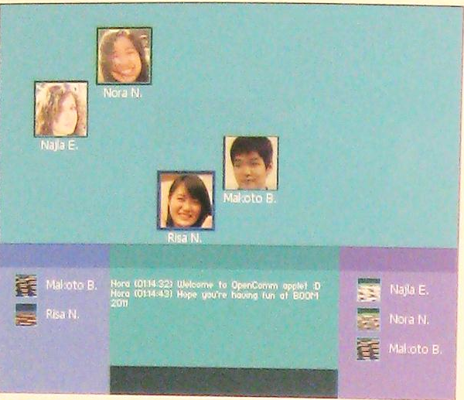
Current situation :: DESKTOP
Front-end
UI written in Processing (http://www.processing.org/)
Private space implemented
Drag/drop + lasso
Back-end
Sound spatialization implemented
Notification of private space NOT implemented
Network: IP address, not JabberIDs
Possible shift to C/C++ Programming for UI

Slide 9
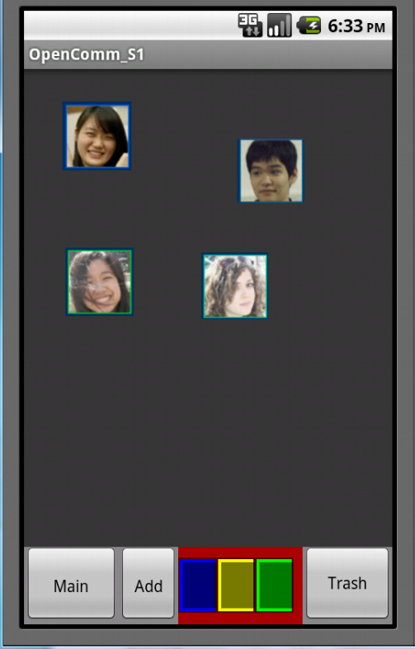
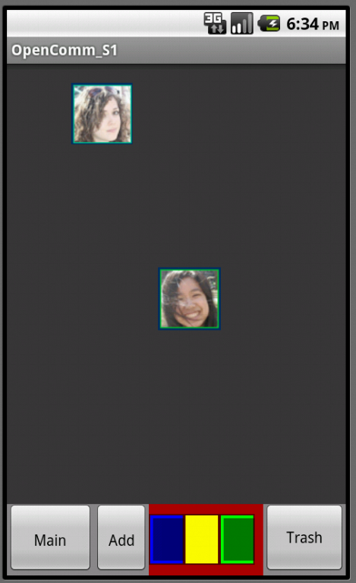
CURRENT SITUATION :: ANDROID
Front-end
Private space implemented
Back-end
Network ready
Sound spatialization ready
Private space notifications not implemented

Slide 10
Basecamp & GitHub
Basecamp: http://opencommgroup.basecamphq.com/
What is GitHub?
What is Git? http://progit.org/book/ch1-3.html
Set up an account: https://github.com/signup/free
Install Git: http://help.github.com/win-set-up-git/

