Slide 1

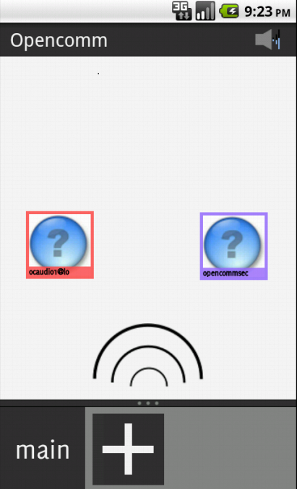
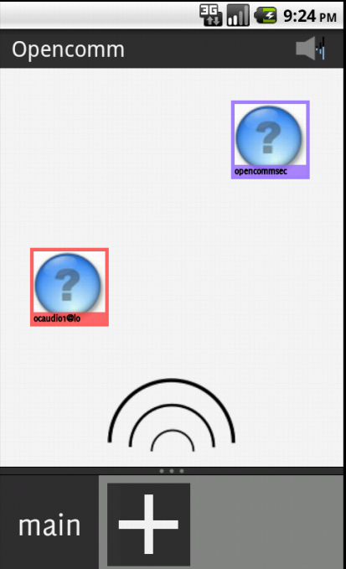
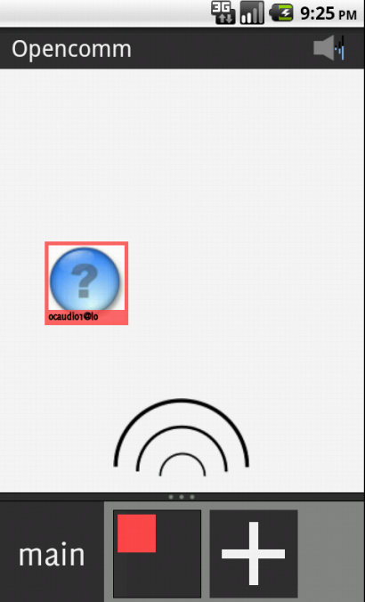

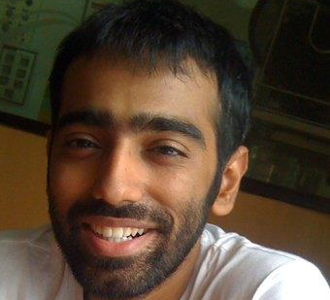
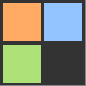


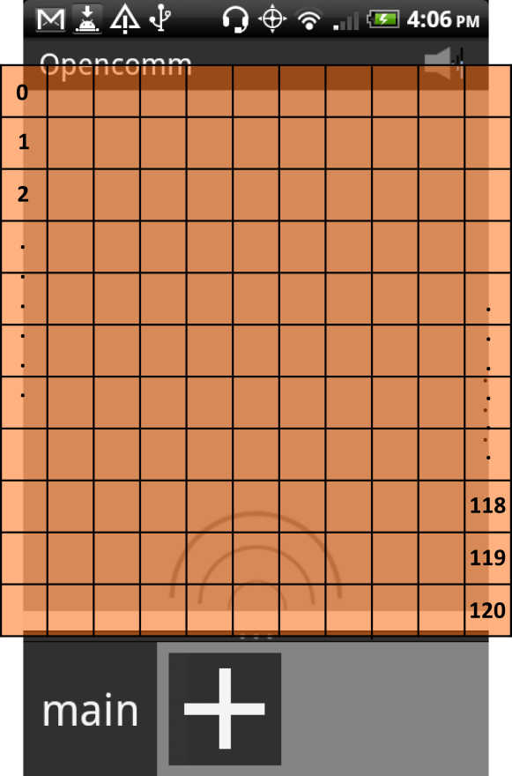
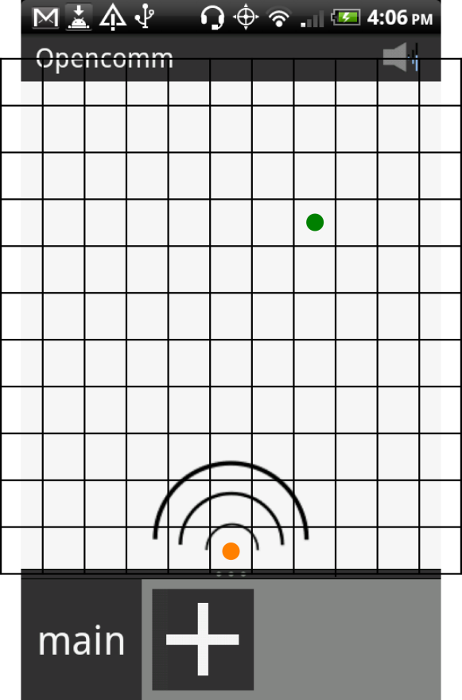
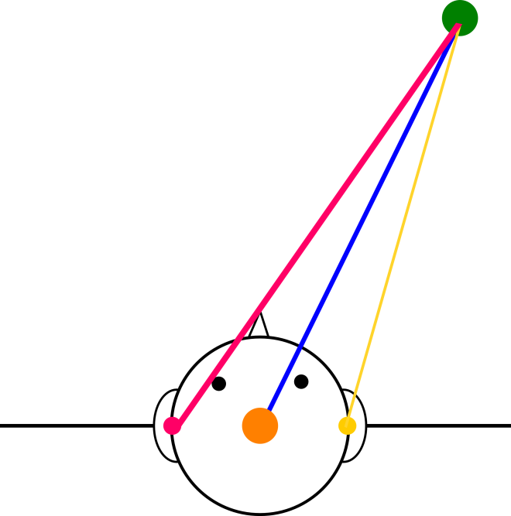
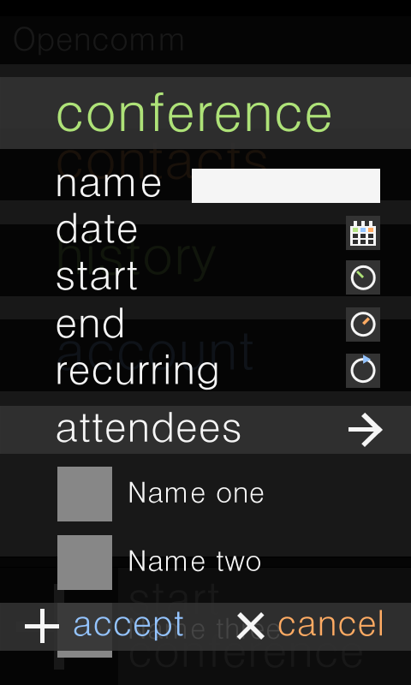
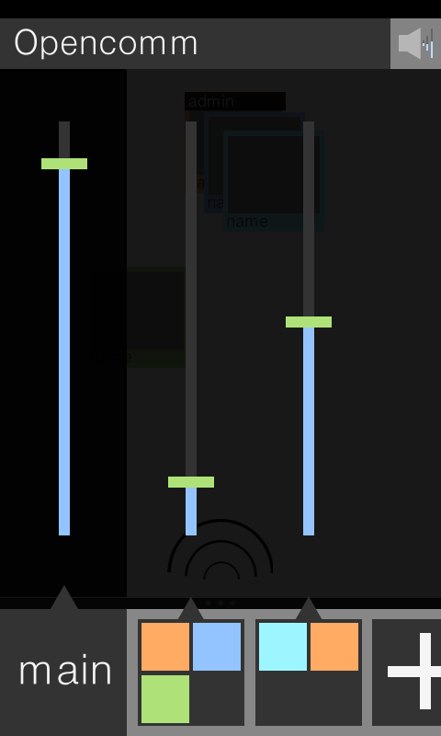
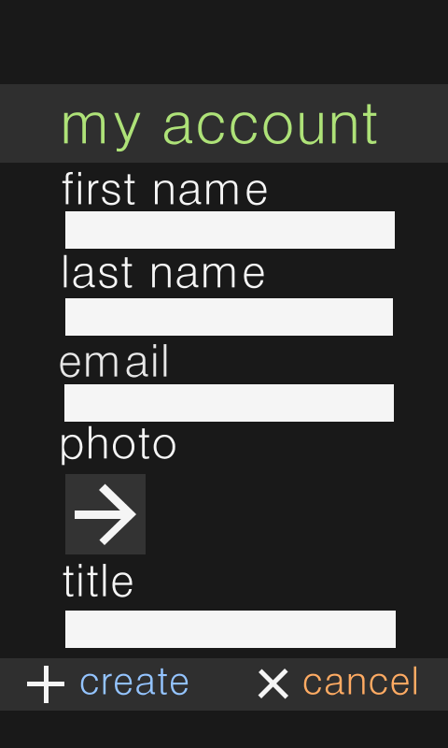

OpenComm is a realistic and intuitive audio conferencing system for Android
Alice talks to Bob and Susan in the main conference. She hears Bob on her left, and Susan on her right.
Alice moves Susan farther away from her, and Susan’s voice becomes softer.
Alice wants to tell Bob a secret and creates a side chat with him. They can still hear Susan chatting away.
Alice and Bob return to the main conference. Susan didn’t even notice they left
Alice’s location relative to Bob and Susan
Clicking this adds a new side chat
A side chat with colors indicating who’s inside
Volume controls for all the chats
main
Alice can navigate back to the main conference
how it works
features
technologies used
regions
itd implementation
sound spatialization
User Interface: Java and Android emulator using Android Virtual Device (AVD)
XMPP: Backbone of the project. Used for connection, multi-user chat room management, and session negotiation. Implemented using the Asmack library.
RTP: Standardized packet format for delivering audio. RTP is not included in Android 2.2, so we use our own implementation.
Jingle (extension of XMPP protocol): Used for multimedia audio session negotiation. Customized library.
Openfire server: Self-hosted solution with database and LDAP connectivity.
The conference space is divided up into regions 0-120, covering 110% of the available conference space. The center point of each user icon is used to determine an icon’s region. The interaural time delay (ITD) and volume difference for each region is calculated based on the region’s center point.
Read in short array of sound
Make copies for left and right stereo channels
Add ITD (short) either front or back of the sound source, depending on whether the sound source is coming from the left or the right
Combine them to create a short array formatted for stereo output
Virtually control the layout of your conference and listen to conversation more attentively as if everyone is in the actual meeting room.
side chats
Seamlessly start simultaneous private conversations to quickly discuss details, to create virtual break rooms, or just for fun.
control
Use administrative tools to restrict your conference and plan ahead all while maintaining a sense of privacy.
interaural time difference (itd)
The primary user, in orange, is located at the origin, (0, 0). The user represented by the green point is in region 80. His coordinates are (96, 476).
The difference in time for the sound to reach the left ear versus the right ear.
volume difference
The difference in volume between the left ear and the right ear.
Aerial ITD representation of the users shown on the left.
progress
the team
history
Recipients of Cisco Pioneer Award and GE Imagination in IT award in BOOM 2011
Rahul Arora, Back-end Lead
Graeme Bailey, Advisor
Justin Bard
Annie Edmundson
Najla Elmachtoub, Publication Lead
Brandon Frankel
Flavian Hautbois
Kris Kooi
Natalie Lin
Chris Liu
Risa Naka, Team Lead
Nora Ng-Quinn
Vinay Maloo, Front-end Lead
Jonathan Pullano
Crystal Qin
Ashley Sams, Design Lead
Joey Triska
Team Photo
The idea for OpenComm was incepted by Professor Graeme Bailey of the Computer Science department over 6 years ago. The team was founded by Makoto Bentz ‘11 in 2009.
since boom 2011
market advantages
The focus of the team has switched from research to implementation. We have developed a full Android application this year and are discussing commercialization.
Useful for group projects
& meetings
More convenient than video chat when on the go
Maintains professionalism
Serves as a way to split up
and reconvene meetings
Achieves goals not met
by competitors
future work
The team will continue to refine the Android application and perhaps explore working with other platforms. We hope to determine to which fields this technology could be beneficial.
find us online
WHERE’S THE BOOM? OpenComm introduces sound spatialization and side chats to create an audio conferencing experience not offered by competitors. Based on the regions of the user’s icons, we accounts for interaural time difference and volume difference when transmitting sound. This is communicated through our user interface and supported by the back-end technologies.
opencomm.github.com

