Slide 1
OpenComm Website
Site content and structure

Slide 2
Content Overview
Homepage
General app description
Demo
Features
Awards
About Us
Join Us

Slide 3
Objectives
An understanding of what the application is
Specific features
What makes OpenComm innovative
Source for help
Tutorial videos
Screenshots
Contact information
Generate interest in OpenComm
Awards OpenComm has received
Learn about the team & roles

Slide 4
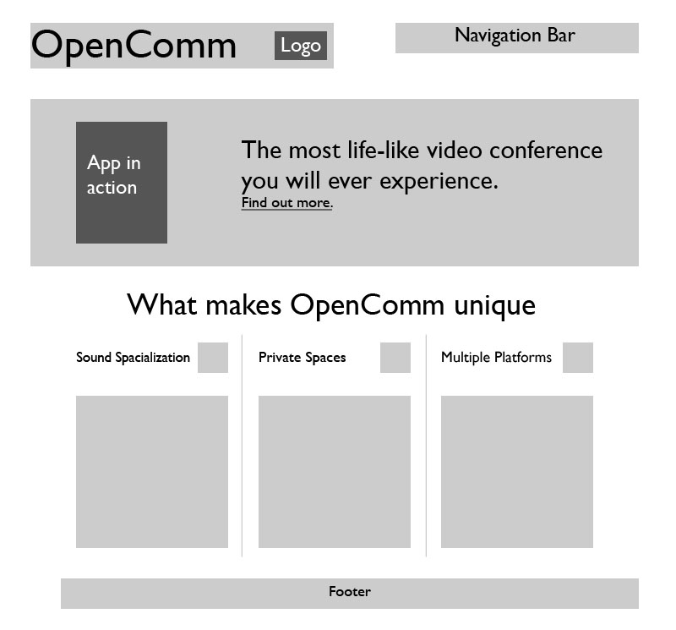
Homepage
Either a screenshot
or a video
Link to demo page
Icons we use
on the app
©OpenComm 2011 | opencomm.github.com | CUOpenComm@gmail.com Portions of this page are modifications of work used according to terms described in the Creative Commons 2.0 Attribution License.

Slide 5
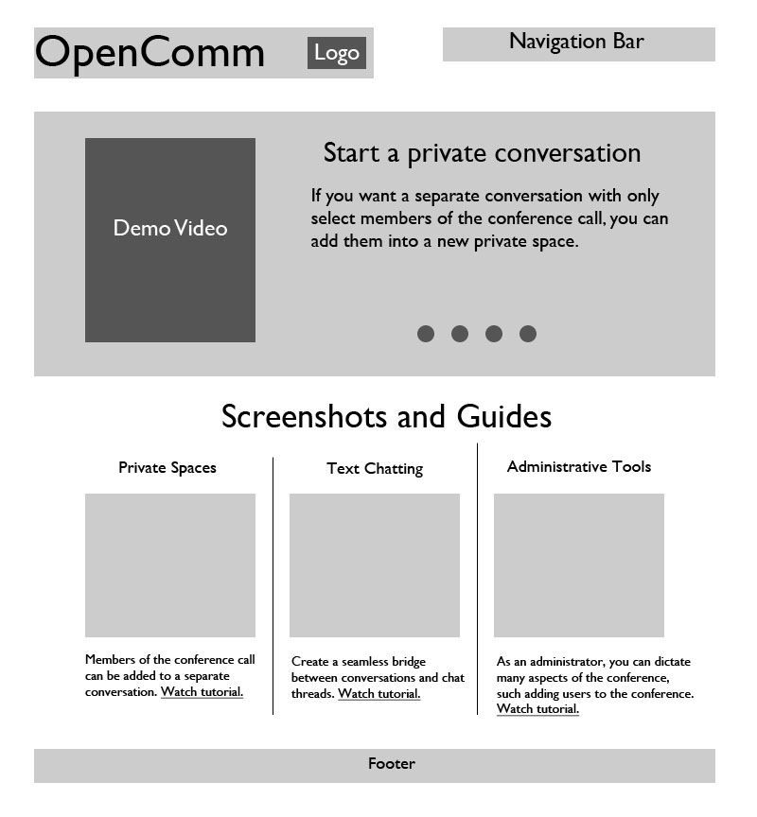
Demo
Slideshow of various
features. Default speed is set to match up with video but users can flip through each slide on their own as well.
Comprehensive video of all features.
Specific features. Links to videos with complete tutorials for that feature.

Slide 6
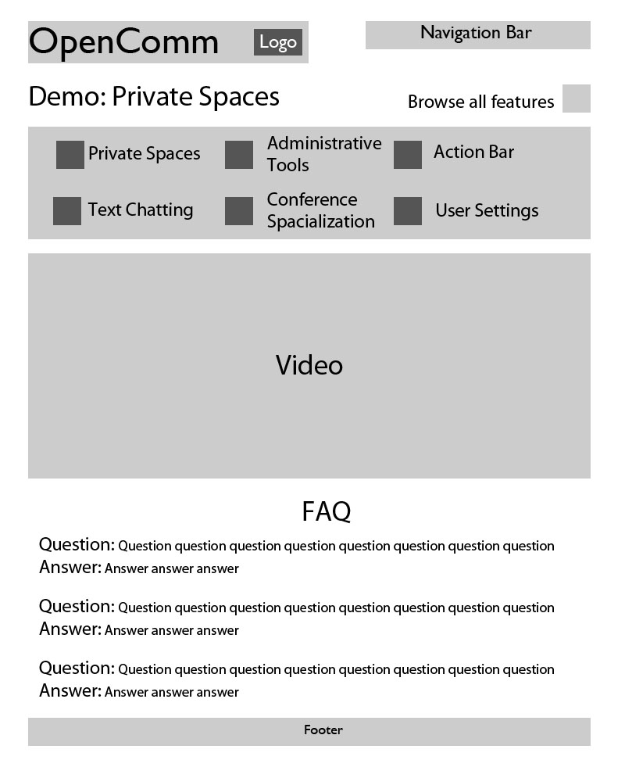
Tutorials
Links to tutorials for all
features. Once someone
clicks browse the feature
bar will open and shift
everything down.
Once browse is clicked
again, feature bar will close
and content will be shifted
back up.
Demo video for
specific feature
FAQ section in case
video is not loading
or user doesn’t want
to watch the entire
video

Slide 7
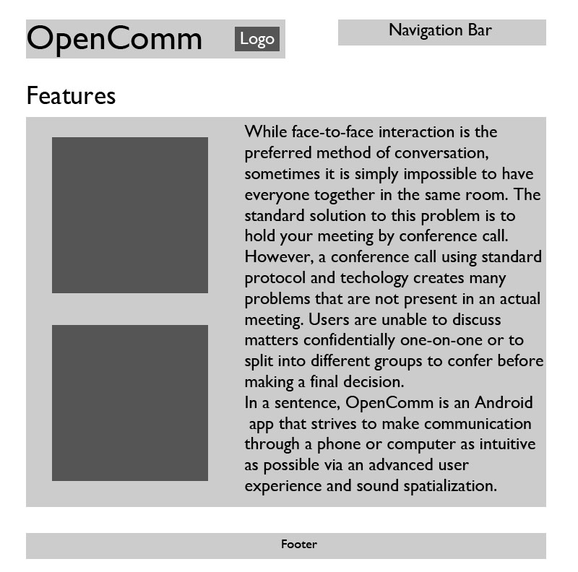
Features
Describe what makes OpenComm interesting and general purposes of using our app.
Can also include specific functionalities, although that will be included in the demo page.
Screenshots

Slide 8

Awards

Slide 9
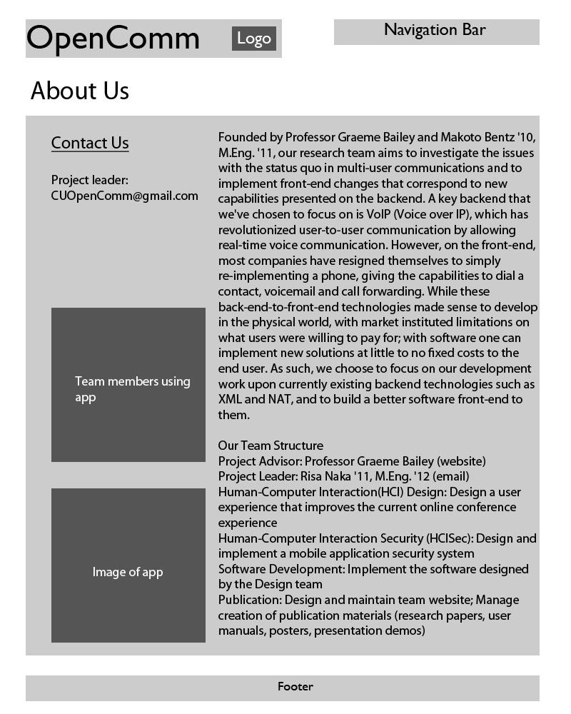
About Us
Email form
(outlook)

Slide 10
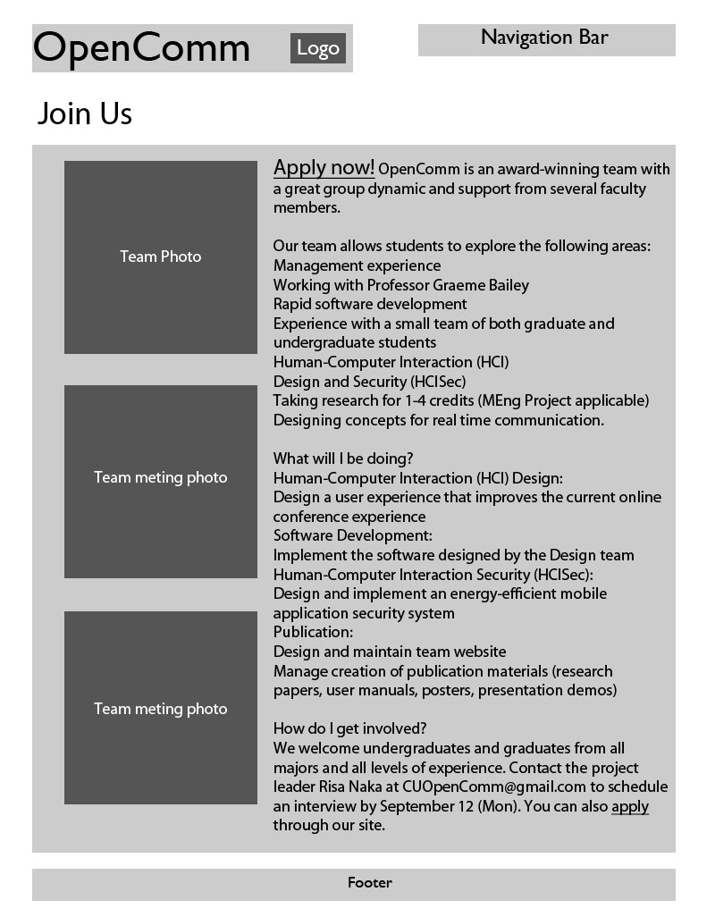
Join Us
Leads to application page

Slide 11
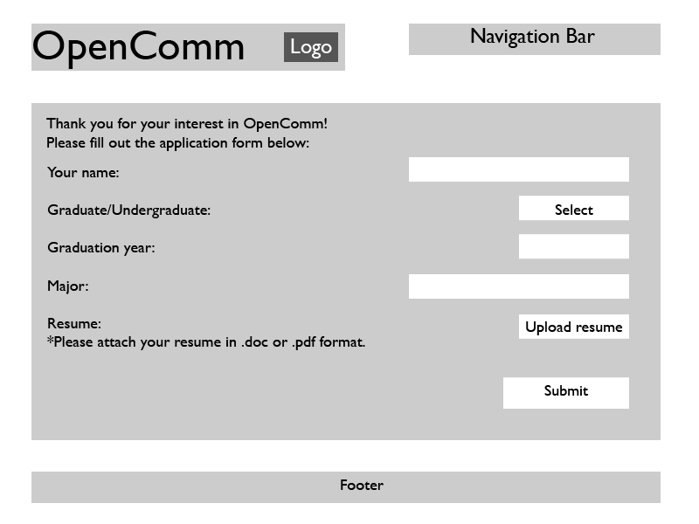
Application form
Message with application will be sent to cuopencomm@gmail.com

