Slide 1
Calibration of an estuary with Delft3D-FM
Martin Verlaan, Nils van Velzen,
Werner Kramer, Alja Vrieling, ...
Deltares, TU Delft, VORtech

Slide 2
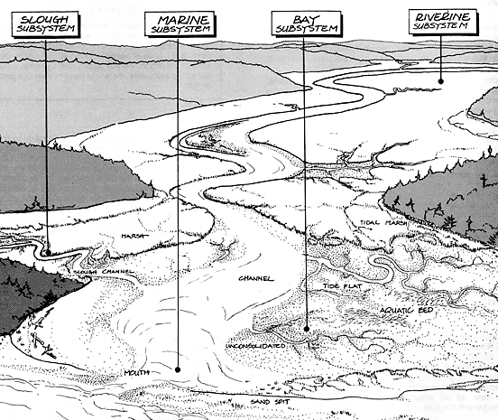
Simplified model of an estuary
Station1
30km
Station2
60km
Station3
90km
Tidal sea boundary
River discharge
boundary
One dimensional model of 100km length
Tidal boundary (left)
M2 (12h25min) and S2 (12h)
Constant slope depth
River inflow 500m³/s
3 Observation locations
Observations are not real but generated with 'truth' model.

Slide 3
Questions part 1
Download estuary_dflow.zip from http://www.openda.org/course and unpack
Delft3D-FM plugin for OpenDA is standard from OpenDA v2.2
Run the simulation with OpenDA, using the main OpenDA file oda_run_gui.bat ->and open Simulation.oda → start run
Prepare some time-series plots with quickplot
  Start matlab in direcory src/tools_lgpl/matlab/quickplot/progsrc and run d3d_qp or start quickplot from your Delft3D release.
  the observations are available as noos files in folder stochObserver. Use add to plot and change the color.
  Model output can be found in stochModel/work0/DFM_output_estuary
What are the most likely causes of differences between observations and model?

Slide 4
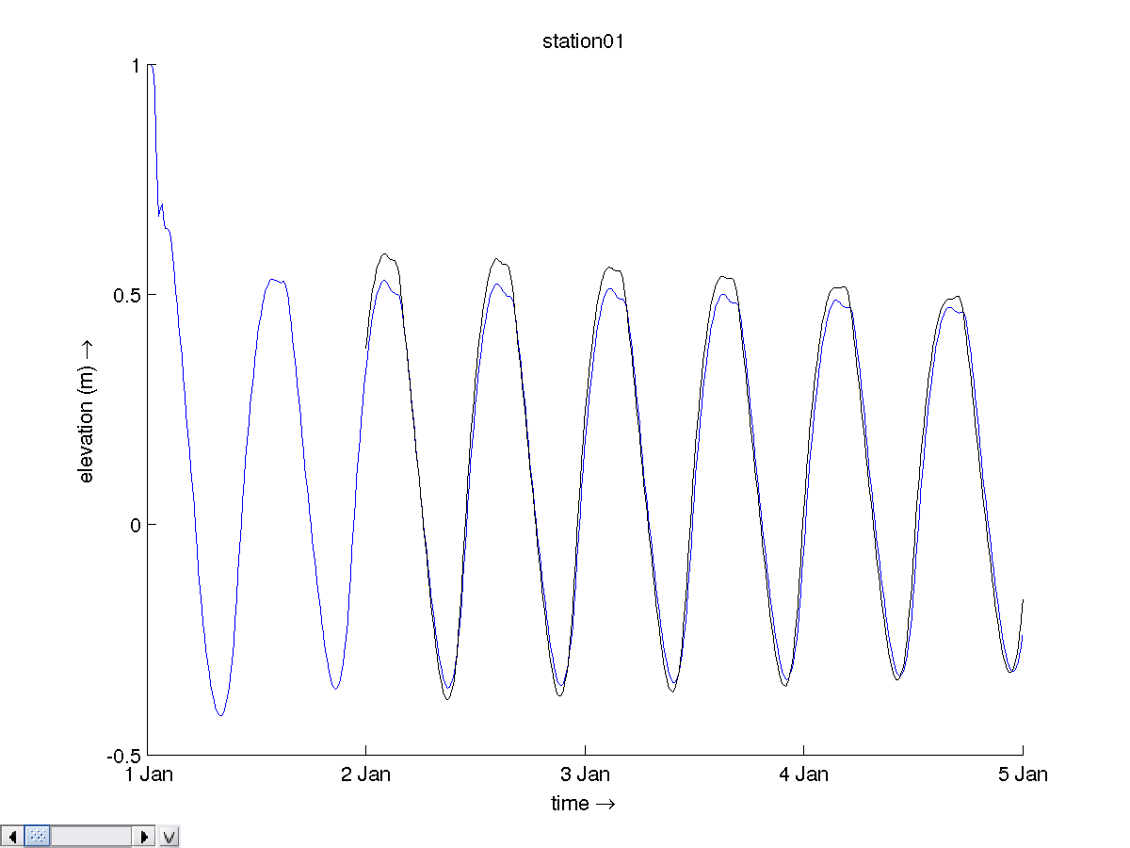
Initial performance
RMSE=4.3cm

Slide 5
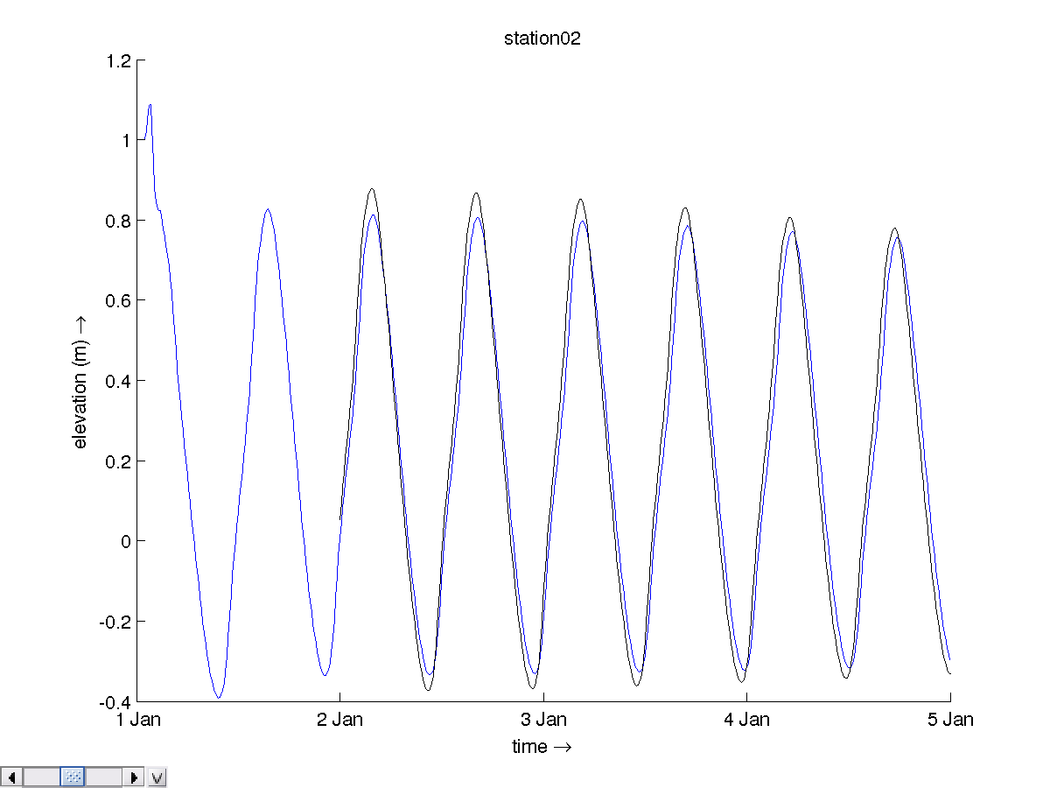
Initial performance
RMSE=7.4cm

Slide 6
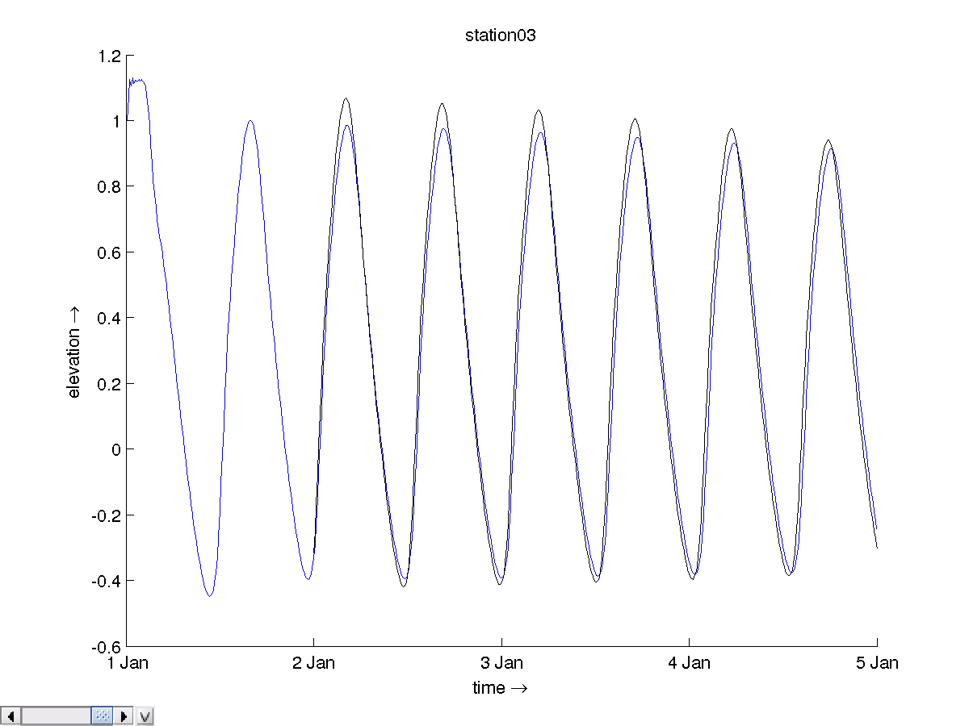
Initial performance
RMSE=7.4cm

Slide 7
Questions part 2
Run the calibration for change to the M2 tidal constituent for the western boundary (experiment M2)
  Start OpenDA with oda_run_gui.bat → Dud.oda
  Look at the output in the control tab and output tab
  Note the ouput in the result files results_dud.csv and results_dud.m
  The output of each of the runs can be found in work/work<number>. For historical reasons the real runs start in work2 for DUD.
  Plot the time-series with quickplot.
Is this what you expected?

Slide 8
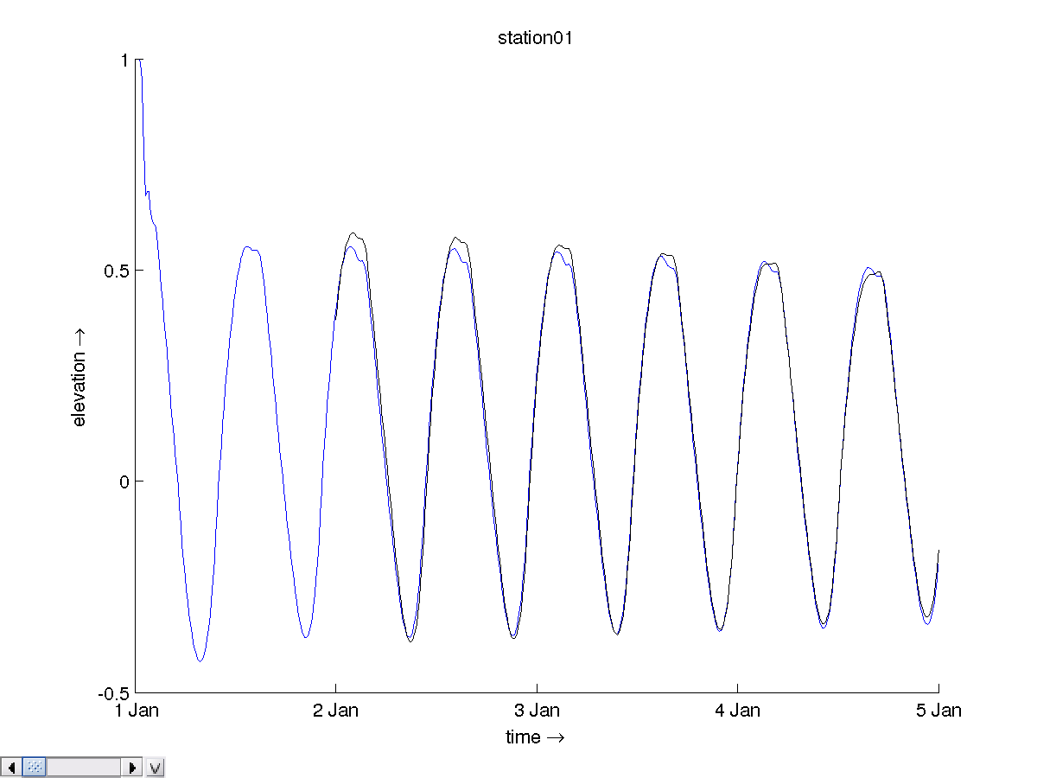
Calibration M2
Name | First guess | M2 calib.
Station 1 | 4.3 cm | 2.2
Station 2 | 7.4 | 2.5
Station 3 | 7.4 | 2.6
Cost | 1118 | 154
Station 1

Slide 9
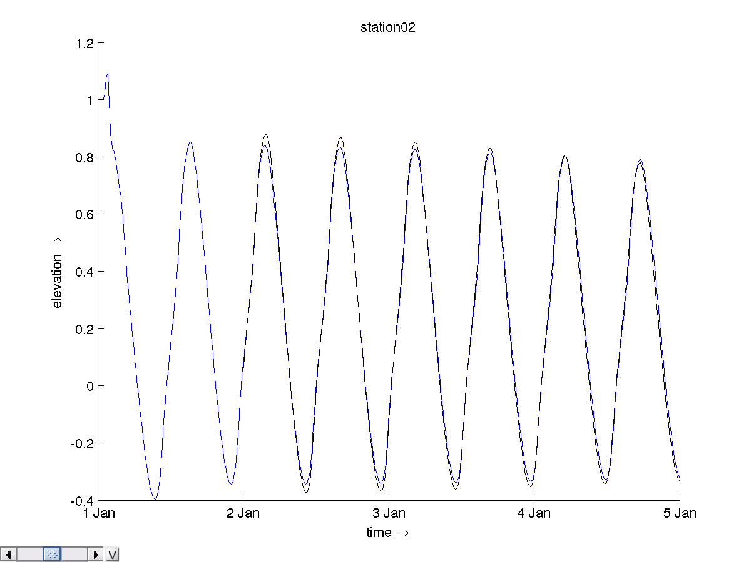
M2 output Station 2

Slide 10
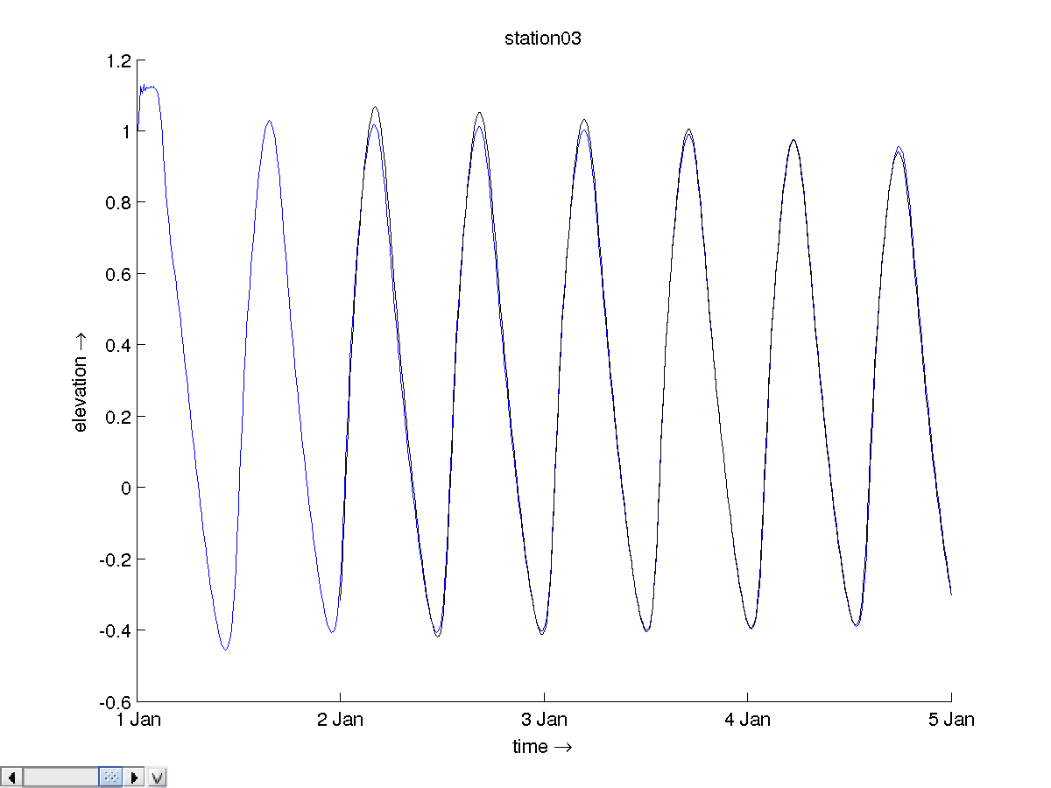
M2 output Station 3

Slide 11
Questions part 3
Although the accuracy is much improved. We still see small phase differences. Let us try to add a calibration of the bathymetry to the optimization.
Add the depth calibration to previous experiment M2+DEP)
  Uncomment DEPTH section in stochModel/dflowfmStochModel.xml
  Run calibration again
  Look at the output and plot the time-series.
  Is this what you expected?

Slide 12
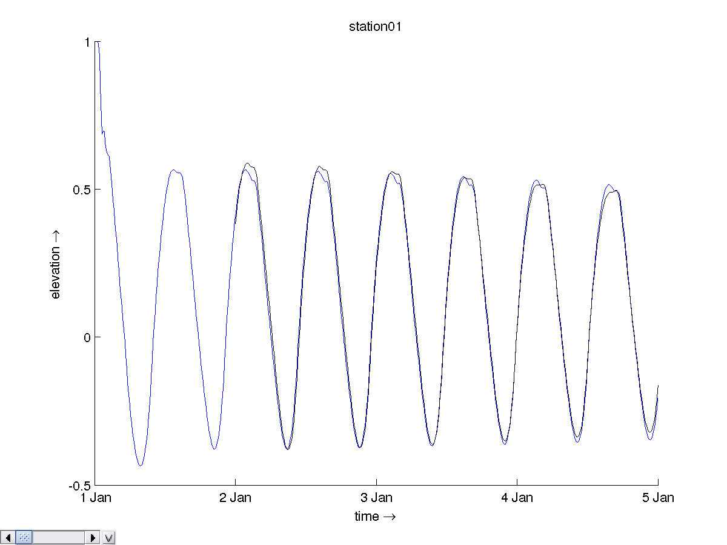
Calibration Depth+M2
Name | First guess | M2 calib. | M2+DEP calib.
Station 1 | 4.3 cm | 2.2 | 2.2
Station 2 | 7.4 | 2.5 | 2.5
Station 3 | 7.4 | 2.6 | 2.3
Cost | 1118 | 154 | 143
Station 1

Slide 13
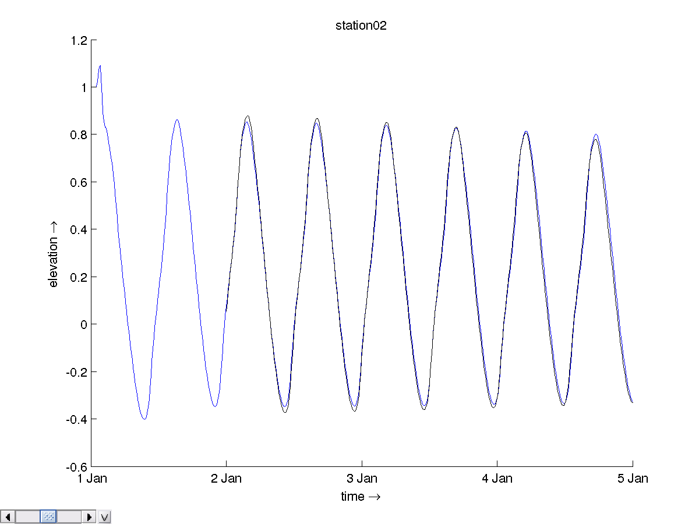
M2+DEP output Station 2

Slide 14
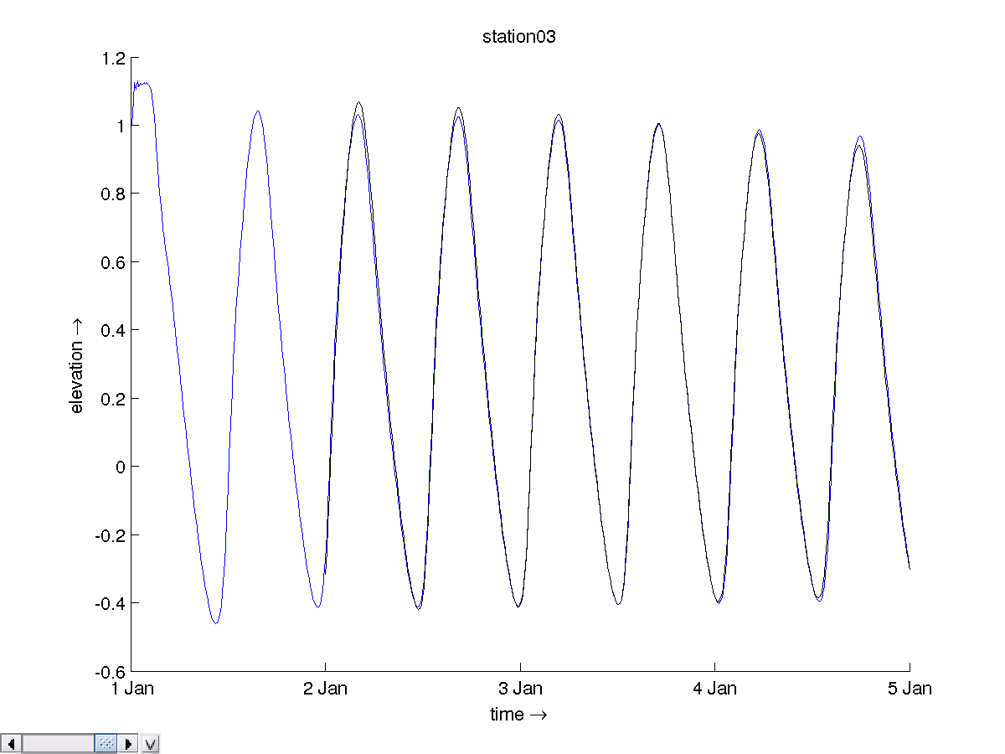
M2+DEP output Station 3

Slide 15
Questions part 4
The output looks nice. The cost-function is a bit lower still, but there is still a problem...
Make a longer run with the final run of experiment M2+DEP
  Modify work/work<last_number>/estuary.mdu and change the TStop = 43200. [hours] which is 30 days
  Run Delft3D-MF for this case
  Make time-series plots
  What is wrong?
  How does one fix this in the calibration?

Slide 16
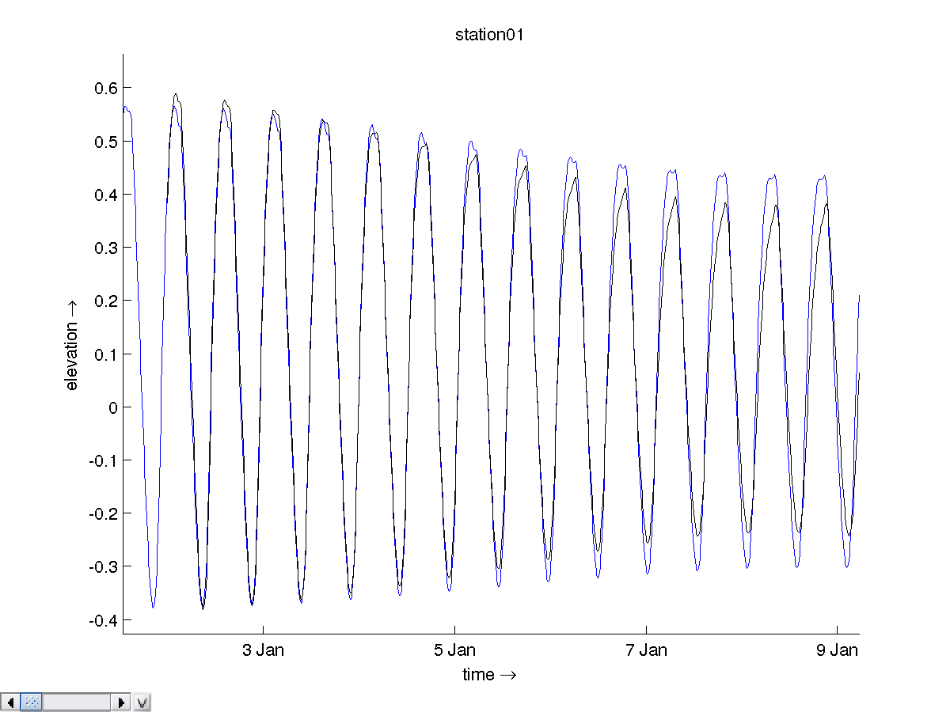
Long run for M2+DEP result

Slide 17
Questions
The error in S2 was attributed to M2. Let's make fix this with a longer simulation and adding S2 to the calibration
Add S2 to calibration and lengthen simulation experiment DEP+M2
  Modify stochModel/input_dflowfm/estuary.mdu and change the TStop = 43200. [hours] which is 30 days
  Lengthen the observations in stochObserver/noosObservations.xml to 31-1-1991 0:00h
  Uncomment S2 section in stochModel/dflowfmStochModel.xml
  Run calibration with OpenDA
What would go wrong if we would use only 3 days of observations for calibration of S2 and M2?

Slide 18
Calibration DEP+M2+S2
Name | First guess | DEP+M2+S2
Station 1 |  | 0.9cm
Station 2 |  | 0.7
Station 3 |  | 0.2
Cost | 5281 | 1.5
Parameter | Final value (change) | True values
M2.Amplitude | 0.1 cm | 0.0 cm
M2.Phase | 0.4 degr | 0.0 degr
S2.Amplitude | 10.1 cm | 10.0 cm
S2.Phase | 0.3 degr | 0.0 degr
Depth | -92cm | -100cm

Slide 19
And much more
Calibration of roughness
Use calibration regions for depth or roughness.
Proportional instead of additive modification of parameters
Make subselections of observations
Parallel computing
Output formats and selection
Try other algorithms
Calibration of other models, such as sobek, swan or waqua
….

