Slide 1


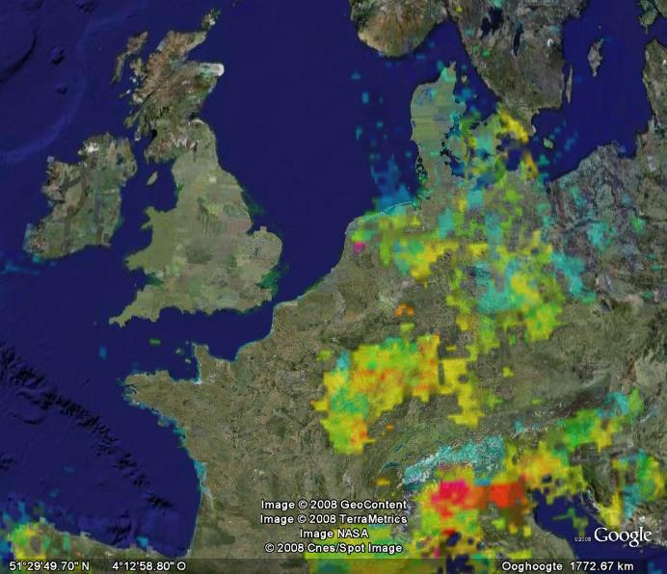
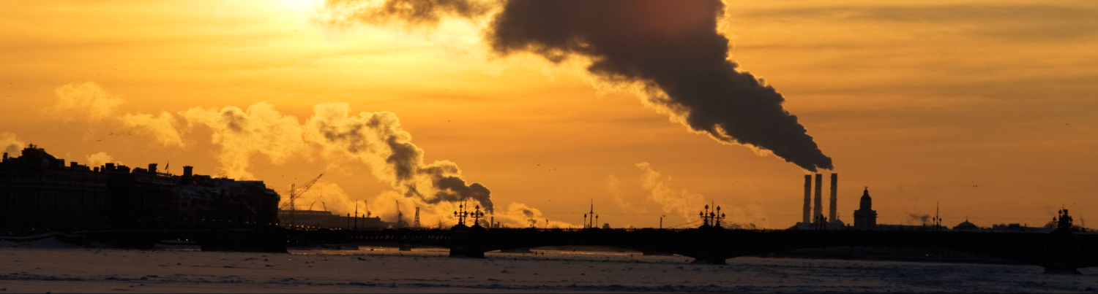
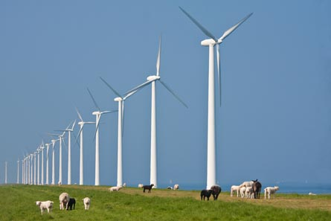
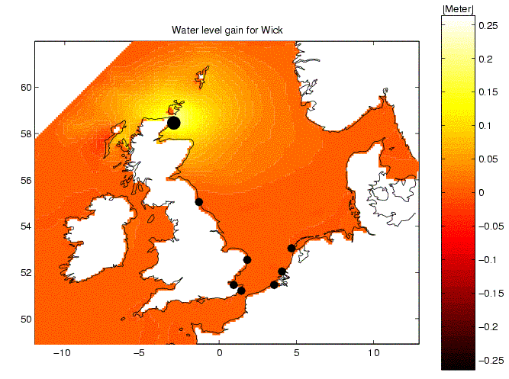
dflowFM exercise
OpenDA course
Dirk van Meeuwen,
Nils van Velzen, Martin Verlaan
06-11-15
Notes:
20-10-15
20-10-15

Slide 2

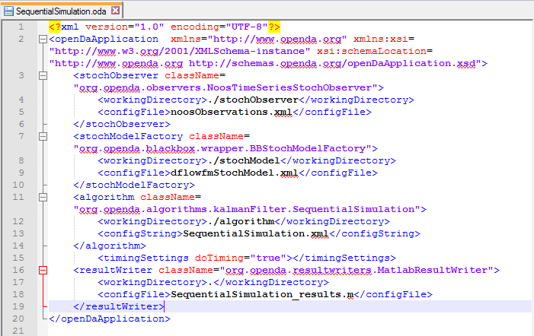
Running your first simulation
1. Where the configuration of the algorithm can be found?
3. To which file the results will be written?
  SequentialSimulation.oda
OpenDA course dflowfm
06-11-15
Notes:
20-10-15
20-10-15

Slide 3
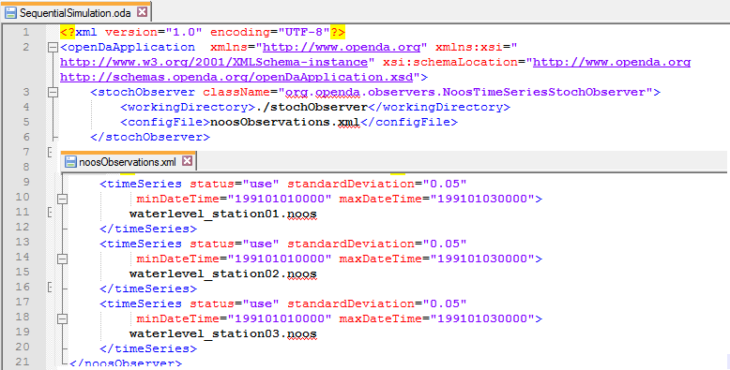
Running your first simulation
2. Where the observations are stored?
  SequentialSimulation.oda
  noosObservations.xml
OpenDA course dflowfm
06-11-15
Notes:
20-10-15
20-10-15

Slide 4
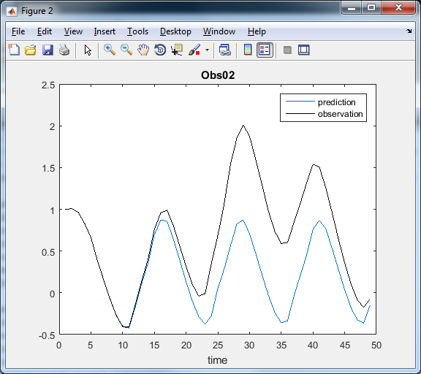
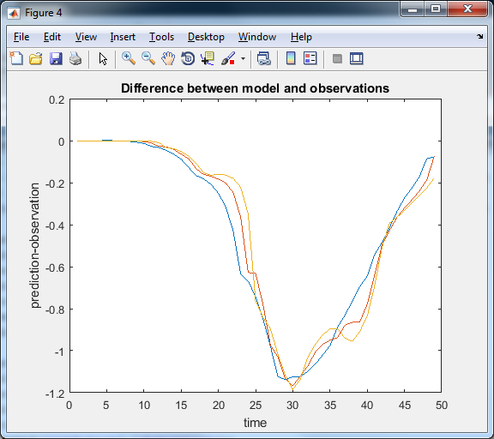
Plot the results
OpenDA course dflowfm
06-11-15
Notes:
20-10-15
20-10-15

Slide 5
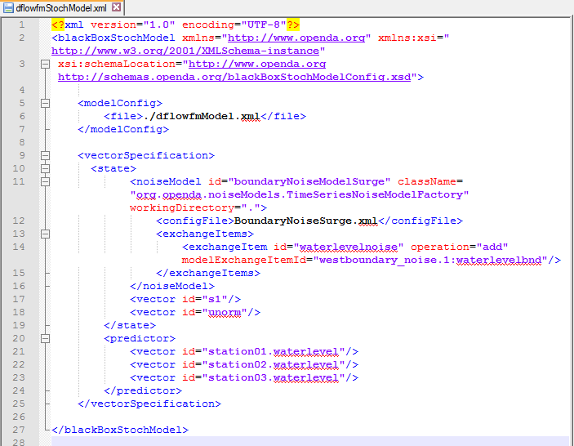
Understanding the configuration
Can you find which variables form the model state vector?
dflowfmStochModel.xml
OpenDA course dflowfm
06-11-15
Notes:
20-10-15
20-10-15

Slide 6
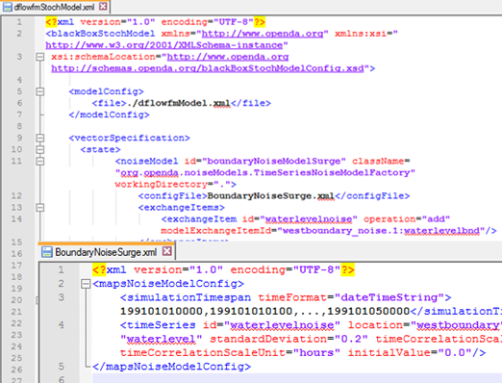
Understanding the configuration
2. How is the uncertainty specified, what should be changed to add more uncertainty to the boundary values of the model?
  dflowfmStochModel.xml
  BoundaryNoiseSurge.xml
OpenDA course dflowfm
06-11-15
Notes:
20-10-15
20-10-15

Slide 7
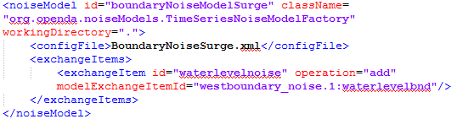

Understanding the configuration
Can you find to which input file noise (uncertainty) will be added?
  dflowfmStochModel.xml
  dflowfmModel.xml
  dflowfmWrapper.xml
  dflowfmModel.xml
OpenDA course dflowfm
06-11-15
Notes:
20-10-15
20-10-15

Slide 8

Understanding the configuration
What do you have to change when you put the model input in a different folder?
  dflowfmWrapper.xml
  dflowfmModel.xml
OpenDA course dflowfm
06-11-15
Notes:
20-10-15
20-10-15

Slide 9
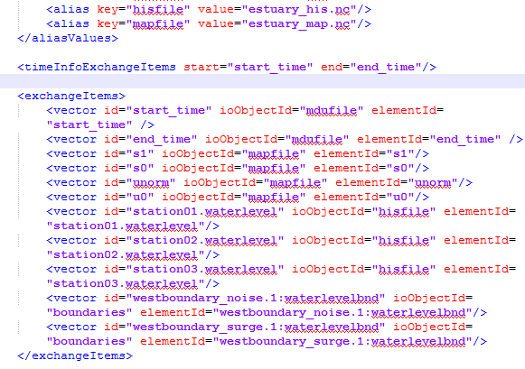

Understanding the configuration
Assume (not the case here) there is a 4-th time series as well written to the estuary_his.nc file where do you need to make changes in order to be able to use this time series?
  dflowfmModel.xml
  dflowfmStochModel.xml
OpenDA course dflowfm
06-11-15
Notes:
20-10-15
20-10-15

Slide 10
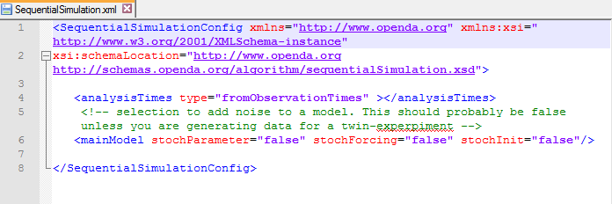
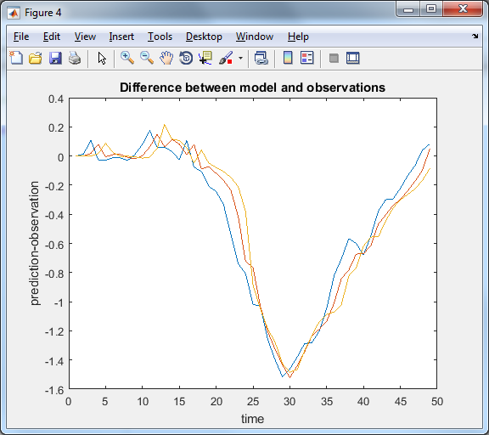
Algorithm configuration
OpenDA course dflowfm
06-11-15
Notes:
20-10-15
20-10-15

Slide 11
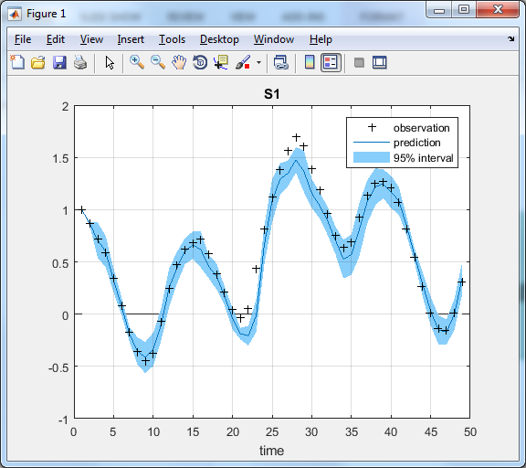
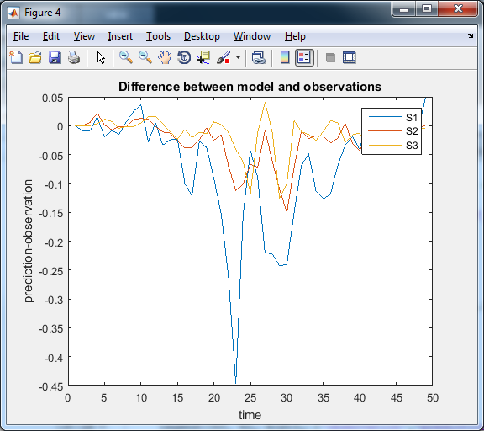
Ensemble Kalman Filter
Reference Run
OpenDA course dflowfm
06-11-15
Notes:
20-10-15
20-10-15

Slide 12
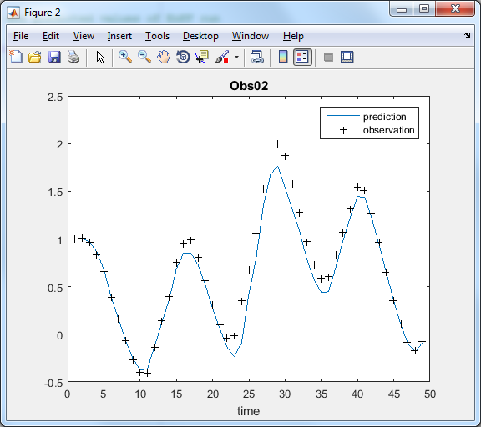
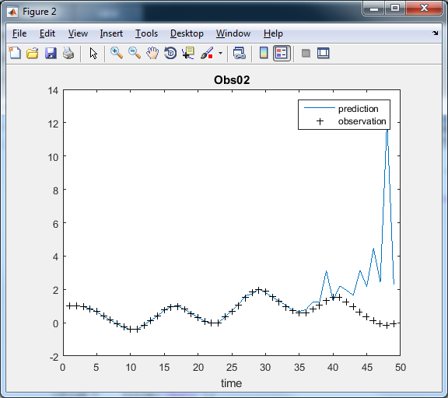
Ensemble Kalman Filter
Standard deviation 0,20
Standard deviation 0,001
OpenDA course dflowfm
06-11-15
Notes:
20-10-15
20-10-15

Slide 13
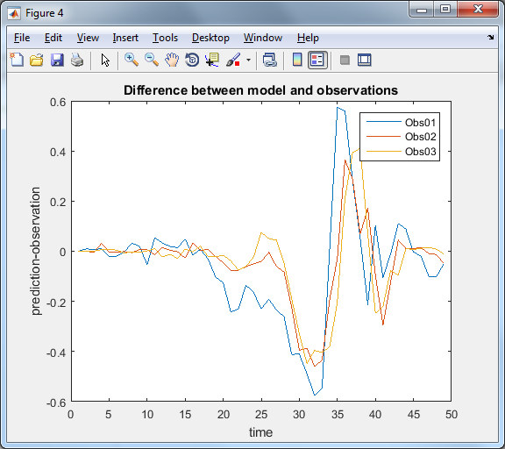
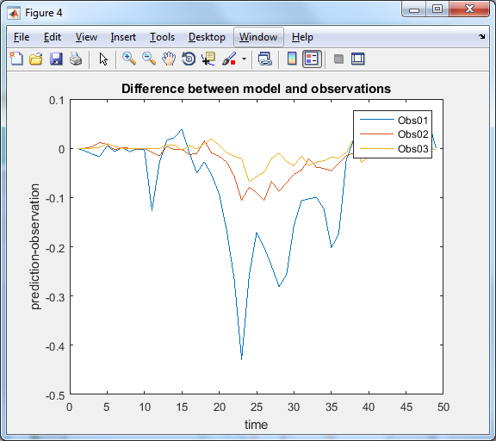
Ensemble Kalman Filter
Ensemble size 3
Ensemble size 25
OpenDA course dflowfm
06-11-15
Notes:
20-10-15
20-10-15

