Slide 1
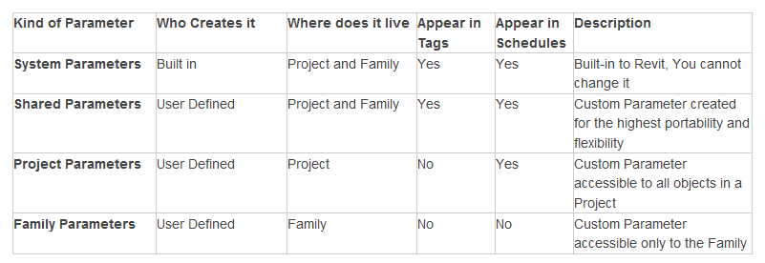
Revit Data Conceptual Map
Project Template (.rte) *
“1” indicates one or none
“ “ indicates a many relationship
“is a” indicates a type relationship
“has” indicates a composition relationship
link RVT
DWGDGN DWFPCG
8
1
8
link
Project File (.rvt)
1
8
has
1
1
* Template Path
** C:\ProgramData\Autodesk\[XXX]\Templates\US Imperial\
has
8
8
Schedule
Sheet
has
View
Family Template (.rft) **
1
8
1
1
is a
Annotation Family
1
has
Legend
8
has
Family Instance
8
1
Family
System or
User Defined
is a
Object
Group
uses
has
1
instance of
1
1
Category
8
8
has
has
1
Instance Parameter
Type Parameter
Model Line
Detail Line
8
is a
is a
Parameter
is a
Source: Paul Aubin website
1
is a
has
System Parameter
Shared Parameter
Project Parameter
Family Parameter
Material Parameter
8
Van Woods, van.woods@usace.army.mil

Slide 2
Parameter Types Defined
Source: Paul Aubin website

Slide 3
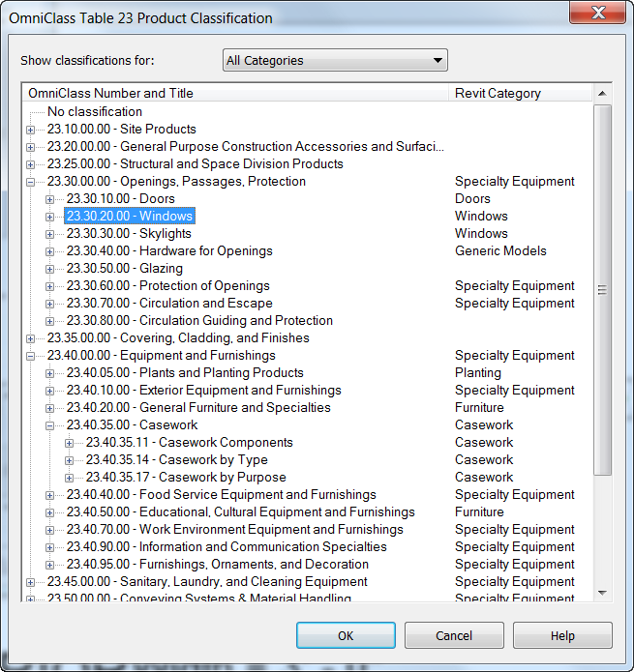
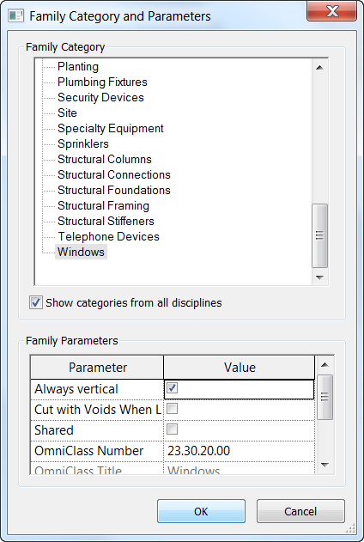
OmniClass as Family Parameter

Slide 4
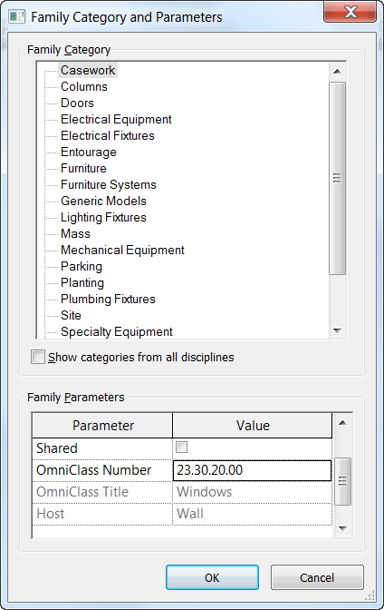
Family Parameter Behavior
Revit maintains the Family Category and Parameters from the Family Template. If you select Casework as the family category from a new family that uses the Window family template, the Omniclass value will retain its Window identity even though Casework is selected. Casework template reports the correct Omniclass number.

Slide 5
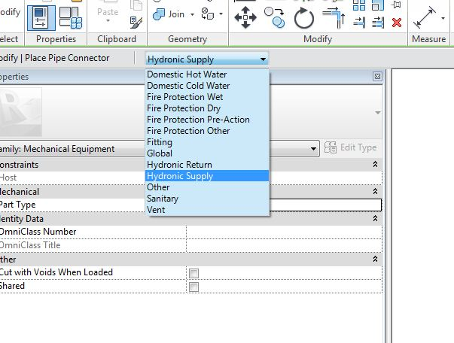
MEP System Classifications

Slide 6
Process Maturity
Consistency Range from Easiest To Most Difficult/Valuable
No Consistency
Consistent With Previous Project
User Consistency
Consistency Within One Project
Consistency Across Multiple Projects
Consistency Across Disciplines (Team)
Consistency Across Offices
Consistency Across System
Consistency Within Identical Facility Types
Consistency Within Similar Facility Types
Consistency Across Enterprise
Consistency Across Industry

