Slide 1
Quality of Service Configuration DSML for the Data Distribution Service
Joe Hoffert
jhoffert@dre.vanderbilt.edu

Slide 2
Outline
Data Distribution Service (DDS)
  DDS Quality of Service (QoS) Policies
DDS QoS Configuration (DQML) Metamodel
DDS Benchmark Environment (DBE)
DBE Interpreter
DQML Demonstration
Future Directions

Slide 3
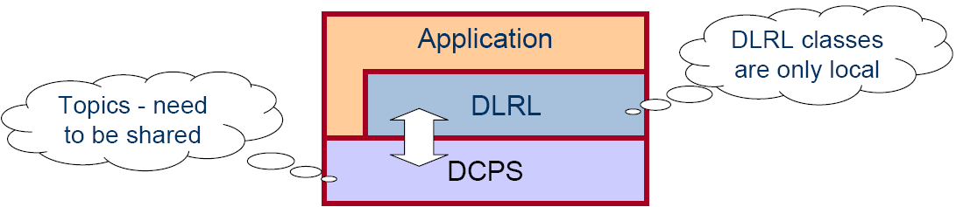
The OMG Data Distribution Service (DDS)
Application
write
read
Application
‘Global’ Data Store
write
Application
write
write
Application
read
read
Application
Provides flexibility, power and modular structure by decoupling:
  Location – anonymous pub/sub
  Redundancy – any number of readers & writers
  Time – asynchronous, time-independent data distribution
  Platform – same as CORBA middleware
Architecturally Broken into:
Data Centric Pub/Sub (DCPS)
  - Lower layer APIs to exchange topic data based on QoS policies
Data Local Reconstruction Layer (DLRL)
  - Upper layer APIs that make topic data appear local

Slide 4
QoS Policies Supported by DDS
DCPS entities (e.g., topics, data readers/writers) configurable via QoS policies
QoS tailored to data distribution in tactical information systems
Request/offered compatibility checked by DDS at Runtime
Consistency checked by DDS at Runtime
  DEADLINE
    Establishes contract regarding rate at which periodic data is refreshed
  LATENCY_BUDGET
    Establishes guidelines for acceptable end-to-end delays
  TIME_BASED_FILTER
    Mediates exchanges between slow consumers & fast producers
  RESOURCE_LIMITS
    Controls resources utilized by service
  RELIABILITY (BEST_EFFORT, RELIABLE)
    Enables use of real-time transports for data
  HISTORY (KEEP_LAST, KEEP_ALL)
    Controls which (of multiple) data values are delivered
  DURABILITY (VOLATILE, TRANSIENT, PERSISTENT)
    Determines if data outlives time when they are written
  … and 15 more …

Slide 5
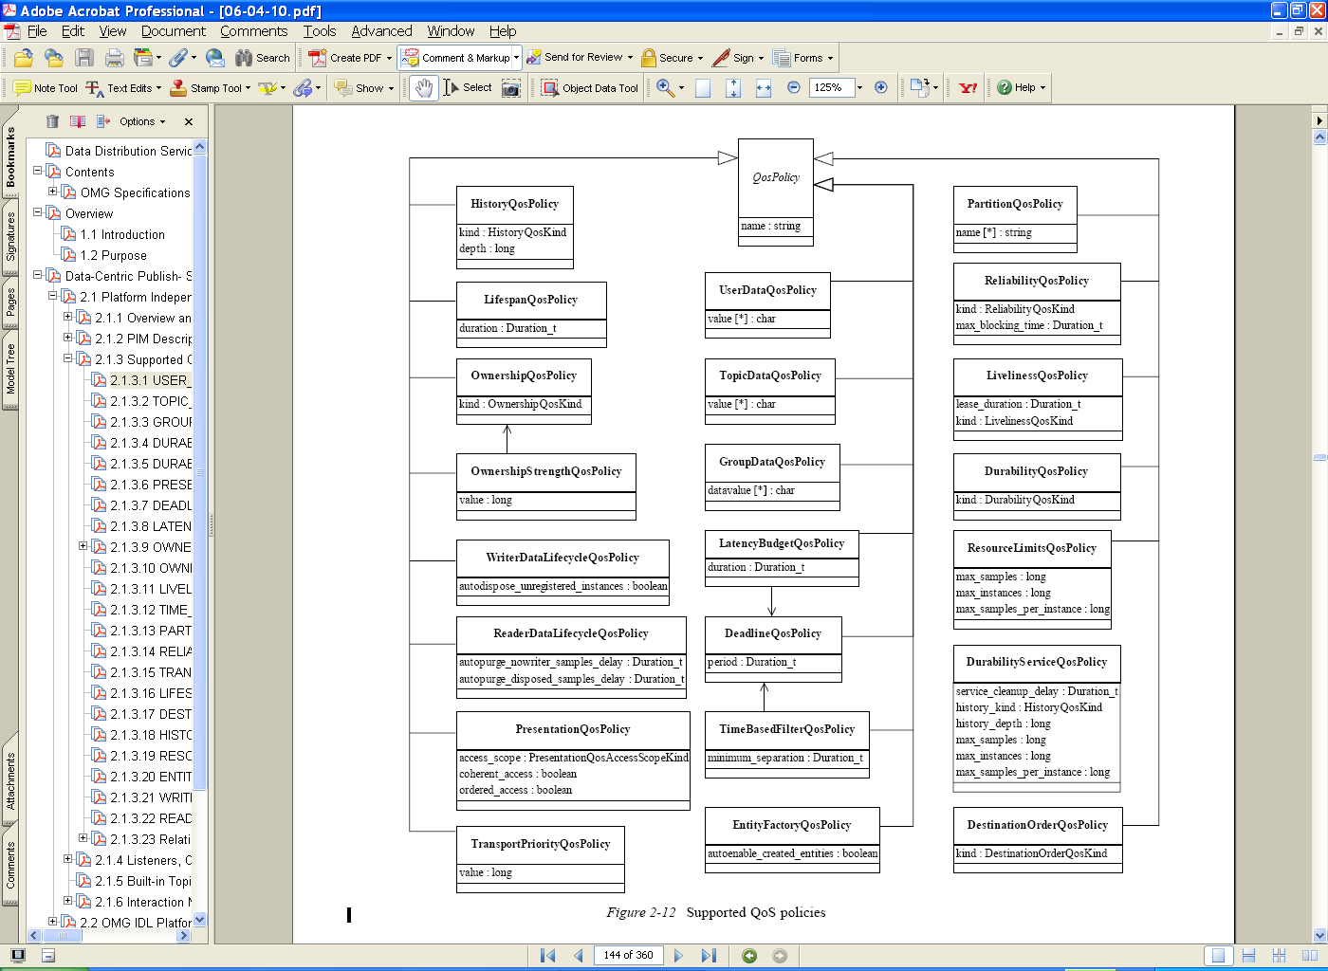








DDS QoS Policies
Interactions of QoS Policies have implications for:
  Consistency/Validity
  e.g., Deadline period < TimeBasedFilter minimum separation (for a DataReader)
  Compatibility/Connectivity
  e.g., best-effort communication offered (by DataWriter), reliable communication requested (by DataReader)
DataWriter
DataReader
Deadline-
10ms
Will Data Flow?
Or Will Changes Be Required?
Durability-
Volatile
Timebased-
15ms
Durability-
Transient
Deadline-
20ms
Liveliness-
Manual By Topic
DataWriter
Topic
DataReader
Reliability-
Best Effort
Reliability-
Reliable
Will Settings Be Consistent?
Or Will Changes Be Required?
Liveliness-
Automatic

Slide 6
DDS QoS Configuration Needs
QoS configurations need to be correct
  Fixing at run-time untenable
    Updating QoS settings on the fly
    Introduces inherent complexity
    Unacceptable for certain systems (e.g., RT, mission critical, provable properties)
  Fixing at code time untenable
    Implies long turn-around times
    Code, compile, run, check status, iterate
    Introduces accidental complexity
DQML allows checking at design/modeling time
  Supports quick and easy fixes by “sharing” QoS policies
QoS configurations need to be generated automatically
  Manual intervention introduces accidental complexities
  Decouple configurations from implementations
    Refinement of configuration separate from refinement of code
DQML generates QoS settings files when the DBE interpreter is invoked.

Slide 7
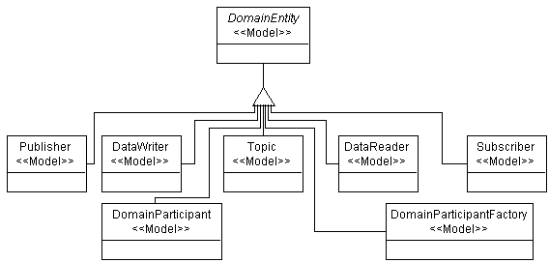
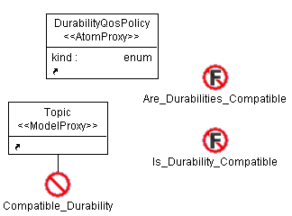
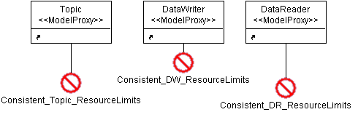
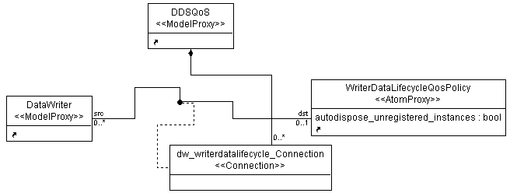
DQML Metamodel
Scope:
  Only Modeling DDS Entities Applicable to QoS Policies
  Not modeling deployment or general DDS entities
OCL Constraints for
  Compatibility
  Consistency
Cardinality Handled in Metamodel

Slide 8
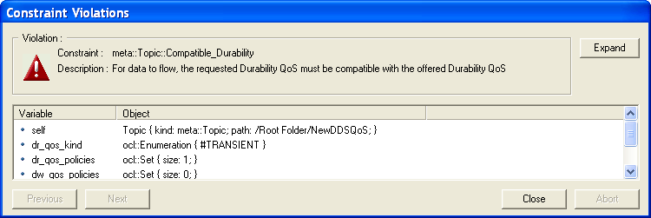
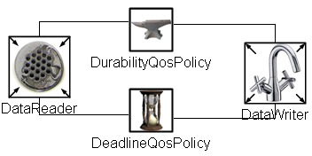
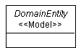
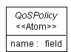
DQML Design Decisions
No Abortive Errors
  User can ignore constraint errors
  May be useful for developing pieces of a distributed application
  Err on side of flexibility initially
Associations vs. Containment
  Entities and QoS Policies associated via connections rather than containment
  Provides more flexibility and reusability
Entities as Models,
QoS Policies as Atoms
  Entities don’t (currently) need to contain anything
  Initially wasn’t sure

Slide 9


Case Study: DDS Benchmark Environment (DBE)
Part of Real-Time DDS Examination & Evaluation Project (RT-DEEP)
  http://www.dre.vanderbilt.edu/DDS
Developed by DRE Group at ISIS
QoS
QoS
QoS
DataReader
DataReader
DBE runs Perl scripts to deploy DataReaders and DataWriters onto nodes
QoS
DataReader
DataReader
QoS
QoS
DataWriter
DataWriter
QoS
QoS
DataWriter
DataWriter
Passes QoS settings files (generated by hand)
Need for testing and evaluating non-trivial configurations

Slide 10
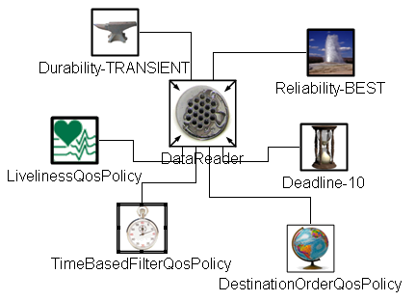
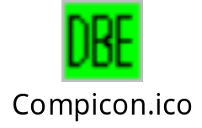
DBE Interpreter
Generates One QoS Settings File for Each DBE
DataReader and DataWriter to Use
DataReader
QoS Settings
Invoke the DBE
Interpreter in GME
DBE
Model the Desired
QoS Policies via DQML
QoS Settings
DataWriter
Have DBE Launch DataReaders
and DataWriters with Generated
QoS Settings Files

Slide 11
DQML Demonstration
Create DDS entities, QoS policies, and connections
Run constraint checking
  consistency check
  compatibility check
  fix at design time
Invoke DBE Interpreter
  automatically generate QoS settings files

Slide 12
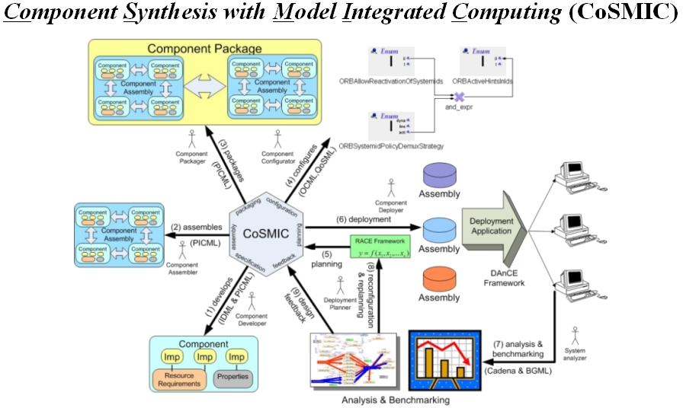
Future Work
Keep DQML in step with DBE
  Support current DBE
  Update for other entities and scenarios as needed
    (e.g., Topics, Subscribers, Publishers)
Incorporate with other Deployment Tools
  e.g., Deployment and Configuration Engine (DAnCE) in CoSMIC Tool Chain
DAnCE
Incorporate with TRUST Trustworthy Systems
  e.g., merging different dimensions (such as RT, FT, security) to provide trustworthy computing capabilities to enterprise DRE systems

Slide 13
Backup Slides

Slide 14
DDS Domains & Domain Participants
The Domain is the basic construct used to bind individual applications together for communication
  Like a VPN
Domain 2
Domain 3
2
3
1
1
Node
Node
Node
2
3
1
1
Node
Node
Node
DomainParticipant
Domain 1

Slide 15
DCPS Entities
DCPS Entities include
  Topics
    Typed data
  Publishers
    Contain DataWriters
  Subscribers
    Contain DataReaders
  DomainParticipants
    Entry points
Data can be accessed in two ways
  Wait-based (synchronous calls)
  Listener-based (asynchronous callbacks)
Sophisticated support for filtering
  e.g., Topic, Content-FilteredTopic, or MultiTopic
Configurable via (many) QoS policies
Topic
Topic
Topic
Domain Participant
Data Reader
Data Writer
Data Writer
Data Reader
Data Reader
Data Writer
Subscriber
Publisher
Subscriber
Publisher
Data Domain

Slide 16










Feedback
User Feedback
  Icons
  Usability
  Scalability
GME Modeling Feedback
  Structure of OCL Constraints
    More Informative Messages
      Maybe add “unneeded” parameters for clarification
  Converting Models to Atoms (for the DDS Entities)
    GReAT?

