Slide 1

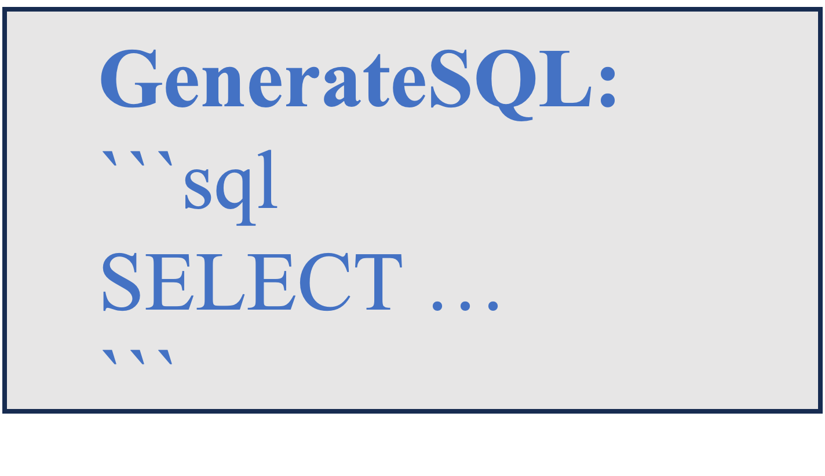
System prompt:
You are intelligent agent who is expert in leveraging SQL programs to retrieve useful information and answer user questions. You will be given a natural language question concerning a PDF file and a database schema which stores the parsed PDF content, and your ultimate task is to answer the input question with predefined output format. You can predict intermediate SQLs, interact with the database in multiple turns, and retrieve desired information to help you better resolve the question.
Action/Observation space:
GenerateSQL:
```sql
SELECT …
```
GenerateAnswer:
```txt
answer string
```
Thought: . . .
Action: GenerateSQL:
```sql
SELECT page_id FROM pages WHERE page_number = 6 AND ref_paper_id = '28789599’;
```
Observation:
| page_id |
|:-------------------------------------|
| 0fb4d204-4726-5b3f-988d-c58221152f2e |
...
Thought: …
Action: GenerateAnswer:
```txt
true
```
ReAct agent framework:
Question: Can you find any figure on the top of this page? (page 6 of PDF with id 28789599)
Database schema:
… CREATE TABLE IF NOT EXISTS metadata …
Answer format: your answer should be “true” of “false” without punctuation.

