Slide 1
Evaluating Online Tutorials for Data Structures and Algorithms Courses June 24, 2013
ASEE Annual Conference & Exposition 2013
Simin Hall, PhD Mechanical Engineering
Prof. Clifford A. Shaffer, Computer Science
Eric Fouh, Computer Science
Mai Hassan ElShehaly, Computer Science
Daniel Breakiron, Computer Science

Slide 2
Motivation
Low usage of learning technologies for teaching in CS (other than programming tasks)
Low usage of Algorithm Visualizations (AVs) despite their educational usefulness
Modest number of assessment activities with immediate feedback due to the lack of time for grading.

Slide 3
Features of OpenDSA
A collection of online, open-source tutorials that combine textbook-quality text with interactive examples and randomly generated instances of exercises
Provides unlimited practice
Provides automatic assessment and immediate feedback
Free and open source
Web-accessible
Interactive, engaging, dynamic material
Content is continually updated and improved

Slide 4
OpenDSA
Modules authored in reStructuredText and compiled into HTML5
Exercises written in HTML5, CSS and JavaScript
Extensive use of jQuery and the JavaScript Algorithm Visualization (JSAV) library
Mastery-based design
Concept of “proficiency”

Slide 5
Exercise Types
Slideshows
Mini-slideshows
Algorithm visualizations (AVs)
Proficiency exercises
Algorithm simulations
Calculators
Khan Academy-style exercises
Mini-proficiency exercises
Summary exercises

Slide 6
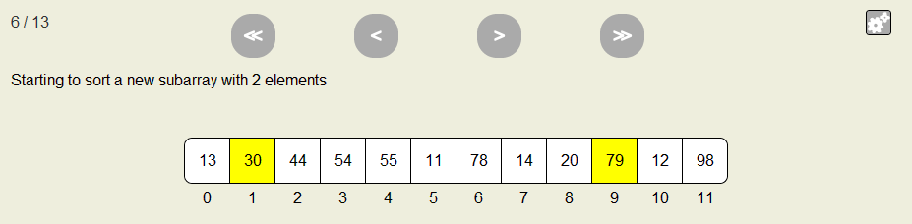
Mini-slideshow
Sorting a sublist in Shellsort
Notes:
http://algoviz.org/OpenDSA/dev/OpenDSA/Books/OpenDSA

Slide 7
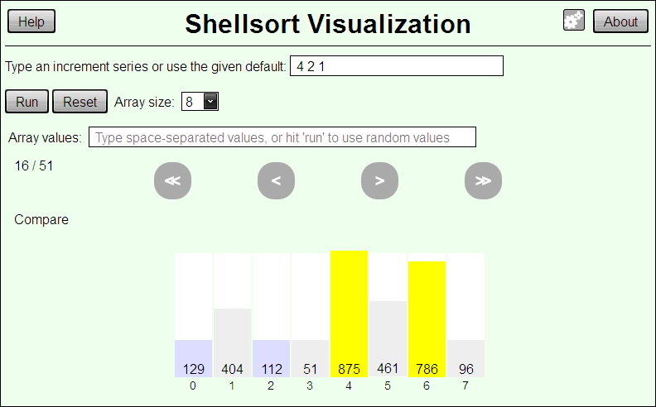
Algorithm Visualization

Slide 8
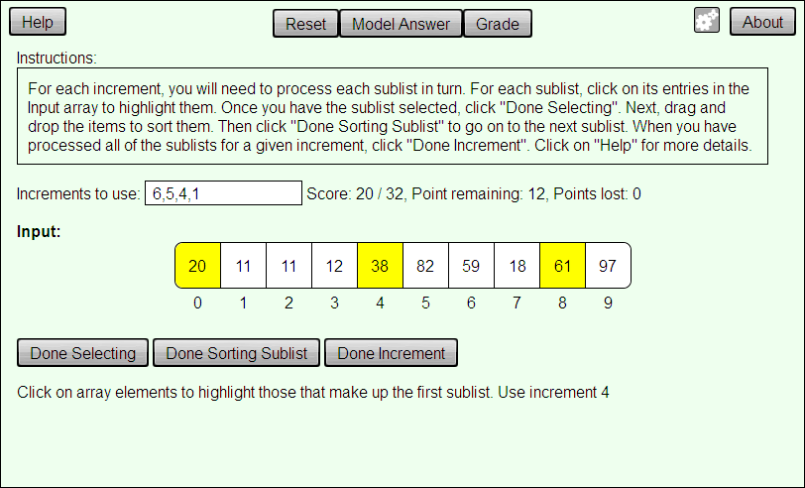
Algorithm Simulation

Slide 9
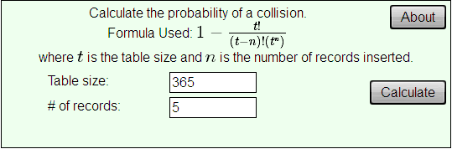
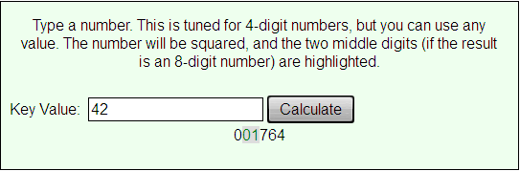
Calculator
Birthday problem calculator
Mid-square calculator

Slide 10
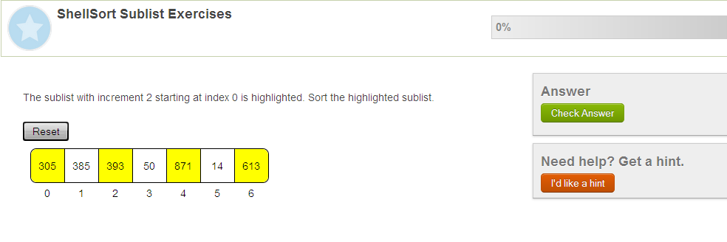
Mini-Proficiency Exercise

Slide 11
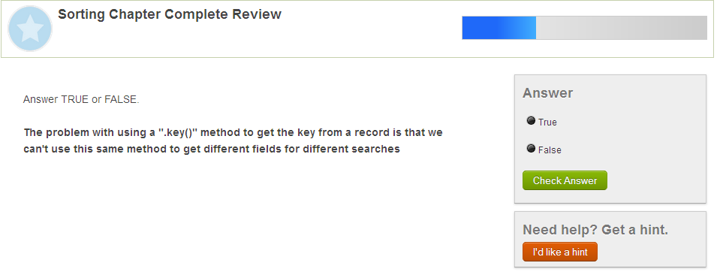
Summary Exercise

Slide 12
Research Questions
Can students learn as well or better using interactive tutorials instead of traditional lecture and textbook?
Will students be accepting of a class focused on interactive tutorials rather than traditional lecture and textbook?
Will our client/server infrastructure adequately support classroom use?
What feedback do students have about the best approaches for using such interactive tutorials in courses?

Slide 13
Research Method
Mixed method evaluation model (quasi-experimentation) – Fall 2012
Control group: received standard lecture and textbook for three weeks on the topics of sorting and hashing
Treatment group: spent their class time working through equivalent content in the form of online material

Slide 14
Research Method, Cont’d
Data collection
Surveys before and after the experiments
Interview
Classroom observations
Exam results and OpenDSA interaction logs
Population:
DSA students (55 and 57 students in the control and treatment groups, respectively).

Slide 15
Results
Most students in treatment group reached the maximum number of points awarded for OpenDSA homework (5% of total class score).
Students in treatment group preferred to be lectured during class time instead of only doing assignments.
Control group mean and median on test was 70, treatment group mean was 75 and median was 79 (not statistically significant).

Slide 16
Results, cont’d
Students in treatment group expressed a positive experience using OpenDSA.
Instructor of treatment section reported being able to spend a greater fraction of lecture time on content related to the more abstract and difficult topics, and less on the mechanics of sorting and hashing algorithms.

Slide 17
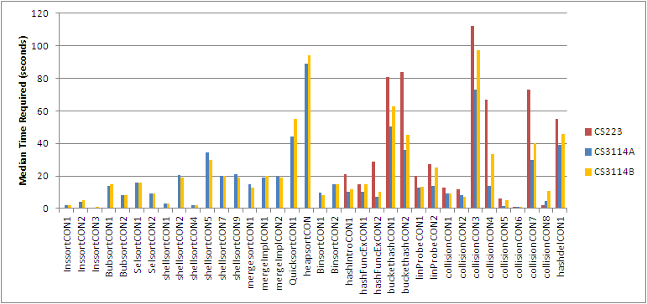
Time Required for Proficiency
Median time required for mini-slideshows

Slide 18
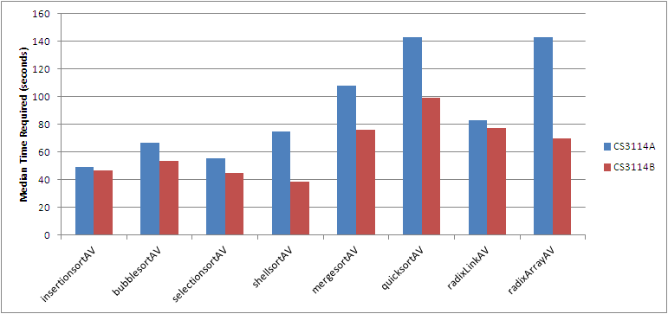
Time Required for Proficiency
Median time required for algorithm visualizations (AVs)

Slide 19
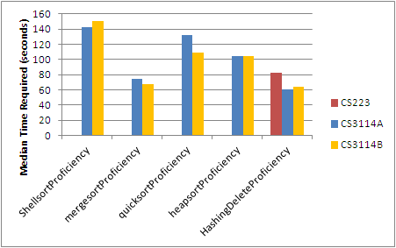
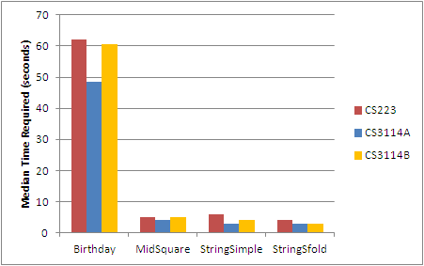
Time Required for Proficiency
Median time required for algorithm simulations
Median time required calculators

Slide 20
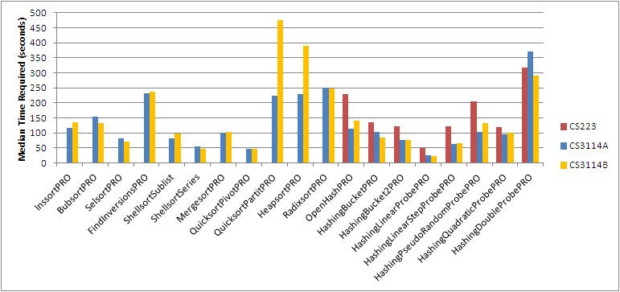
Time Required for Proficiency
Median time required for Khan Academy-style mini-proficiency exercises

Slide 21
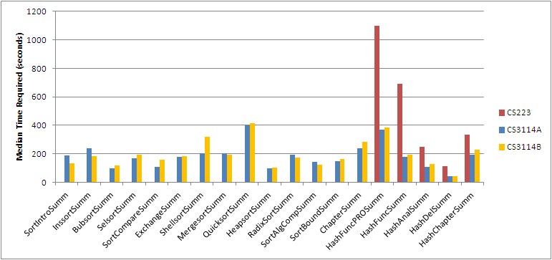
Time Required for Proficiency
Median time required for Khan Academy-style summary exercises

Slide 22
Summary of our results
The approach of online tutorials was well received by our students.
Made us reassess our planned teaching strategy for the next deployment, to include more in-class lecture on the more difficult concepts to reinforce online materials.
Gave us insight on how to improve our server-side logging and scoring infrastructure.

Slide 23
Summary of our results, cont’d
Gave us insight on what log data to collect for our next round of testing, and what tools we need to analyze it.
Allowed us to perform fine-grained tuning of specific exercises in terms of things like making sure that students take the right amount of time to complete and adequately cover the material.

Slide 24
Acknowledgements
NSF
Grant DUE-1139861
Virginia Tech
the Institute of Distance & Distributed Learning,
the Center for Instructional Development and Educational Research,
the Institute for Society, Culture, and Environment

Slide 25
Questions?
Project web site: http://algoviz.org/OpenDSA/dev/OpenDSA/Books/OpenDSA
Cliff Shaffer shaffer@cs.vt.edu
Simin Hall simin.hall@vt.edu

