Slide 1

An Interactive Tutorial for NP-Completeness
Masters Thesis
by
Nabanita Maji
Advisor - Dr. Clifford Shaffer
May - 2015

Slide 2
Outline
Background and Motivation
Visualizations
The NP-Complete Problems
Practice Exercises on NP-Complete Problem Instances.
Proof of NP-Completeness
Analysis of Usage
Conclusion and Future work

Slide 3
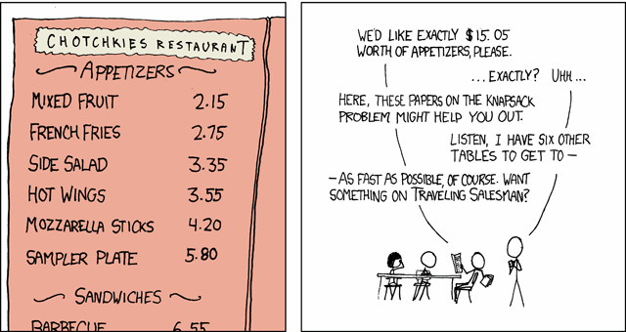
NP-Completeness

Slide 4
Students’ perception of NP-Completeness

Slide 5
Related Work
“Using Interactive Visualization for Teaching the Theory of NP- completeness.”
“Incorporating an interactive visualization of NP-Completeness proofs into a web-based learning environment.”
“Visualizing NP-completeness through circuit-based widgets.”
GraphBench
AlViE
Swan

Slide 6


Tools and Framework
OpenDSA
JSAV - JavaScript Algorithm Visualization library
Khan Academy exercises

Slide 7
Outline
Background and Motivation
Visualizations
The NP-Complete Problems
Practice Exercises on NP-Complete Problem Instances.
Proof of NP-Completeness
Analysis of Usage
Conclusion and Future work

Slide 8
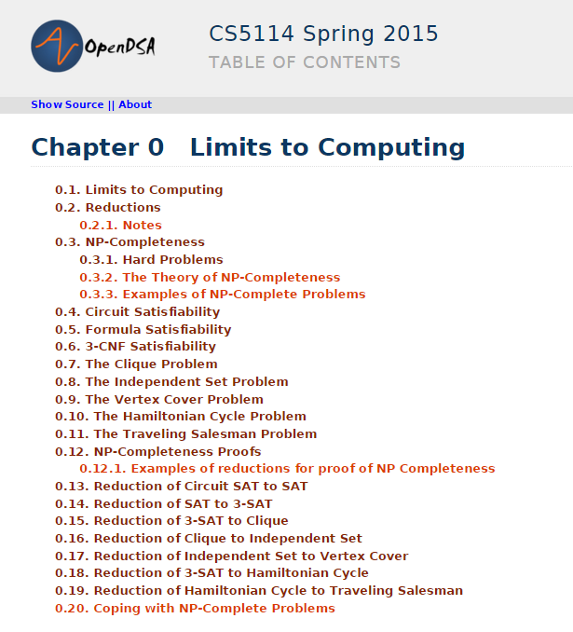
NP-Complete problems covered:
Circuit-SAT
SAT
3-SAT
Clique
Independent Set
Vertex Cover
Hamiltonian Cycle
Traveling Salesman.

Slide 9
Outline
Background and Motivation
Visualizations
The NP-Complete Problems
Practice Exercises on NP-Complete Problem Instances.
Proof of NP-Completeness
Analysis of Usage
Conclusion and Future work

Slide 10
Introducing the problem
Explanation of relevant context (Example)
Definition of the problem
Illustration with examples.

Slide 11
The NP-Complete problems
Circuit Satisfiability problem (Circuit-SAT)
The Formula Satisfiability problem (SAT)
The 3CNF Satisfiability problem ( 3SAT )
The Clique problem
The Independent Set problem
The Vertex Cover problem
The Hamiltonian Cycle problem
The Traveling Salesman problem

Slide 12
Outline
Background and Motivation
Visualizations
The NP-Complete Problems
Practice Exercises on NP-Complete Problem Instances.
Proof of NP-Completeness
Analysis of Usage
Conclusion and Future work

Slide 13
Practice Exercises – Why?
Better illustration of the problem
Hands-on experience on problem instances
Help to appreciate the computation complexity.

Slide 14
Practice Exercises – Design aspects
Generation of problem instances
Level of Difficulty
Solution and Verification

Slide 15
The Practice Exercises
3-SAT
The Maximum Clique problem
The Maximum Independent Set problem
The Minimum Vertex Cover problem
The Hamiltonian cycle problem
The Traveling Salesman problem

Slide 16
Outline
Background and Motivation
Visualizations
The NP-Complete Problems
Practice Exercises on NP-Complete Problem Instances.
Proof of NP-Completeness
Analysis of Usage
Conclusion and Future work

Slide 17
Proving NP-Completeness
NP
NP-Complete
NP-Hard
Reductions

Slide 18
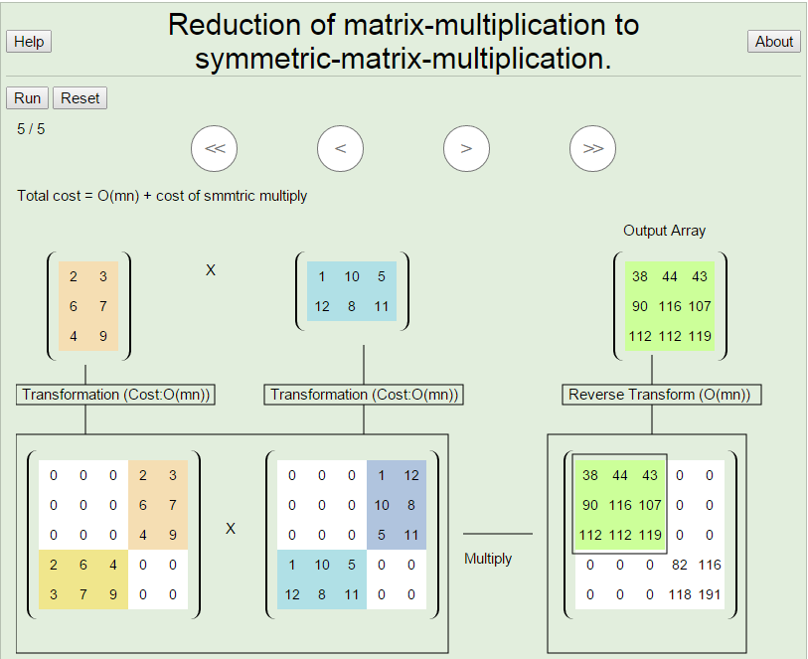
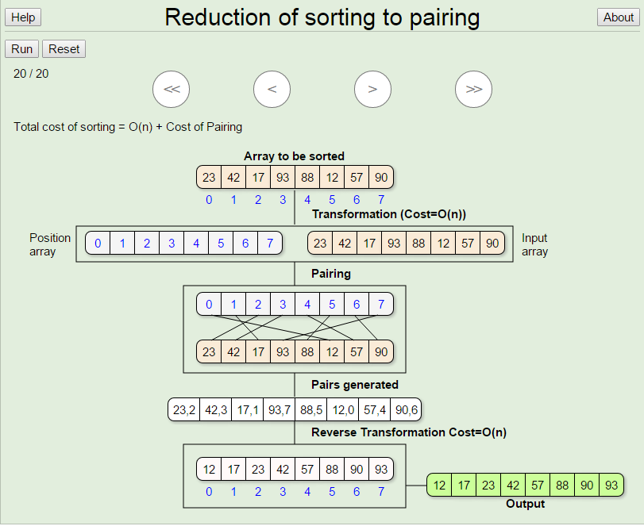
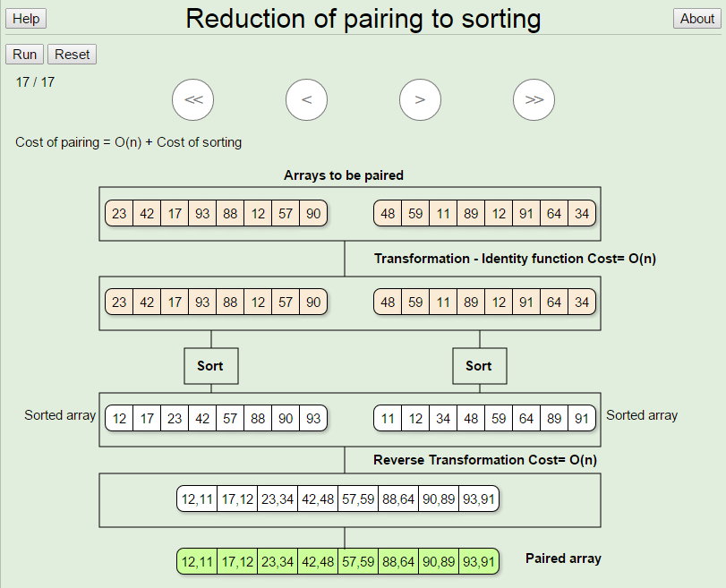
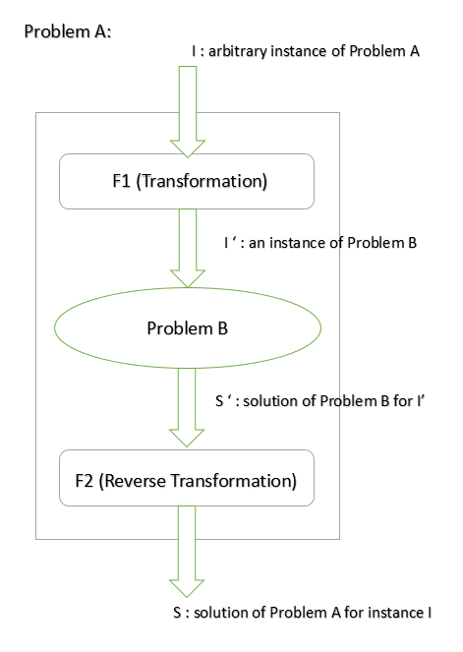
Reductions

Slide 19
Proof of NP-Completeness
The visualizations should include –
Description of each step of a reduction.
Explanation of correctness of the reduction.
Illustration using examples.

Slide 20
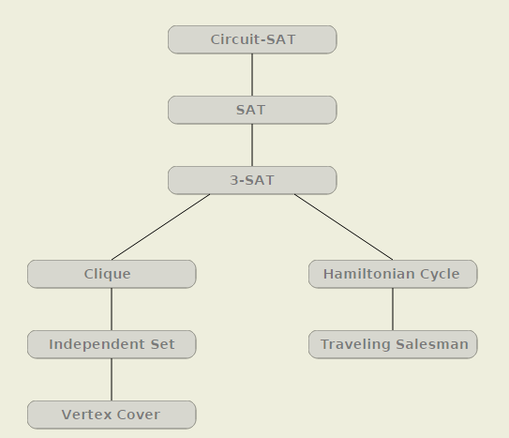
Order of Reductions

Slide 21
Reductions in proving NP-Completeness
Reduction of Circuit-SAT to SAT
Reduction of SAT to 3-SAT
Reduction of 3-SAT to Clique problem
Reduction of Clique to Independent Set problem
Reduction of Independent Set to Vertex Cover problem
Reduction of 3-SAT to Hamiltonian Cycle problem
Reduction of Hamiltonian Cycle to Traveling Salesman problem

Slide 22
Outline
Background and Motivation
Visualizations
The NP-Complete Problems
Practice Exercises on NP-Complete Problem Instances.
Proof of NP-Completeness
Analysis of Usage
Conclusion and Future work

Slide 23
Hypothesis
Students would spend a reasonable amount of time on the tutorial if it helps in their learning.
Students would have a good experience with the tutorial.

Slide 24
Analysis of Usage – Methodology
The tutorial was introduced as a supplementary resource in CS 5114 and CS 4104 in Spring 2015.
Interaction logs : We analyzed the logs of students’ interactions with the tutorial.
Student survey : We collect feedback from students in the form of a survey.

Slide 25
Challenges in analyzing Interaction logs
Distinguishing between users.
Distinguishing between actual usage and idle time.

Slide 26
CS-5114 : Categorized Usage

Slide 27
CS-5114 : Usage per module

Slide 28
CS-4104 : Categorized Usage

Slide 29
CS-4104 : Usage per module

Slide 30
Time spent of exercises

Slide 31
Overall usage for CS 5114

Slide 32
Overall usage for CS 4104

Slide 33
Student Survey
CS 5114
23 out of 34 responded to the survey
Average time spent as reported - 2.28 hours
65% found it useful for their homework
82% say they will use the tutorial to prepare for finals.
97% of the students provided a positive feedback when asked about their experience with the tutorial.
CS 4104
36 out of 62 responded to the survey
Average time spent as reported - 32 minutes
19% found it useful for their homework
86% say the tutorial will be helpful for their finals.
72% of the students had a positive feedback when asked about their experience with the tutorial.

Slide 34
Outline
Background and Motivation
Visualizations
The NP-Complete Problems
Practice Exercises on NP-Complete Problem Instances.
Proof of NP-Completeness
Analysis of Usage
Conclusion and Future work

Slide 35
Conclusion
18 visualizations and 6 practice exercises in the tutorial.
Students think it is a good resource.
They use it on a need-to-know basis.

Slide 36
Future work
Visualizations on more NP-Complete problems.
Pedagogical evaluation of the material.

Slide 37
Thank you ☺
Special mentions:
Dr . Cliff Shaffer
Dr. Lenwood Heath
Mohammed Farghally
Questions ??

