Slide 1

Potential customers
SME Owners
Franchises
Real-Estate Agents
Private Schools
Marketing Managers
Government

Slide 2
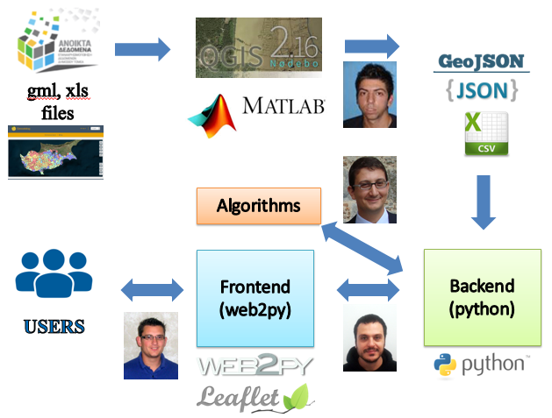
Technical description
Backend: Tornado Server (Python). Custom BizPlace API.
Frondend: Web2Py Framework (Python), Leaflet js
GIS Platform: QGIS
Data: Geographic information: Administrative Units (GIS), Post Codes Boundaries (GIS), Demographic Statistical Data (GIS/CyStat).
Market data extracted from open data sources (Pharmacies, Elderly Care, Adult trainings) using regular expressions.

Slide 3
business
Revenue stream from subscriptions (B2B)
Access premium for real-estate agents
Consulting Services

Slide 4
Bizplace™ team dland
We help companies decide where to set up their business. Because, location matters.

Slide 5
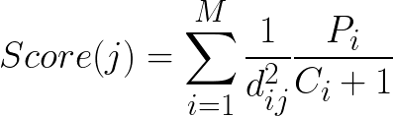
Score algorithm
j-th post-code
M: number of Post-codes
dij: eucledian distance between centroids
Pi: sum of population segment
Ci: number of competing companies

Slide 6
Location, location, location
Pharmacies, Doctors, Baby Day-care, Bakeries, Private Tutoring Schools, Franchises, Elderly Homes, Customer service centres, Coffee houses,…

Slide 7
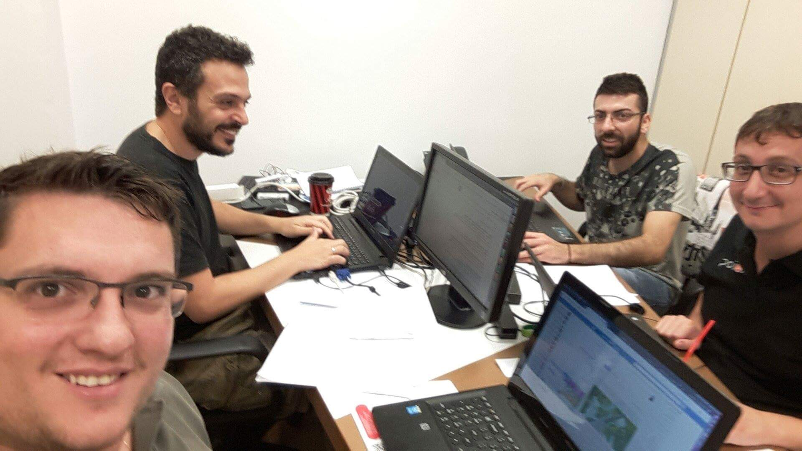
Who We are
Demetris Stavrou, Backend Developer
Michalis Skitsas, Frontend Developer
Marios Kyriakou, GIS/MATLAB
Demetris Eliades, Algorithms

