Slide 1
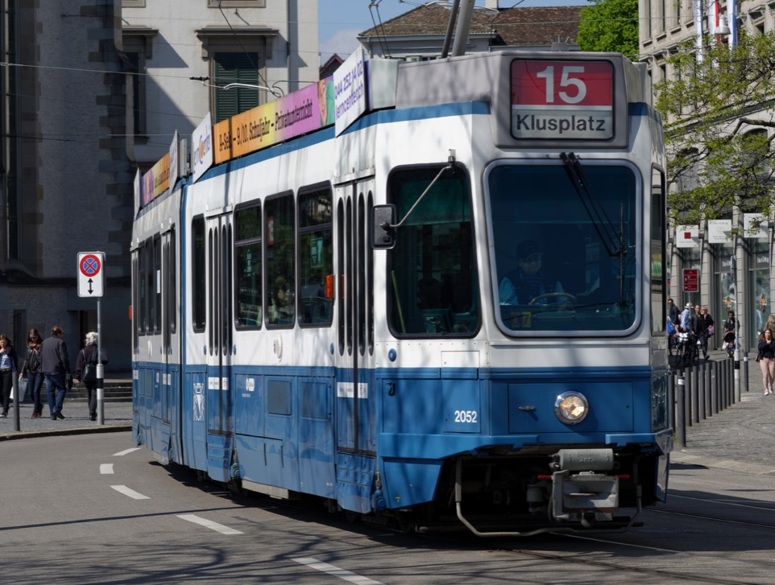






Visualizing the frequency of transit delays using QGIS
and the Leaflet javascript library in R
Open Data Day Zurich, Hack-a-thon 2017
Peter B. Pearman
Thomas Roth
Open Data Day Zürich
sponsors:
Our open tools:
Master Program in Biostatistics

Slide 2
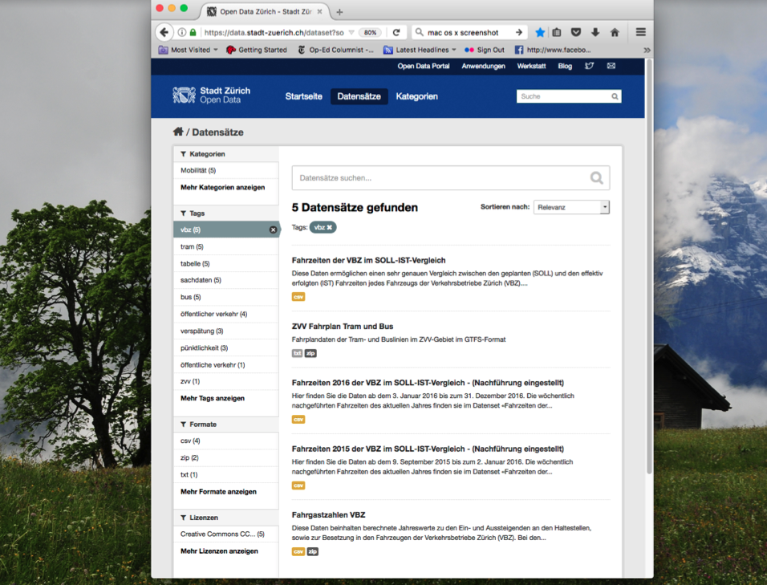

Slide 3
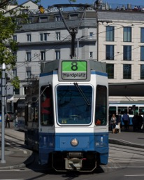
VBZ Soll-Ist-Vergleich Data Set
An observation:
A departure stop (‘von’) and an destination stop (‘nach’)
Essential variables:
sol_an_von: Scheduled time to arrive at the departure stop
ist_an_von: Actual time of arrival at the departure stop
sol_ab_von: Scheduled time to leave departure stop
ist_ab_von: Actual time of leaving departure stop
same four variables for the destination stop
line number, direction label, reference time

Slide 4
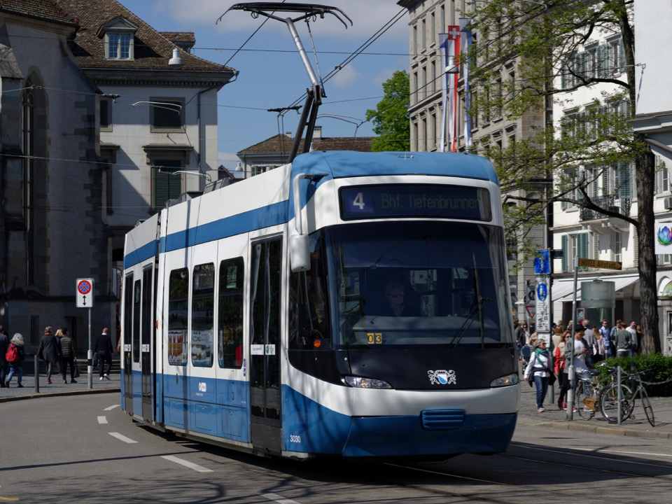
The Issue:
Dependable public transportation =>
reliability => reducing unscheduled delays
Goal: Improve on-time performance:
Focus management efforts on tram and bus stops
where delays most frequently occur
Question:
Where along lines do delays most-frequently occur?
At stops? Along segments between stops?
Objective or Task:
Use Sol-Ist-Vergleich data
Visualize for each line the locations where delays occur

Slide 5
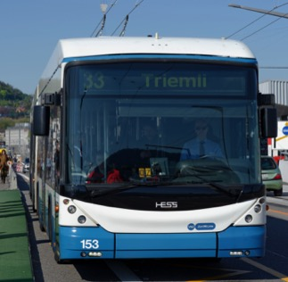
Initial work: Zürich Open Data Day Hack-a-thon
Less than 8 hours to get preliminary results
(and attend a talk or two)
78 bus and tram lines
72 weeks of delay data
each with > 10⁶ lines of data
Simplify to get a quick result:
Bus 33 --a fairly long route
12 weeks of data
Simple metric of delay:
--exceed scheduled elapsed time at stop
--exceed scheduled elapsed time on stretch

Slide 6
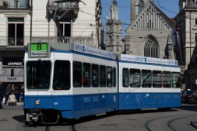
library(tidyverse)
library(lubridate)
delays <- function(in.tibble,out.tibble,work.line,min_delay_seg_min,
min_delay_von_min){
delay2 <- small_tib %>%
filter(linie == work.line) %>%
mutate(soll_seg = soll_an_nach - soll_ab_von, #delay during segments of the line
ist_seg = ist_an_nach1 - ist_ab_von,
delay_seg = ist_seg - soll_seg,
soll_at_von = soll_ab_von - soll_an_von, # delay at the stop (Haltstelle)
ist_at_von = ist_ab_von - ist_an_von,
delay_von = ist_at_von - soll_at_von)
delay3 <- delay2 %>% # filter data lines lacking at least one
mutate(delay_seg_min = floor(delay_seg/60), # delay greater than the
delay_von_min = floor(delay_von/60)) %>% #necessary minimum
filter(delay_seg_min >= min_delay_seg_min | delay_von_min >= min_delay_von_min)
return(delay3)
}

Slide 7
out_tib <- tibble()
temp=list.files('../data/fahrzeiten_data')
work.line <- 33
data_set=0
num_datasets = 12
min_delay_seg_min = 0
min_delay_von_min = 0
for (i in temp){
data_set <- data_set + 1
print(i)
delay1 <- read.csv(paste('../data/fahrzeiten_data/',i,sep=""),stringsAsFactors = FALSE)
out_tib <- delays(delay1,out_tib,work.line,min_delay_seg_min,min_delay_von_min)
if ((data_set>=num_datasets)==TRUE) break()
}
# make an index for QGIS plotting
out_tib$index <-
paste(out_tib$linie,'-',out_tib$halt_punkt_id_von,'-',out_tib$halt_punkt_id_nach,sep='')
```

Slide 8
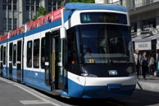
QGIS 2.18
+ PostgreSQL 9.4 DB (for data loaded from R)
+ a few shapefiles from GIS of Kanton Zürich
QGIS

Slide 9
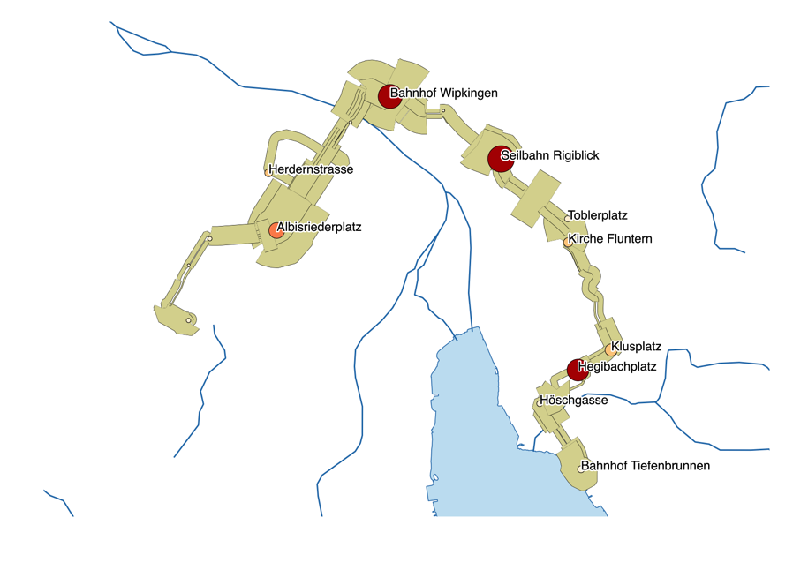
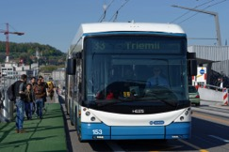
The final result
Stops with more than 0.5s mean delay labelled
Distinct segments for both directions with offset. Width proportional to abs(delay)
Buses recorded also the way back to the garage
(hidden)
QGIS

Slide 10
Observations on Hackathon Activity
Essentially glad to have a small result at the end of the Hackathon ☺
Lots of fun!
Much of the effort spent with the DIVAesque nature of the data and the interface (the segment key) between the Calc- and the Visualisation team
NB: Some effort went into having the correct line color: who cares with only the line 33 displayed?
Not enough time to verify the actual visualization data

Slide 11
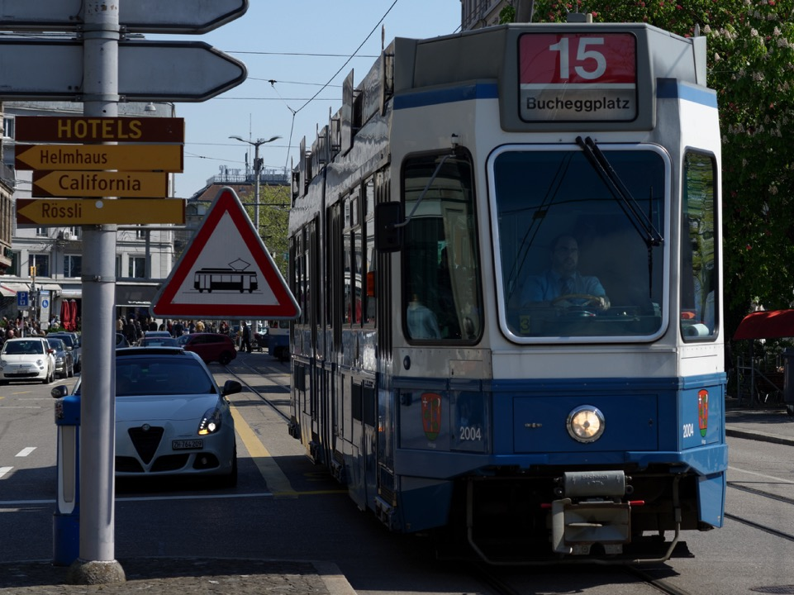
?
> <
Delays at stops
Delays along segments
How about all those delays of < 1 minute?

Slide 12
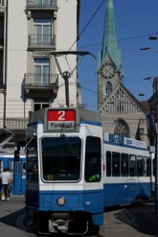
out_tib$day.of.week <- factor(weekdays(as.POSIXct(out_tib$soll_ab_von,
origin=dmy(out_tib$datum_von))),
levels=c("Monday","Tuesday","Wednesday",
"Thursday”,"Friday","Saturday","Sunday"))
plt <- ggplot(data=delays_by_type, aes(x=delay)) +
geom_histogram(data=subset(delays_by_type,Type_of_value=="stop"),
aes(fill=Type_of_value),
alpha=0.3, binwidth=1, boundary=0) +
geom_histogram(data=subset(delays_by_type,Type_of_value=="seg"),
aes(fill=Type_of_value),
alpha=0.3, binwidth=1, boundary=0) +
scale_fill_manual(name="Counts", values = c("blue","red"),
labels = c("Segments","Stops")) +
facet_wrap(~day.of.week, nrow = 3) +
ggtitle(" Delays on Route 33, By Day of Week") +
theme(plot.title = element_text(hjust = 0.5))

Slide 13
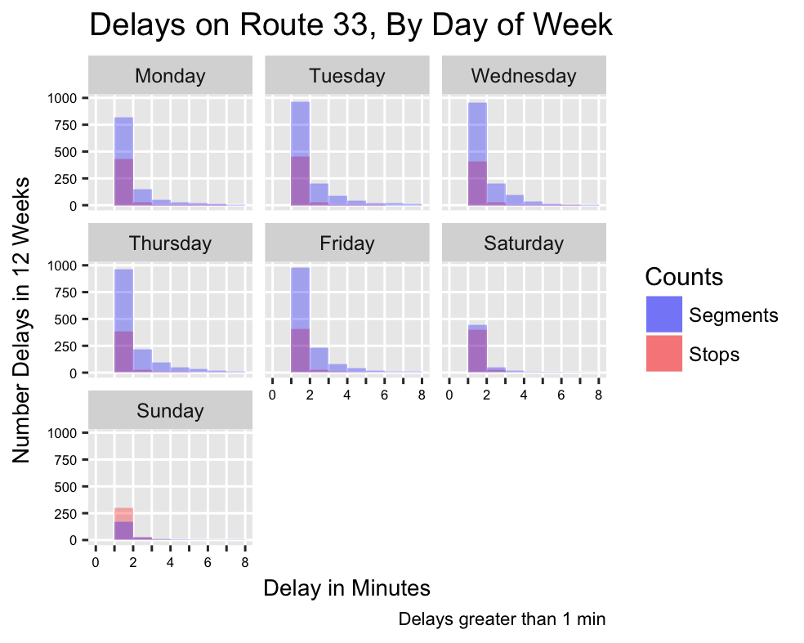
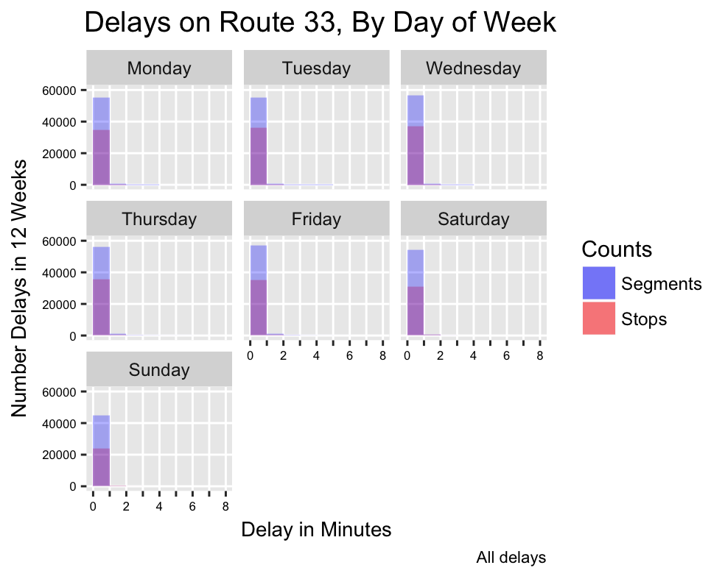


Slide 14
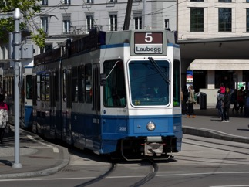
Is exceeding time at a stop really a delay?
scheduled
arrival
scheduled
departure
time
Don’t count early arrival toward delay
Table for each line and stop:
Tally number of delays longer than a threshold
Thresholds: 1,2,3,4,5,6 minutes
Separate the tallies by direction

Slide 15
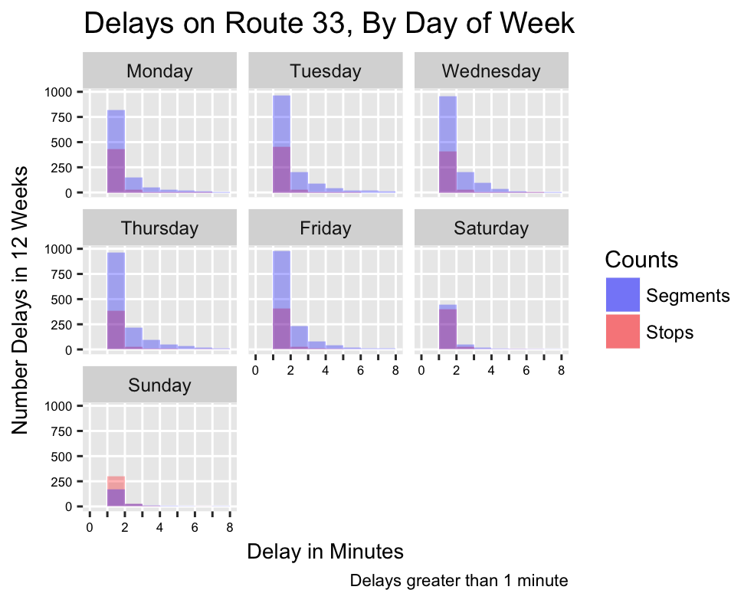
Note: Includes early arrivals

Slide 16

R interface for the Leaflet javascript library:
interactive maps
Leaflet for R
https://rstudio.github.io/leaflet/

Slide 17
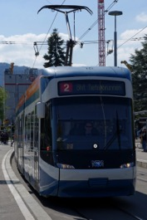
Generate html map widgets with
Leaflet javascript library for R
for (i in lines){
df <- # read a line’s .csv file %>%
# filter out Garages and Depots %>%
# mutate to create a variable that has label information
pal <- colorBin(palette = "Reds", domain=df$del_1_1, 6, pretty = FALSE)
m <- leaflet(df) %>%
addTiles2() %>%
setView(lng=8.5402,lat=47.3778,zoom=12) %>%
addCircles(~lon,~lat, label = ~content, radius = 150, stroke=TRUE, color="Black",
weight=1, fillColor = pal(df$del_1_1), fillOpacity = 0.8) %>%
addLabelOnlyMarkers(~lon,~lat,label = ~content)
m <- m %>%
addLegend("bottomright", pal=pal, values= ~del_1_1,
title = 'Delays > 1 min', opacity =0.8)
saveWidget(widget = m, file= paste("./line_",i,".html",sep=''),selfcontained = TRUE)
}

Slide 18

Let’s look at an R Leaflet widget

Slide 19
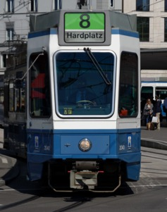
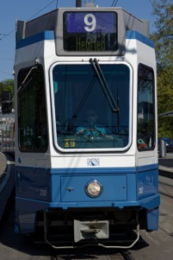
call the widget in an RStudio html_notebook….
```{r echo = FALSE}
m_2 # example name of a widget object
```
Render the notebook from RStudio into html
See it all here:
github.com/OpenDataDayZurich2016/visualization_delays

Slide 20
Thank You
github.com/OpenDataDayZurich2016/visualization_delays

