Slide 1
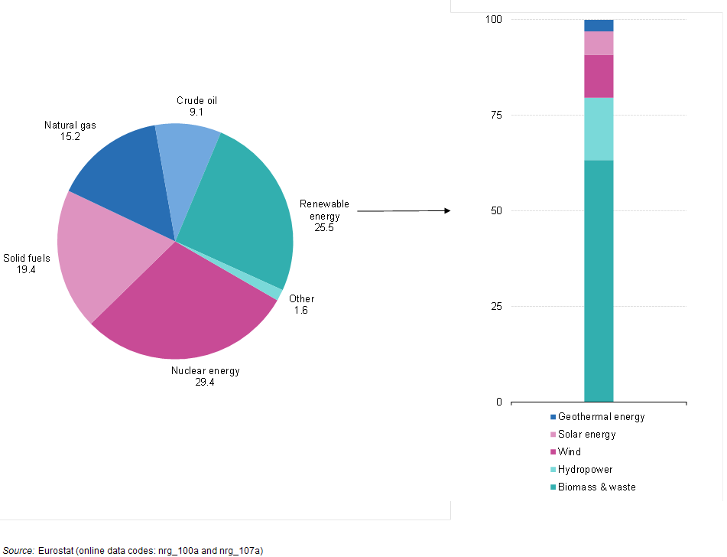
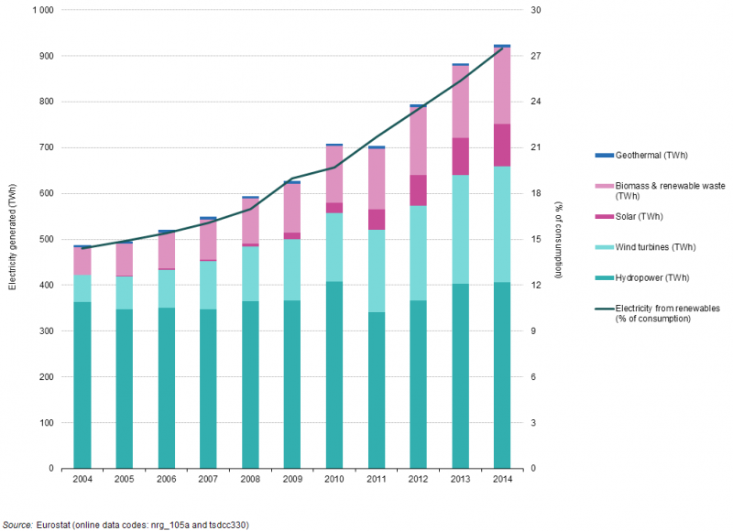
What?
HidroNext: A web application for assisting hydroelectric sector in acquiring and using climate information in decision making processes.
Why?
Hydroelectricity = the most important renewable source in Europe (and worldwide) but…. No climate services being developed at the moment (at least in the R&D programs as Copernicus, H2020,etc.)

Slide 2
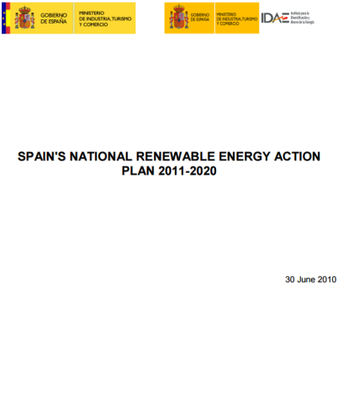

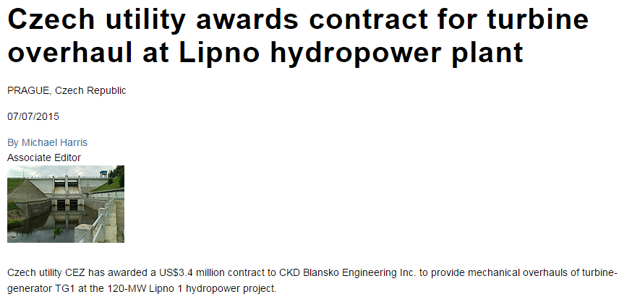

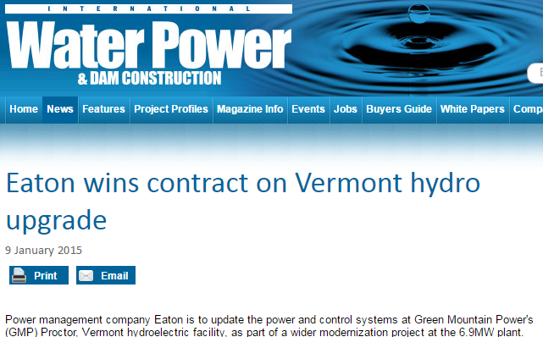
Who?
Engineers, managers, investors, planners, politicians,…
Are these actors using climate information?
Yes…..BUT THE WRONG ONE.
Seasonal forecast and Climate change projections are unknown for them

Slide 3
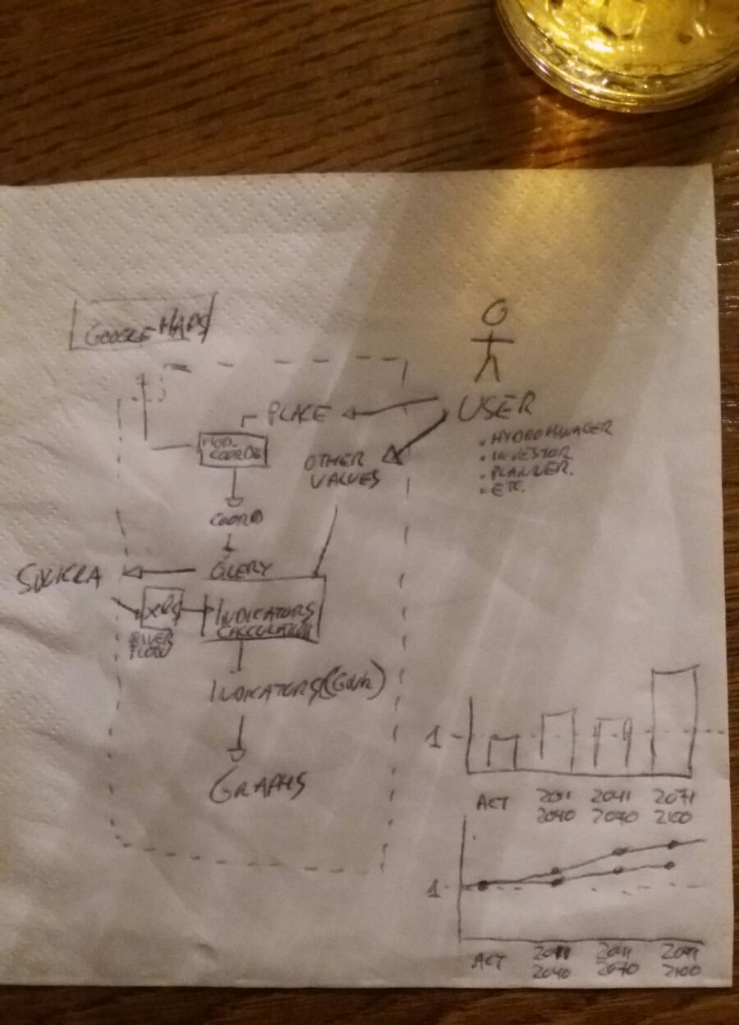
How?
ECMWF Web Coverage Service (WCS)

Slide 4
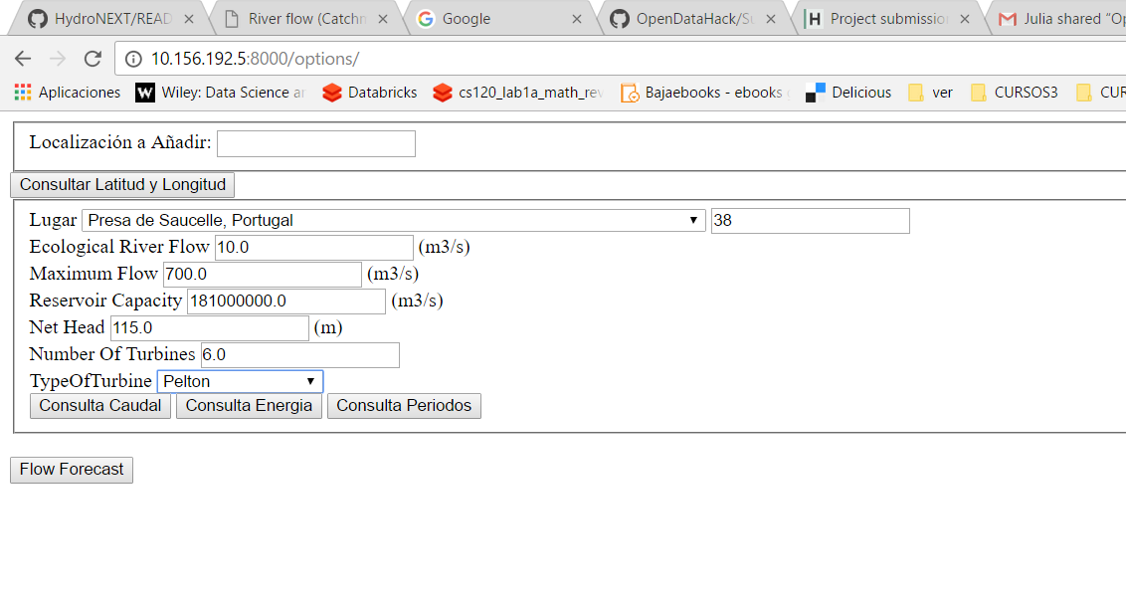
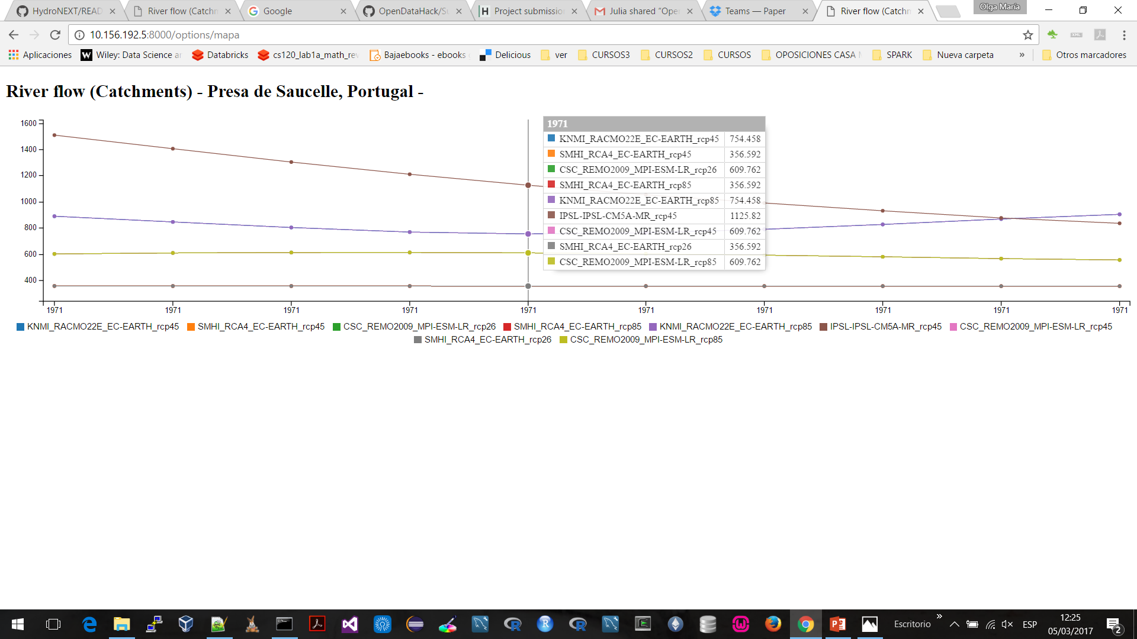
User interface
River flow projections
1970-2100

Slide 5
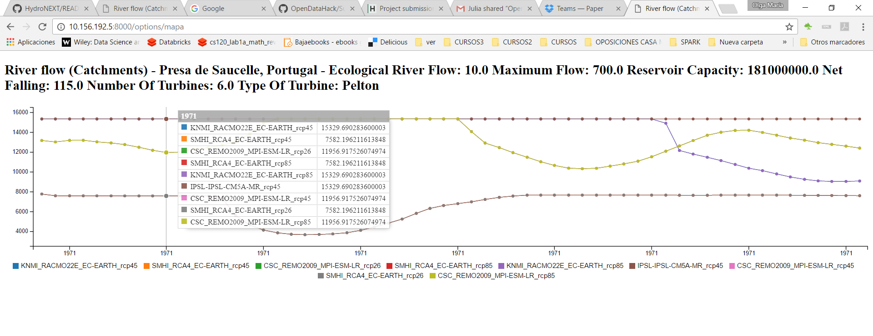
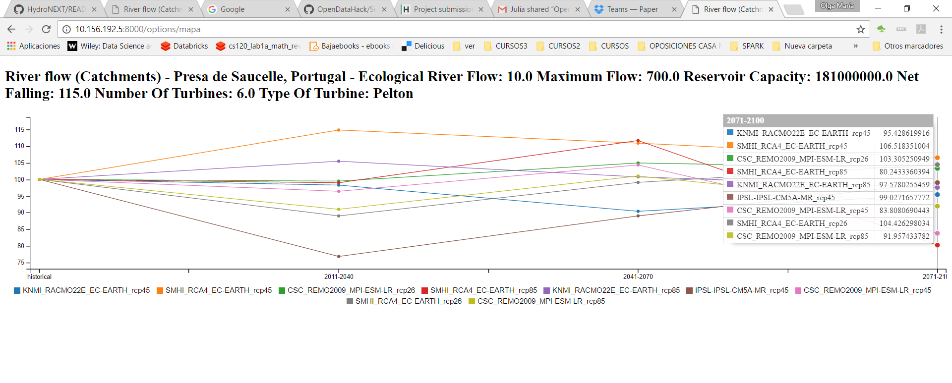
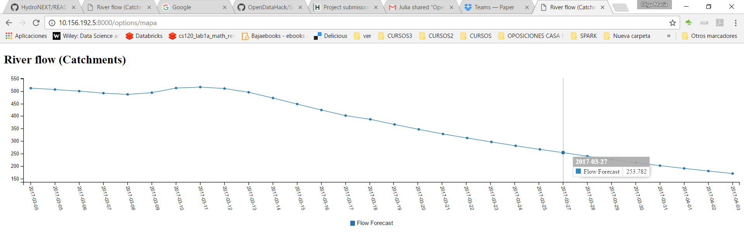
Energy projections
1970-2100
Energy projections
1970-2100
Energy projections
Next 30 days

Slide 6
MARKET
Is there any intelligent life out there?
Client | Project/plant | State/County | Powerl (MW) | Características
Ecuadorian government | Coca-Codo Sinclair | Ecuador: Napo y Sucumbíos | 1.500 | High power run of river. Small reservoir (Daily regulation)
 | Toachi Pilatón | Ecuador: Pichincha, Santo Domingo de los Tsáchilas y Cotopaxi | 253 (+1,4) | 2 plats. Cascade configuration. Half power, One big reservoir (seasonal)
 | Quijos | Ecuador: Napo | 50 | Small run-off river
CAF | Mazar-Dudas | Ecuador: Azuay | 18 | Small run-off river (3x)
 | Paute Mazar | Ecuador: Azuay | 170 | Big reservoirs + high power plants system. Highly interconnected.
 | Paute Molino | Ecuador: Azuay | 1.075
 | Paute Sopladora | Ecuador: Azuay | 487
 | Paute Cardenillo | Ecuador: Azuay | 596
TOTAL ALREADY EXECUTED / IN EXECUTION |  |  | 4.150
OLADE | to be defined | Colombia
 | to be defined | Venezuela
 | to be defined | Ecuador
 | to be defined | Perú
 | to be defined | Bolivia
Demand of studies is emerging but….
Reports (no dynamic applications)
Funded by public institutions
Not in Europe
Let´s go for the European private sector!!!!
How?? Freemium service:
Free access to HydroNEXT
Additional services:

Slide 7
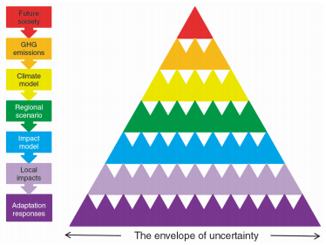
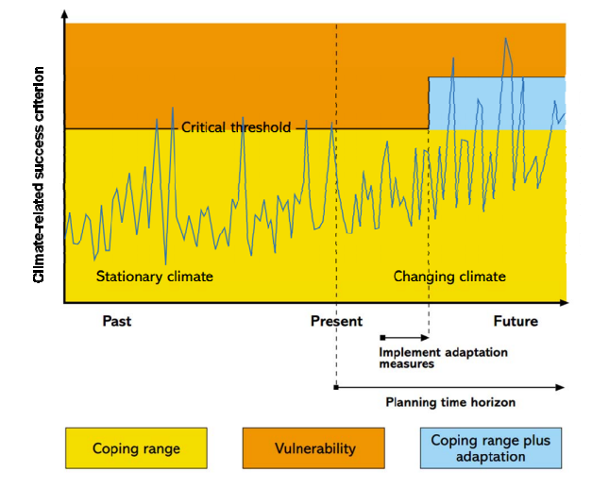
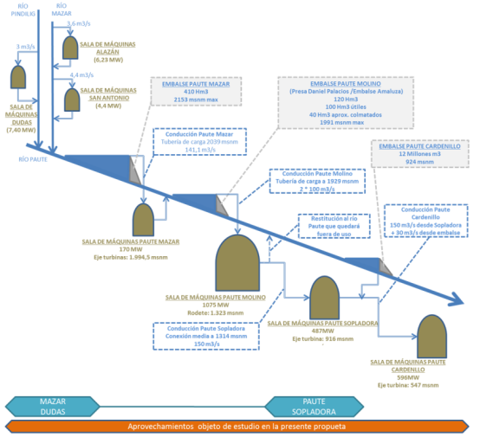
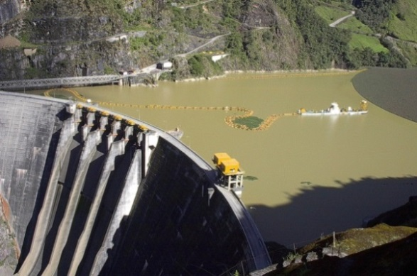
Market (premium services)
HydroNext shows a reduced part of the cascade of uncertainty.
Users needs more “ready to be used” information:
When should I upgrade my plant?
HydroNext can not handle complex systems.
Sediments: Main concern in dams and not provided by Hydronext
7

