Slide 1


Beyond Census Data
Sponsor: Seattle Public Library
Intern: Karalyn Ostler

Slide 2
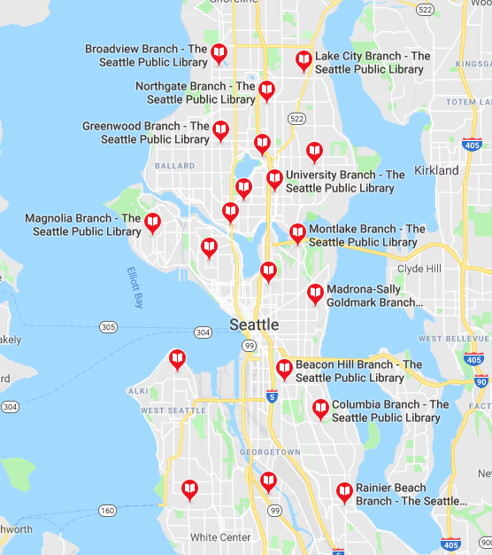
Seattle Public Library (SPL)
Public library system serving Seattle
27 Locations
6 regions
Variety of services and outreach programs
Note: Separate library system than King County Library System

Slide 3
Problem Statement
How can a large public library system like Seattle Public Libraries use open data to help inform staff about services and outreach?
How can open data be transformed into easier to understand materials?

Slide 4
Project Goals
Identify data needs of SPL frontline staff
Identify relevant open datasets related to Seattle and SPL
Create materials using selected datasets for use by SPL staff

Slide 5
Assessing Data Needs: Interviews
2 SPL Regional Managers
Findings:
More granular data
Age
Income
Language Spoken at home
Private Schooling versus Public Schooling

Slide 6
Search for Suitable Open Data
Local Data:
City of Seattle Open Data portal
Washington State Open data portal
Data.gov
US Census Bureau

Slide 7

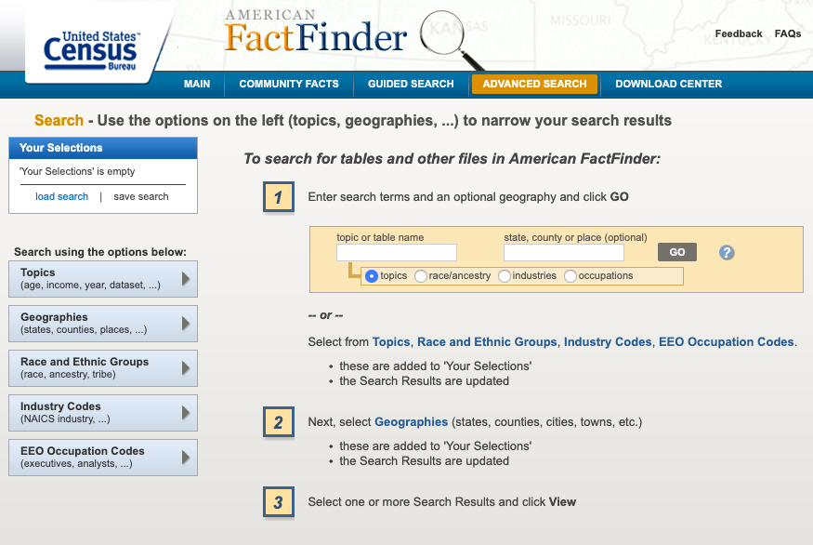
Census Data
Types of Data:
Censuses
Decennial Census
Economic Census
Census of Governments
Surveys
American Community Survey (ACS)
Demographic surveys
Economic surveys
Sponsored surveys
Ways to Get Data:
American FactFinder
API

Slide 8
Working with Census Data
Most recent relevant data: 2017 ACS
Estimates not raw data
Different geographical units
Census Tracts
Census Blocks
API
Table Numbers

Slide 9
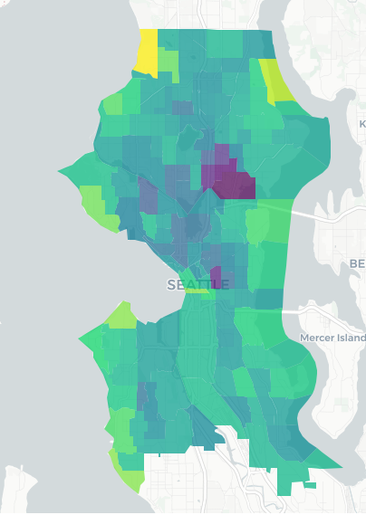
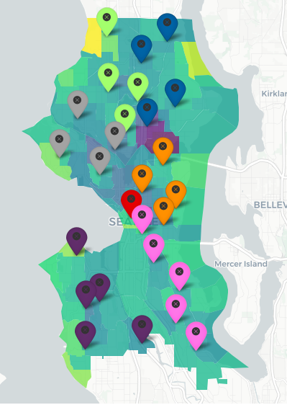
Maps
R and Rstudio
Leaflet Package
Shiny app

Slide 10
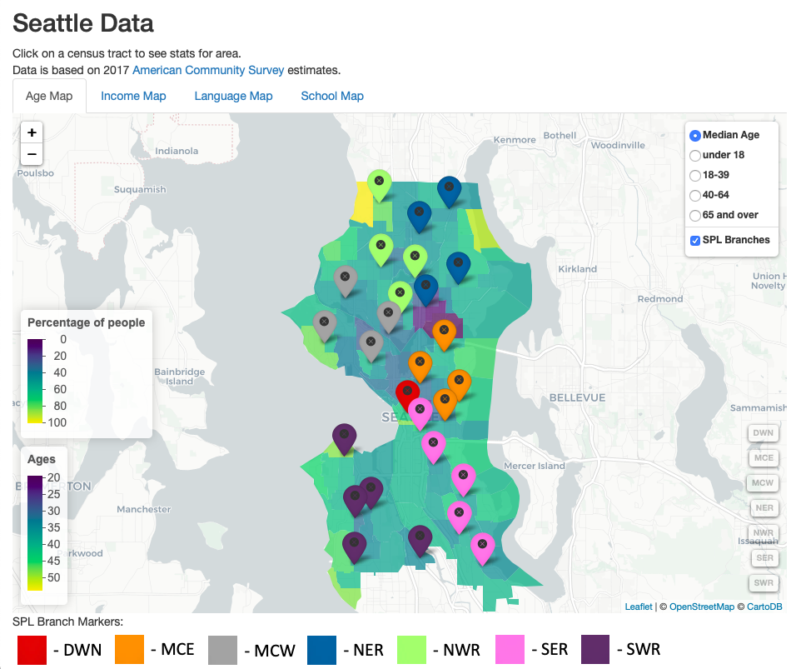
Interactive Maps and shinyapp.io
(Insert picture of finished app)
URL
Browser based
Hosted by Rstudio
Interactive

Slide 11
Internal Datasets
Insert
Picture/Graph
SPL Borrower Data
Age of Borrower
# of active uses of card
Divided by branches
Goal: Compare internal data with findings from external open data

Slide 12
Short Reports
Information about what datasets were found and were not found
Quick stats for each branch in selected regions about topics covered
Maybe an example of the stats?

Slide 13
Final Results
App with data about the community
Short report for each region
Available datasets found
Stats for each branch on topics
Documented code
Available via GitHub repo

Slide 14
Challenges
Keeping the project scale manageable, very easy to try and do too much
First time creating maps, especially interactive maps
Keeping things simple with visualizations, not overwhelming users

Slide 15
Next steps for SPL
Distribute the maps for use by staff
Add other datasets to maps
Update when 2018 ACS data or 2020 Census data available
Collect feedback from frontline staff about maps and reports to see if they have been helpful and how they could be improved

