Slide 1


Beyond Census Data: Using Open Data to Understand Communities Around Public Libraries
Sponsor: Seattle Public Library
Intern: Karalyn Ostler

Slide 2
Open data literacy (ODL)
University of Washington Information School
Works with public institutions to create, manage, and publish open data
Projects range from working with data policy to curating datasets for publication
Mentor: David Christensen, Data Analysis Lead
Questions for this project:
How can a large public library system like Seattle Public Libraries use external open data to help inform staff about the needs of the community to better plan services and outreach?
How can open data be transformed into materials that are accessible and easy to understand?

Slide 3
1
Identify relevant open datasets related to Seattle and SPL
3
Identify data needs of SPL frontline staff
2
Create materials using selected datasets for use by SPL staff

Slide 4
Assessing Data Needs: Interviews
Interviewed two SPL Regional Managers
Northeast Region: Francesca Wainwright
Southeast Region: Wei Cai
Findings:
More granular data
Age
Income
Language Spoken at home
Private Schooling versus Public Schooling

Slide 5





Search for Suitable Open Data
Local Data:
City of Seattle Open Data portal
Washington State Open data portal
Data.gov
Packaged Data in R
US Census Bureau

Slide 6
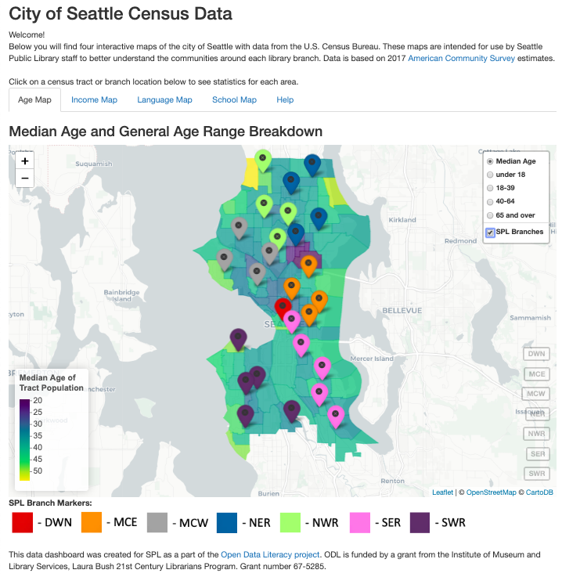
Map Dashboard
URL: https://kostler.shinyapps.io/SPL-Seattle-Census-Data/
Available Maps:
Median Age
Median Household Income
Language Spoken at Home
Student Enrollment Type (private versus public)
Features:
Interactive
Easily accessible

Slide 7
Comparison with Internal Dataset and reports
International District/Chinatown
Dataset: SPL Borrower Data
Divided by branches
# of active uses of card by age of borrower
Age Statistics
Average age of borrower at Branch
Percentage Breakdown:
Under 18
18-39
40-64
Over 65
 | SPL | Census
Average Age | 39.25 | 35.99
Under 18 | 17.04 % | 8.22 %
18-39 | 35.49 % | 53.36 %
40-64 | 35.8 % | 26.25 %
Over 65 | 11.67 % | 12.17 %

Slide 8
Example: NewHolly Branch
Age
Average Median
Age:
38.57 years old
Language
Language | % of the Population within about 1 mile
Only English | 52.64 %
Spanish | 5.89 %
Other Indo-European | 1.39 %
Asian and Pacific Island | 30.35 %
Other Languages | 9.73 %
Age Range | % of the Population within about 1 mile | 2017 % of total Borrowers at branch | 2018 % of total Borrowers at branch
Under 18 | 21.48 % | 30.20 % | 28.37 %
18-39 | 31.37 % | 43.43 % | 44.72 %
40-64 | 33.78 % | 22.62 % | 22.8 %
65 and over | 13.38 % | 3.74 % | 4.11 %
School Enrollment
Type
 | % of the enrolled students within about 1 mile
Grades | Private School | Public School
All grades | 21.63 % | 78.37 %
Preschool | 2.51 % | 6.06 %
K-4 | 3.64 % | 25.53 %
5-8 | 13.02 % | 23.86 %
9-12 | 2.46 % | 22.92 %
Income
Average Median
Household Income:
$ 62,055.27

Slide 9
Example: NewHolly Branch
Age
Average Median
Age:
38.57 years old
Language
Language | % of the Population within about 1 mile
Only English | 52.64 %
Spanish | 5.89 %
Other Indo-European | 1.39 %
Asian and Pacific Island | 30.35 %
Other Languages | 9.73 %
Age Range | % of the Population within about 1 mile | 2017 % of total Borrowers at branch | 2018 % of total Borrowers at branch
Under 18 | 21.48 % | 30.20 % | 28.37 %
18-39 | 31.37 % | 43.43 % | 44.72 %
40-64 | 33.78 % | 22.62 % | 22.8 %
65 and over | 13.38 % | 3.74 % | 4.11 %
School Enrollment
Type
 | % of the enrolled students within about 1 mile
Grades | Private School | Public School
All grades | 21.63 % | 78.37 %
Preschool | 2.51 % | 6.06 %
K-4 | 3.64 % | 25.53 %
5-8 | 13.02 % | 23.86 %
9-12 | 2.46 % | 22.92 %
Income
Average Median
Household Income:
$ 62,055.27

Slide 10
Example: NewHolly Branch
Age
Average Median
Age:
38.57 years old
Language
Language | % of the Population within about 1 mile
Only English | 52.64 %
Spanish | 5.89 %
Other Indo-European | 1.39 %
Asian and Pacific Island | 30.35 %
Other Languages | 9.73 %
Age Range | % of the Population within about 1 mile | 2017 % of total Borrowers at branch | 2018 % of total Borrowers at branch
Under 18 | 21.48 % | 30.20 % | 28.37 %
18-39 | 31.37 % | 43.43 % | 44.72 %
40-64 | 33.78 % | 22.62 % | 22.8 %
65 and over | 13.38 % | 3.74 % | 4.11 %
School Enrollment
Type
 | % of the enrolled students within about 1 mile
Grades | Private School | Public School
All grades | 21.63 % | 78.37 %
Preschool | 2.51 % | 6.06 %
K-4 | 3.64 % | 25.53 %
5-8 | 13.02 % | 23.86 %
9-12 | 2.46 % | 22.92 %
Income
Average Median
Household Income:
$ 62,055.27

Slide 11
Example: NewHolly Branch
Age
Average Median
Age:
38.57 years old
Language
Language | % of the Population within about 1 mile
Only English | 52.64 %
Spanish | 5.89 %
Other Indo-European | 1.39 %
Asian and Pacific Island | 30.35 %
Other Languages | 9.73 %
Age Range | % of the Population within about 1 mile | 2017 % of total Borrowers at branch | 2018 % of total Borrowers at branch
Under 18 | 21.48 % | 30.20 % | 28.37 %
18-39 | 31.37 % | 43.43 % | 44.72 %
40-64 | 33.78 % | 22.62 % | 22.8 %
65 and over | 13.38 % | 3.74 % | 4.11 %
School Enrollment
Type
 | % of the enrolled students within about 1 mile
Grades | Private School | Public School
All grades | 21.63 % | 78.37 %
Preschool | 2.51 % | 6.06 %
K-4 | 3.64 % | 25.53 %
5-8 | 13.02 % | 23.86 %
9-12 | 2.46 % | 22.92 %
Income
Average Median
Household Income:
$ 62,055.27

Slide 12
Final Results
Dashboard with data about the community
Available publicly via https://kostler.shinyapps.io/SPL-Seattle-Census-Data/
Four interactive maps of census data and SPL branches
Short report for each region
Available datasets found
Stats for each branch on topics
Documented code
Available via GitHub repository: https://github.com/OpenDataLiteracy/SPL-KO
Easily adapted by other library systems

Slide 13
Next steps for SPL
Distribute the maps and reports for use by staff
Share maps with SPL Foundation, in annual reports about demographics served by SPL, or even in policy advocacy (e.g. Library Levee that just passed)
Add other datasets to maps
School district data, low-income housing
Update when 2018 ACS data or 2020 Census data available
Collect feedback from frontline staff about maps and reports
Are they helpful? How could they be improved?

Slide 14
Next steps for ODL
Independent Study:
Add a few improvements to maps
Research on other library systems
Write journal article about project
Create Binder instance for R Notebook in GitHub Repo

