Slide 1


Beyond Census Data: Using Open Data to Understand Communities Around Public Libraries
Sponsor: Seattle Public Library
Intern: Karalyn Ostler

Slide 2
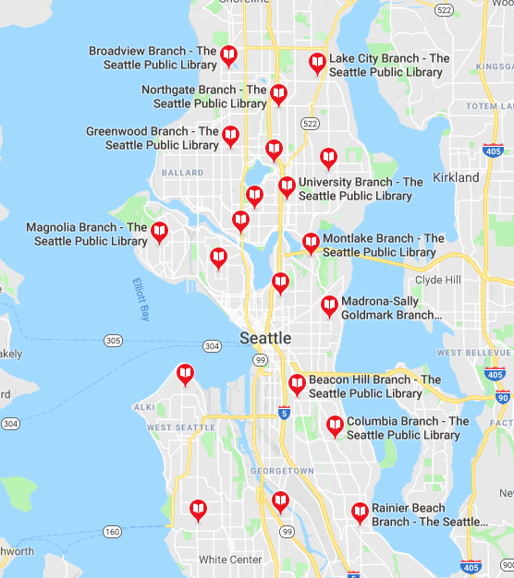
Seattle Public Library (SPL)
Public library system serving Seattle
27 Locations
6 regions
Variety of services and outreach programs
Note: Separate library system than King County Library System
SPL Mentor: David Christensen, Data Analysis Lead

Slide 3
Problem Statement
How can a large public library system like Seattle Public Libraries use external open data to help inform staff about the needs of the community to better plan services and outreach?
How can open data be transformed into materials that are accessible and easy to understand?

Slide 4
Project Goals
Identify data needs of SPL frontline staff
Identify relevant open datasets related to Seattle and SPL
Create materials using selected datasets for use by SPL staff

Slide 5
Assessing Data Needs: Interviews
Interviewed two SPL Regional Managers
Northeast Region: Francesca Wainwright
Southeast Region: Wei Cai
Findings:
More granular data
Age
Income
Language Spoken at home
Private Schooling versus Public Schooling

Slide 6





Search for Suitable Open Data
Local Data:
City of Seattle Open Data portal
Washington State Open data portal
Data.gov
Packaged Data in R
US Census Bureau

Slide 7
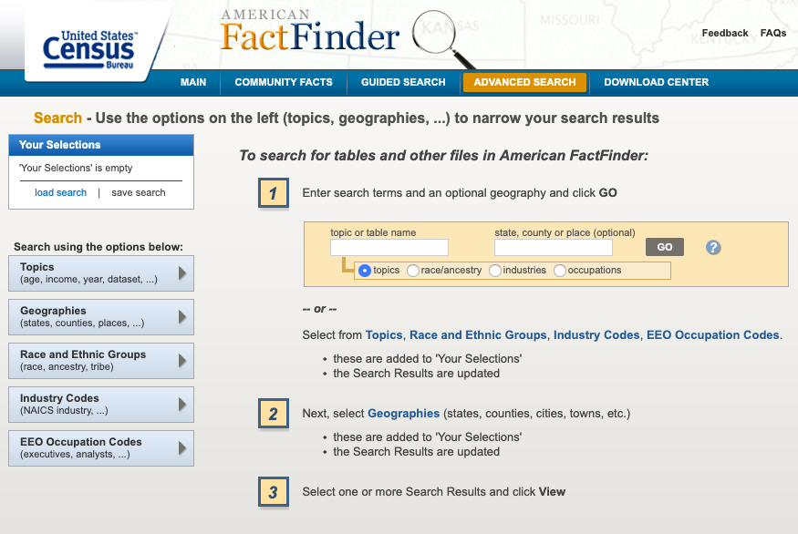
Census Data
Ways to Get Data:
API
American FactFinder
Types of Data:
Censuses
Decennial Census
Economic Census
Census of Governments
Surveys
American Community Survey (ACS)
Demographic surveys
Economic surveys
Sponsored surveys

Slide 8
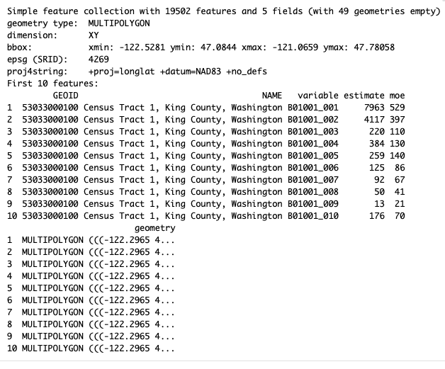

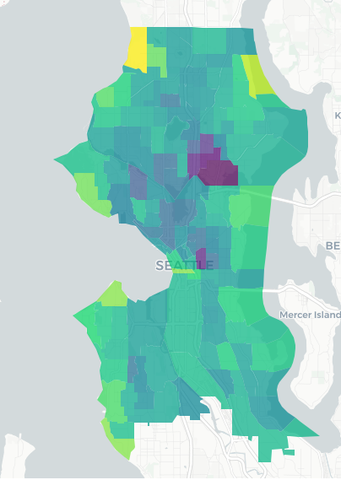
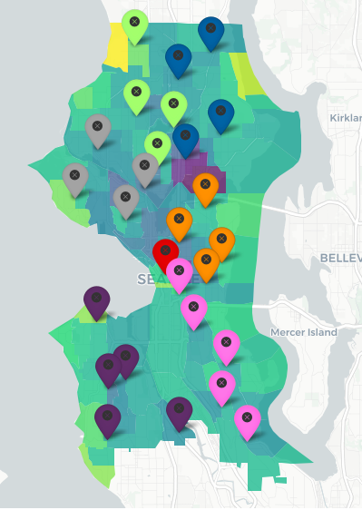
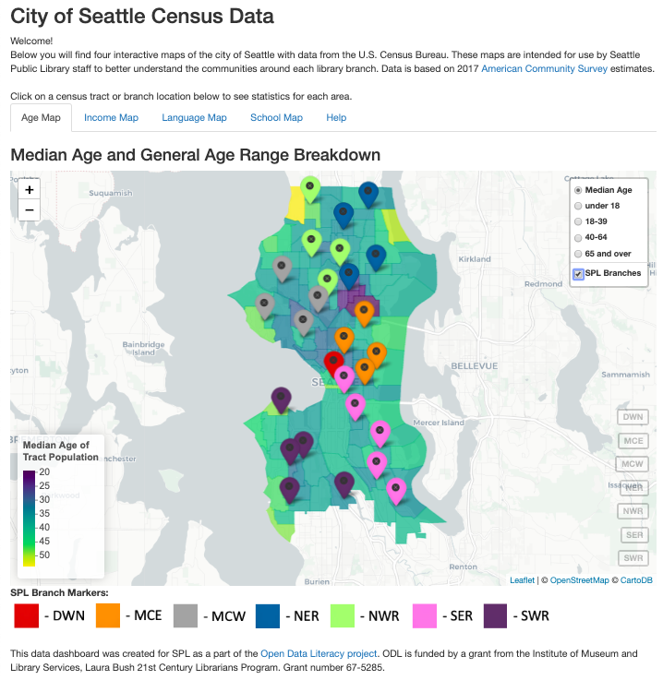
Maps
+
R and Rstudio
Download 2017 ACS data via API
Leaflet package: Create interactive maps
Shiny: Create application for data dashboard
Shinyapps.io: upload dashboard to URL for sharing

Slide 9
Map Dashboard
URL: https://kostler.shinyapps.io/SPL-Seattle-Census-Data/
Browser based
Hosted by Rstudio
Interactive
Code easily modified:
Update with yearly census data releases
Add new data layers
Different city or library system

Slide 10
Comparison with Internal Dataset
Dataset: SPL Borrower Data
Divided by branches
# of active uses of card by age of borrower
Age Statistics
Average age of borrower at Branch
Percentage Breakdown:
Under 18
18-39
40-64
Over 65
Central Library
 | SPL | Census
Average Age | 40.2 | 35.8
Under 18 | 4.0% | 5.9%
18-39 | 52.1% | 56.6%
40-64 | 34.5% | 26.5%
Over 65 | 9.4% | 11.0%

Slide 11
Final Results
Dashboard with data about the community
Available publicly via https://kostler.shinyapps.io/SPL-Seattle-Census-Data/
Four interactive maps of census data and SPL branches
Short report for each region
Available datasets found
Stats for each branch on topics
Documented code
Available via GitHub repository: https://github.com/OpenDataLiteracy/SPL-KO
Easily adapted by other library systems

Slide 12


Sustainability
Open file types and softwares
R and Rstudio
Preferred programming language for sponsor
Good visualization packages
GitHub Repository
All Code
Publicly available
U.S. Census Bureau Data
Federally maintained
Consistent formatting and data releases
Dashboard on shinyapps.io
Can easily be modified for future years’ data
Hosted by RStudio

Slide 13
Challenges
Keeping the project scale manageable, very easy to try and do too much
First time creating maps, especially interactive maps
Keeping things simple with visualizations, not overwhelming users

Slide 14
Next steps for SPL
Distribute the maps and reports for use by staff
Share maps with SPL Foundation, in annual reports about demographics served by SPL, or even in policy advocacy (e.g. Library Levee that just passed)
Add other datasets to maps
School district data, low-income housing
Update when 2018 ACS data or 2020 Census data available
Collect feedback from frontline staff about maps and reports
Are they helpful? How could they be improved?

Slide 15
Next steps for ODL
For this project:
Write journal article about project
Create Binder instance for R Notebook in GitHub Repo
Directed Field Work or Capstone
In general:
Data Science/Coding and Librarians
Using Open data and open data software in an everyday workflow

