Slide 1
Marc Van Achter
ICT Programme Operations Unit
14 Feb 2014
DG Communications Networks,
Content and Technology
H2020 Infoday on e-Infrastructures
H2020 Rules for participation, Proposal guidelines &
Submission procedures

Slide 2
Outline
Guidance and information
H2020 rules for participation
Submit your proposal
Evaluation process

Slide 3
Guidance and information
••• <number>

Slide 4
H2020 Calls
Call and all necessary documentation are published on the Research Participant Portal
_x000b_http://ec.europa.eu/research/participants/portal
User friendly Participant Portal
Easy to find funding opportunities
Interaction with EC services through ECAS login
••• <number>

Slide 5

Home page
Notes:
This is the home page of the new more ergonomic and user-friendly Participant Portal.
(It does not include yet H2020 information because we thought of going public with it well before the launch of the first H2020 calls, but we could update it with the H2020 information before the Cabinet meeting though)

Slide 6

Funding opportunities landing page
Notes:
This is the Funding Opportunities landing page. The text gives a short overview of the information that a user can find in this section and some priority highlights of H2020. When clicking, for instance, on the link "SME instrument" in the text, a user will access directly a specific page with all the related topics of open calls.
The left hand menu gives targeted entry points both for old and new users: the experienced user finds an opportunity to go directly to the calls of specific parts of H2020, and the new user can click on "Search topics" and search funding opportunities just with free keywords, without having to know the structure of the programme.

Slide 7
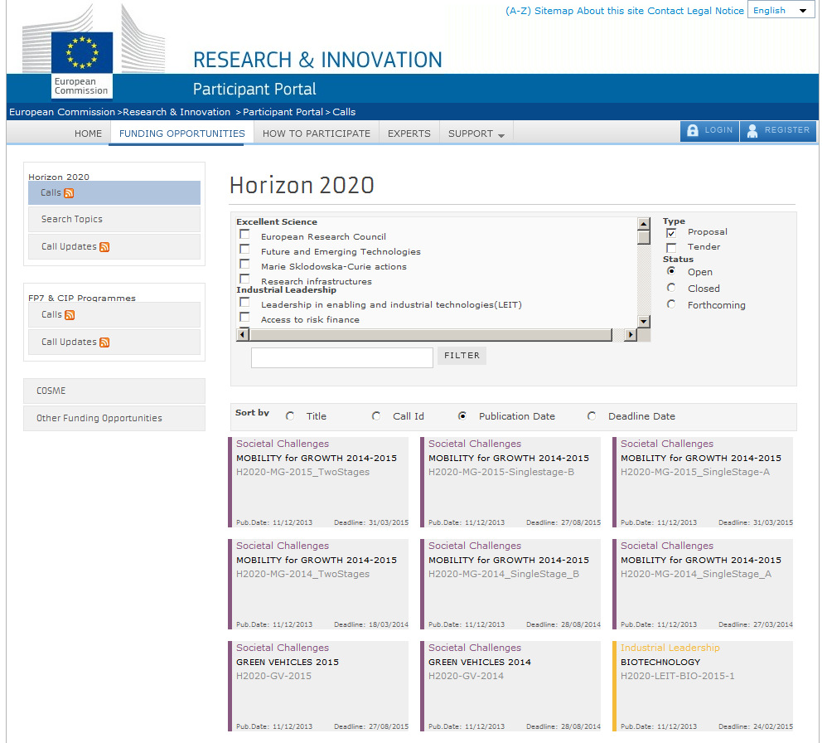
Horizon 2020 calls
Notes:
This is the H2020 Calls page. The Calls are presented as clickable "cards" that lead to the call details. When landing on the page the user will see all the open calls in the order of their publishing dates, but he or she has also the possibility to see forthcoming and open calls when filtering accordingly. The user can also filter calls by programmes and themes.

Slide 8

Search topics
Notes:
This is the page for newcomers that allows searching for call topics by free keywords without having to know the structure of the programme. In addition, the users can also access topics with predefined horizontal priorities for easy access to all topics involving the SME instrument, international cooperation opportunities, gender issues, etc. Each item will have a "tool tip" that explains it shortly, e.g. KETs including advanced manufacturing technologies, photonics, nanotechnologies, advanced materials, micro/nanoelectronics, and biotechnology.

Slide 9
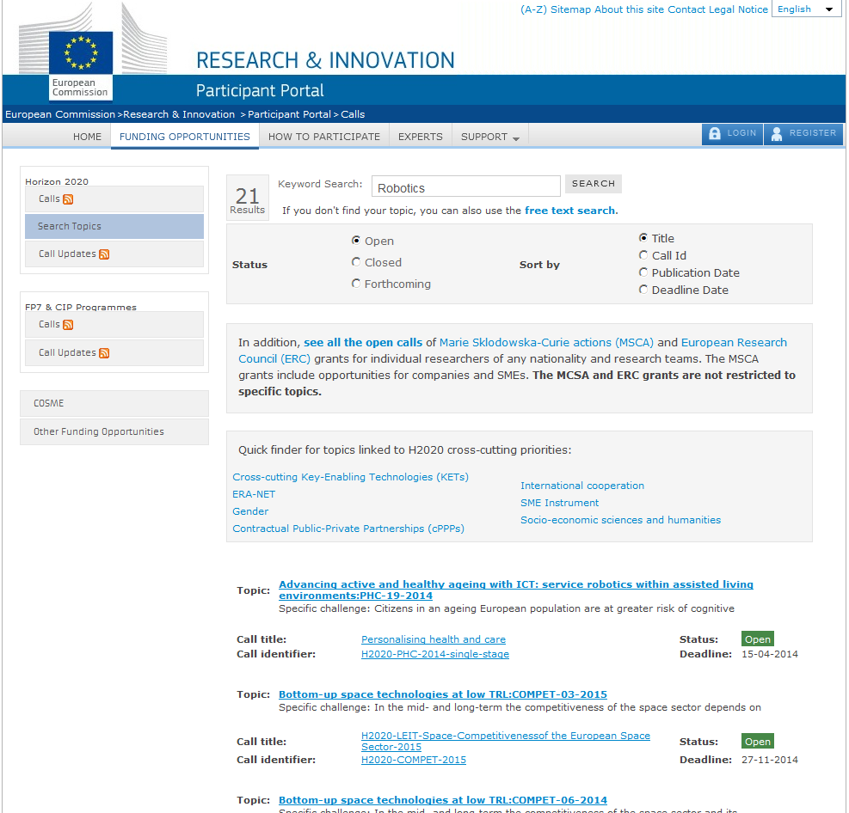
Notes:
This is the page of results that the user gets after searching with the key word "climate change". It is a list of topics (result of a Google-like search) from all open calls with relevance for the free search term "climate change"(search in the full text and in the metadata – tags). If he or she finds a topic of interest, the user can get more detailed information when clicking on the topic title. It is also possible to see the Call information when clicking on the call identifier.

Slide 10
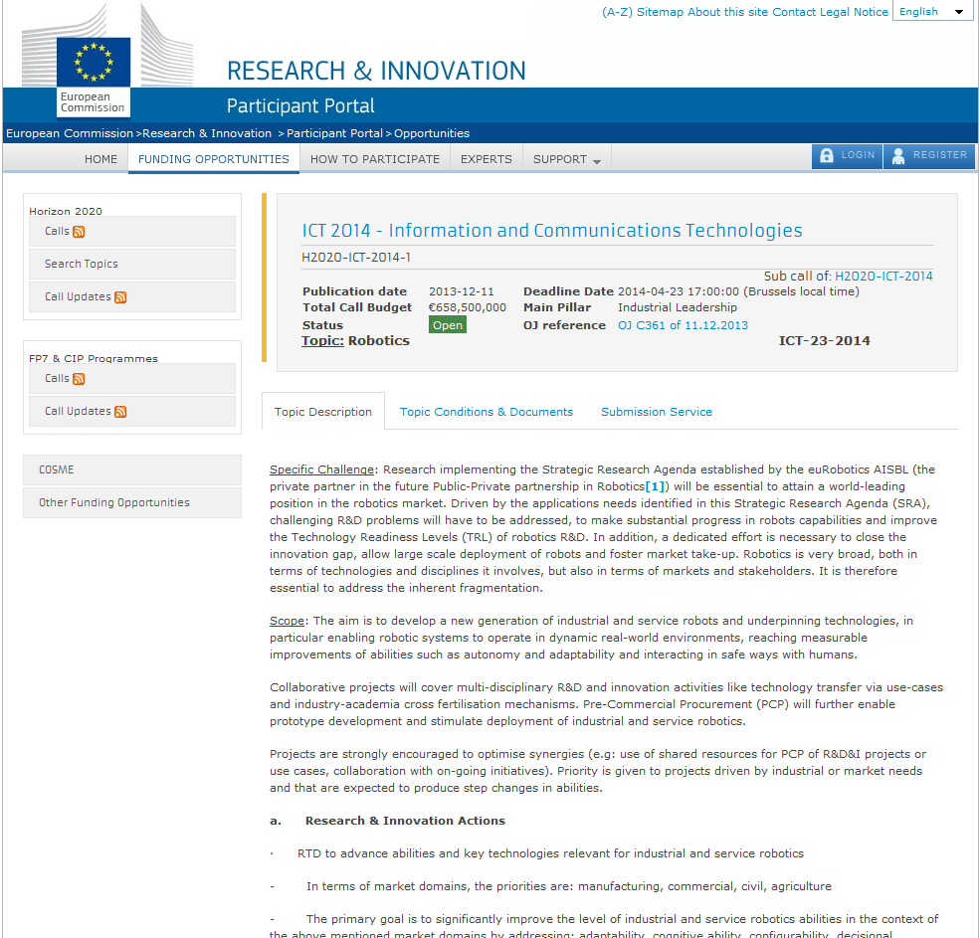
Horizon 2020 calls – Topic details: topic description
Notes:
This is the topic details page presenting all information necessary to prepare a proposal for the topic (specific challenge, scope of projects and their expected impact).
The button Call Documents takes you back to the Call page – section Call Documents that is the information package, including submission rules and guide for applicants among other key documents for proposals. The eligibility and evaluation conditions of the topic are available under "Topic Conditions" leading to the following section of the same page.

Slide 11
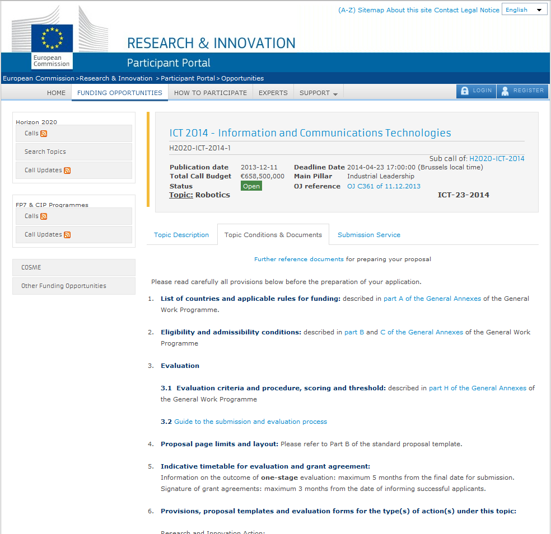
Horizon 2020 calls – Topic details: topic description
Notes:
This is the topic details page presenting all information necessary to prepare a proposal for the topic (specific challenge, scope of projects and their expected impact).
The button Call Documents takes you back to the Call page – section Call Documents that is the information package, including submission rules and guide for applicants among other key documents for proposals. The eligibility and evaluation conditions of the topic are available under "Topic Conditions" leading to the following section of the same page.

Slide 12
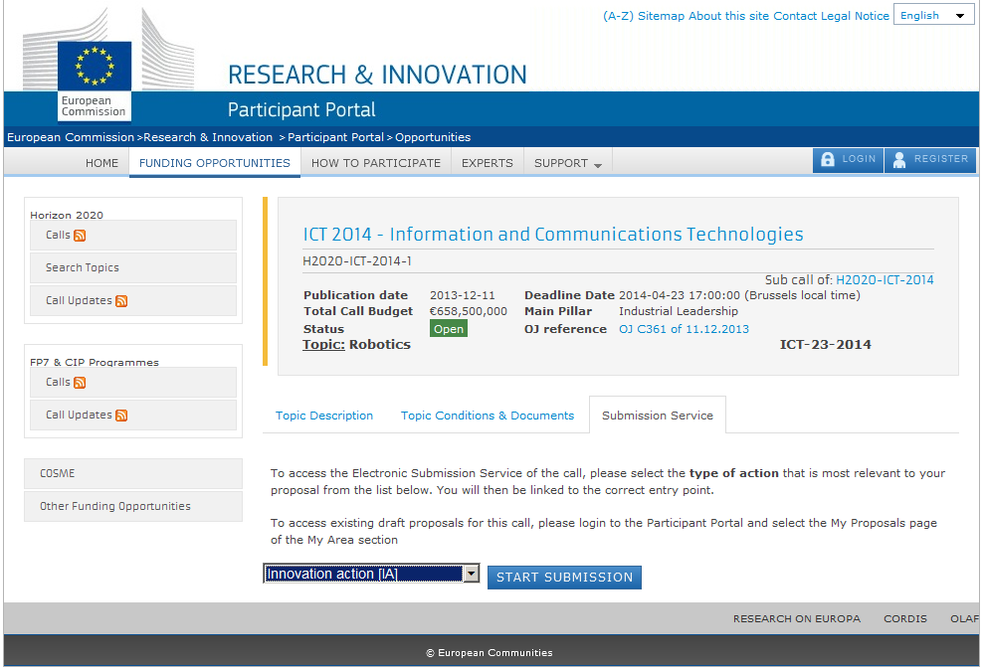
Horizon 2020 calls – Topic details: submission service
Notes:
Clicking on the button Submission Service leads to the page for accessing the submission tool. The hanging menu allows choosing one of the type of action of the topic, push the button Start Submission and enter the electronic proposal forms.
We will go once again back to the search topics page now.

Slide 13
H2020 rules for participation
••• <number>

Slide 14
Forms of funding
Grants
Research and innovation actions
Innovation actions
Coordination and support actions
SME instrument
Programme co-fund
  ERANET co-fund
  Pre-commercial procurement co-fund
  Public procurement of innovative solutions co-fund
Other
Framework Partnership Agreement
Prizes, procurement, financial instruments
••• <number>

Slide 15
Conditions for participation
Minimum conditions
  For standard collaborative actions (RIA and IA)
    3 legal entities, each established
    in different Member State or Associated country
  For CSA
    1 legal entity
  For SME instrument and programme co-fund
    1 legal entity established in a MS/AC
Additional conditions
  To be set out in the Workprogramme
  (i.e. number of participants, type of participants, etc.)

Slide 16
Eligibility for funding
Entities established in Member State, Associated country or third country identified in the WP
Entities created under Union law
International European interest organisation
Other entities may receive funding if:
  participation is essential or
  such funding foreseen in bilateral arrangement between the Union and third country/international organisation

Slide 17
Simplified Funding Model
1 reimbursement rate by action
(same rate for all beneficiaries and all activities):
  Up to 100% for Research and Innovation actions and CSAs
  Up to 70% for Innovation actions (non-profit entities up to 100%)
  and Programme co-fund actions
  WP to specify the reimbursement rate
  (e.g. 33% for ERANET co-fund)
1 method for calculation of indirect costs:
  Flat rate of 25% of total direct costs, excluding subcontracting, costs of third parties and financial support to third parties
  If provided in WP, lump sum or unit costs
Funding of the action cannot exceed total eligible costs minus receipts

Slide 18
Submit your proposal
••• <number>

Slide 19

Electronic Submission
Electronic Submission System accessed from the call page
ECAS password
Participant Identification Code (PIC) compulsory for all partners
Prepare proposal
  On-line for structured part – Administrative forms
  Upload non-structured part – Technical annex - pdf files
Validation checks
Submit the proposal before the 17h00 deadline
Submission failure rate = + 1%
Only reason for failure: waiting till the last minute
    Technical problems
    Panic-induced errors (uploading the wrong proposal)
    Too late starting upload, run out of time
••• <number>

Slide 20
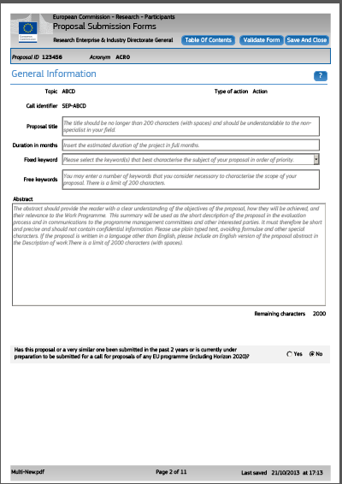
Administrative forms 1/2
Section 1: General information
  Title, acronym, topic, etc.
  Fixed and free keywords
  2000 character proposal abstract
  Previous/current submission
  Declarations
Section 2: Participants & contacts
(one form per partner)
  PIC to identify the partner
  Department
  Dependences
  Contact information
••• <number>

Slide 21
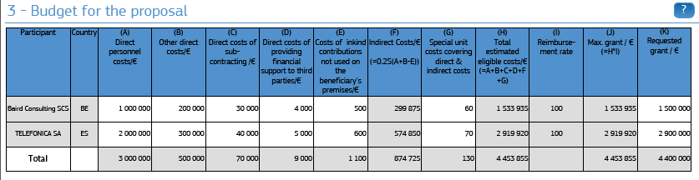
Administrative forms 2/2
Section 3: Budget and requested grant
Section 4: Ethics' questionnaire
Section 5: Call specific questions
  Clinical trial, Stage 2, SME instrument, Open Data Pilot, ERANET, PCP, PPI
••• <number>

Slide 22
Technical annex – 2 pdf files 1/2
1st PDF: Sections 1-3
Based around evaluation criteria:
Section 1: Excellence
  E.g. Objectives, concept, progress beyond state-of-art,...
Section 2: Impact
  E.g. Potential impact (incl. with reference to WP); measures to maximise impact (dissemination, communication, exploitation)
Section 3: Implementation
  Including work packages descriptions
  Information on third parties and subcontractors

Slide 23
Technical annex – 2 pdf files 2/2
2nd PDF: Sections 4-5
Section 4: Members of the consortium
Section 5: Ethics and Security
Templates supplied by the submission system and
available on Participant Portal (under topic conditions)

Slide 24
Submission in H2020
  Simpler but tougher page limits:
  - 70 pages for RIA and IA full proposals
  - 50 pages for CSA
  - also for SME Instrument, PCP, PPI, ERANET co-fund,...
  applies to sections 1-3 of Technical Annex (1st PDF)
  check page limit in topic conditions or proposal template
  “warn and watermark” in first round of calls
  Self-check for SME status, financial viability

Slide 25
Successful electronic submission
For calls with
fixed deadline
Each submission overwrites the previous one
Make an early submission to check out the procedure and your proposal
Make your final submission in good time ...
... then look at what you submitted while there is still time to resubmit a correct version
Never (ever!) plan to submit in the last 30 minutes
of the call!
If in trouble,
immediately call the submission service helpdesk
••• <number>

Slide 26
Evaluation process
••• <number>

Slide 27
Evaluation process
Eligibility
Check?
yes
Individual
Reading
(Remote)
Consensus
Panel review
Process monitored by independent experts
••• <number>

Slide 28
…but adapting to Horizon 2020
Coherence across the programme
New types of call; new types of proposals
  multi-disciplinary and multi-sectorial; more emphasis on innovation and close-to-market
Simplification, for applicants, experts, and for streamlined operations;
    8 months time to grant:
      5 months to inform applicants on evaluation outcome
      3 months for finalising + signing grant

Slide 29
Evaluation of proposals
  Evaluation to be carried out by independent experts
Award criteria
  Excellence
  Impact
  Quality and efficiency in the implementation
  Details, weightings and thresholds are described in the Workprogramme

Slide 30
Selection criteria
  Operational capacity (no specific provisions)
Operational capacity means that the applicants must have the professional competencies and qualifications required to complete the proposed action or work programme: it may be assessed on the basis of specific qualifications, professional experience and references in the field concerned.
  Financial capacity
  Only coordinator of actions equal or superior 500 kEUR, except specific cases
  No verification for public bodies , entities guaranteed by MS or AC and higher and secondary education establishments

Slide 31
Scoring/weights/thresholds
As in FP7: each criterion scored out of 5;
individual threshold of 3; overall threshold of 10
Unlike FP7: for Innovation Actions and SME instrument…
  impact criterion weighted by factor of 1.5
  impact considered first when scores equal
Any deviations are mentioned in the call fiche of the Workprogramme

Slide 32
Selection of proposals
All above threshold proposals in each topic are listed in descending order of overall score
We select proposals starting from
the top of the list,
until the available budget is exhausted
So, ranking of proposal is very important
••• <number>

Slide 33

Experts
Appropriately qualified individuals may apply to work as experts in H2020 evaluations
Application via
Participant Portal
Selection per call to ensure
broad ranging and expert
group; avoiding conflicts of interest
    Call for experts opened
••• <number>

Slide 34

••• <number>

