Slide 1
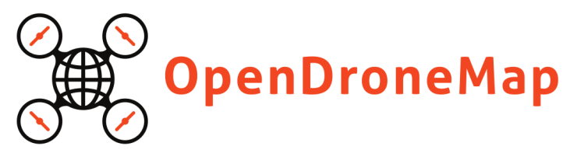
Stephen Mather
GIS Manager, Cleveland Metroparks

Slide 2
OpenDroneMap is an open source toolkit for aerial drone imagery. It is modern photogrammetry - fully automated matching, digital surface model, and mosaicking, including stitching and blending.

Slide 3
OpenDroneMap
https://www.youtube.com/0UctfoeNB_Y

Slide 4
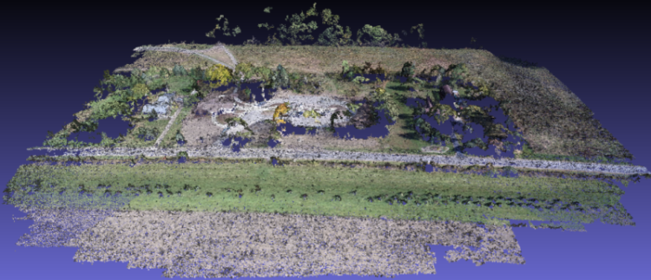
Point Cloud

Slide 5
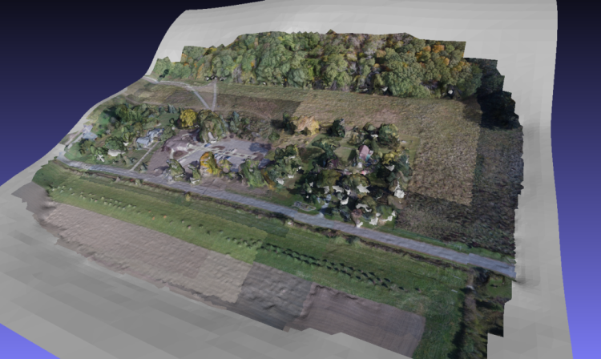
Textured Mesh

Slide 6
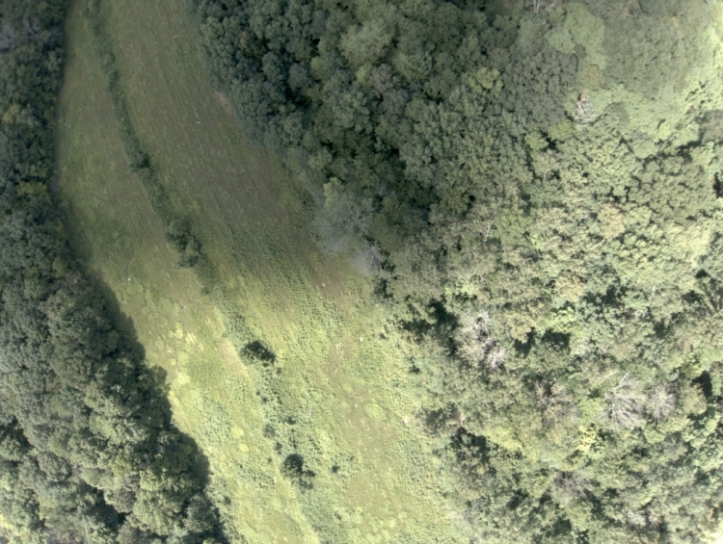
Raw Images

Slide 7
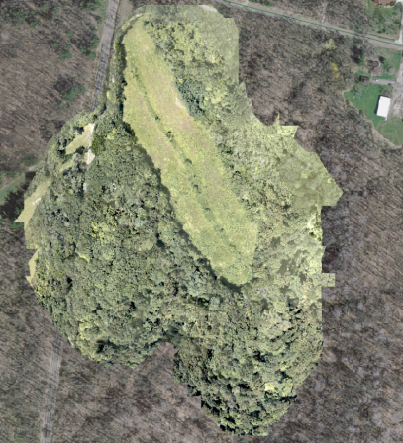
Completed 2D Orthomosaic

Slide 8

Portable OpenStreetMap (POSM) Integration
https://tinyurl.com/OpenDroneMap-POSM

Slide 9
OpenDroneMap is an open source toolkit for aerial drone imagery. It is modern photogrammetry - fully automated matching, digital surface model, and mosaicking, including stitching and blending.

