Slide 1
Learning Intents behind Interactions with Knowledge Graph for Recommendation
www’21
CCF A
”: 30
In this study, we explore intents behind a user-item interaction by using auxiliary item knowledge, and propose a new model, Knowledge Graph-based Intent Network(KGIN)
Furthermore, we devise a new information aggregation scheme for GNN.

Slide 2


问题描述
交互信息
知识图谱
问题描述
给定交互信息和知识图谱，得到一个模型用于预测用户对商品的感兴趣程度。

Slide 3
主流方法
特征工程
MLP
神经网络
原始向量
embedding向量
输出概率
图神经网络
图神经网络
原始向量+知识图谱
输出概率
两个方面建模效果差
用户意图
关系路径

Slide 4
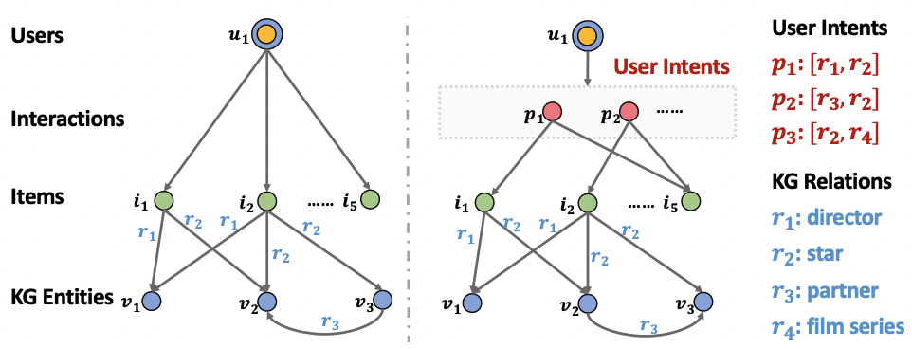
用户意图
意图
用户
物品

Slide 5
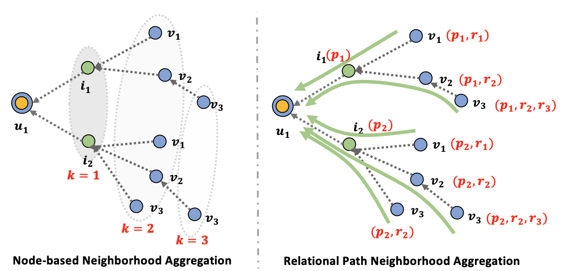
关系路径
仅考虑节点信息
考虑关系信息

Slide 6
Knowledge Graph-based Intent Network
User Intent Modeling
Each user-item interaction is enriched with the underlying intents.
Relational Paths
This relational modeling allows us to identify influential intents and encode relation dependencies and semantics of paths into the representations.

Slide 7
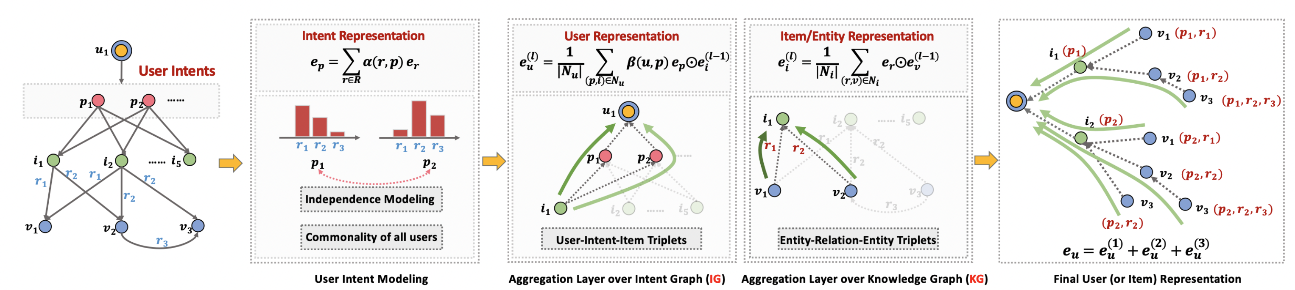

Knowledge Graph-based Intent Network
User Intent Modeling
Representation Learning of Intents.
Independence Modeling of Intents.
Relational Path-aware Aggregation
Aggregation Layer over Intent Graph.
Aggregation Layer over Knowledge Graph.
Capturing Relational Paths.
Model Prediction
Final User Representation.
Predict how likely the user would adopt the item:

Slide 8
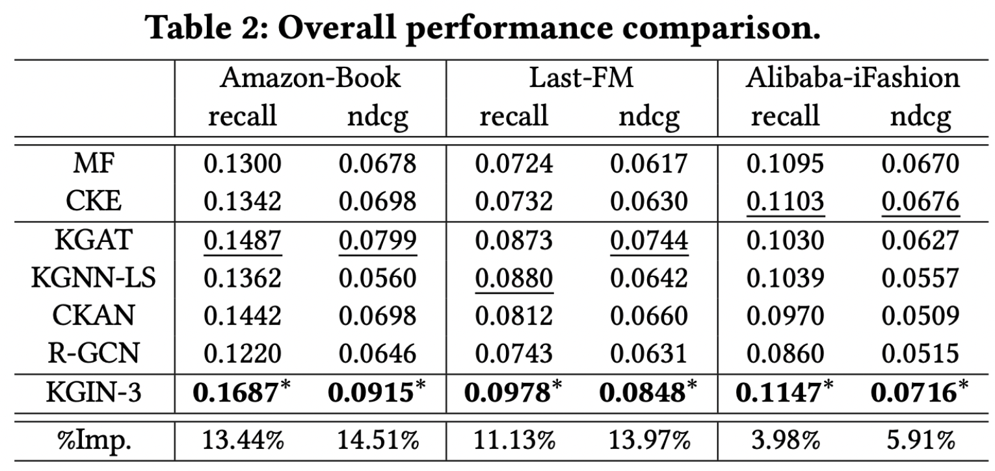
EXPREMENTS
KGIN consistently outperforms all baselines across three datasets in terms of all measures.
The improvement on Amazon-Book is more significant than that on Alibaba-iFashion.

Slide 9
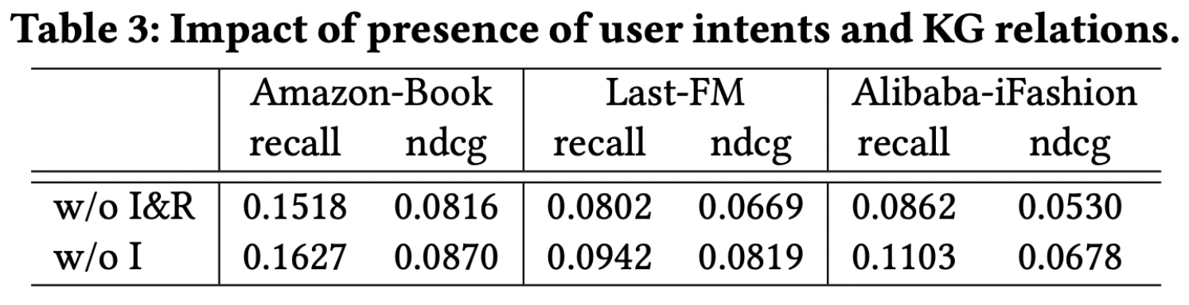
EXPREMENTS
removing all relations dramatically reduces the predictive accuracy, indicating the necessity of relational modeling.
“w/0 I” only considers coarser-gained preference of users and thus leads to suboptimal user representations.

Slide 10
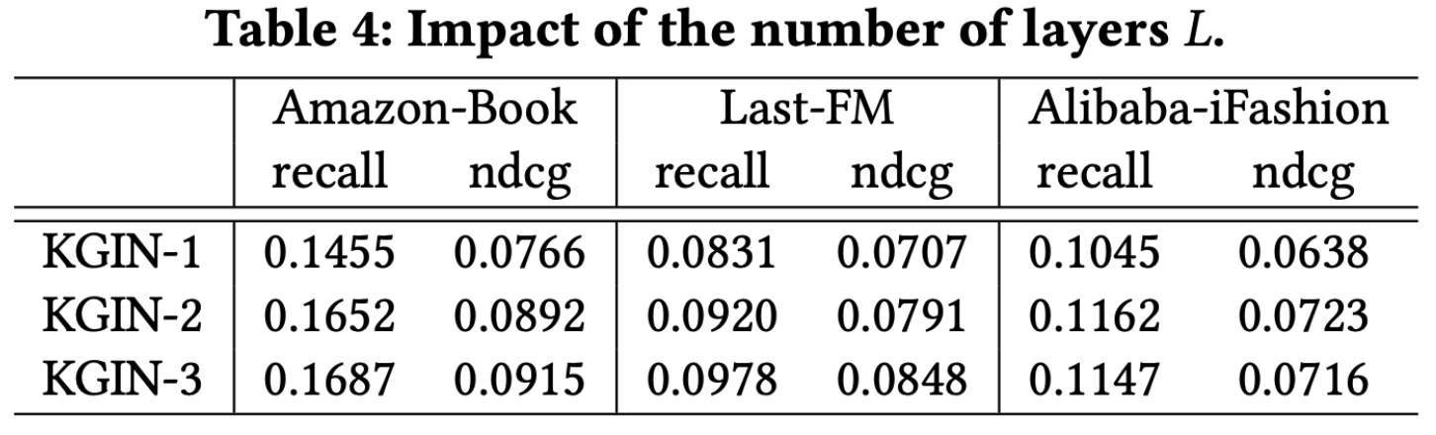
EXPREMENTS
Increasing the model depth is able to enhance the predictive results in most cases.
Some dataset is not suitable for long range connectivity.

Slide 11
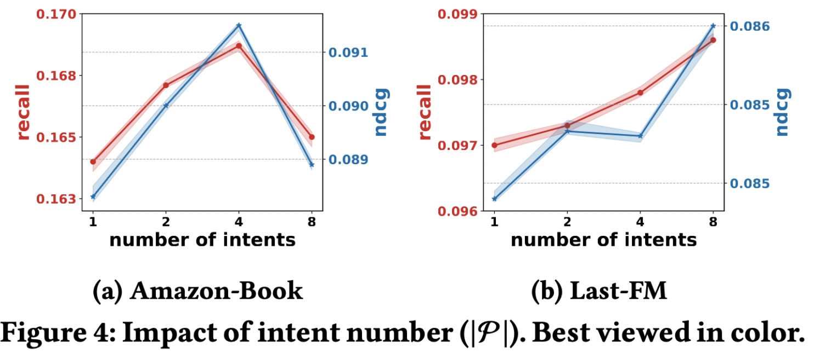
EXPREMENTS
Increasing the intent number enhances the performance in most cases.
In Amazon-Book, continuing one more partition beyond |P | = 4 impairs the accuracy.

