Slide 1
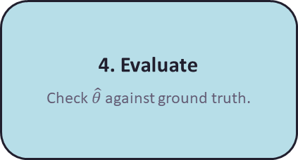
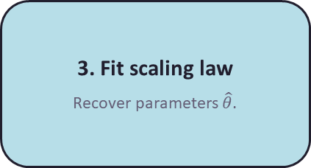
Budget grows each round up to given limit.
1. Data acquisition
Select and measure points,
spend up to budget B.
2. Fantasize points
Fit a surrogate and predict loss across the grid.
3. Fit scaling law
Recover parameters $\hat{θ}$.
4. Evaluate
Check $\hat{θ}$ against ground truth.

