Slide 1
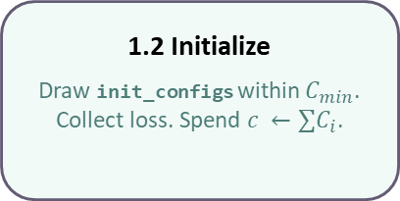
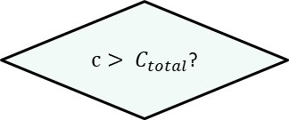
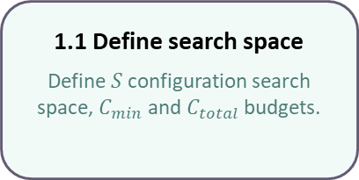
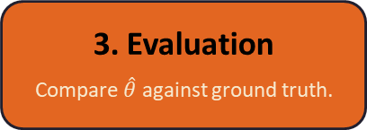
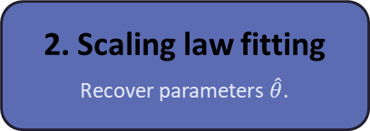
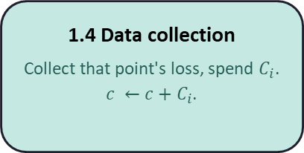
1.1 Define search space
Define $S$configuration search space, $C_{min}$ and $C_{total}$ budgets.
1.2 Initialize
Draw init_configs within $C_{min}$. Collect loss. Spend $c ←∑C_{i}$.
1. Data acquisition
1.3 Next point selection
Pick one point to acquire next
based on selection strategy.
1.4 Data collection
Collect that point's loss, spend $C_{i}$.
$c ←c+C_{i}$.
1.5 Fantasize extended configuration space
Fit a surrogate model and predict loss across the remaining configuration space.
No
$c> C_{total}$?
Yes
3. Evaluation
Compare $\hat{θ}$ against ground truth.
2. Scaling law fitting
Recover parameters $\hat{θ}$.

