Slide 1
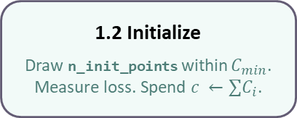
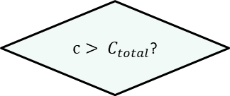
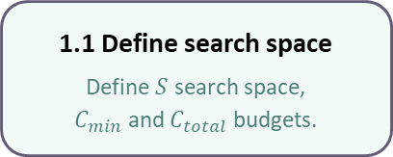

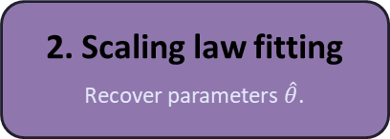
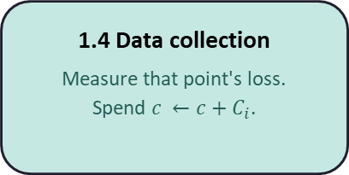
1.1 Define search space
Define $S$ search space,
$C_{min}$ and $C_{total}$ budgets.
1.2 Initialize
Draw n_init_points within $C_{min}$. Measure loss. Spend $c ←∑C_{i}$.
1. Data acquisition
1.3 Next point selection
Pick one point to acquire next
based on selection strategy.
1.4 Data collection
Measure that point's loss.
Spend $c ←c+C_{i}$.
1.5 Fantasize
Fit a surrogate and predict loss
for remaining points.
(optional)
$c> C_{total}$?
No
Yes
3. Evaluation
Compare $\hat{θ}$ against ground truth.
2. Scaling law fitting
Recover parameters $\hat{θ}$.

