Slide 1
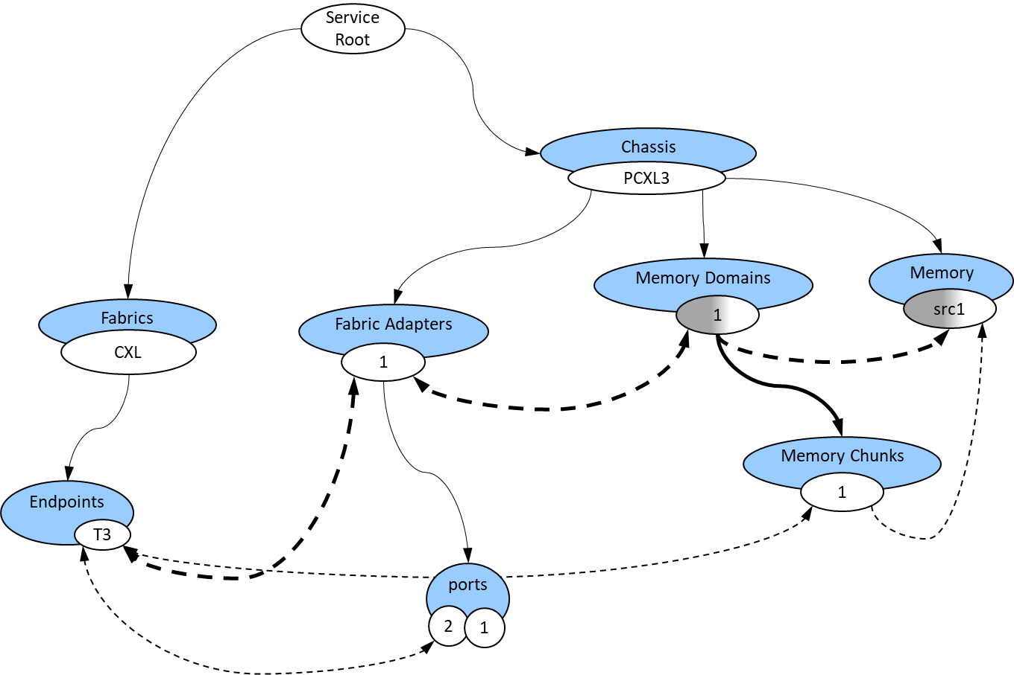
Sunfish Clients see abstracted Fabric Attached Resource objects
Sunfish Services manages the Redfish models of all resources from multiple hardware Agents
Sunfish Agents hide the hardware specifics by creating appropriate Redfish models of resources
Sunfish Services
Users, Apps, utilities, monitors, Resource Managers or Admins
Hardware Specific Agent
Hardware
Managers
Specific
HW
RESTful API (RF/SF)
Sunfish defines the policies that Agents follow when creating resource models so that Clients know how to interpret and manipulate them
Notes:
Sunfish purpose block diagram

Slide 2
Clients
Composability and Resources Managers
Sunfish Core Services
Sunfish Agents
Hardware Managers
CXL HW
CXL Hardware Manager(s)
CXL HW
Composability Services
Sunfish Services
CXL
Agent
App driven system reconfiguration
Fabric Resources
Monitoring
Resource Inventory
Application Domain
Composition
Policies
NVMe-oF Hardware Manager
NVMe
HW
RF tree management
NVMe-oF Agent
Resource Managers
(e.g., Compute, FAM, Storage, Fabric)
Resource Configuration
API
Fabric Configuration
API
Infiniband
Hardware Managers
Infini-Band
HW
RESTful API (RF/SF)
InfiniBand
Agent
Authentication
Systems composition,
Systems update
Access Control
Events
Events & Logs
Events & Logs
Events
Other
Hardware managers
otherHW
Data Store
Additional
Agents
Data Store
Administration Domain
Infrastructure management
RedFish
API
Redfish / Native
API Translation
Vendor Native API
Sunfish Framework
Notes:
Sunfish Detailed Block Diagram

Slide 3
Resources Involved in Connection
Root
CXL
fabric
Chassis
Chassis 1
Systems
Fabrics
CXL_
System3
CXL
Memory
Domains
Memory
CXL_
System2
Zones
Connections
2
2
25
1
Fabric
Adapters
2
CPUs
1
I3
endpoints
T2
1
Ports
Ports
2
1
1
Switches
Memory
Chunks
CXL1
CXL2
1
Ports
F1
F1
F2
Ports
D2
U3
F2
F4
F4
Notes:
Redfish 2-switch topology (for FAM)

Slide 4
Resources Involved in Connection
Root
Chassis
Chassis 1
Systems
Fabrics
CXL_
System3
CXL
Memory
Domains
Memory
Connections
Zones
2
2
25
1
Fabric
Adapters
2
CPUs
1
I3
endpoints
T2
Memory
Chunks
1
Notes:
Redfish FAM Model

Slide 5
Root
Chassis
FAM1
Fabric
Adapters
Memory
Domains
Fabrics
2
Memory
1
2
2
endpoints
PCIe
Devices
vT2
T2
2
switches
Memory
Chunks
S2
Ports
1
1
Ports
D2
Notes:
Redfish FAM model 3
(generic FAM model)

Slide 6
Root
Chassis
FAM1
Fabric
Adapters
Memory
Domains
Fabrics
2
Memory
1
2
2
endpoints
PCIe
Devices
vT2
T2
2
switches
Memory
Chunks
S2
Ports
1
1
CXL LDs
Ports
2
D2
Memory
Regions
Extents
1
1
Notes:
Redfish FAM model 4
(includes CXL LDs when a CXL fabric)

Slide 7
Host 1
CXL
Fabric Switch
1 Fabric Switch w/ manager
1 FAM Enclosure w/ manager
2 Host systems w/ BMCs as host hardware managers
1 BMC Agent
Sunfish Core Services
Host 2
1
2
9
10
10
C1
CXL
Switch
GFD 1
BMC
Agent
C2
SLD 2
C3
SLD 3
SLD 4
Enclosure Mgr
Switch Mgr
Sunfish
Core
CXL Fabric Manager Agent
CXL Fabric Manager Agent
Clients
⁷
Notes:
Example Simple CXL Fabric

Slide 8
Resources Involved in Connection
Root_G
Chassis
CXL
F1
Chassis 1
Systems
Fabrics
CXL_SYS1
CXL_G
Processors
P1
I3
endpoints
Ports
Switches
1
CXL_1
CXL_A
Ports
F1
F1
F2
Ports
U3
F2
F4
F4
⁸
Notes:
CXL1 Switch Manager View

Slide 9
Resources Involved in Connection
Root_Y
CXL
fabric1
Chassis
CXL_T3
Fabrics
CXL_Y
Memory
Domains
Memory
2
2
Fabric
Adapters
2
endpoints
T2
Ports
1
Switches
Memory
Chunks
CXL_A
CXL_1
1
Ports
F1
F1
F2
Ports
D2
F2
F4
F4
⁹
Notes:
CXL2 Switch Manager View

Slide 10
Resources Involved in Connection
Root
Chassis
CXL
F1
CXL_T3
Systems
Fabrics
CXL_SYS1
CXL1
Memory
Domains
Memory
2
2
Fabric
Adapters
2
Processors
1
I3
endpoints
T2
Ports
Ports
1
1
Switches
Memory
Chunks
CXL1
CXL2
1
Ports
F1
F1
F2
Ports
D2
U3
F2
F4
F4
¹⁰
Notes:
Merged Manager View (Green + Yellow)
Cyan objects are presented by Agent to Sunfish core.

Slide 11
Sunfish
Core
Hardware Agent
Event: ResourceEvents.1.x.AggregationSourceDiscovered
1
2
Generate UUID and create AggregationSource
3
PATCH: EventDestination object
4
Event: ResourceEvents.1.x.ResourceCreated
5
Crawl the tree under the newly advertised resource and replicate in main Sunfish tree
GET: /redfish/v1/….

Slide 12
Host 1
Host 2
Host 1
Host 2
CXL Switch
CXL Switch
FAM 1
FAM 2
FAM 1
FAM 2
Single Logical Devices
Multiple Logical Devices
Notes:
Sharing of Memory Resources

