Slide 1
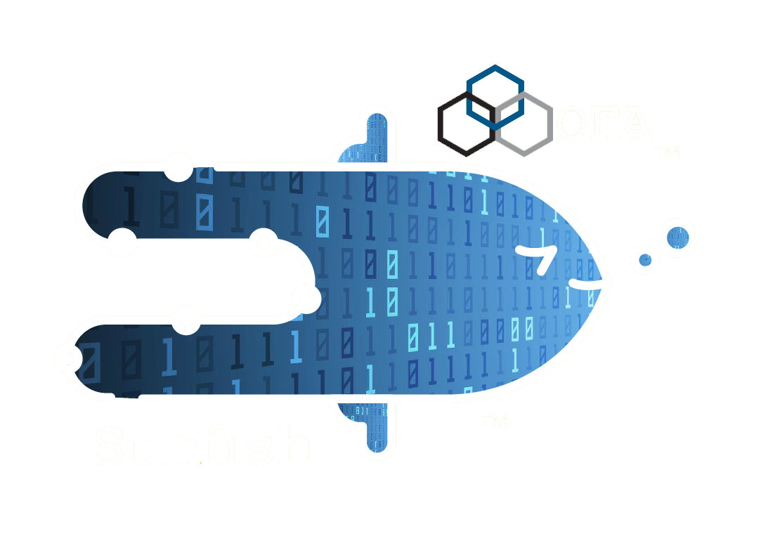
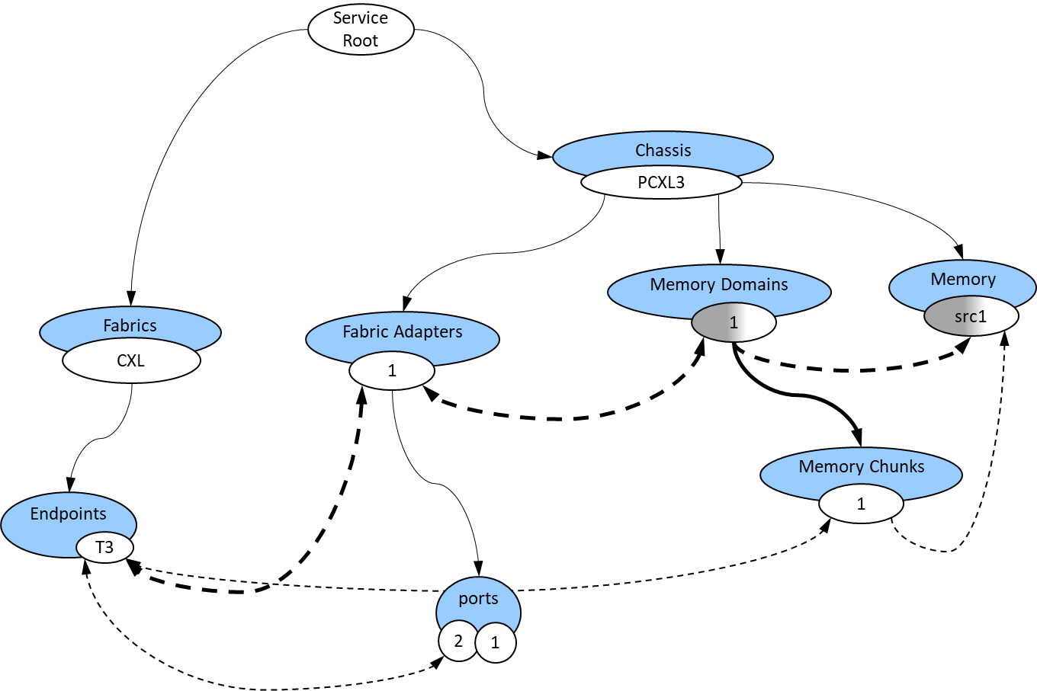
The Sunfish Objective in Visual Form
Sunfish Clients see abstracted Fabric Attached Resource objects
Sunfish Services manages the Redfish models of all resources from multiple hardware Agents
Sunfish Agents hide the hardware specifics by creating appropriate Redfish models of resources
Sunfish Services
Users, Apps, utilities, monitors, Resource Managers or Admins
Hardware Specific Agent
Hardware
Managers
Specific
HW
RESTful API (RF/SF)
Sunfish defines the policies that Agents follow when creating resource models so that Clients know how to interpret and manipulate them
Notes:
Sunfish purpose block diagram

Slide 2
The Sunfish Open Fabric Management Framework
Clients
Composability and Resources Managers
Sunfish Core Services
Sunfish Agents
Hardware Managers
CXL HW
CXL Fabric Manager(s)
CXL HW
Composability Layer
Sunfish Services
CXL
Agent
App driven system reconfiguration
Fabric Resources
Monitoring
Resource Inventory
Application Domain
Composition
Policies
NVMeoF Fabric Manager
NVMe
HW
RF tree management
NVMeoF Agent
Resource Managers
(e.g., Compute, FAM, Storage, Fabric)
Resource Configuration
API
Fabric Configuration
API
Infiniband
Managers
Infini-Band
HW
RESTful API (RF/SF)
InfiniBand
Agent
Authentication
Systems composition,
Systems update
Access Control
Events
Events & Logs
Events & Logs
Events
Additional
HW managers
???
HW
Data Store
Additional
Agents
Data Store
Administration Domain
Infrastructure management
RedFish
API
Redfish / Native
API Translation
Vendor Native API
Sunfish Framework
Notes:
Sunfish Detailed Block Diagram

Slide 3
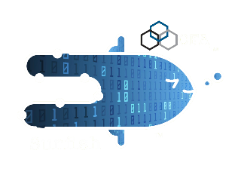
Resources Involved in Connection
© OpenFabrics Alliance 2023
Root
CXL
fabric
Chassis
Chassis 1
Systems
Fabrics
CXL_
System3
CXL
Memory
Domains
Memory
CXL_
System2
Zones
Connections
2
2
25
1
Fabric
Adapters
2
CPUs
1
I3
endpoints
T2
1
Ports
Ports
2
1
1
Switches
Memory
Chunks
CXL1
CXL2
1
Ports
F1
F1
F2
Ports
D2
U3
F2
F4
F4
³
Notes:
Redfish 2-switch topology (for FAM)

Slide 4
Resources Involved in Connection
© OpenFabrics Alliance 2023
Root
Chassis
Chassis 1
Systems
Fabrics
CXL_
System3
CXL
Memory
Domains
Memory
Connections
Zones
2
2
25
1
Fabric
Adapters
2
CPUs
1
I3
endpoints
T2
Memory
Chunks
1
⁴
Notes:
Redfish FAM Model

Slide 5
How Redfish Models Fabric Attached Memory
Root
Chassis
FAM1
Fabric
Adapters
Memory
Domains
Fabrics
2
Memory
1
2
2
endpoints
PCIe
Devices
vT2
T2
2
switches
Memory
Chunks
S2
Ports
1
1
Ports
D2
Notes:
Redfish FAM model 3
(generic FAM model)

Slide 6
How Redfish Models CXL FAM
Root
Chassis
FAM1
Fabric
Adapters
Memory
Domains
Fabrics
2
Memory
1
2
2
endpoints
PCIe
Devices
vT2
T2
2
switches
Memory
Chunks
S2
Ports
1
1
CXL LDs
Ports
2
D2
Memory
Regions
Extents
1
1
Notes:
Redfish FAM model 4
(includes CXL LDs when a CXL fabric)

