Slide 1
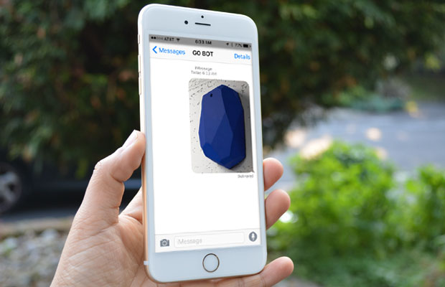


Slide 2
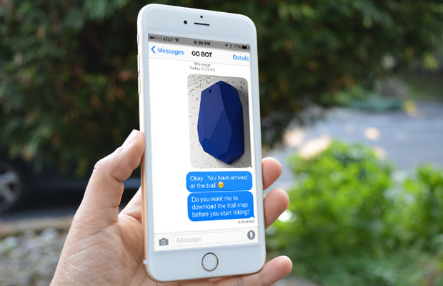

Okay. You have arrived at the trail.
Do you want me to download the trail map before you start hiking?

Slide 3
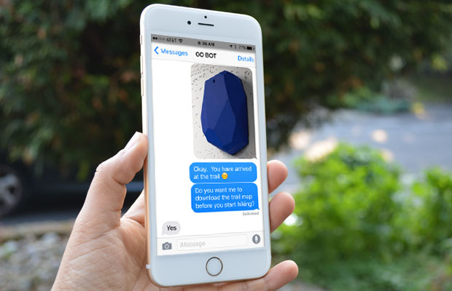

Okay. You have arrived at the trail.
Do you want me to download the trail map before you start hiking?
Yes.

Slide 4
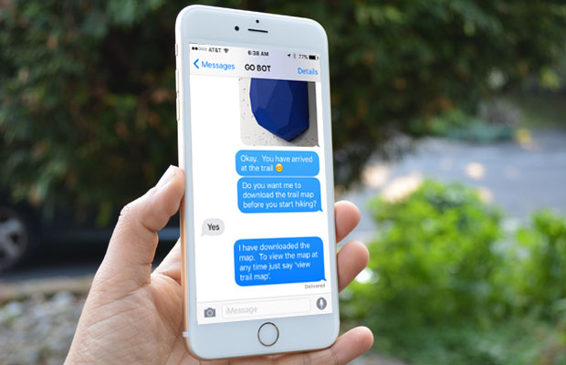
I have downloaded the map. To view the map at any time just say “view trail map”.

Slide 5

I have downloaded the map. To view the map at any time just say “view trail map”.
view trail map

Slide 6
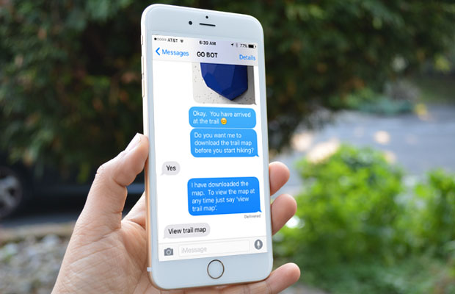
view trail map

Slide 7
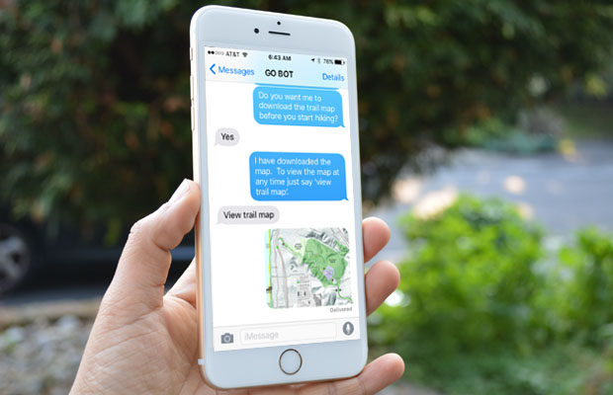
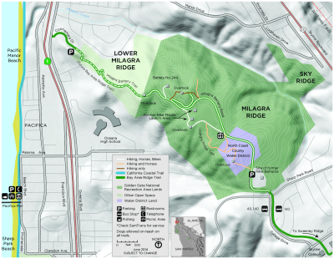
view trail map

Slide 8
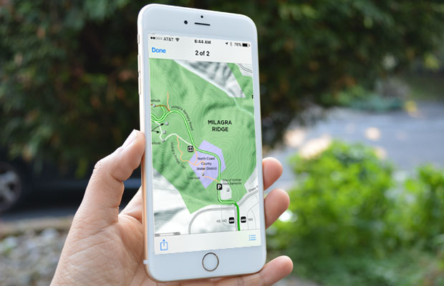
view trail map

Slide 9
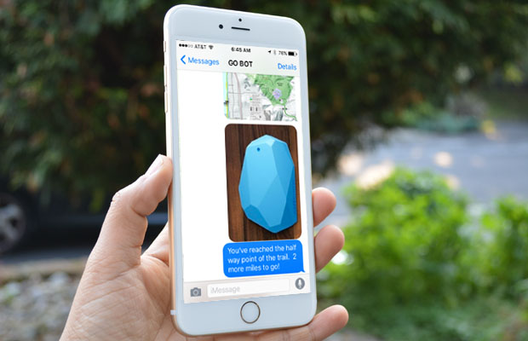
You’ve reached the half way point of the trail. 2 more miles to go!

Slide 10
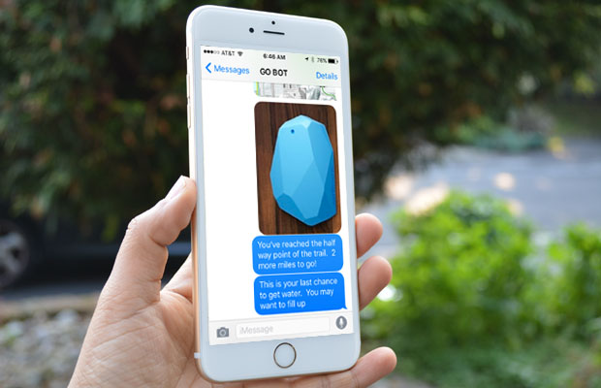
You’ve reached the half way point of the trail. 2 more miles to go!
This is your last chance to get water. You may want to fill up.

Slide 11
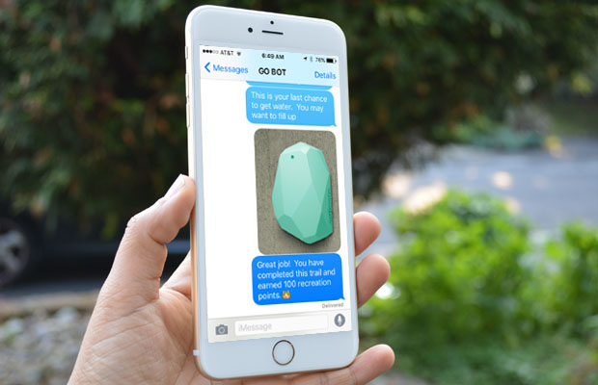
Great job! You have completed this trail and earned 100 recreation points.

Slide 12
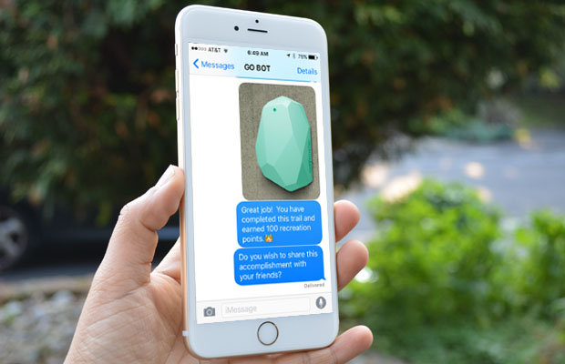
Great job! You have completed this trail and earned 100 recreation points.
Do you wish to share this accomplishment with your friends?

Slide 13
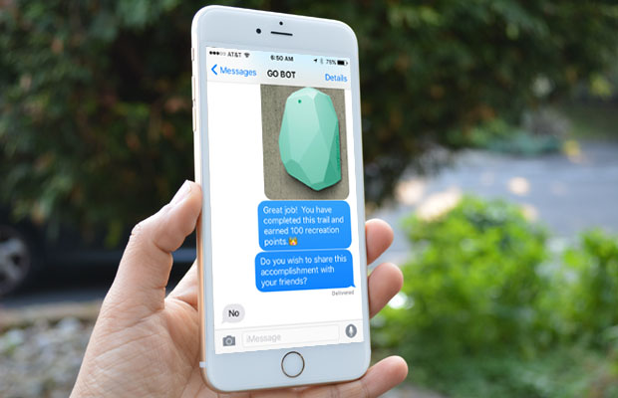
Great job! You have completed this trail and earned 100 recreation points.
Do you wish to share this accomplishment with your friends?
No

Slide 14


How would you rate this trail on a scale of 0-5?

Slide 15


How would you rate this trail on a scale of 0-5?

Slide 16

How would you rate this trail on a scale of 0-5?
I really enjoyed hiking with you. Please take me with you on your next trip.

