Slide 1
Language Connections
Tips to Create, Maintain, and Present Non-English Digital Content
Michael Mulé, Attorney-Advisor
Federal Coordination and Compliance Section
Limited English Proficiency Committee
Title VI Interagency Working Group

Slide 2
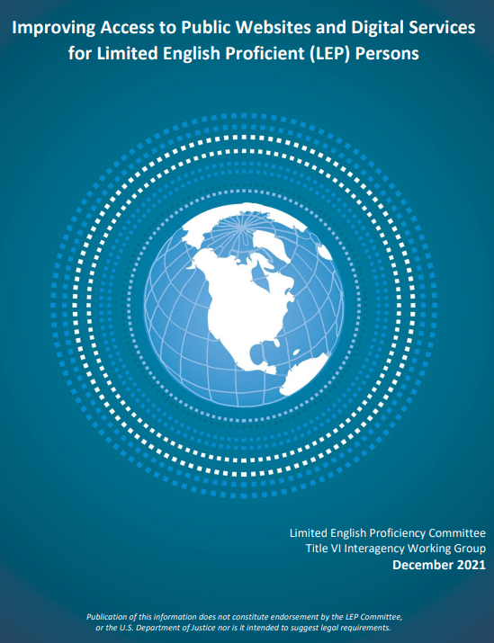
Overview
go.usa.gov/xt8uj
Ideas
Examples
Resources
1

Slide 3
Ideas
2

Slide 4

Machine Translation
A translation without a human translator
Before posting, secure a competent human translator to proofread the content for accuracy
3

Slide 5

Signs of Trouble
Directions for translations only in English
Use machine translation, not a translator
Inaccessible voicemail or call lines
4

Slide 6

Best Practices
Multilingual notice of language services
Translated indicator for English content
Accessible call numbers and voicemail
Translated vital information
5

Slide 7

Effective Design
Prominently display translated content
Language selector in the upper right of each page
Links to language specific pages
6

Slide 8

Usability Testing
LEP users test a site or digital service
Collect data, identify features that are helpful and problematic for LEP users
7

Slide 9

Examples
8

Slide 10

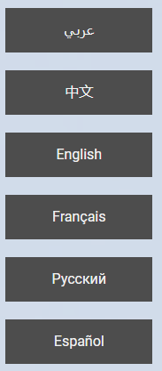
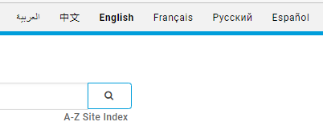

Language Selector
Welcome
Header
Mobile
9

Slide 11
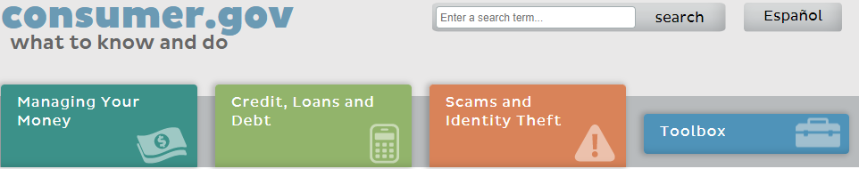
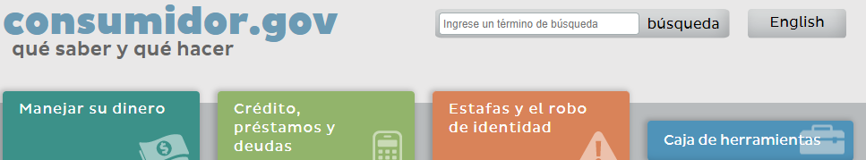
Mirror Site
English
Spanish
10

Slide 12

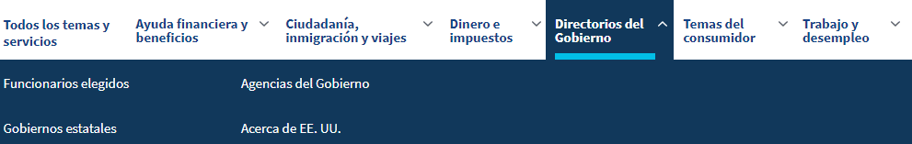

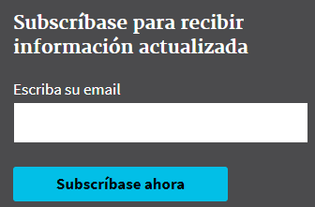
User Features
Menu
Search
Subscriptions
11

Slide 13
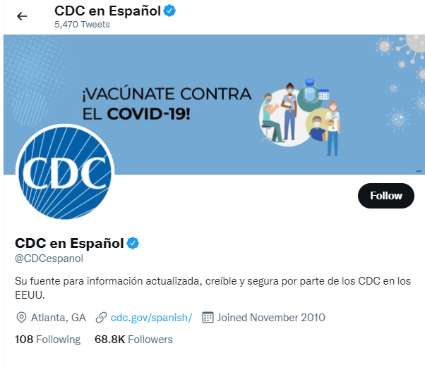
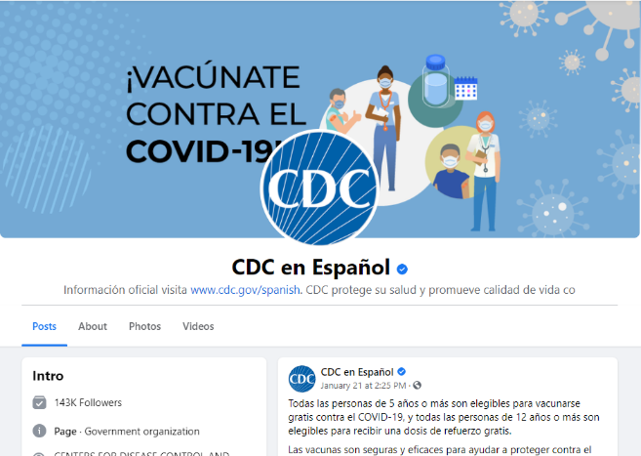
Social Media
Twitter
Facebook
12

Slide 14
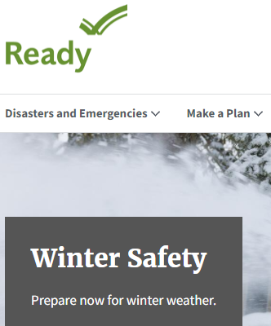
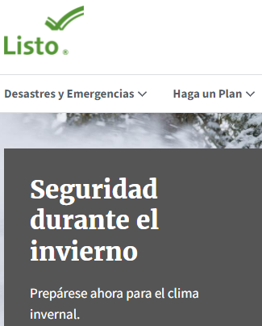
Translated Page Address
ready.gov
listo.gov
13

Slide 15
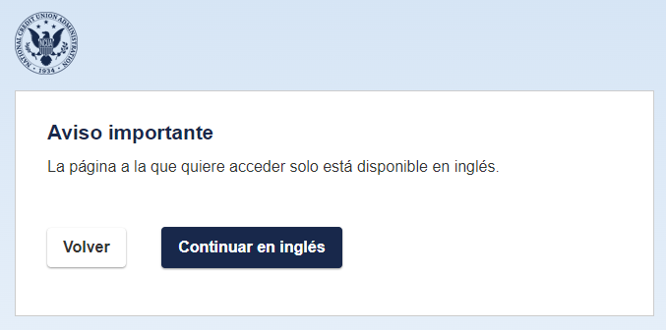
Translated Notices
espanol.ncua.gov
14

Slide 16
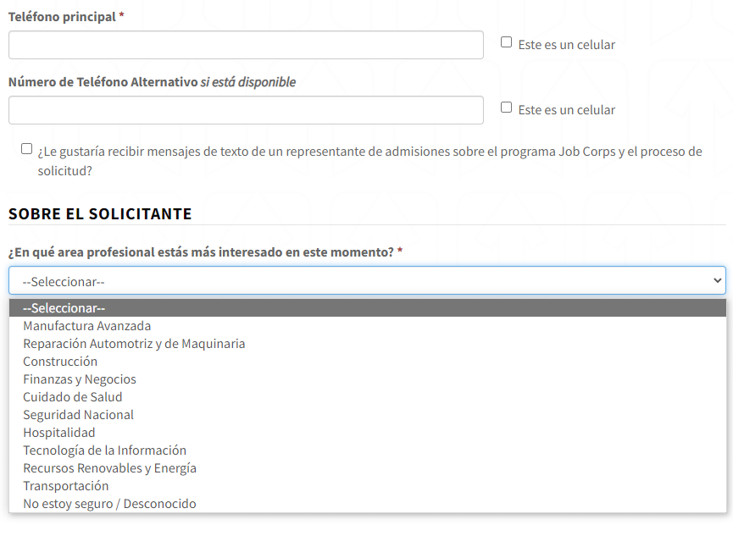
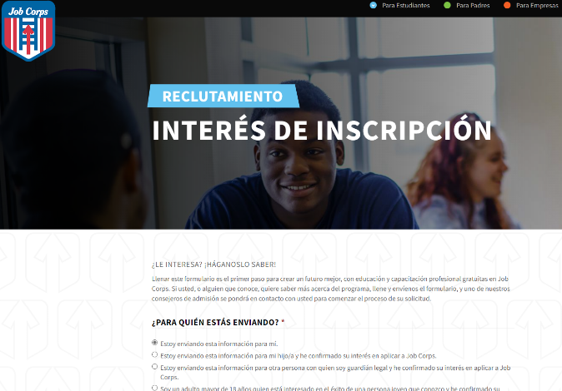
Translated Forms
jobcorp.gov/es
15

Slide 17
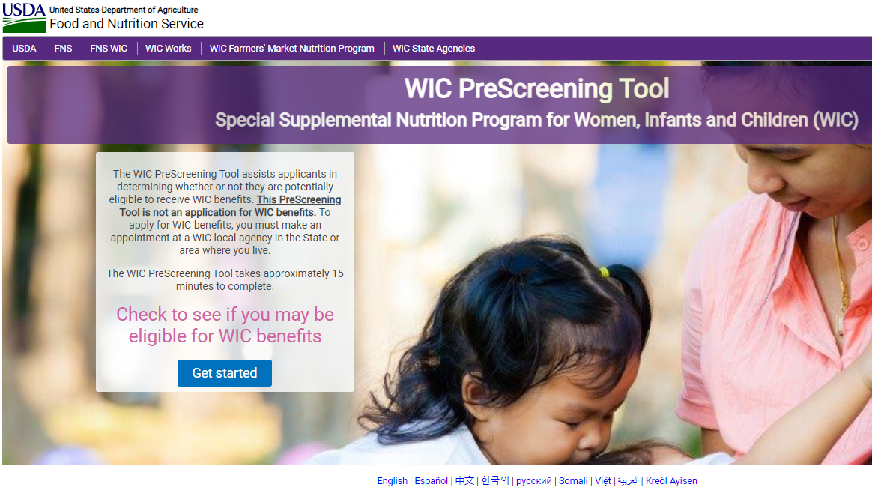
Main Page Links
wic.fns.usda.gov/wps/pages/preScreenTool.xhtml
16

Slide 18

Resources
17

Slide 19
Resources
Improving Access to Public Websites and Digital Services for LEP Persons, go.usa.gov/xtXee
Digital.gov Multilingual Community, go.usa.gov/xtXeu
GSA, Automatic Translation Good Solution or Not, go.usa.gov/xtXtb
Usability.gov, go.usa.gov/xtXtB
18

Slide 20
Questions
Michael Mulé, Michael.Mule@usdoj.gov
19

