Slide 1
An Introduction to
Python For Data Science
October, 2017

Slide 2
What Is Python?
Python is:
A High Level
General Purpose Language
Object Oriented (with full support for other paradigms)
Interpreted
Created in the early 1990’s
Python 3.6 is the current version

Slide 3
Code Along 1
Jump right in – Code Along 1
Simple Hello World Program

Slide 4
Code Along 1
Takeaways - Code Along 1:
Python Interpreter Vs Python modules
Use Interpreter for testing or quick experiments
.py files – modules that can be rerun, need a Python interpreter to be executed
Variables
Get assigned values
Can be reused, manipulated, reassigned … etc.
Printing
Visual output of your code – is It working as it should be?
…You just wrote your first python code!

Slide 5
Code Along 2
Code Along 2
Variables and Operators (and comments)

Slide 6
Code Along 2
Takeaways - Code Along 2:
Variables
No type declaration necessary (Python figures out the type)
first assignment created the variable
Assignment is done using “=“
Operations
Carried out on variables (operands)
Operator can behave differently based on the data type
+ Adds Integers, concatenates Strings
Strongly-Typed is the way! (No implicit type conversions)
Comments Keep code clean and readable
Whoever reads your code will thank you!
# used to comment a single line

Slide 7
Code Along 3
Code Along 3
More on Variables

Slide 8
Code Along 3
Takeaways - Code Along 3:
Multiple Assignment
x,y=4,6
Basic Data Types:
Integers (Default for Numbers) 5, 17 , 3000
Floats :5.3, 7.324, -34.11, 5/2
Strings: “Bob”, ‘John’, “Kevin’s”, “””Mark’s car is “black””””
Variable names are :
Case Sensitive!
Can NOT start with a number
Can contain underscores, letters, numbers
Can NOT be a reserved word (if, elif, global, return, pass, import …..etc.)

Slide 9
Code Along 3
Additional Notes:
Python binds variables to object references
Assigning a variables created a reference to an object, NOT a copy of the object
A variable name does not imply the object type, the object referenced does
X=7 , X=“Bob” is completely fine.
Some datatypes are mutable, some are immutable
More on that in later courses

Slide 10
Code Along 4
Code Along 4
More Data Types

Slide 11
Code Along 4
Takeaways - Code Along 4:
Tuples
A collection of “Elements”
Can be sliced
Elements Accessible individually using [n] or [-n]
Ranges [1:2], [:2], [2:], [1:-1], [:]
Elements cannot be changed (immutable)
Check for element presence using “in” clause
Lists
Like a Tuple, but with added functionalities
Slower but more useful
Elements can be inserted, appended, removed, deleted, “popped” and changed
Use len(x) to find length, x.index(n) on lists and tuples to “know your way”
A string is also a sequence type, closer to a tuple (immutable)!

Slide 12
Code Along 4
Takeaways - Code Along 4 (Continued):
You can “Add” sequences:
[1,2,3]+[4,5,6]
(1,2,3)+(4,5,6)
"Hello"+" "+"World! " (Look familiar?)
You can “Multiply” a sequence and an integer:
[1,2,3]*3
(1,2,3)*2
"Hello"*3

Slide 13
Code Along 5
Code Along 5
Conditionals and loops

Slide 14
Code Along 5
Takeaways - Code Along 5 (Continued):
Code blocks are identified using Indentation (no { } here!)
Standard is 4 white spaces – tabs not recommended
Conditions can be evaluated using if, elif, else statements
= used for assignment, == used for comparison
!= is the opposite of ==
Loops allow you to execute a block of code several times using while or for..in
Else condition in loops are executed when condition is false
Stop a loop using break
Watch out for infinite loops!

Slide 15
Code Along 6
Code Along 6
Functions

Slide 16
Code Along 6
Takeaways - Code Along 6:
Functions are defined using the keyword def
def addition_function(x,y):
Values are returned using the return keyword (even if not present!)
None value
Functions take arguments
A function can be an argument to another function
addition_function(3,addition_function(3,5))
No types are defined for arguments or return types
Functions can call other functions
Objects have scopes

Slide 17
Code Along 7
Code Along 7
Scopes

Slide 18
Code Along 7
Takeaways - Code Along 7:
Objects have scopes
Be careful of what you are trying to reference
Use of return to make an object available

Slide 19
Code Along 8
Code Along 8
Modules

Slide 20
Code Along 8
Takeaways - Code Along 8:
A module gains access to code in another module by importing it
Modules provide a way of code reuse
Python comes with a library of standard modules
Such as the datetime module
…or the statistics module
Import statistics
print(statistics.mean([1,2,3,4,5,6]))

Slide 21
Questions?

Slide 22
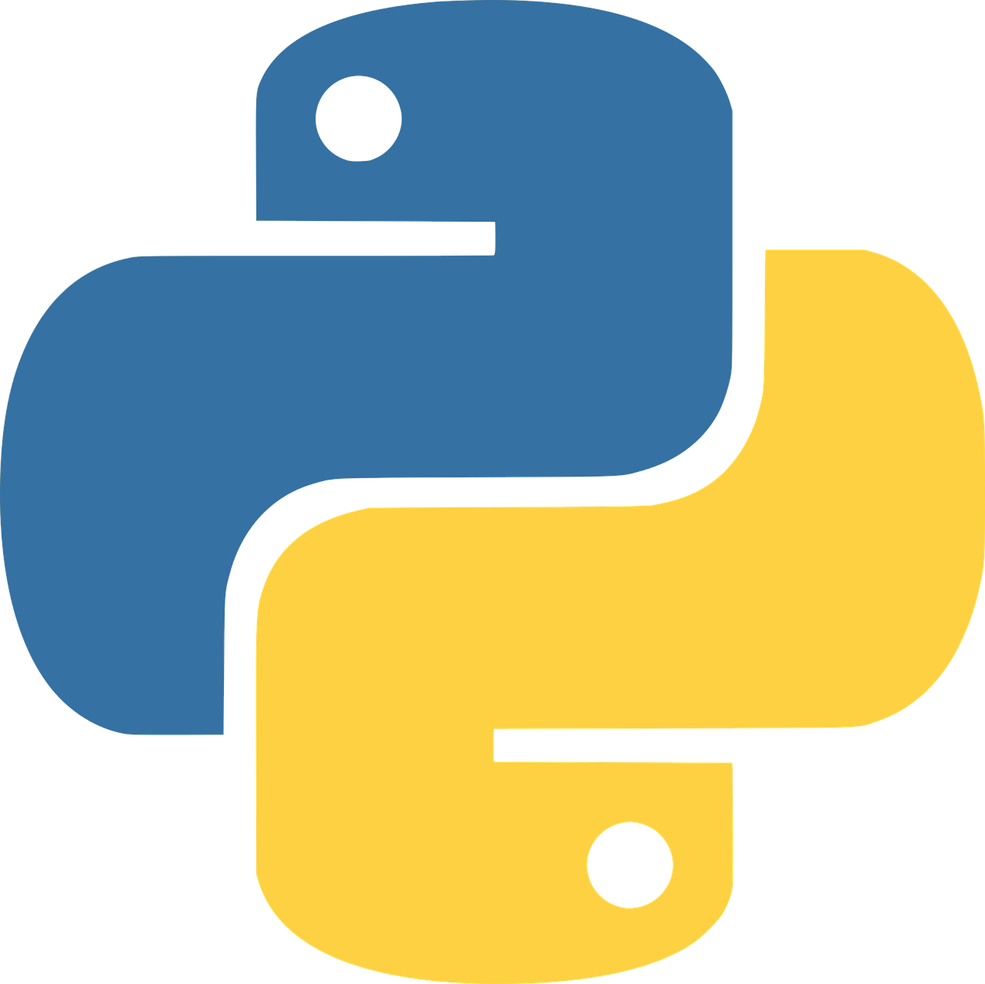
Thank You
Get to coding!

