Slide 1

Version Control and GitHub
Data Science Code-Along
October 20, 2017

Slide 2
What we’ll cover
The basics:
Version control
Git
GitHub
Labs:
Lab 0: Setup
Lab 1: Issues
Lab 2: Forking
Lab 3: Commits
Lab 4: Pull requests
Notes:
We’ll do:
A very brief overview of version control and Git
A detailed explanation of GitHub
Several hands-on exercises using GitHub features
By the end of this class, you’ll be able to:
Manage your data science code, such as R and Python code
Open up your data science code to the public
Contribute to data science projects

Slide 3
The basics: Version control
Notes:
Ultimately, we want to use Git and GitHub. The core concept behind these tools is version control.

Slide 4
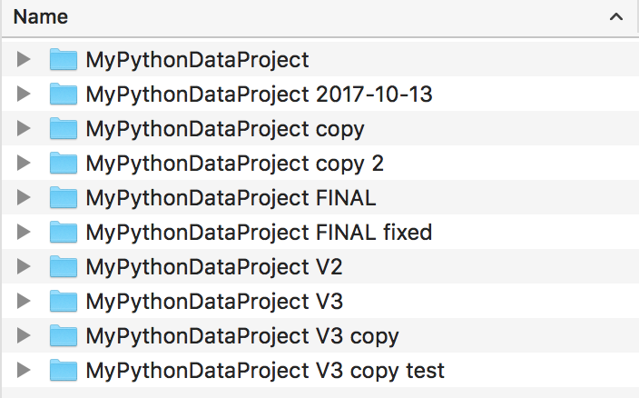
Notes:
Familiar? Unsustainable, especially with multiple participants.
The answer: version control
Tracks changes
Lets you jump to any point in history
Lets you compare any two versions
If multiple participants, lets you merge work
Many different ways to implement version control. Maybe you’ve heard of some:
CVS
Subversion
ClearCase
Even Google Drive has a simple form of version control: Version History

Slide 5
The basics: Git
Notes:
Today, focus on a version control system that has taken the developer world by storm: Git

Slide 6
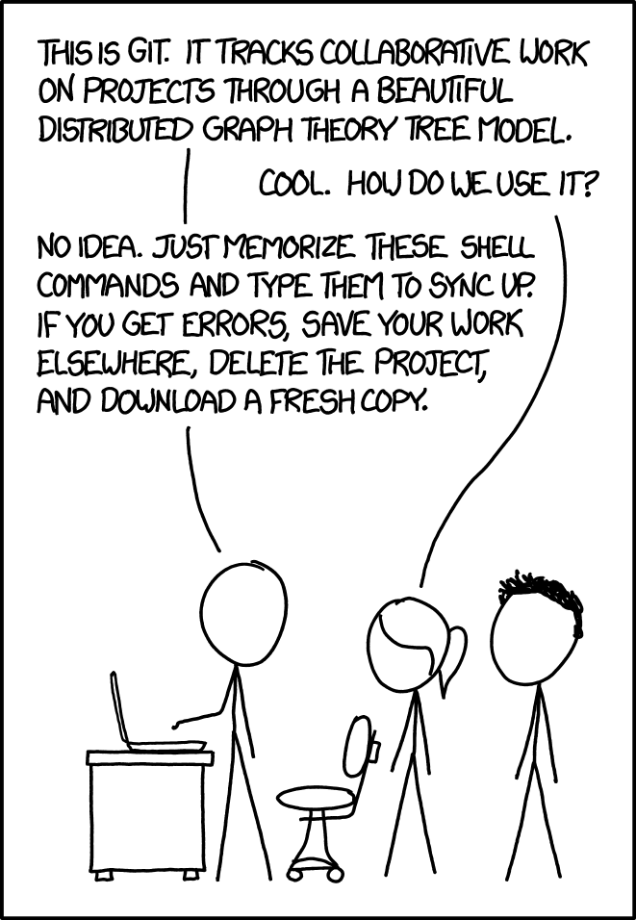
https://xkcd.com/1597/
Notes:
Git is an incredibly powerful system that can also be incredibly complex.
Primarily used on the command line, but has great desktop tools that make it easier to use.
Easy enough to learn for basic everyday use. Also easy enough to recover from mistakes.
Beyond the basics, the learning curve suddenly becomes steep. We will focus on the basics and how GitHub helps us with that.

Slide 7
The basics: GitHub
Notes:
GitHub is a service that takes Git and builds a web interface on top of it, among many other things.
It’s only one of many services built on top of Git. Others:
GitLab
Bitbucket
Visual Studio Team Services

Slide 8
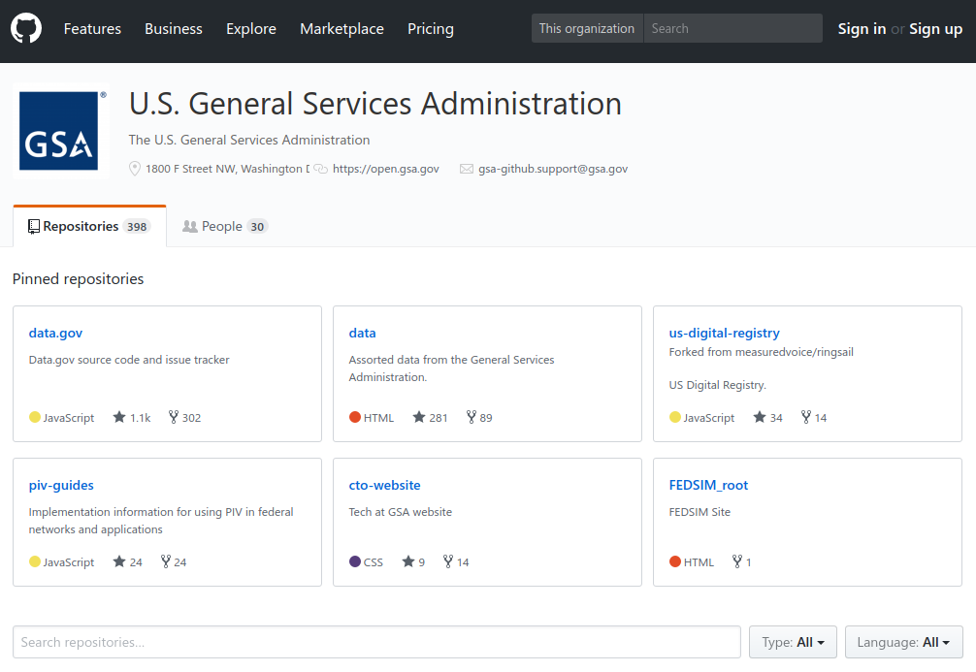
https://github.com/GSA
Notes:
We’re studying GitHub in this class because GSA has many repositories on it (almost 1400 at last count, GSA + 18F).
Also, it’s the most popular Git service out there. Because it has many users, that helps enable us to interact with a larger audience when we work in the open.
Quick tour of GitHub features:
Code
Issues
Pull requests
Projects
Wiki
These features help enable collaboration. Great for public engagement.
In open source, anyone can:
Contribute code
Open an issue
Try to resolve an issue

Slide 9
Modules and Labs:
git.io/vd5HV
Notes:
Let’s actually get started using GitHub.
Visit the URL to go to the class page on GitHub, where you’ll find our labs. We’re using GitHub to teach a class on GitHub.

Slide 10
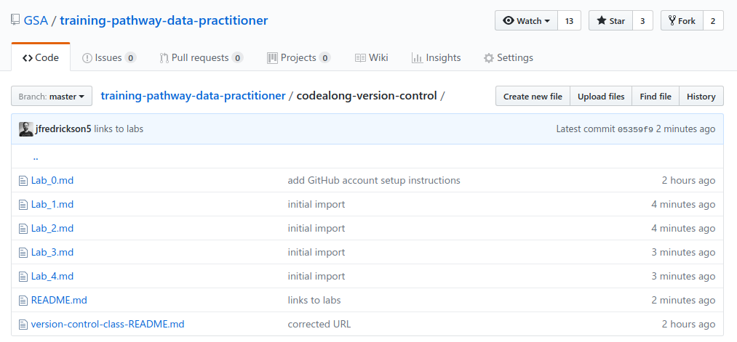
https://git.io/vd5HV
Notes:
Make sure you can bring up our class page. You should see labs 0 through 4 in the list of files.
As we do each lab, return to this page and click on the appropriate lab file to bring up instructions.

Slide 11
Lab 0: Setup
Notes:
Everyone needs to:
Create a GitHub account
Verify their email
Log in to GitHub

Slide 12
Module 1: Issues
Notes:
GitHub Issues: A simple, yet useful, way to participate in an open source project

Slide 13
GitHub Issues
Items that track work
Bug reports
Enhancement requests
Tasks
Every project has different guidelines
Look for a CONTRIBUTING file or check the wiki
Some repositories have issue templates
Writing good issues
Concise, useful title
Bug report? Describe the problem, specific error messages, how to reproduce
Enhancement? Explain what it should be, why it would be useful, who would benefit
Notes:
Working with issues: One of the simplest and most useful ways you can contribute to open source projects.
Also a good way to track work on your own projects.

Slide 14
help wanted
Notes:
GitHub issues aren’t just a place to open new issues.
Open source depends on community contributions. If you ever see an issue you can tackle, don’t be afraid to ask how you can help!
Many projects use the “help wanted” label to tag issues that they need help with.

Slide 15
Lab 1: Issues
Notes:
Lab 1: Create a issue on GitHub.
Visit the class repository and open up Lab 1.

Slide 16
Module 2: Forking

Slide 17
GitHub Forks
Forking creates an exact copy of a GitHub repository
A fork remembers the connection between the original repository and your new one
Two primary uses:
A workspace for you to make changes to contribute back to the original repository
A starting point for a new project
Notes:
Forks are one of the core features of GitHub that enable social coding.

Slide 18
Lab 2: Forking

Slide 19
Module 3: Commits

Slide 20
Commits
Commits record your changes for posterity in version control
A commit can include a single file or many files
Each commit has a log message
Best practices
Group related changes
Write useful log messages

Slide 21
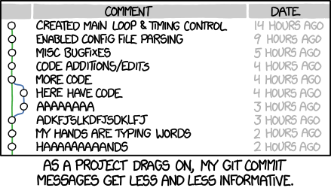
https://xkcd.com/1296/

Slide 22
Lab 3: Commits

Slide 23
Module 4: Pull requests

Slide 24
GitHub pull requests (PRs)
Offer your code to a project
Best practices
Small, incremental PRs
Descriptive messages
Associate with issues
Notes:
Another component of social coding, PRs essentially offer up your code to a project.

Slide 25
Lab 4: Pull requests

