Slide 1
DFDL WG Session 1
Summary of Status
Mike Beckerle
Ascential Software

Slide 2
DFDL-WG Session 1
Summary of Status
Agenda
Presentation: primer material (45 mins)
  Review of purposes/goals
  XML / XSD impact: Data Model
  Examples from primer
General discussion (40 mins)
Overview of other sessions (5 mins)

Slide 3
Data Interchange Formats
Prescriptive: Put your data in this format!
  XML – textual
  Binary – ASN.1, XDR, NetCDF, HDF...
Descriptive: What format is your data in?
  Various commercial products. Nothing standard.
  DFDL

Slide 4
Why Descriptive?
Allows us to achieve two goals simultaneously:
Interoperability
  Modern and Legacy data formats
Performance!
  Density
    Fewest bytes to represent data without resorting to compression
  Optimized I/O
    Seekable random access
    Memory mapped, aligned
      Without sacrificing general access

Slide 5
Why the GGF for DFDL?
Grids are about big-data and big-computation problems
  Simplistic solutions like “use XML” won’t cut it!
Grids are about universal data interchange

Slide 6
Related Standards Efforts
Prescriptive systems:
  W3C binary XML (http://www.w3.org/XML/Binary/)
    Formed, but discussion group has no items.
Descriptive systems:
    None known

Slide 7
XML Synergy
Use XSD to describe the logical data
Use annotations within the XSD to describe the representation of it.

Slide 8
XSD Types
Elements
  A.k.a. fields
Sequence groups, All groups
  All = unordered group
Choice
  A.k.a. union, redefine,
Vectors
  Use element with minOccurs, maxOccurs.
Nillability
  A.k.a. Nullable values

Slide 9
XML/XSD – basic types
anySimpleType
string
QName
NOTATION
float
double
decimal
boolean
base64Binary
hexBinary
anyURI
normalizedString
integer
token
long
nonPositiveInteger
nonNegativeInteger
language
Name
NMTOKEN
int
negativeInteger
positiveInteger
unsignedLong
NCName
NMTOKENS
short
unsignedInt
ID
IDREF
ENTITY
byte
unsignedShort
IDREFS
ENTITIES
unsignedByte
date
time
dateTime
gYear
gYearMonth
gMonth
gMonthDay
gDay
duration

Slide 10
Example 1: XML
<w>5</w>
<x>7839372</x>
<y>8.6E-200</y>
<z>-7.1E8</z>

Slide 11
Example 1: XSD
<xs:sequence>
<xs:element name="w" type=“int"/>
<xs:element name="x" type=“int"/>
<xs:element name="y" type=“double"/>
<xs:element name="z" type=“float"/>
</xs:sequence>

Slide 12
Example 1 DFDL - binary
0000 0005 0077 9e8c
169a 54dd 0a1b 4a3f
ce29 46f6

Slide 13
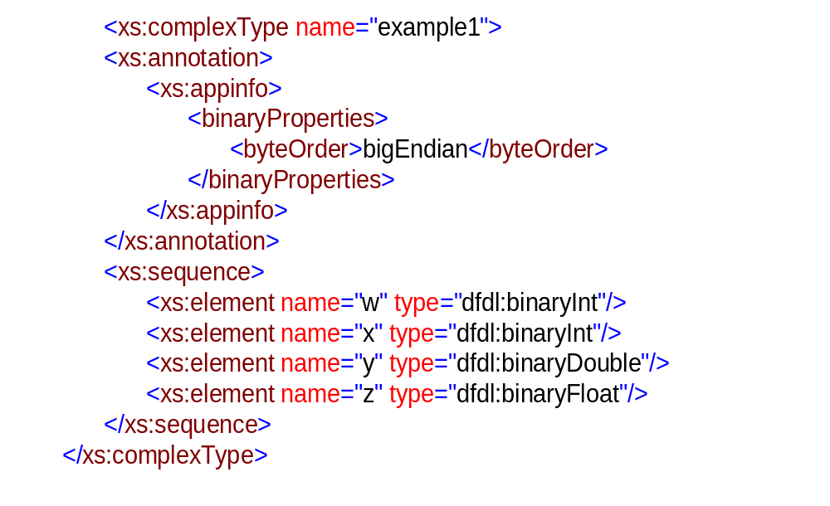
Example 1 DFDL - binary

Slide 14
Example 1 DFDL - textual
“5, 7839372, 8.6E-200, -7.1E8”

Slide 15
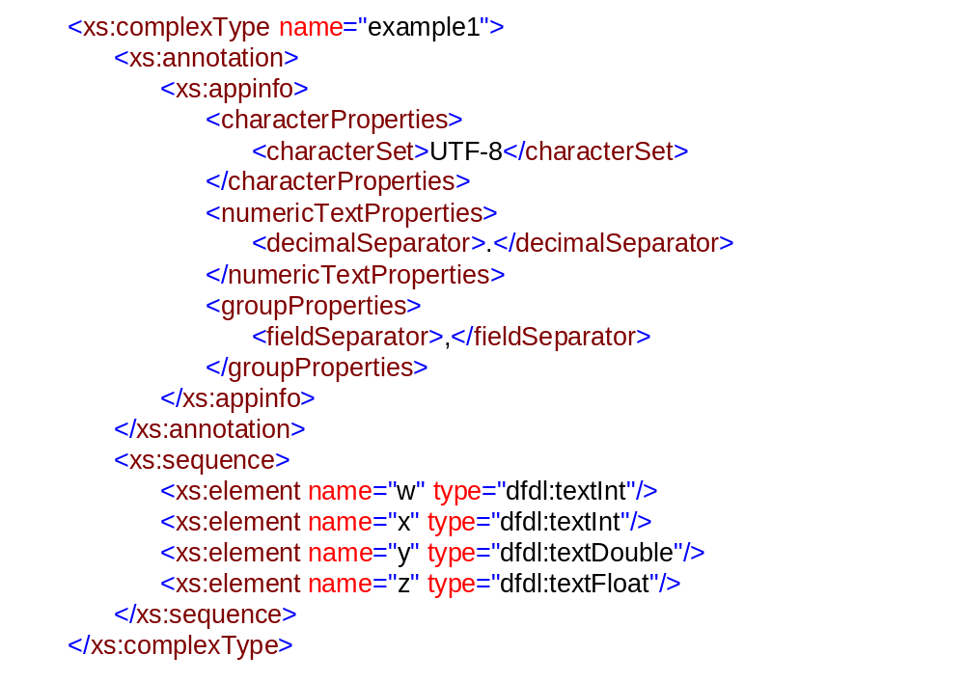
Example 1 DFDL - textual

Slide 16
The pieces of the puzzle
Primitive types: XSD
Data structure: XSD
Mappings – representations to/from primitives: DFDL mappings
Composition – modular composition of basic mappings: DFDL mapping composition
References – associate primitives in a structure with correct mapping: DFDL mapped types
N.B. Problem parts have some level independence

Slide 17
Mappings
Named black boxes
Implementations know how to call them
Semantics not described
  Name
  Range type
  Domain type
  Directionality
<definitions>
<mapping name="dfdl:data-bytes"
rangeType="dfdl:data"
domainType="dfdl:bytes.unbounded"
direction="bidirectional"/>
<mapping name="dfdl:bytes-int"
rangeType="dfdl:bytes.4"
domainType="xs:int"
direction="bidirectional"
argumentType="dfdl:binaryProperties"/>
</definitions>

Slide 18
Composing mappings
Simple linear composition (from primer)
<compositeMapping>
<mapping name=''databytes''/>
<mapping name=''bytes-int''/>
</compositeMapping>
May be too restricted more complex composition (mapping trees) possible.

Slide 19
Mapped types
Associate a new type with a composed mapping
Use a trick, null restriction with annotation
New type is a valid XML type
Simple composition could be included in annotation
<xs:simpleType name="binaryInt">
<xs:restriction base="xs:int">
<xs:annotation>
<xs:appinfo>
<compositeMapping>
<mapping name="data-bytes"/>
<mapping name="bytes-int"/>
</compositeMapping>
</xs:appinfo>
</xs:annotation>
</xs:restriction>
</xs:simpleType>

Slide 20
About USE
For convenience instead of textInt or binaryInt, you create a “use” association
Means: All uses of type “xs:int” in the scope of this declaration mean “dfdl:binaryInt”
<use type="dfdl:binaryInt"/>

Slide 21
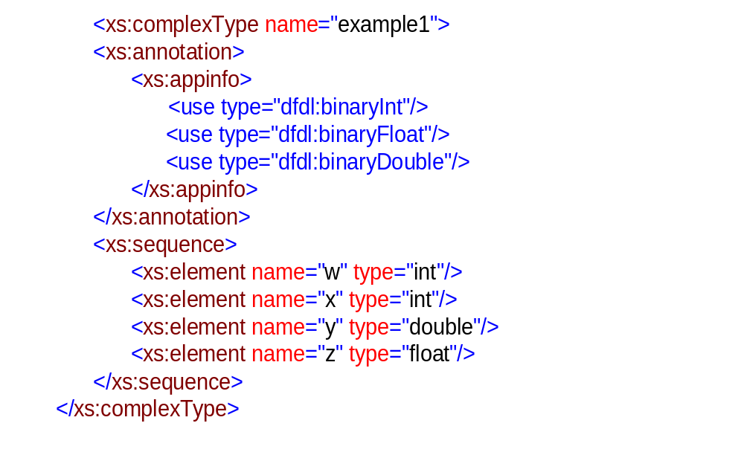
Example 1 – binary with ‘use’

Slide 22
Next Steps
Tuesday session
  Open Issues
  Richer data formats: stored length, choice/unions
  Layered translation, modularity
Wednesday session
  Continuation on Open Issues
  XML/XSD concerns

