Slide 1

JSDL/BES/GLUE2 Missing Links
Taking Lessons Learned from GIN into Standardization
Morris Riedel et al.
Group Co-Chair Grid Interoperation Now & Production Grid Infrastructure

Slide 2
Outline

Slide 3
Outline
Agenda
Goal & Vision
GIN & PGI
Concept: HPC Extensions
Concept: Better Application Support
Concept: Manual Data-Staging
Concept: Sequences(not WF!)
Concept: Execution Adjacencies
Summary
References

Slide 4
Agenda

Slide 5
Agenda
All Sessions Today
  Session One: Where are we, roadmap checks and Specification Work
  Session Two: Focus on Job Description Aspects & Specification Work
  Session Three: State Model Implications & Specification Work
PGI Workshop @Friday/Saturday
  Intensive work on specification

Slide 6
Goals & Vision

Slide 7
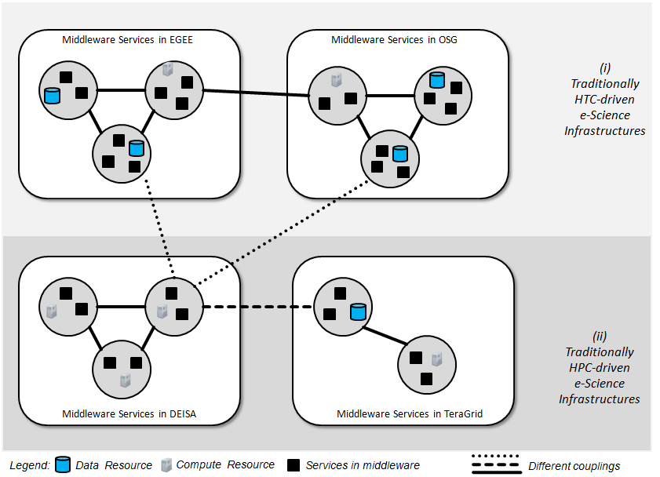
Now: Middleware-based Clusters

Slide 8
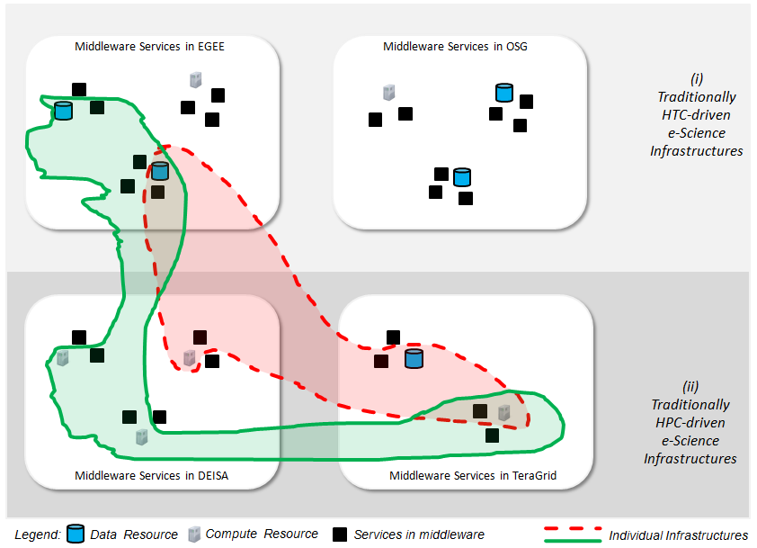
Goal: Network of interoperable Grids

Slide 9
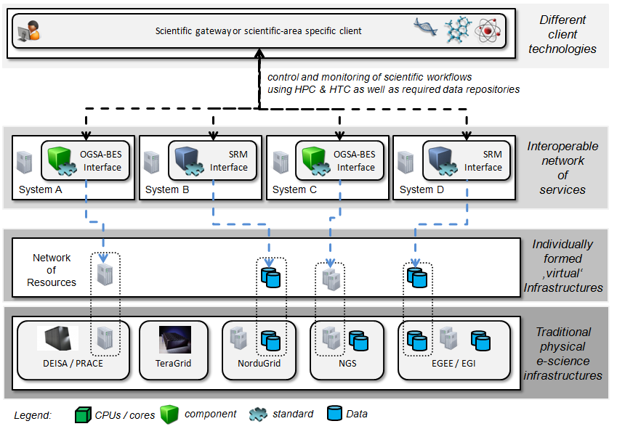
Vision: Individual Infrastructures

Slide 10
GIN & PGI

Slide 11
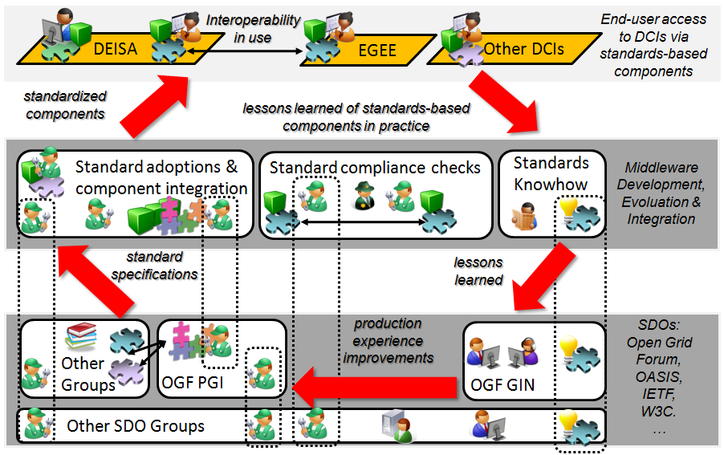
GIN & PGI
[4] Riedel and Laure et al., Interoperation of World-Wide Production e-Science Infrastructures, 2008

Slide 12
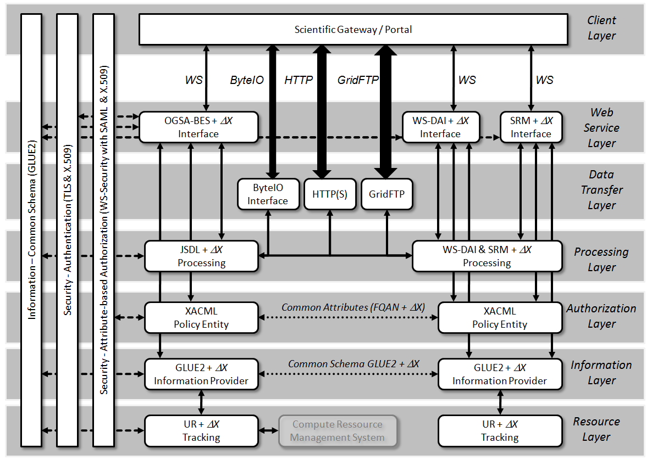
PGI Reference Model / Roadmap
[1] Riedel et al., Research Advances by using Interoperable e-Science Infrastructures, 2009

Slide 13
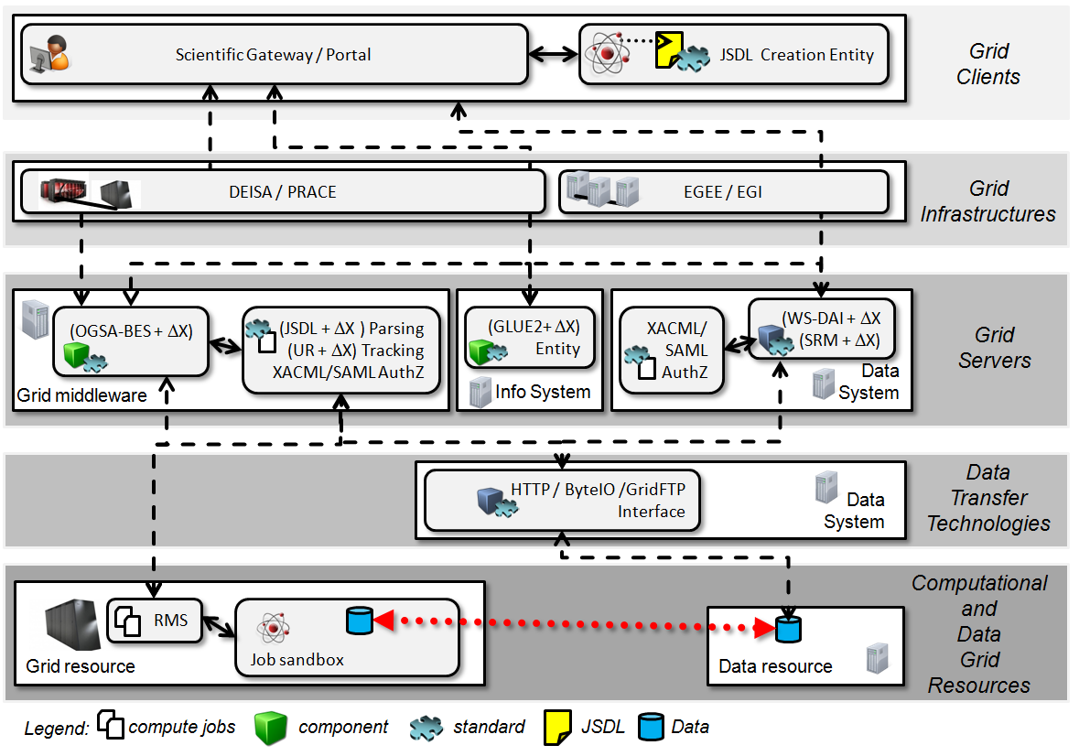
PGI Reference Model / Roadmap
[1] Riedel et al., Research Advances by using Interoperable e-Science Infrastructures, 2009

Slide 14
Concept: HPC Extensions

Slide 15
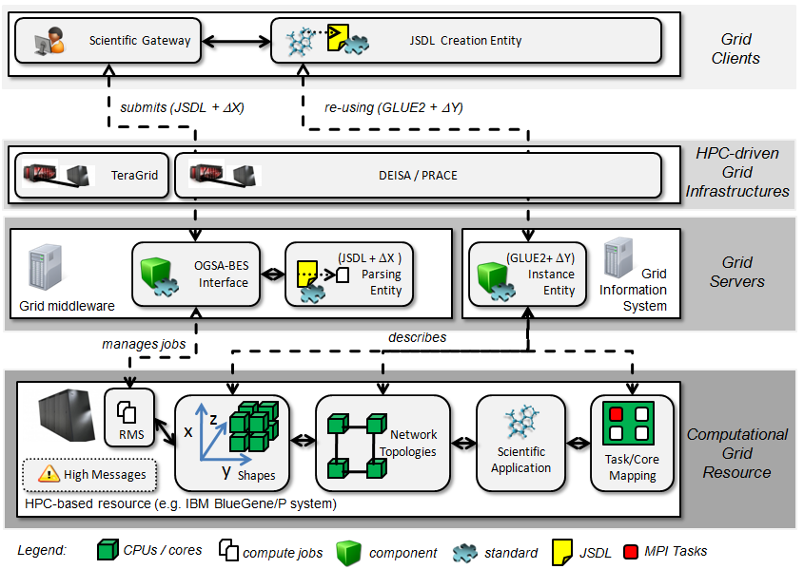
Concept: HPC Extensions
[6] Riedel et al., ., Improvements of Common Open Grid Standards to Increase HTC and HPC Computing Effectiveness…, 2010

Slide 16
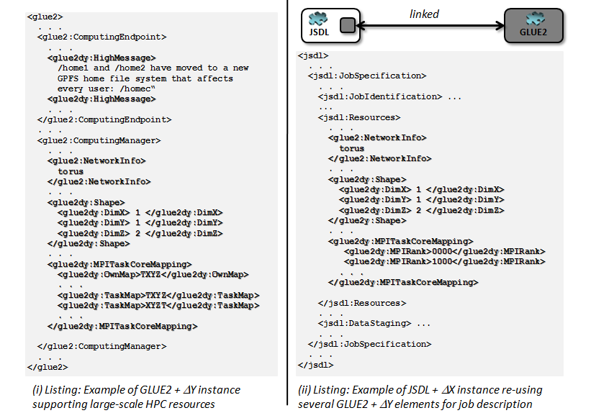
Concept: HPC Extensions
[6] Riedel et al., ., Improvements of Common Open Grid Standards to Increase HTC and HPC Computing Effectiveness…, 2010

Slide 17
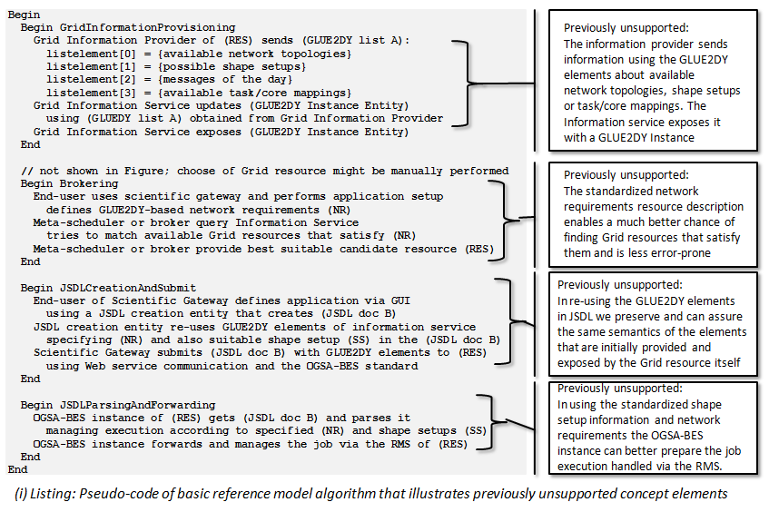
Concept: HPC Extensions
[6] Riedel et al., ., Improvements of Common Open Grid Standards to Increase HTC and HPC Computing Effectiveness…, 2010

Slide 18
Concept: Better Application Support

Slide 19
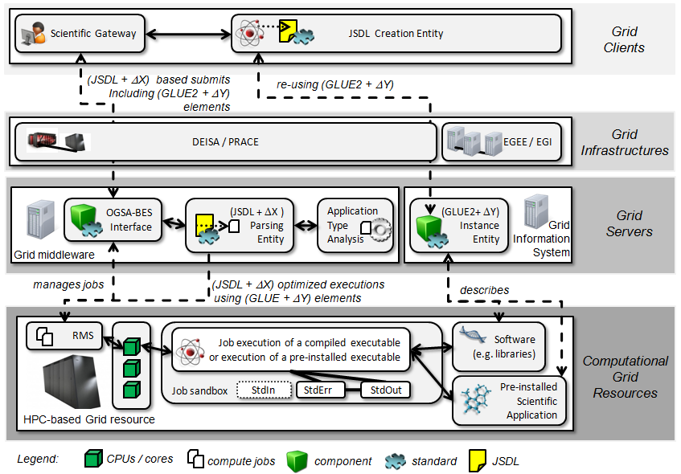
Concept: Better Application Support
[6] Riedel et al., ., Improvements of Common Open Grid Standards to Increase HTC and HPC Computing Effectiveness…, 2010

Slide 20
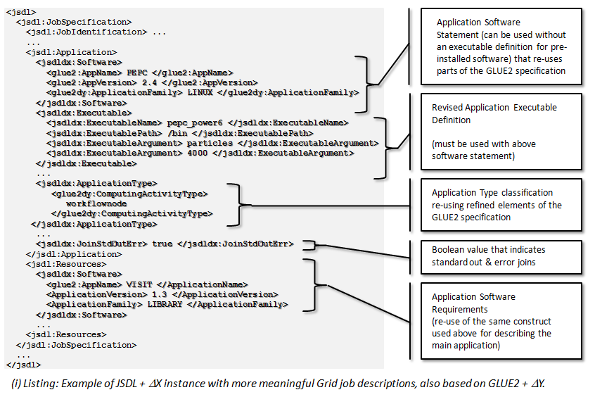
Concept: Better Application Support
[6] Riedel et al., ., Improvements of Common Open Grid Standards to Increase HTC and HPC Computing Effectiveness…, 2010

Slide 21
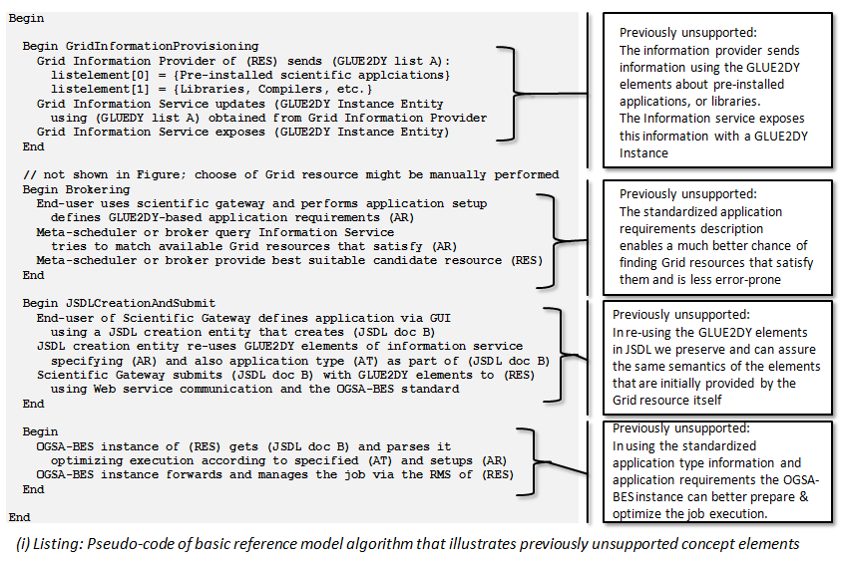
Concept: Better Application Support
[6] Riedel et al., ., Improvements of Common Open Grid Standards to Increase HTC and HPC Computing Effectiveness…, 2010

Slide 22
Concept: Manual Data-Staging

Slide 23
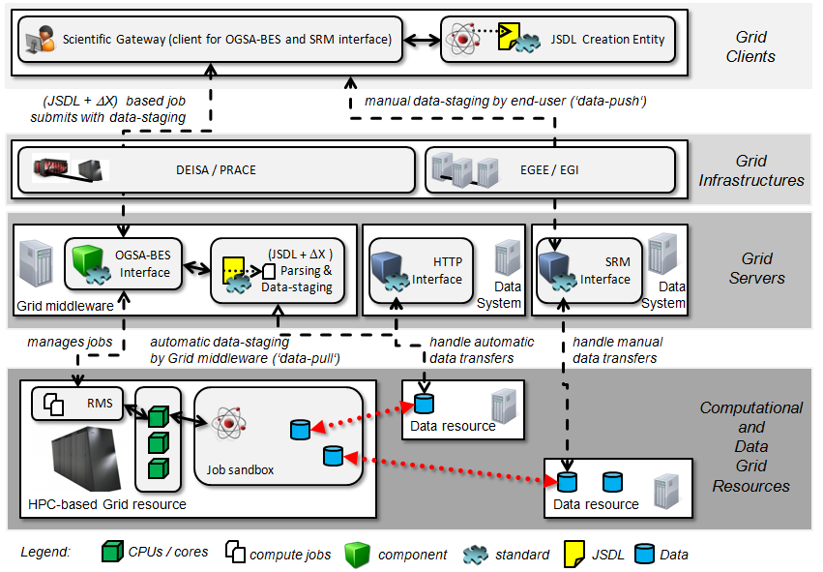
Concept: Manual Data-Staging
[2] Riedel et al., ., Concepts and Design of an Interoperability Reference Model for Scientific- and Grid Computing Infrastructures

Slide 24
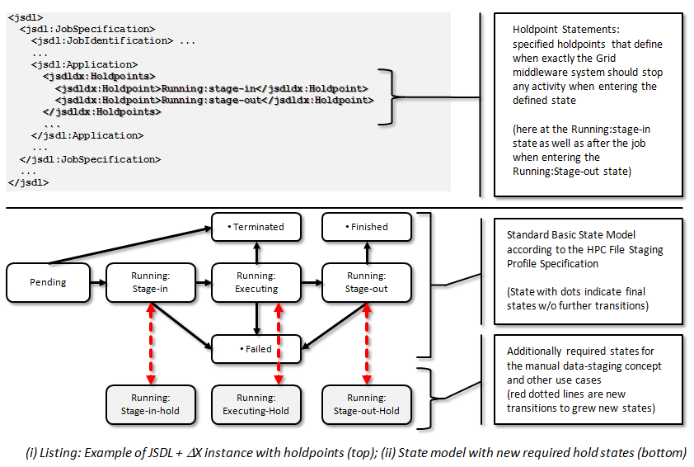
Concept: Manual Data-Staging
[2] Riedel et al., ., Concepts and Design of an Interoperability Reference Model for Scientific- and Grid Computing Infrastructures

Slide 25
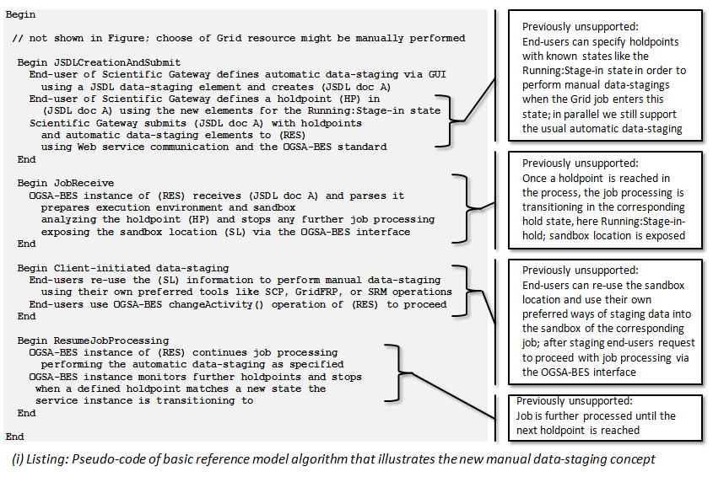
Concept: Manual Data-Staging
[2] Riedel et al., ., Concepts and Design of an Interoperability Reference Model for Scientific- and Grid Computing Infrastructures

Slide 26
Concept: Sequences (not WF!)

Slide 27
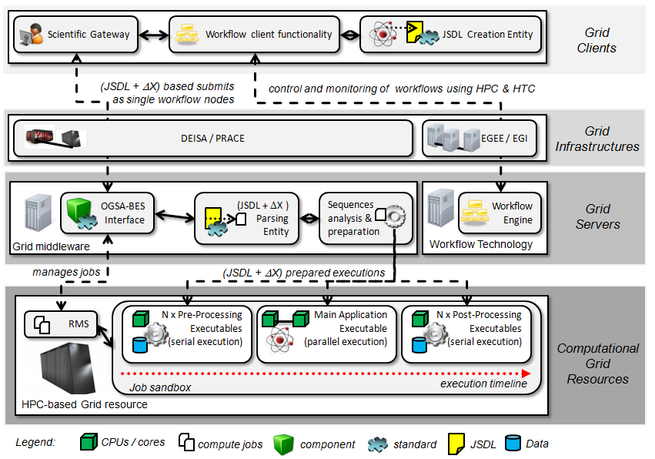
Concept: Sequences (not WF!)
[6] Riedel et al., ., Improvements of Common Open Grid Standards to Increase HTC and HPC Computing Effectiveness…, 2010

Slide 28
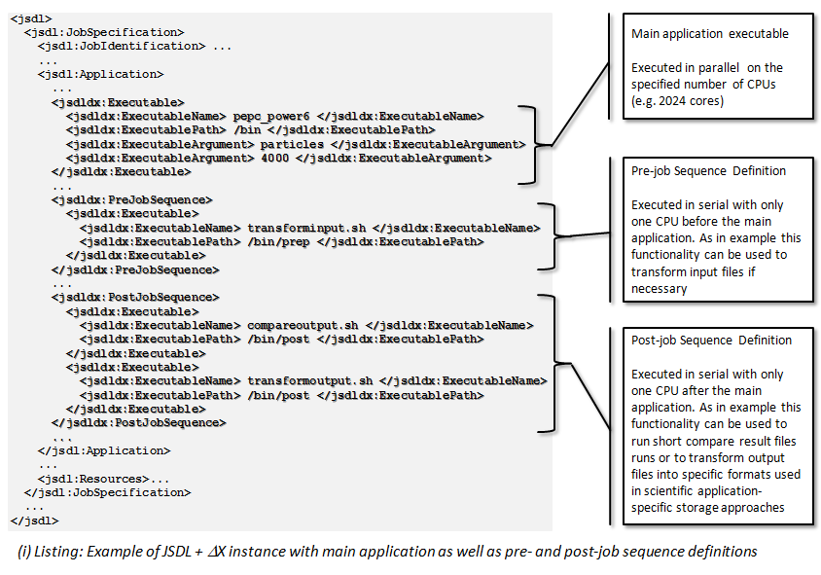
Concept: Sequences (not WF!)
[6] Riedel et al., ., Improvements of Common Open Grid Standards to Increase HTC and HPC Computing Effectiveness…, 2010

Slide 29
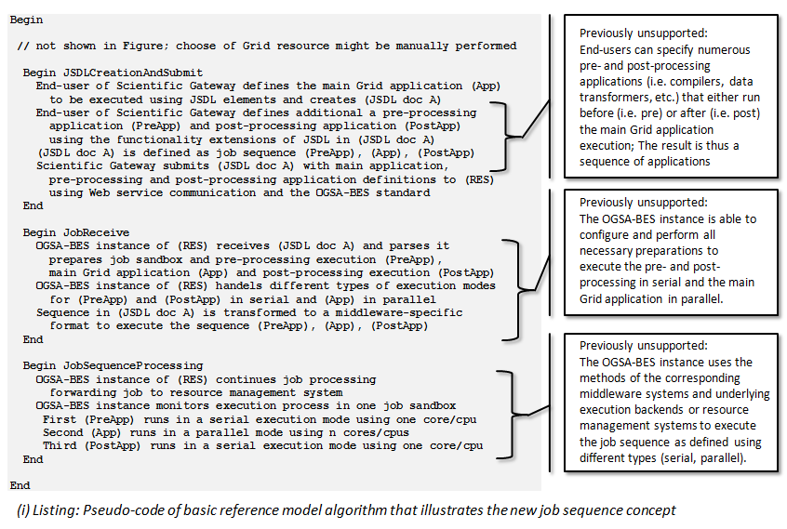
Concept: Sequences (not WF!)
[6] Riedel et al., ., Improvements of Common Open Grid Standards to Increase HTC and HPC Computing Effectiveness…, 2010

Slide 30
Concept: Execution Adjacencies

Slide 31
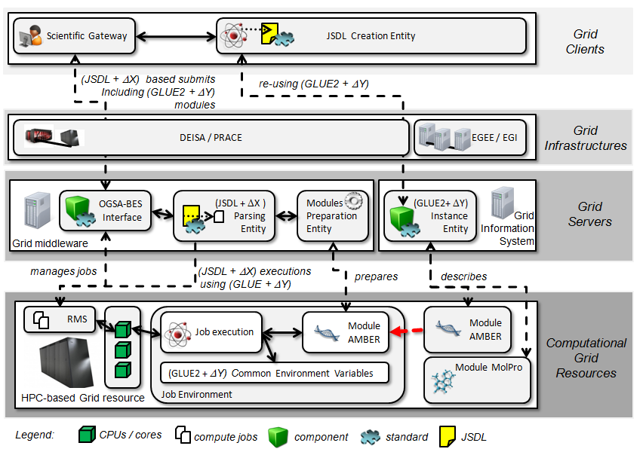
Concept: Execution Adjacencies
[6] Riedel et al., ., Improvements of Common Open Grid Standards to Increase HTC and HPC Computing Effectiveness…, 2010

Slide 32
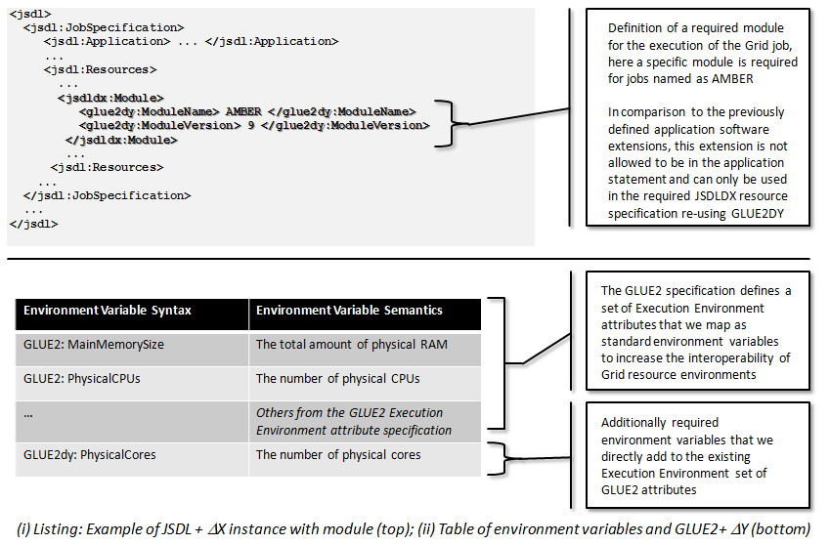
Concept: Execution Adjacencies
[6] Riedel et al., ., Improvements of Common Open Grid Standards to Increase HTC and HPC Computing Effectiveness…, 2010

Slide 33
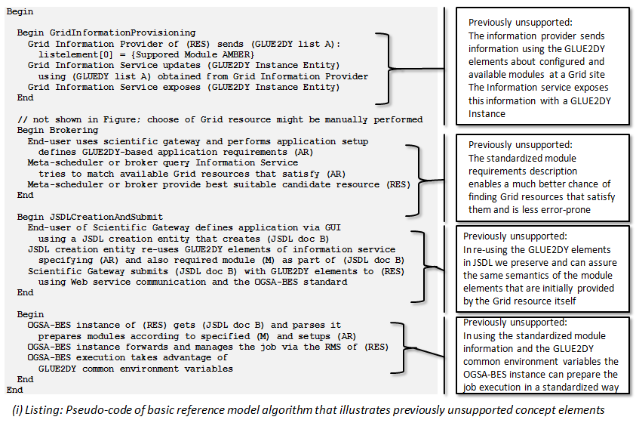
Concept: Execution Adjacencies
[6] Riedel et al., ., Improvements of Common Open Grid Standards to Increase HTC and HPC Computing Effectiveness…, 2010

Slide 34
Summary

Slide 35
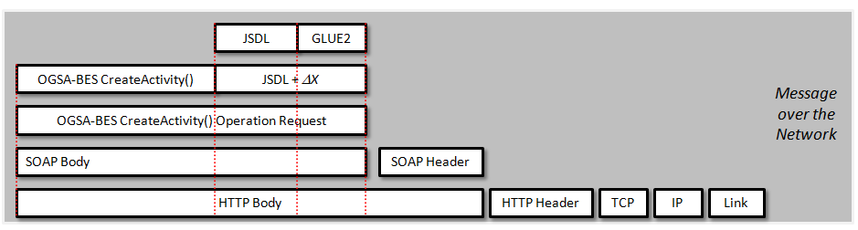
Summary

Slide 36
References

Slide 37
References
[1] M. Riedel, F. Wolf, D. Kranzlmüller, A. Streit, T. Lippert - Research Advances by using Interoperable e-Science Infrastructures - The Infrastructure Interoperability Reference Model applied in e-Science, Journal of Cluster Computing, Special Issue Recent Advances in e-Science, Cluster Computing (2009) Vol. 12, No. 4, pp. 357-372, DOI 10.1007/s10586-009-0102-2, December 2009
[2] M. Riedel, A. Streit, Th. Lippert, F. Wolf, D. Kranzlmueller
Concepts and Design of an Interoperability Reference Model for Scientific- and Grid Computing Infrastructures
Proceedings of the Applied Computing Conference, in Mathematical Methods and Applied Computing, Volume II, WSEAS Press 2009, ISBN 978-960-474-124-3, Pages 691 - 698
[3] M. Riedel, B. Schuller, M. Rambadt, M.S. Memon, A.S. Memon, A. Streit, F. Wolf, Th. Lippert, S.J. Zasada, S. Manos, P.V. Coveney, F. Wolf, D. Kranzlmüller - Exploring the Potential of Using Multiple e-Science Infrastructures with Emerging Open Standards-based e-Health Research Tools, Proceedings of the The 10th IEEE/ACM International Symposium on Cluster, Cloud and Grid Computing (CCGrid 2010), May 17-20, 2010, Melbourne, Victoria, Australia, to be published
[4] M.Riedel and E.Laure et al., Interoperation of World-Wide Production e-Science Infrastructures
Concurrency and Computation: Practice and Experience, 21 (2009) 8, 961 - 990
[5] M.Riedel, Belief Online Article, Enabling Interoperable e-Infrastructures with Common Open Standards - URI: http://www.beliefproject.org/zero-in/zero-in-first-edition-emagazine/enabling-interoperable-e-infrastructures-with-common-open-standards
[6] M.Riedel, et al., Improvements of Common Open Grid Standards to Increase High Throughput and High Performance Computing Effectiveness on Large-scale Grid and e-Science Infrastructures - Seventh High-Performance Grid Computing (HPGC) Workshop at International Parallel and Distributed Processing Symposium (IPDPS) 2010, April 19-23, 2010, Atlanta, USA, to be published

