Slide 1
Market for Computational Services
John Ainsworth

Slide 2
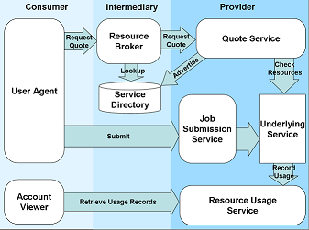
Architecture

Slide 3
Markets Demo
Independent
Broker
Quote Service
Altix
SD-A
QS Altix
Altix
QS Origin
Job Submission Service
Altix
Resource Broker I
Resource Usage Service Altix
Altix Service Provider
User Agent
RB-I
RB-R
Quote Service
Origin
Origin
Job Submission Service Origin
Re-seller
Quote
Service
Re-seller
Altix
Resource Usage Service Altix
Origin
Service Provider
Origin
Notes:
Depending on your measure of success we are one of the best Universities
in the UK.
In most tables we appear around 5th.

Slide 4
SVE @ Manchester Computing
World Leading Supercomputing Service, Support and Research
Bringing Science and Supercomputers Together
www.man.ac.uk/sve
sve@man.ac.uk

