Slide 1



GridSAM - Job Submission and Monitoring Web Service
London e-Science Centre
Department of Computing, Imperial College London

Slide 2
GridSAM Overview
Grid Job Submission And Monitoring Service
What is GridSAM?
  Funded by the OMII Managed Programme (Started in Sept, 04)
    Client Perspective
      Job Submission and Monitoring Web Service that bridges to existing systems (e.g. Condor, SGE)
      Job described in Job Submission Description Language
      File input and output staging
      Tools and simplified Java API for submission and monitoring
    Developer Perspective
      Extensible JobManager API interfacing with existing Distributed Resource Managers (DRM)
      Fault-tolerance and persistence
      Can be used as an embedded library (e.g. in Job Submission Portal, Grid Applications)

Slide 3
Interoperability and Portability
Web Service
  WS-I
  SOAP over HTTPS
  WS-Security
  JSDL*
  WS-(Some Notification Mechanisms)*
Implementation
  Java - Cross Platform
  JAX-RPC - Portable Java Web Service
  JDBC - Database persistence
  JMX - Manageability

Slide 4
Job Submission Description Language
Job Submission Description Language (JSDL)
  Being defined in JSDL-WG
  XML template language for describing core aspects of a job
<JobDefinition>
<JobDescription>
<JobIdentification>?
<User>?
<Application>
<Resource>*
<DataStaging>*

Slide 5
GridSAM Service Port Types
_{JSDL}
GridSAMService
JobSubmissionSOAPBinding
JobMonitoringSOAPBinding
JobSubmissionPortType
JobMonitoringPortType
submitJob
Input: JobDescription
Output: JobIdentifier
Fault: SubmissionFault
Fault: UnsupportedFeatureFault
getJobStatus
Input: JobIdentifier
Output: JobStatus
Fault: UnknownJobFault
_{<JobStatus>}
_{<Stage>+}
_{<State>pending|…|done</Stage>}
_{<Time>xsd:dateTime</Time>}
<Description>xsd:string</Description>
_{</Stage>}
_{<Property key=“xsd:anyURI”>?}
_{xsd:string}
_{</Property>}
_{</JobStatus>}

Slide 6
Job States
ACTIVE
PENDING
STAGING-IN
STAGED-IN
EXECUTED
STAGING-OUT
STAGED-OUT
UNDEFINED
FAILED
DONE

Slide 7
Implementation
Deployment
  OMII v1.1.1 Container
    Effectively Apache Tomcat + Axis + WS-Security
  Adhere to JAX-RPC API and J2EE Deployment Model, therefore can target other J2EE compliant containers
Extensibility
  Core functionalities reside in JobManager API, front-ends are pure wrappers providing front-line security and manageability to the underlying system.
  Job Persistence and Fault-tolerant Submission Pipeline implemented using Hibernate and OpenSymphony Quartz.
  Version 0.1 supports
    Fork / SSH launching
    Condor
    File Staging (e.g. ftp://, http://, webdav://, sftp://) is implemented on top of the Apache Virtual File System API. Potential to contribute our plugins back to the community.

Slide 8
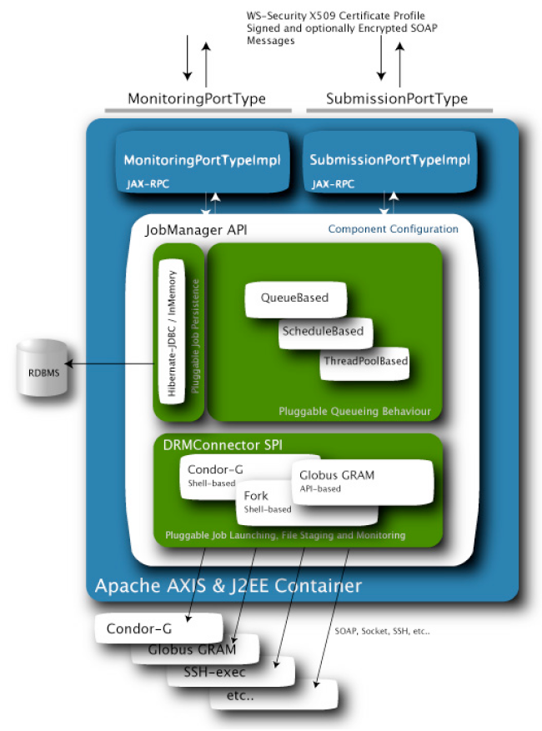
Architecture

Slide 9
Discussion
GridSAM interface is consistent with current BES idea
  Notification and the rendering is an issue to be discussed in BES
  Unified state transitions?
  Control operations (e.g. kill, suspend?, migrate?)

Slide 10
Summary
GridSAM is an open-source system for simple job submission and monitoring to a variety of DRM systems.
JSDL is used as the language for describing a single job to be executed
Upcoming works
  Currently supports a poll monitoring model. Will support notification in the upcoming months.
  Planned works include other DRM connectors (SGE, Globus), file staging (GridFTP), credential delegation and clustering.
  Possible works include job control interface or adaptation to standardised job submission/monitoring/control interfaces.

