Slide 1

Using JSDL in the
Grid Programming Environment (GPE)
Ralf Ratering
Intel
October 5, 2005

Slide 2
Grid Programming Environment - GPE
Applications
Grid SDK
Grid Beans
Client Framework
GPE
Grid Programming Library
High-level Grid API
Descriptions
Resources (CIM)
Jobs (JSDL)
Workflows (BPEL)
Open Grid Services
Architecture (OGSA)
Web Service Resource
Framework (WSRF)
Operations
Job management
File transfers
Brokering
Steering, etc.
WSRF-
enabled
Servers
WSRF-
enabled
Storage
WSRF-
enabled
Network

Slide 3
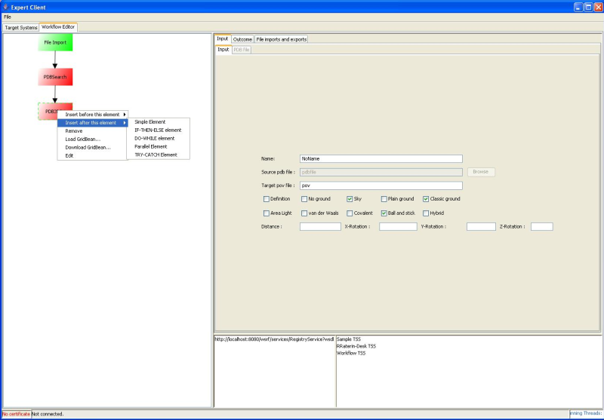
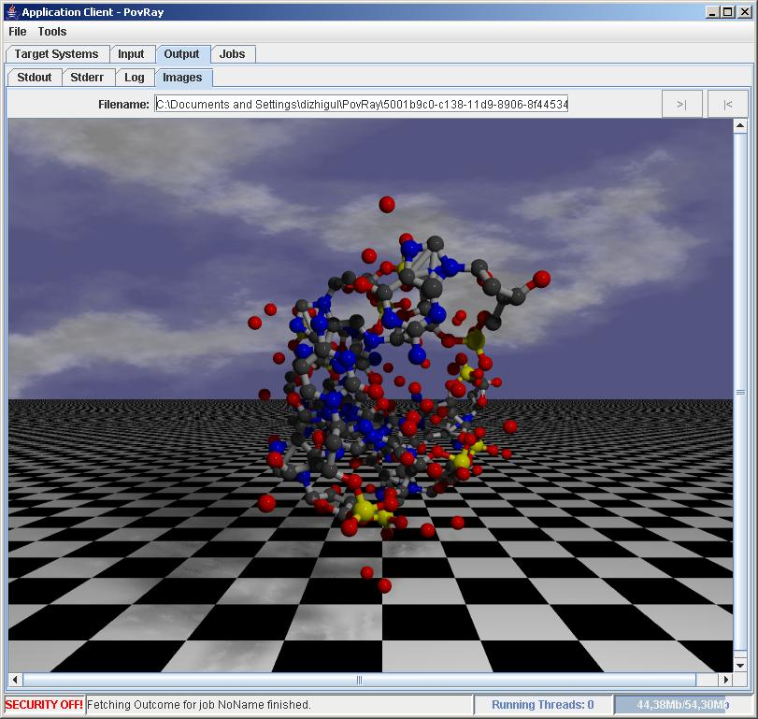
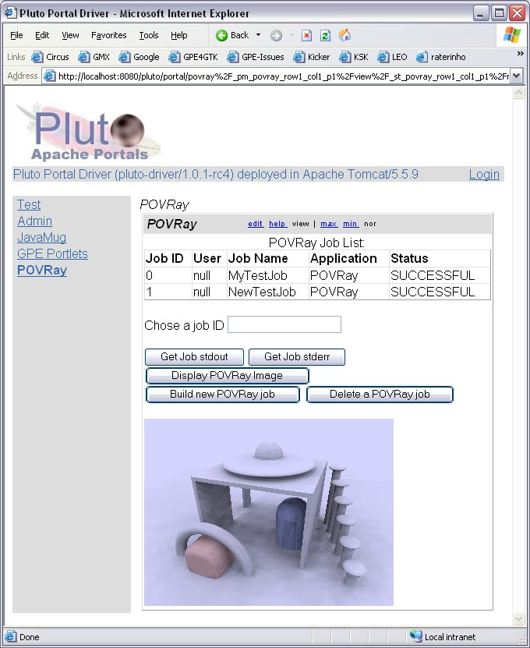
GPE Client Framework
Full access to Grid for expert users and administrators
Workflow Editor
Supports multiple applications and user identities
Expert Client
Light-weight Java application running on mobile devices
Simple application specific interface
Application Client
JSR-168 compliant application portlets that can be integrated into existing portals like UPortal, Jetspeed or GridSphere
Portal Client

Slide 4
GridBeans create JSDL descriptions
GridBean SDK
GridBean
Atomic Service Client API, libraries and tools
GridBean
GridBean
Expert Client
GridBean Service
GridBean
GridBean
GridBean
Application Client
GridBean
A GridBean dynamically integrates application-specific user interfaces in different clients
GridBean
GridBean
GridBean
Portal Client

Slide 5
GPE as interoperability framework
SOAP, WSDL,
WSRF,
WS-Addressing,
WS-Security,
JSDL
and other specifications
UNICORE/GS
Expert Client
Globus
Toolkit 4
China Grid Support
Package
Application Client
Other OGSA-compliant Grid servers
Atomic Service
Client API
Atomic Services
Portal Client

Slide 6
Atomic Services Overview
Target System Factory
(TSF)
Atomic service interfaces define basic set of operations and properties that have to be available on a Grid system
Different implementations of interfaces for different infrastructures
  Protocols, languages, security models, ...
Add a new target system
to the Grid
Target System
Service
(TSS)
Manage
target system
Operations
EPR submit(JSDL)
...
Manage
Jobs on target system
Job
Management
Service
(JMS)
Resource Properties
OriginalJSDL
ExecutionJSDL
...
Storage
Management
Service
(SMS)
Manage
files on
storage
Manage transfers to/from storage
File
Transfer
Service
(FTS)

Slide 7
Original vs. Execution JSDL
Incarnation
Database
Lookup system-specific information
Target System Service (TSS)
Target System Interface (TSI)
Original abstract JSDL
Execute concrete command
Client
<jsdl:JobDefinition id="MyDemoJob“ …>
<jsdl:JobDescription xsi:type="jsdl:JobDescription_Type">
<jsdl:Application xsi:type="jsdl:Application_Type">
<jsdl:ApplicationName xsi:type="xsd:string">POVRay</jsdl:ApplicationName>
<jsdl:ApplicationVersion xsi:type="xsd:string">3.5</jsdl:ApplicationVersion>
<jsdl-posix:POSIXApplication>
<jsdl-posix:WorkingDirectory xsi:type="jsdl-posix:DirectoryName_Type">
$TEMPORARY_DIRECTORY
</jsdl-posix:WorkingDirectory>
<jsdl-posix:Environment name="OUTPUT_FORMAT" xsi:type="jsdl-posix:Environment_Type">
PNG
</jsdl-posix:Environment>
<jsdl-posix:Environment name="SOURCE" xsi:type="jsdl-posix:Environment_Type">
povray.pov
</jsdl-posix:Environment>
<jsdl-posix:Environment name="WIDTH" xsi:type="jsdl-posix:Environment_Type">
320
</jsdl-posix:Environment>
…

Slide 8
A Workflow Execution Service based on WSRF, JSDL and BPEL
Target System
Workflow Execution Service
(TSS)
Target System
orchestrate
BPEL-enabled JSDL
Client
Target System
Use Grid-specific BPEL subset
Implemented as WSRF service itself
  EPR submit(JSDL) operation
  Information about workflow (state, input/output files, etc.) is kept in BPEL variables
  BPEL variables are accessible as resource properties of the Workflow TSS

Slide 9
JSDL Extensions for BPEL Workflows
<schema xmlns="http://www.w3.org/2001/XMLSchema"
targetNamespace="http://gpe.intel.com/workflow"
xmlns:jsdl-wf="http://gpe.intel.com/workflow"
elementFormDefault="qualified" attributeFormDefault="unqualified">
<element name="WorkflowApplication" type="jsdl-wf:WorkflowApplication_Type"/>
<complexType name="WorkflowApplication_Type">
<sequence>
<element ref="jsdl-wf:WorkingDirectory"/>
<element ref="jsdl-wf:Variable" minOccurs="0" maxOccurs="unbounded"/>
<element ref="jsdl-wf:Process"/>
</sequence>
</complexType>
<element name="WorkingDirectory" type="string"/>
<element name="Variable" type="jsdl-wf:Variable_Type"/>
<complexType name="Variable_Type">
<sequence>
<any/>
</sequence>
<attribute name="name" type="NCName"/>
<attribute name="part" type="NCName"/>
</complexType>
<element name="Process" type="jsdl-wf:Process_Type"/>
<complexType name="Process_Type">
<sequence>
<any/>
</sequence>
</complexType>
</schema>

Slide 10
A GPE-BPEL Workflow
<invoke inputVariable="submitJobRequest"
operation="Submit"
outputVariable="submitJobResponse"
partnerLink="targetSystem"
portType="tss:TargetSystem" />
<assign>
<copy>
<from part="SubmitResponse"
query="/tss:SubmitResponse/tss:JobReference"
variable="submitJobResponse" />
<to partnerLink="jobManagement" />
</copy>
</assign>
<while condition="bpws:getVariableData('getJob1StateResponse',
'GetResourcePropertyResponse')/child::text()[1]!='READY'
and bpws:getVariableData('getJob1StateResponse',
'GetResourcePropertyResponse')/child::text()[1]!='FAILED'">
<invoke inputVariable="getJobStateRequest"
operation="GetResourceProperty"
outputVariable="getJobStateResponse"
partnerLink="jobManagement“
portType="u-rp:ResourcePropertiesPortType" />
</while>
<invoke inputVariable="startJobRequest"
operation="Start"
outputVariable="startJobResponse"
partnerLink="jobManagement"
portType="jms:JobManagement" />
<while condition="bpws:getVariableData('getJobStateResponse',
'GetResourcePropertyResponse')/child::text()[1]!=
'SUCCESSFUL' and
bpws:getVariableData('getJobStateResponse',
'GetResourcePropertyResponse')/child::text()[1]!='FAILED'">
<invoke inputVariable="getJobStateRequest"
operation="GetResourceProperty"
outputVariable="getJobStateResponse"
partnerLink="jobManagement"
portType="u-rp:ResourcePropertiesPortType" />
</while>
JSDL
Submit JSDL to target system service
Retrieve the job EPR from the SubmitResponse through jobManagement partnerlink
Wait until the job status is READY or FAILED
Start the job: Start request is stored in startJobRequest variable
Wait until job status is SUCCESSFUL or FAILED

Slide 11
Passing JSDL documents as BPEL variables
VARIABLE:
name: submitJobRequest
part: SubmitRequest
value:
<ns2:Submit xmlns:ns2="http://unigrids.org/2005/06/services/tss">
<jsdl:JobDefinition id="MyDemoJob"
xmlns="http://www.example.org/"
xmlns:jsdl="http://schemas.ggf.org/jsdl/2005/06/jsdl"
xmlns:jsdl-posix="http://schemas.ggf.org/jsdl/2005/06/jsdl-posix"
xmlns:xsi="http://www.w3.org/2001/XMLSchema-instance">
<jsdl:JobDescription xsi:type="jsdl:JobDescription_Type">
<jsdl:Application xsi:type="jsdl:Application_Type">
<jsdl:ApplicationName xsi:type="xsd:string">POVRay</jsdl:ApplicationName>
<jsdl:ApplicationVersion xsi:type="xsd:string">3.5</jsdl:ApplicationVersion>
...
</ns2:Submit>
JSDL description may contain BPEL variables that are substituted by the workflow engine at run-time
  See parameter studies, etc.

Slide 12
File Transfers
Atomic Services support different protocols
  FTP, GridFTP, plain HTTP(s), SOAP with Attachements, any other
Storage management announces available protocols via its resource properties
  Client queries available protocols and selects appropriate one
JSDL DataStaging element is used for 3rd party file transfers
  Use URIs to specify remote files (no SMS EPRs)
<jsdl:DataStaging>
<jsdl:Source>
<jsdl:URI>
http://xyz.intel.com:8011/home/rraterin/test.txt
</jsdl:URI>
</jsdl:Source>
...
</jsdl:DataStaging>

Slide 13
Current State and Next Steps
GPE Alpha version has been released at UNICORE SourceForge on June 1, 05
  Full working version for demos and developers
GPE-enhanced GTK4 implementation
  Separate SourceForge project „GPE4GTK“
  First release Oct 28
  Beta release Dec 31, 05
UNICORE/GS support in UniGridS project
Thanks to the JSDL Team for the great work!!!

