Slide 1
JSDL Future
Ali Anjomshoaa, Fred Brisard, Michel Drescher,
Donal K. Fellows, William Lee, An Ly, Steve McGough,
Darren Pulsipher, Andreas Savva, Chris Smith
15 February 2006

Slide 2
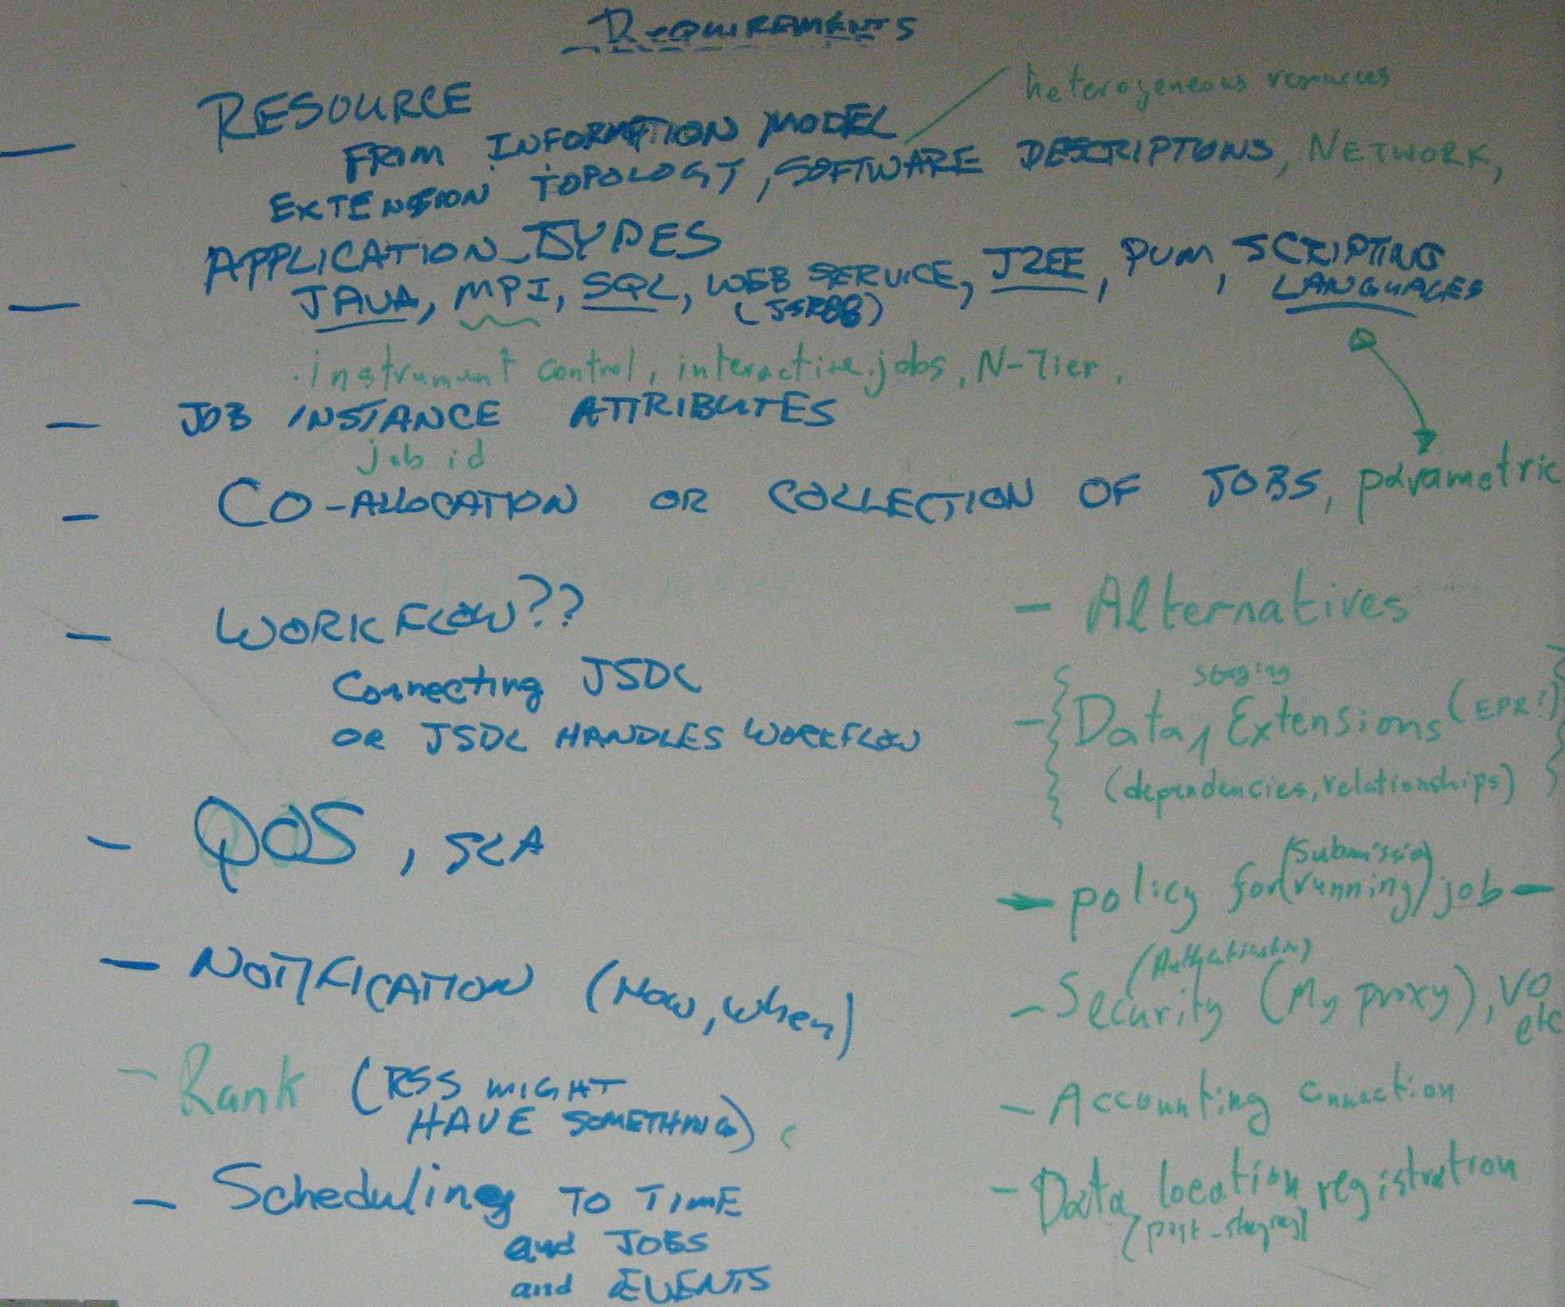
The Lot

Slide 3
In More Space
Resources
From information model
Heterogeneous Model
Extension topology
Software Descriptions
Network
Relationship to CDDLM
Partial Data Staging / File Systems

Slide 4
Application Types
Java
MPI
SQL
Web Services
J2EE
PVM
Scripting Languages
Instrument control
interactive jobs
n-tier
Parameterized

Slide 5
In More Space
Job Instance Attributes
Job ID
Reservation of … (everything – Network/Resource/…)
QOS, SLA
Coallocation of collection of Jobs
Parametric
Variable substitution (ala C++ templates)
The ability to reference elements
Workflow
Connecting JSDL
JSDL handles workflow?
Notification (How, When)

Slide 6
In More Space
Rank (RSS might have something)
Scheduling to time, jobs, or events
Alternatives
Data Staging Extensions (Error handling)
Dependencies, relationships

Slide 7
In More Space
Policy for submission, running jobs
Security (My Proxy), Virtual Orgs etc..
Accounting Connection
Data location registration (Post-staging)

Slide 8
GGF Full Copyright Notice
Copyright (C) Global Grid Forum (2006). All Rights Reserved.
This document and translations of it may be copied and furnished to others, and derivative works that comment on or otherwise explain it or assist in its implementation may be prepared, copied, published and distributed, in whole or in part, without restriction of any kind, provided that the above copyright notice and this paragraph are included on all such copies and derivative works. However, this document itself may not be modified in any way, such as by removing the copyright notice or references to the GGF or other organizations, except as needed for the purpose of developing Grid Recommendations in which case the procedures for copyrights defined in the GGF Document process must be followed, or as required to translate it into languages other than English.
The limited permissions granted above are perpetual and will not be revoked by the GGF or its successors or assigns.
This document and the information contained herein is provided on an "AS IS" basis and THE GLOBAL GRID FORUM DISCLAIMS ALL WARRANTIES, EXPRESS OR IMPLIED, INCLUDING BUT NOT LIMITED TO ANY WARRANTY THAT THE USE OF THE INFORMATION HEREIN WILL NOT INFRINGE ANY RIGHTS OR ANY IMPLIED WARRANTIES OF MERCHANTABILITY OR FITNESS FOR A PARTICULAR PURPOSE."

