Slide 1
JSDL-based Job Submission
Interface in HPC-Europa
Ariel Oleksiak
ariel@man.poznan.pl
Poznan Supercomputing and Networking Center (PSNC)
JSDL Workshop, GGF16, Athens, 15 February 2006

Slide 2
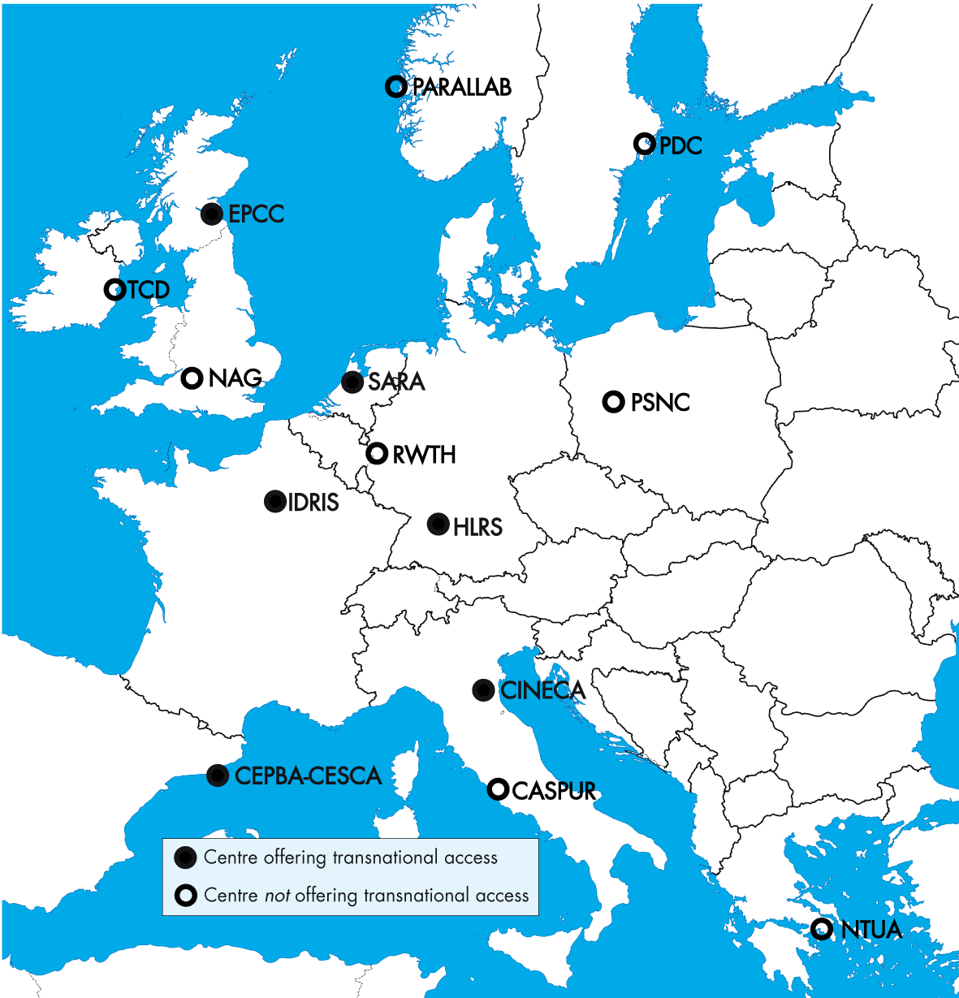
HPC-Europa
Goal: to provide advanced computational services in an integrated way to the European research community
Budget: ~13 mln EURO
14 Partners across Europe
  6 Transnational Access centers
Project activities
  Transnational Access Programme
  Networking Activities
  Joint Research Activities (JRA1, JRA2)

Slide 3
JRA2: Single Point of Access
Motivation
  To provide a uniform access to resources of all centers, transparently and regardless of user physical location
Main objectives
  Ease of use,
  Improvement of resources availability and utilization,
  Enabling HPC centers to use their own middleware and local policies
To achieve these goals JRA2:
  Builds the HPC-Europa portal based on the GridSphere framework
  Develops interfaces to needed tools and services

Slide 4

HPC-Europa Infrastructure
End users
GRMS
UNICORE
Pre-WS Globus 3.2
PBS
PSNC
SPA
CINECA
JOSH
Globus 3.2
GRIA
SGE
eNANOS
Globus 3.2
UNICORE
EPCC
LoadLeveler
NTUA
BSC
HLRS

Slide 5
Single Point of Access Portal
Application-specific
Job Submission
Job Monitoring
Resource Inform
Definition of the common interface
  For each functionality, e.g. job submission
  Based on standards where possible (e.g. JSDL)
  Taking into account both gathered requirements and available functionality
Use & extension of the GridSphere’s GridPortlets
Capability check
  Description of implemented capabilities
  to disable not available options and controls in portal
Portlets
JSDL
JSDL
Job Submission
Job Monitoring
Resource Inform
Services
JSDL
eNANOS
GRIA
GRMS
JOSH
UNICORE
Plugin
Plugin
XSL
GJD
Plugins
UNICORE
GRMS
JOSH
eNANOS
GRIA

Slide 6
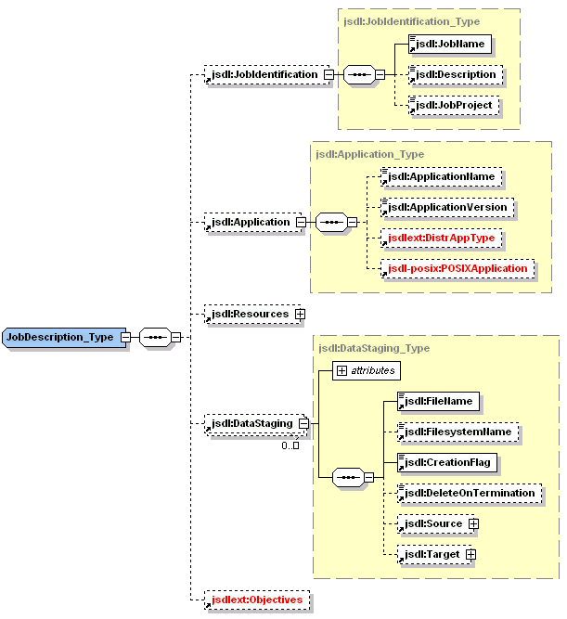
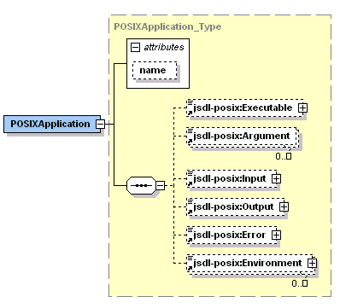
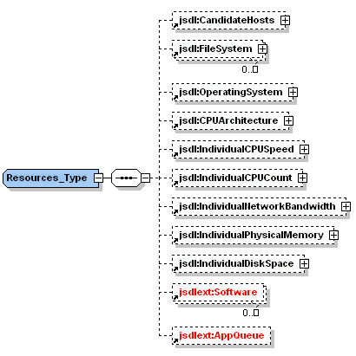
Job Submission Interface
Consists of set of operations +
  Job Description
  Job Information
Job submission operations
  submitJob, cancelJob, findResources, submitJobToBestResource , getJobStatus, findBestResource, getJobInfo
Job description based on the Job Submission Description Language (JSDL) specification
Subset of JSDL defines the common job description
Recently upgrade of the job submission interface to version 1.0

Slide 7

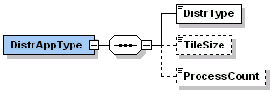
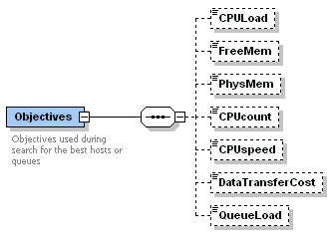
Extensions
Software
  software required to be installed at destination sites
  e.g. JVM, graphical libraries, VNC for interactive apps, etc.
Queue
DistrType
  type of application (e.g. single, mpi, mpichg)
  total number of processes
  number of processes per node
Objectives
  to express preferences concerning selection of the best resources
  importance of selected parameters

Slide 8
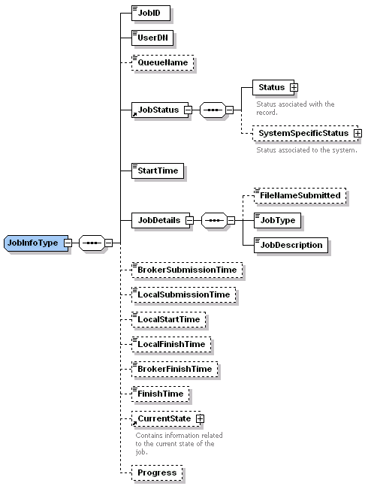
Job Information
Information about
  Current job status
  Host and queue
  Job submission, start and finish time
  History of events (changes of job status)
  Details specific to certain monitoring tools

Slide 9
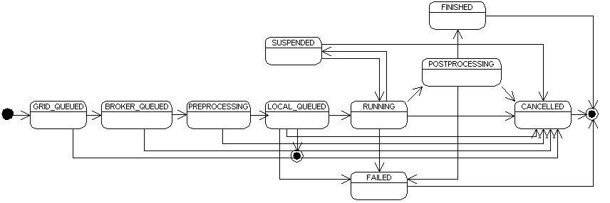
Job States

Slide 10
Dynamic GUI Adaptation
Two types of portlets
  Generic interfaces, e.g. for job submission
  Application-specific portlets
Some of plugins may implement only a part of the uniform interface
Two descriptions must be returned by plugins
  description of available methods
  description of data structures (i.e. job description)
Job Submission plugins return the XML schema which contains a subset of the JSDL schema
The Job Submission Portlet uses this information to
  Validate generated JSDL documents
  Disable appropriate fields and limit lists of feasible values

Slide 11
Example of Plugin: GRMS
Basic functionality provided:
  submitJob, submitJobToBestResource, findResources, getStatus
Transformation from JSDL to GRMS Job Description Language done using the XSL style sheet
  Easy to modify without looking into source code
  Can be changed in a runtime (no need to restart portal)!
GRMS
Plugin
XSLT
JSPortlet
JSDL
GJD
GRMS

Slide 12
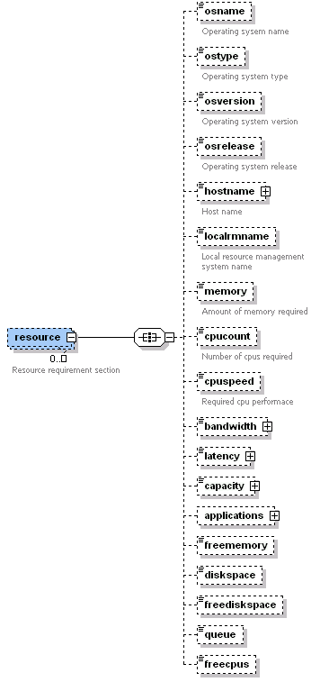
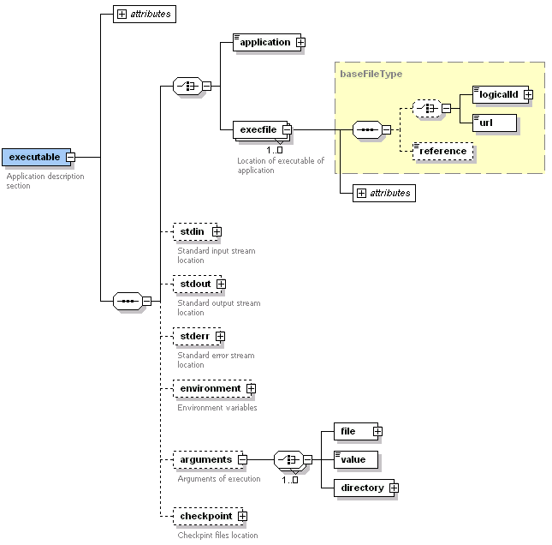
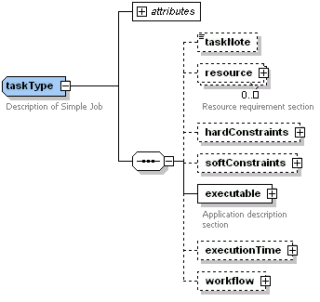
Translation to GJD

Slide 13
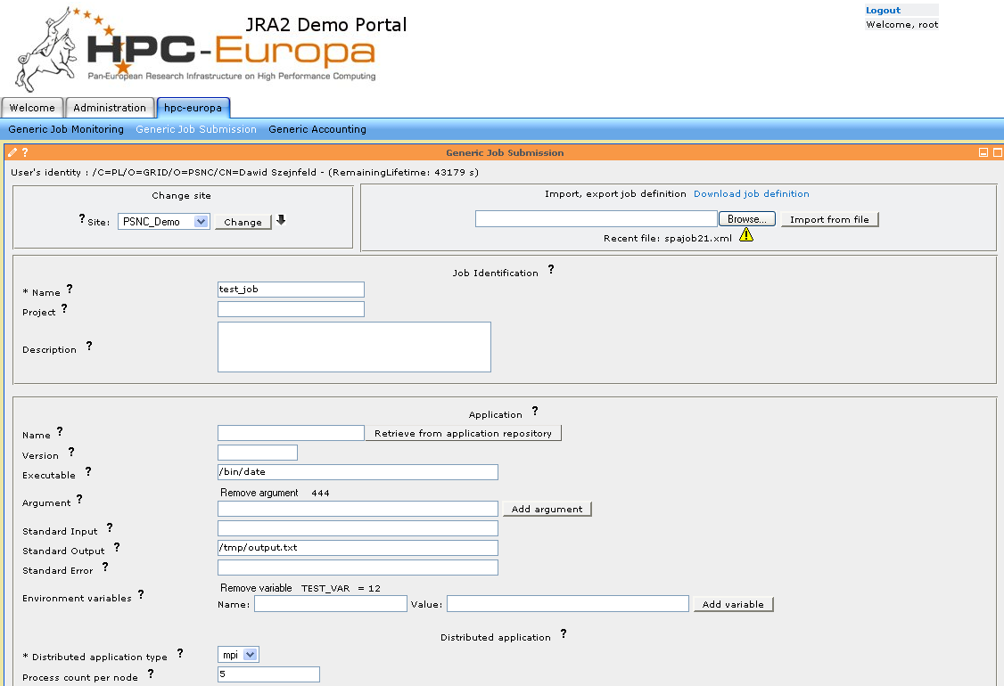
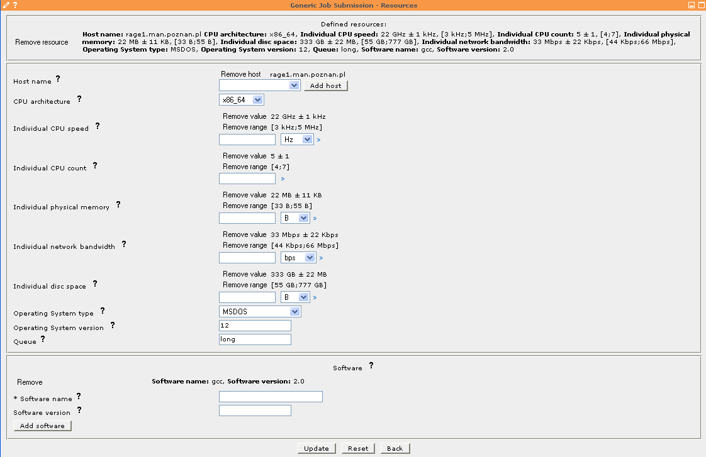
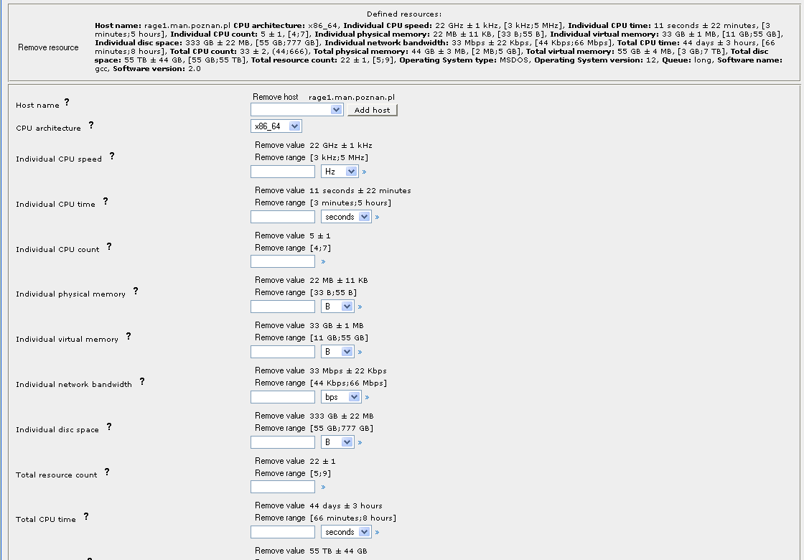
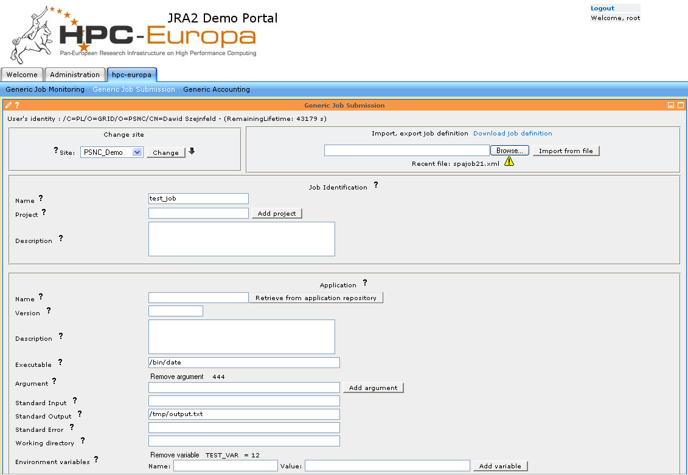
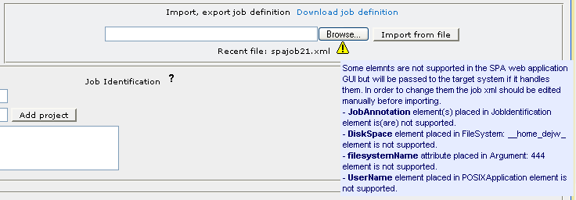
Generic Job Submission Portlet

Slide 14
Advantages & Problems
Advantages
  Relatively easy to translate to other job descriptions (based on XML)
  Only a small, well-defined part of the whole job submission procedure
    Easy to deploy – does not impose protocol, methods etc.
    Possible to use with other standards
  Generic enough
  Easily extensible
Issues
  Significant effort needed to make an upgrade to version 1.0
  Much harder to validate than system-specific job descriptions
  Only job description – requires definition/adoption of the remaining parts of the interface
  Not well suited for description of distributed jobs
  Problems with description of more complex requirements, e.g. alternatives
  Other issues: network bandwidth, file systems, directories

Slide 15
Conclusion
JSDL used in HPC-Europa to
  enable uniform access from the portal to different available job submission services
  define job description of Grid resource brokers / job submission services instead of local systems
  describe Grid resource brokers capabilities (to automatically adapt GUI to functionality of plugin)
A few extensions and a design of the remaining parts of the job submission interface had to be made
Till the end of February 2006 a working prototype allowing submitting jobs to 5 systems available in HPC-Europa will be provided for test users
At present, the project is more focused on application-specific portlets built on top of the uniform job submission interface

