Slide 1


Community Scheduler Framework
Chris Smith, Platform Computing
csmith@platform.com

Slide 2
Agenda
Community Scheduler Framework (CSF)
Experiences in implementing Advance Reservation
CSF and JSDL

Slide 3
What is CSF ?
Open source Grid services for implementing community schedulers
Support multiple metaschedulers
Based on Globus Toolkit 3.0 (GT3)
Enterprise
Grid:
Platform MultiCluster
Partner Grid
Solutions
Service Grid:
On Demand
Scheduler
Community Scheduler Framework (CSF)
Base on Globus Toolkit 3, OGSA core service,
OGSI-agreement, Open Source,
Part of Globus Toolkit,
Web Services enabled,
Gateway to 3rd party systems
Platform LSF
Family
Off-line /
Batch
Platform Symphony
On-line /
Service
Oriented
Condor
SGE
PBS
… others

Slide 4



What’s in it for you
GT3.0
GT3.0
Queuing
Service
RM
Adapter
for LSF
LSF 1
Internet
Job
Service
Site A
Reservation
Service
GT3.0
VO
RM
Adapter
for PBS
PBS
Interoperability of the RMs
Reliability/Scalability
Platform for more interesting work
  VO security and trust model
  Economy scheduler
  xSPs
Site B
GT3.0
RM
Adapter
for SGE
SGE
Site C

Slide 5
CSF Grid Services
Job Service creates, monitors and controls compute jobs
Reservation Service guarantees resources are available for running a job
Queueing Service provides a service where administrators can customize and define scheduling policies at the VO level and/or at the different resource manager level
RM Adaptor Service provides a Grid service interface that bridges the Grid service protocol and resource managers (LSF, PBS, SGE, Condor and other RMs)

Slide 6
What’s in it for metascheduler developers
Implement four call-back functions and plug-in!
Scheduler Modules
Scheduler framework API
Queueing Service
_{Resource}
_{Job Ctrl Actions}
Reservation Service
Job Service
Notes:
The scheduler is going to take on a new look.

Slide 7
How to get it
CSF is in Beta phase
http://www.platform.com/services/support/csf/beta.asp

Slide 8

Experiences with WS-Agreement

Slide 9
Reservation Service uses WS-Agreement
GT3.0
GT3.0
Queuing
Service
RM Adapter
LSF
Internet
Job
Service
Site A
Reservation
Service
GT3.0
VO
RM Adapter
PBS
Site B
_{Reservation Agreement Exchange}
GT3.0
RM
Adaptor
SGE
Site C

Slide 10
What we implemented
Exposed an advance reservation as an Agreement Service
Defined the reservation agreement terms, currently to only use
  “all” agreement terms
  Wsp:Usage=“required” and Gsa:Negotiability=“fixed”
Negotiation is being explored in implementing Platform LSF MultiCluster’s resource leasing feature on top of OGSI-Agreement

Slide 11
Agreement terms for Advance Reservation
<metascheduler:agreement>
<wsp:All wsp:Usage="wsp:Required">
<metascheduler:ResReq gsa:Negotiability="gsa:Fixed">
<resReq>type==LINUX86</resReq>
</metascheduler:ResReq>
<metascheduler:hostTerm
gsa:Negotiability="gsa:Fixed">
<host>bf01</host>
</metascheduler:hostTerm>
<metascheduler:userTerm
gsa:Negotiability="gsa:Fixed">
<userName>jlam</userName>
</metascheduler:userTerm>
<metascheduler:cpuTerm gsa:Negotiability="gsa:Fixed">
<number>32</number>
</metascheduler:cpuTerm>
<metascheduler:startTime
gsa:Negotiability="gsa:Fixed">
<time>2003-08-29T17:00:00.000Z</time>
</metascheduler:startTime>
<metascheduler:endTime gsa:Negotiability="gsa:Fixed">
<time>2003-08-29T23:00:00.000Z</time>
</metascheduler:endTime>
</wsp:All>
</metascheduler:agreement>
_{CONT}

Slide 12
Reservation Service PortType
<gwsdl:portType name="ReservationPortType" extends="ogsi:GridService">
<operation name="modify">
<input message="tns:ModifyInputMessage"/>
<output message="tns:ModifyOutputMessage"/>
<fault name="ReservationFault" message="tns:ReservationFaultMessage"/>
</operation>
<operation name="cancel">
<input message="tns:CancelInputMessage"/>
<output message="tns:CancelOutputMessage"/>
<fault name="ReservationFault" message="tns:ReservationFaultMessage"/>
</operation>
<operation name="getStatus">
<input message="tns:GetStatusInputMessage"/>
<output message="tns:GetStatusOutputMessage"/>
<fault name="ReservationFault" message="tns:ReservationFaultMessage"/>
</operation>
<operation name="getRsvData">
<input message="tns:GetRsvDataInputMessage"/>
<output message="tns:GetRsvDataOutputMessage"/>
<fault name="ReservationFault" message="tns:ReservationFaultMessage"/> </operation>
</gwsdl:portType>
To be updated to extend AgreementPortyType
_{CONT}

Slide 13
Reservation Agreement Factory SDs
<ns3:supportedAgreement qname="ns4:createByAgreement" xmlns:ns3="http://www.platform.com/namespaces/2003/05/metascheduler/gsa" xmlns:ns4="http://www.platform.com/namespaces/2003/05/metascheduler/reservation" xmlns:xsi="http://www.w3.org/2001/XMLSchema-instance" xsi:type="ns3:SupportedAgreementType">
<ns3:term qname="ns5:hostsTerm" xmlns:ns5="http://com.platform.metascheduler/2003/05/rsl/metascheduler" xsi:type="ns3:SupportedTermType"/>
<ns3:term qname="ns6:cpuTerm" xmlns:ns6="http://com.platform.metascheduler/2003/05/rsl/metascheduler" xsi:type="ns3:SupportedTermType"/>
<ns3:term qname="ns7:userTerm" xmlns:ns7="http://com.platform.metascheduler/2003/05/rsl/metascheduler" xsi:type="ns3:SupportedTermType"/>
<ns3:term qname="ns8:startTime" xmlns:ns8="http://com.platform.metascheduler/2003/05/rsl/metascheduler" xsi:type="ns3:SupportedTermType"/>
<ns3:term qname="ns9:endTime" xmlns:ns9="http://com.platform.metascheduler/2003/05/rsl/metascheduler" xsi:type="ns3:SupportedTermType"/>
<ns3:term qname="ns10:reqReq" xmlns:ns10="http://com.platform.metascheduler/2003/05/rsl/metascheduler" xsi:type="ns3:SupportedTermType"/>
</ns3:supportedAgreement>

Slide 14
Reservation Agreement Service SD
Status as per Agreement:status
<ns3:status
Activity="gsa:Inactive"
Negotiation="wsp:Observed"
Satisfaction="gsa:Satisfied"
xmlns:ns3="http://www.platform.com/namespaces/2003/05/metascheduler/gsa"
xmlns:xsi="http://www.w3.org/2001/XMLSchema-instance" xsi:type="ns3:StatusType"/>
Agreement as per Agreement:agreement
<ns3:agreement xmlns:ns3="http://www.platform.com/namespaces/2003/05/metascheduler/gsa" xmlns:xsi="http://www.w3.org/2001/XMLSchema-instance" xsi:type="ns3:AgreementType">
<ns3:all Preference="0" Usage="wsp:Required" xmlns:ns4="http://schemas.xmlsoap.org/ws/2002/12/policy" xsi:type="ns4:Compositor">

Slide 15
Reservation Agreement Service SD (cont)
<ns4:TextEncoding xsi:nil="true"/>
<ns4:Language xsi:nil="true"/>
<ns4:SpecVersion xsi:nil="true"/>
<ns4:MessagePredicate xsi:nil="true"/>
<ns5:hostsTerm xmlns:ns5="http://com.platform.metascheduler/2003/05/rsl/metascheduler" xsi:type="ns5:HostsTermType">
<ns5:host>bf01 dev04</ns5:host>
</ns5:hostsTerm>
<ns6:cpuTerm xmlns:ns6="http://com.platform.metascheduler/2003/05/rsl/metascheduler" xsi:type="ns6:CpuTermType">
<ns6:number>32</ns6:number>
</ns6:cpuTerm>
<ns7:userTerm xmlns:ns7="http://com.platform.metascheduler/2003/05/rsl/metascheduler" xsi:type="ns7:UserTermType">
<ns7:user>jlam</ns7:user>
</ns7:userTerm>

Slide 16
Reservation Agreement Service SD (cont)
</ns7:userTerm>
<ns8:startTime xmlns:ns8="http://com.platform.metascheduler/2003/05/rsl/metascheduler" xsi:type="ns8:TimeTermType">
<ns8:time>2003-08-29T17:00:00.000Z</ns8:time>
</ns8:startTime>
<ns9:endTime xmlns:ns9="http://com.platform.metascheduler/2003/05/rsl/metascheduler" xsi:type="ns9:TimeTermType">
<ns9:time>2003-08-29T23:00:00.000Z</ns9:time>
</ns9:endTime>
<ns10:reqReq xmlns:ns10="http://com.platform.metascheduler/2003/05/rsl/metascheduler" xsi:type="ns10:ResReqTermType">
<ns10:resReq>type==LINUX86</ns10:resReq>
</ns10:reqReq>
</ns3:all>
<ns3:id xsi:nil="true"/>
<ns3:language xsi:nil="true"/>
<ns3:messagePredicate xsi:nil="true"/>
<ns3:name xsi:nil="true"/>

Slide 17
Reservation Agreement Service SD (cont)
<ns3:policyReference xsi:nil="true"/>
<ns3:specVersion xsi:nil="true"/>
<ns3:targetNamespace xsi:nil="true"/>
<ns3:textEncoding xsi:nil="true"/>
</ns3:agreement>

Slide 18
CSF and JSDL

Slide 19
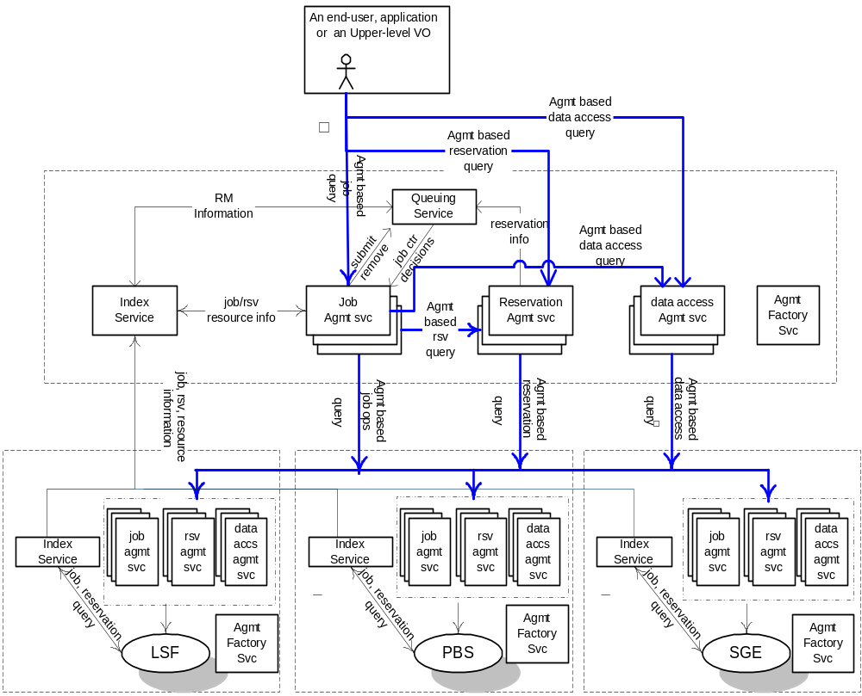
Agreement based architecture
_{VO}

Slide 20
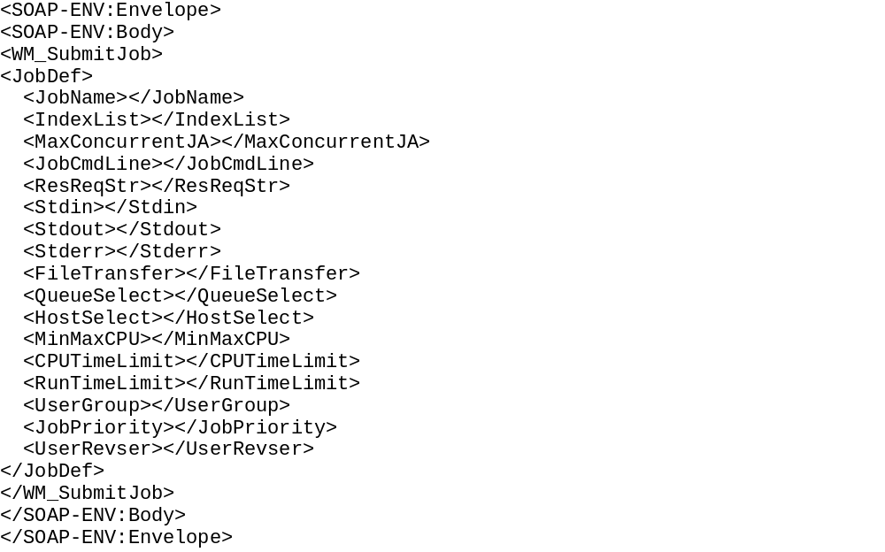
Bridging to LSF
The RM Adapter (currently) and Job/Reservation services (later) talk to LSF’s “Grid Access Broker Daemon” (GABD)
This service acts as the OGSI to resource manager bridge, and must translate between JSDL job terms and the RM’s native interfaces

Slide 21
Mapping JSDL job terms to LSF terms
<jsdl:executable wsp:Usage="wsp:Required" wsa:Negotiability="wsa:Fixed"
wsa:filePath="/bin/processData"/>
<wsp:OneOrMore wsp:Usage="wsp:Required">
<jsdl:host jsdl:hostName=“node1" wsp:Preference="10"/>
<jsdl:host jsdl:hostName=“node2"/>
<jsdl:host jsdl:hostName=“node3"/>
</wsp:OneOrMore>
<WM_SubmitJob>
<JobDef>
<JobCmdLine>/bin/processData</JobCmdLine>
<HostSelect>node1+10 node2 node3</HostSelect>
</JobDef>
</WM_SubmitJob>

