Slide 1

JSDL-WG Session
OGF28 – General Session
5:30-6:30pm, 16 March 2010
Munich, Germany

Slide 2

OGF IPR Policies Apply
“I acknowledge that participation in this meeting is subject to the OGF Intellectual Property Policy.”
Intellectual Property Notices Note Well: All statements related to the activities of the OGF and addressed to the OGF are subject to all provisions of Appendix B of GFD-C.1, which grants to the OGF and its participants certain licenses and rights in such statements. Such statements include verbal statements in OGF meetings, as well as written and electronic communications made at any time or place, which are addressed to:
    the OGF plenary session,
    any OGF working group or portion thereof,
    the OGF Board of Directors, the GFSG, or any member thereof on behalf of the OGF,
    the ADCOM, or any member thereof on behalf of the ADCOM,
    any OGF mailing list, including any group list, or any other list functioning under OGF auspices,
    the OGF Editor or the document authoring and review process
Statements made outside of a OGF meeting, mailing list or other function, that are clearly not intended to be input to an OGF activity, group or function, are not subject to these provisions.
Excerpt from Appendix B of GFD-C.1: ”Where the OGF knows of rights, or claimed rights, the OGF secretariat shall attempt to obtain from the claimant of such rights, a written assurance that upon approval by the GFSG of the relevant OGF document(s), any party will be able to obtain the right to implement, use and distribute the technology or works when implementing, using or distributing technology based upon the specific specification(s) under openly specified, reasonable, non-discriminatory terms. The working group or research group proposing the use of the technology with respect to which the proprietary rights are claimed may assist the OGF secretariat in this effort. The results of this procedure shall not affect advancement of document, except that the GFSG may defer approval where a delay may facilitate the obtaining of such assurances. The results will, however, be recorded by the OGF Secretariat, and made available. The GFSG may also direct that a summary of the results be included in any GFD published containing the specification.”
OGF Intellectual Property Policies are adapted from the IETF Intellectual Property Policies that support the Internet Standards Process.
Notes:
IPR Notices Note Well for OGF meetings

Slide 3
OGF28 Sessions
Activity instance document schema
  [Tuesday, 10:30-12:00, @HGB-A 120]
  Working session on activity instance
General Session
  [Tuesday, 5:00-6:30pm, @HGB-A 120]
  State of working group
  Next steps
NOTE THESE ARE PRIMARILY WORKING SESSIONS

Slide 4
Work done since OGF27
Activity instance document schema
  Schema updates
  Near complete specification
  Submit for public comment soon
  Work done during {bi/weekly,monthly} calls

Slide 5
To do list
Agreed following should be started (little progress)
  SPMD survey & experience document
    Discussion with SAGA-WG etc to support muticore
  Mini-spec to enable other resource descriptions (?)
  Dependencies/workflow experience document based on projects that have used jsdl+custom workflow
Left the following for later
  XQuery/Glue connection for resource requirements
    Profile to use GLUE (needs BES GLUE adaptation)
    Outlined in “Information and Data Modeling in OGSA® Grids” GFD.137
  Mini-spec on “May ignore” attribute on elements as discussed at Singapore and before
  Parameter sweep experience document
    First full implementation reported (Genesis II)

Slide 6
Agenda
Presentations
  XtreemOS JSDL extensions
  PGI-WG JSDL requirements
  Data/file staging/copying generalization
Discussion

Slide 7
Full Copyright Notice
Copyright (C) Open Grid Forum (2010). All Rights Reserved.
This document and translations of it may be copied and furnished to others, and derivative works that comment on or otherwise explain it or assist in its implementation may be prepared, copied, published and distributed, in whole or in part, without restriction of any kind, provided that the above copyright notice and this paragraph are included on all such copies and derivative works.
The limited permissions granted above are perpetual and will not be revoked by the OGF or its successors or assignees.
Notes:
OGF Full Copyright Notice if necessary

Slide 9
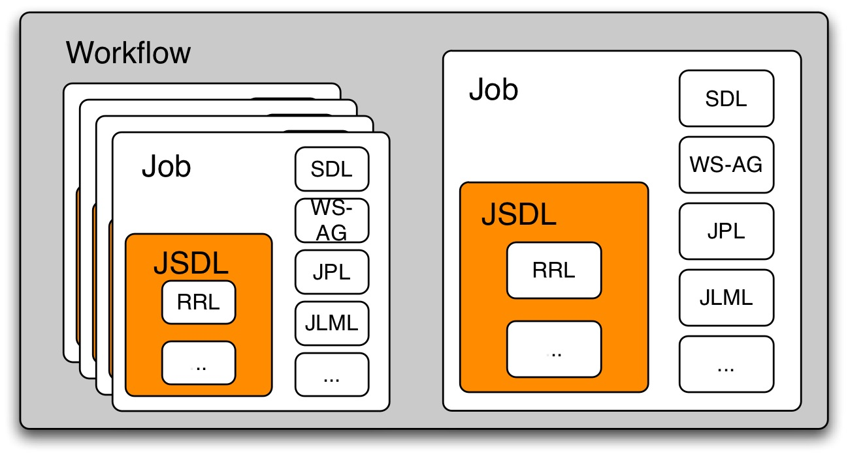
Activity instance document schema
Collected use cases
Identified requirements
Prioritized requirements
Initial XML schema

Slide 10



JSDL Activities/Documents
Now
GFD.56
JSDL 1.0 Recommendation(GFD.136)
GFD.111
GFD.115
JSDL Experience GFD.140
Ongoing, Working session this OGF
Activity instance document schema
Dependencies
GFD.149
Parameter Sweep
Need people willing to start work on this
XQuery Extension
to GFD.136
JSDL 2.0

Slide 11
JSDL, XQuery, GLUE and OGSA Information Modeling Architecture
Two documents
  A job description
  A resource description
Goals
  Does the job meet the resource’s requirements?
  Does the resource meet the job’s requirements?
<Resource>
</Resource>
<Job>
</Job>
<Capabilities>
</Capabilities>
<Capabilities>
</Capabilities>
<Requirements>
</Requirements>
<Requirements>
</Requirements>
See “Information and Data Modeling in OGSA® Grids” GFD.137

Slide 12
XQuery extension to GFD.136
JSDL 1.0
JSDL 1.0 with XQuery extension
<JobDefinition>
<JobDescription>
<JobIdentification…/>?
<Application…/>?
<Resources…/>?
<DataStaging…/>*
</JobDescription>
<xsd:any##other/>*
</JobDefinition>
<JobDefinition>
<JobDescription>
<JobIdentification…/>?
<Application.../>?
<Resources…/>?
<DataStaging…/>*
</JobDescription>
<JobRequirements>
Your XQuery here
</JobRequirements>?
</JobDefinition>

