Slide 1

JSDL Inputs: GLUE2 (V1)
Production Grid Infrastructure (PGI) - WG
Morris Riedel et al.
Juelich Supercomputing Centre
PGI Co-Chair

Slide 2
OGF IPR Policies Apply
“I acknowledge that participation in this meeting is subject to the OGF Intellectual Property Policy.”
Intellectual Property Notices Note Well: All statements related to the activities of the OGF and addressed to the OGF are subject to all provisions of Appendix B of GFD-C.1, which grants to the OGF and its participants certain licenses and rights in such statements. Such statements include verbal statements in OGF meetings, as well as written and electronic communications made at any time or place, which are addressed to:
    the OGF plenary session,
    any OGF working group or portion thereof,
    the OGF Board of Directors, the GFSG, or any member thereof on behalf of the OGF,
    the ADCOM, or any member thereof on behalf of the ADCOM,
    any OGF mailing list, including any group list, or any other list functioning under OGF auspices,
    the OGF Editor or the document authoring and review process
Statements made outside of a OGF meeting, mailing list or other function, that are clearly not intended to be input to an OGF activity, group or function, are not subject to these provisions.
Excerpt from Appendix B of GFD-C.1: ”Where the OGF knows of rights, or claimed rights, the OGF secretariat shall attempt to obtain from the claimant of such rights, a written assurance that upon approval by the GFSG of the relevant OGF document(s), any party will be able to obtain the right to implement, use and distribute the technology or works when implementing, using or distributing technology based upon the specific specification(s) under openly specified, reasonable, non-discriminatory terms. The working group or research group proposing the use of the technology with respect to which the proprietary rights are claimed may assist the OGF secretariat in this effort. The results of this procedure shall not affect advancement of document, except that the GFSG may defer approval where a delay may facilitate the obtaining of such assurances. The results will, however, be recorded by the OGF Secretariat, and made available. The GFSG may also direct that a summary of the results be included in any GFD published containing the specification.”
OGF Intellectual Property Policies are adapted from the IETF Intellectual Property Policies that support the Internet Standards Process.
Notes:
IPR Notices Note Well for OGF meetings

Slide 3
Outline

Slide 4
Outline
PGI Approach Overview
Clear XML Suggestions
Open Issues
References

Slide 5
PGI Approach Overview

Slide 6
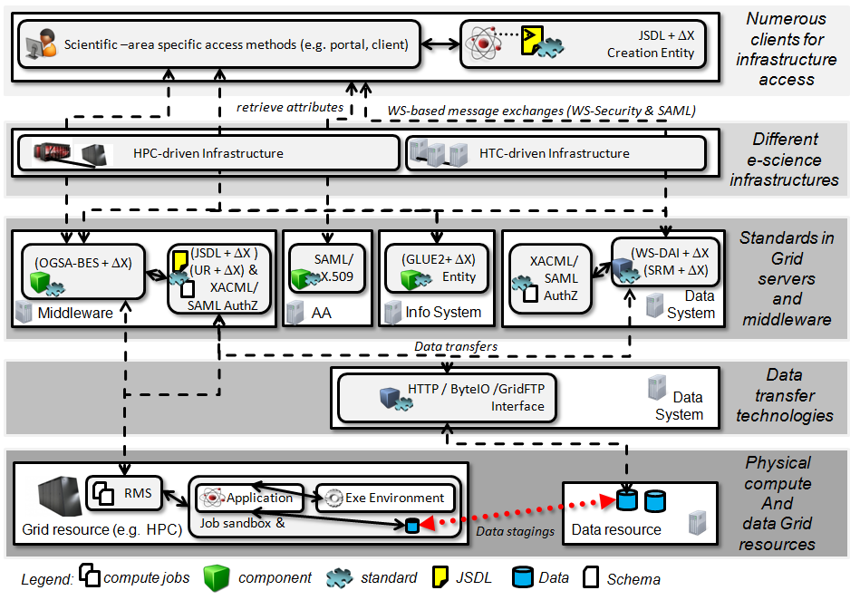
PGI Approach Overview (1)

Slide 7
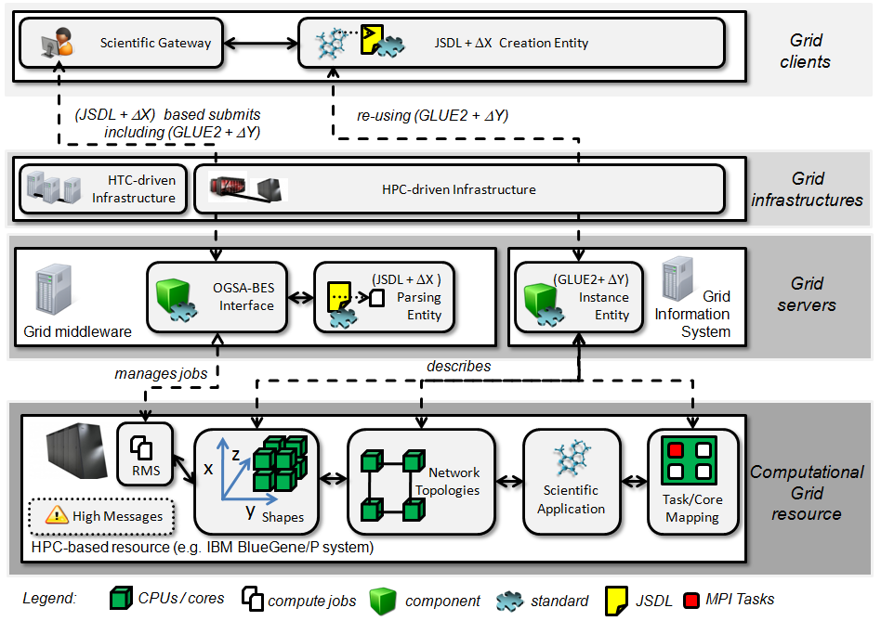
PGI Approach Overview (2)
3
4
2
5
1

Slide 8
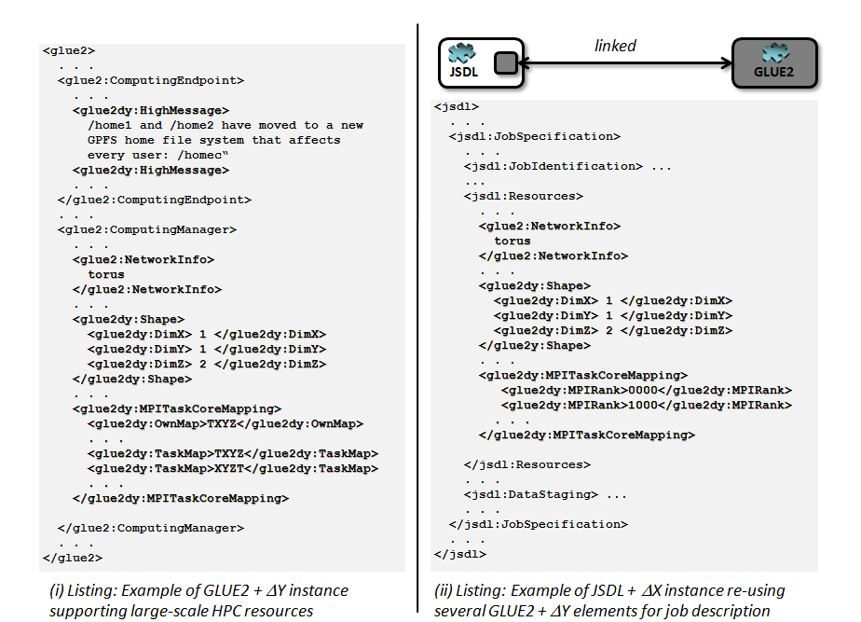
PGI Approach Overview (3)

Slide 9
Clear XML Suggestions

Slide 10


Clear XML Suggestions
XML Rendering Issue
linked
<glue2>
. . .
<glue2:ComputingEndpoint>
. . .
</glue2:ComputingEndpoint>
<glue2:ComputingManager>
. . .
</glue2:ComputingManager>
// relevant material available in the JSDL / GLUE2 document – just transfer elements here
<glue2:ComputingService.Name>
<glue2:ComputingEndpoint.Name>
<glue2:ComputingShare.Name>
<glue2:ExecutionEnvironment.OSFamily>
<glue2:ExecutionEnvironment.OSName>
<glue2:ExecutionEnvironment.OSVersion>
</glue2>
JSDL
GLUE2
<jsdl>
. . .
<jsdl:JobSpecification>
<jsdl:Resources>
. . .
// relevant material available in the JSDL / GLUE2 document – just transfer elements here
<jsdl:HostName>
. . .
<jsdl:OperatingSystemName>
...
<jsdl:OperatingSystemVersion>
</jsdl:Resources>
</jsdl:JobSpecification>
. . .
</jsdl>

Slide 11
Open Issues

Slide 12
Open Issues
XML Rendering of GLUE2
  No progress and chairs largely inactive
  Shiraz tries to ping though – no session at OGF34 again
  Challenges to agree between ‘US flat’ and ‘EU hierarchical’ approach
  Suggestion: Two XML Renderings…
  Impact for JSDL here: no clear ‘XML elements’ available, but abstract reference possible
Approach for specify the ideas
  Complete separate GLUE2 Profile of JSDL?
    There seem to be other information schemas around (e.g. CIM), so should be encapsulated
    What other information schemas are relevant (UoVirginia?)
  JSDL Profile with other add-ons?
Backwards compatibility
  Elements of GLUE2 and JSDL cover same space
  For backwards compatibility the GLUE2 elements should be additional?!

Slide 13
References

Slide 14
References
[1] JSDL Specification 1.0
https://forge.gridforum.org/sf/go/doc16186?nav=1
[1] PGI JSDL/GLUE2 Document
https://forge.gridforum.org/sf/go/doc16186?nav=1

Slide 15
Full Copyright Notice
Copyright © Open Grid Forum (2007). All Rights Reserved.
This document and translations of it may be copied and furnished to others, and derivative works that comment on or otherwise explain it or assist in its implementation may be prepared, copied, published and distributed, in whole or in part, without restriction of any kind, provided that the above copyright notice and this paragraph are included on all such copies and derivative works.
The limited permissions granted above are perpetual and will not be revoked by the OGF or its successors or assignees.
Notes:
OGF Full Copyright Notice if necessary

