Slide 1

OGSA F2F meeting
Sept. 14, 2006 in Washington DC

Slide 2

OGF IPR Policies Apply
“I acknowledge that participation in this meeting is subject to the OGF Intellectual Property Policy.”
Intellectual Property Notices Note Well: All statements related to the activities of the OGF and addressed to the OGF are subject to all provisions of Appendix B of GFD-C.1, which grants to the OGF and its participants certain licenses and rights in such statements. Such statements include verbal statements in OGF meetings, as well as written and electronic communications made at any time or place, which are addressed to:
    the OGF plenary session,
    any OGF working group or portion thereof,
    the OGF Board of Directors, the GFSG, or any member thereof on behalf of the OGF,
    the ADCOM, or any member thereof on behalf of the ADCOM,
    any OGF mailing list, including any group list, or any other list functioning under OGF auspices,
    the OGF Editor or the document authoring and review process
Statements made outside of a OGF meeting, mailing list or other function, that are clearly not intended to be input to an OGF activity, group or function, are not subject to these provisions.
Excerpt from Appendix B of GFD-C.1: ”Where the OGF knows of rights, or claimed rights, the OGF secretariat shall attempt to obtain from the claimant of such rights, a written assurance that upon approval by the GFSG of the relevant OGF document(s), any party will be able to obtain the right to implement, use and distribute the technology or works when implementing, using or distributing technology based upon the specific specification(s) under openly specified, reasonable, non-discriminatory terms. The working group or research group proposing the use of the technology with respect to which the proprietary rights are claimed may assist the OGF secretariat in this effort. The results of this procedure shall not affect advancement of document, except that the GFSG may defer approval where a delay may facilitate the obtaining of such assurances. The results will, however, be recorded by the OGF Secretariat, and made available. The GFSG may also direct that a summary of the results be included in any GFD published containing the specification.”
OGF Intellectual Property Policies are adapted from the IETF Intellectual Property Policies that support the Internet Standards Process.
Notes:
IPR Notices Note Well for OGF meetings

Slide 3
Thursday afternoon (2:30-6pm)
A joint EMS/Data session (Dave and Andreas, 1 hr)
HPCP interop (Andrew 5 min)
OGSA-RSS (Donal Fellows, 1 hr)
  discuss the EPS and its relation to the rest of the EMS arch
General discussion (Hiro, 1 hr)

Slide 4
Friday morning (8:30am-noon)
JSDL session (Steve McGough, 2 hr)
  Bashing out ideas for JSDL 2.0
OGSA general session (Tom and Hiro, 2H)
  OGSA WSRF BP R0711 (WS-BaseFault) discussion
  DMTF WorkRegister update
  document status review
  OGSA roadmap v1.1 (Chris Jordan)
  telecon schedule

Slide 5
OGSA general session
OGSA direction and priority
  Security
OGSA WSRF BP R0711 (WS-BaseFault) discussion
DMTF WorkRegister update
document status review
OGSA roadmap v1.1 (Chris Jordan)
winter F2F schedule
telecon schedule

Slide 6
OGSA direction and priority (1)
EMS scenario and architecture
  Scenario document “v1.0/profile” is close to complete
  Another scenario document “v1.1/capability” which covers beyond HPC
    online services
    eBay, Saas
    data/EMS joint scenario
  Architecture document is not started yet
Information modeling
  Guideline: Complete before thanksgiving
  BES model (appendix of BES spec v27)
Roadmap v1.1

Slide 7
OGSA direction and priority (2)
OGSA and EGA reference model
  Joint team (Hiro, Ravi and Paul)
Security architecture/roadmap
  Build use case scenarios
  Security design team (DaveS, Duane, RichC)
Information services
  Does RSS need info service?
  Porttype for Directory
  StevenN
Self-* services
Interop fest
SAGA-API

Slide 8
OGSA WSRF BP
R0711 (WS-BaseFault) discussion
Tom Maguire

Slide 9
DMTF WorkRegister update
Alliance Scope
Open Grid Services Architecture and the Resource Management Design team (OGSA in ARCH) - Corresponding to work in DMTF's Utility Computing and Behavior and State WGs

Slide 10
DMTF WorkRegister update
Milestones / Dates (1)
"The DMTF will publicize the following: (February, 2006)
  namespaces to identify XML schemas for properties produced from a particular version of a CIM model
  the XML schemas themselves Completing this milestone will allow:
    GGF specifications (and other specifications) to refer to the XML schemas for properties without embedding the schemas in the body of the specifications
    XML schemas for properties for CIM resources to be consistent across multiple specifications "

Slide 11
DMTF WorkRegister update
Milestones / Dates (2)
The DMTF and GGF will work to define and publicize a draft generic abstract wsdl:portType mapping for classes in the CIM model (1Q/2006)
Each 'extrinsic' operation on a CIM class will be modeled as a wsdl:operation Properties of the CIM class which are rendered in XML schema (detailed in xml schema and namespace milestone) will be available through the wsdl:types section
It is envisioned that some set of qualifiers will be mapped to xml schema and wsdl constructs. The specifics of this mapping are viewed as explicitly part of the work to render the model. As such GGF has no specific requirements for qualifiers at this time but may have requirements as the work product develops.
The intent of this deliverable is to make available a set of standard wsdl:portTypes representing the CIM modeled aspect of classes (extrinsics and properties only). It is envisioned that these portTypes will be mixed in with additional capabilities from Grid disciplines to support Basic Execution Services, Data Virtualization and other areas as they are developed.

Slide 12
Document schedule (from charter)
Document name | First draft available | Ready for PC | GFD publication
OGSA WSRF Basic Profile 1.0 | May 2005 May 2005 | Sept. 2005 Sept. 2005 | June 2006 Sept 2006
OGSA Architecture & Glossary 1.5 | Oct. 2005 Oct. 2005 | Nov. 2005 Mar. 2006 | July 2006 Sept 2006
OGSA Security Profile 1.0 – Secure Channel | Sept. 2005 Sept. 2005 | Nov. 2005 Feb. 2006 | Aug. 2006 Oct. 2006
OGSA Basic Security Profile 1.0 – Core | Sept. 2005 Sept. 2005 | Nov. 2005 Feb. 2006 | Aug. 2006 Oct. 2006
Plan date
Actual date
completed
delayed

Slide 13
Document schedule (from charter)
Document name | First draft available | Ready for PC | GFD publication
OGSA EMS Architecture scenarios 1.0 | July 2006 July 2006 | Sept. 2006 Oct. 2006 | Nov. 2006 Dec. 2006
OGSA EMS Architecture scenarios capability | TBD (3~6 month)
OGSA EMS Architecture | Sept. 2006 ? | Nov. 2006 ? | Feb. 2007 ?
OGSA roadmap | Sept. 2006 | Nov. 2006 | Jan. 2007
Plan date
Actual date
completed
delayed

Slide 14
Document schedule (from charter)
Document name | First draft available | Ready for PC | GFD publication
Guidelines for Information Modeling for OGSA Entities (explain necessary process) GFD-I | Jan. 2006 Jan. 2006 | Sept. 2006 Feb. 2007 | Jan. 2007 April 2007
container information model (appendix of BES spec) GFD-R.P | Jan. 2006 Jan. 2006 | Sept. 2006 Oct. 2006 | Jan. 2007 Feb. 2007
Information Modeling in OGSA XML schema and semantics Best practices GFD-R.P Also wiki page | Sept. 2006 Nov. 2006 | Sept. 2006 Feb. 2007 | Jan. 2007 April 2007
These document should go together!!
Plan date
Actual date
completed
delayed

Slide 15
OGSA roadmap v1.1
Chris Jordan

Slide 16
OGF19 and OGF20
OGF19
  Chapel Hill NC
  Jan. 29 (M) ~ Feb. 2 (F)
  WG sessions and workshop only
OGF20
  Manchester
  May 7 (M) ~ 11 (F)
  Major event

Slide 17
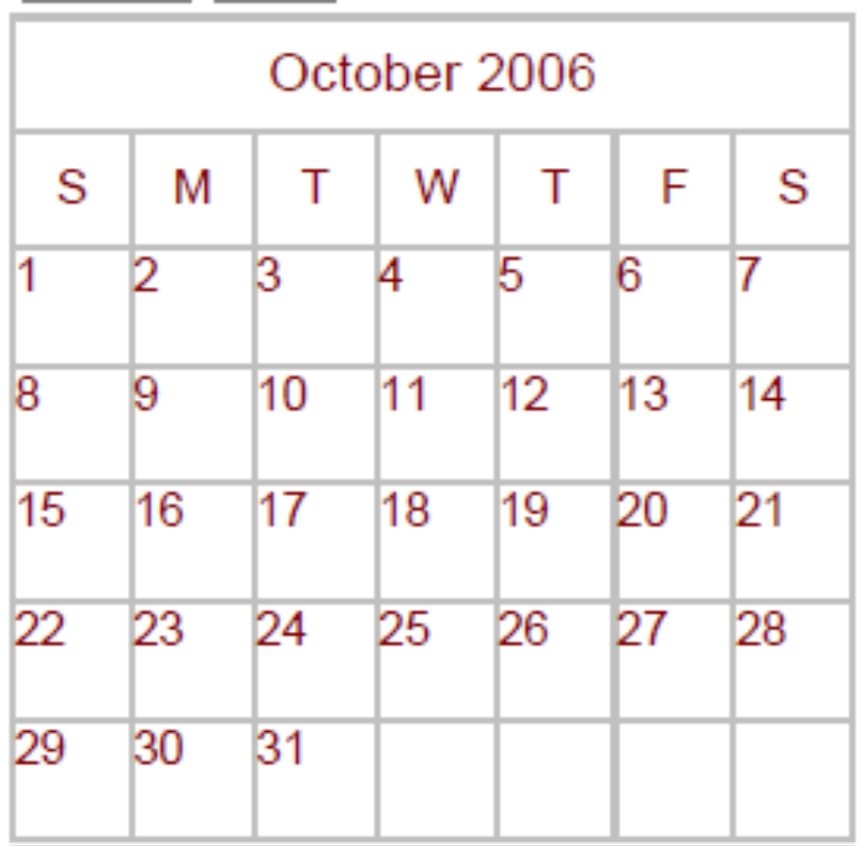
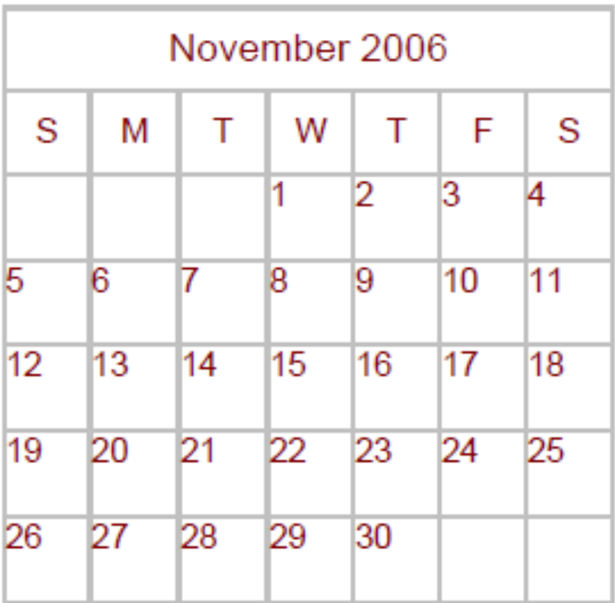
Winter F2F meeting
November 9th & 10th in Florida
SC06 Tampa, FL

Slide 18
Telecon Topics
Monday
  Information modeling (Ellen, Fred)
  EGA reference model (Hiro, Paul, Ravi)
  Roadmap (Chris)
Thursday
  Security (Dave, Duane, RichC)

Slide 19
Telecon Schedule (7 weeks to F2F) #1
CT
2006/9/18 | Mon | 5-7pm | No-call
2006/9/21 | Thur | 8:30-10:30am | Security
2006/9/25 | Mon | 5-7pm | EGA reference model Roadmap
2006/9/28 | Thur | 8:30-10:30am
2006/10/2 | Mon | 5-7pm | Information modeling
2006/10/5 | Thur | 8:30-10:30am | Security
2006/10/9 | Mon | 5-7pm | EGA reference model Roadmap
2006/10/12 | Thur | 8:30-10:30am

Slide 20
Telecon Schedule (7 weeks to F2F) #2
2006/10/16 | Mon | 5-7pm | No-call
2006/10/19 | Thur | 8:30-10:30am | Information modeling
2006/10/23 | Mon | 5-7pm | Security
2006/10/26 | Thur | 8:30-10:30am | EGA reference model Roadmap
2006/10/30 | Mon | 4-6pm
2006/11/2 | Thur | 7-9am | Information modeling
2006/11/6 | Mon | 4-6pm | Security
2006/11/9 | Thur | 7-9am | EGA reference model Roadmap
Summer time ends Oct. 29

Slide 21
Teleconference time/day
day | TZ | Summer time | Standard time
Mon | ET | 6-8pm | 5-7pm
 | CT | 5-7pm | 4-6pm
 | PT | 3-5pm | 2-4pm
 | JP | 7-9am | 7-9am
 | UK | 11pm-1am | 10pm-midnight
Thu | ET | 9:30-11:30am | 8-10am
 | CT | 8:30-10:30am | 7-9am
 | PT | 6:30-8:30am | 5-7am
 | JP | 10:30pm-12:30am | 10pm-midnight
 | UK | 2:30-4:40pm | 1-3pm
Summer time ends Oct. 29

Slide 22
Full Copyright Notice
Copyright (C) Open Grid Forum (applicable years). All Rights Reserved.
This document and translations of it may be copied and furnished to others, and derivative works that comment on or otherwise explain it or assist in its implementation may be prepared, copied, published and distributed, in whole or in part, without restriction of any kind, provided that the above copyright notice and this paragraph are included on all such copies and derivative works.
The limited permissions granted above are perpetual and will not be revoked by the OGF or its successors or assignees.
Notes:
OGF Full Copyright Notice if necessary

