Slide 1
Circuit Monitoring
September 20th 2011, OGF 33: NML-WG
Jason Zurawski, Internet2 Research Liaison

Slide 2
Dynamic Circuits
Scientific disciplines require greater network capacity and predictably to cope with growing data sets sizes and time constrained operations
Cross-domain dynamic circuits, like those provided by the Internet2 ION Service, can be used to improve the connectivity
  Provides guaranteed bandwidth
  Ensures that the high bandwidth traffic doesn’t interfere with other production traffic
DYNES
  A NSF-funded project to deploy dynamic circuit networking technology in support of the High Energy Physics community
    Will use the OSCARS circuit provisioning software
  Will bring 33 new sites into the dynamic circuit network “cloud” with hundreds of users
<number> – 11/07/26, © 2011 Internet2

Slide 3
Current View Of Circuits
If a failure occurs, what can a user do?
<number> – 11/07/26, © 2011 Internet2

Slide 4
Fixing This Circuit View
Goal: to enable users to get measurements in their circuits while allowing domains to provide as much or as little information to the user as the domain wants
Develop a solution in collaboration with other groups and organizations including DANTE, ESnet, the Network Markup Language Working Group and the Network Measurement Control Working Group
  Broad agreement ensures that users can monitor their circuits, no matter what domains they traverse
Multi-faceted approach
  Enable domains to export monitoring data about circuits
  Enable users to discover the domains that make up their circuit, and the monitoring data those domains contain about the circuit
Leverage the standard perfSONAR infrastructure when available
<number> – 11/07/26, © 2011 Internet2

Slide 5
Circuit Monitoring Architecture
<number> – 11/07/26, © 2011 Internet2
Notes:
A normal inter-domain circuit is going to cross network elements in a variety of domains. Currently, the client would have no standardized ability to see into the networks to discover problems.

Slide 6
Circuit Monitoring Architecture
perfSONAR Topology Service
perfSONAR Topology Service
perfSONAR Topology Service
<number> – 11/07/26, © 2011 Internet2
Notes:
In our architecture, the domains describe the topology of their segments of the circuits, and register these descriptions up into the perfSONAR topology service

Slide 7
Circuit Monitoring Architecture
perfSONAR Measurement Archive
perfSONAR Topology Service
perfSONAR Measurement Archive
perfSONAR Topology Service
perfSONAR Measurement Archive
perfSONAR Topology Service
<number> – 11/07/26, © 2011 Internet2
Notes:
Domains begin storing monitoring data about the circuit into a perfSONAR measurement archive

Slide 8
Circuit Monitoring Architecture
perfSONAR Measurement Archive
perfSONAR Topology Service
perfSONAR Measurement Archive
perfSONAR Topology Service
perfSONAR Measurement Archive
perfSONAR Topology Service
<number> – 11/07/26, © 2011 Internet2
Notes:
The client queries the topology services to obtain the intra-domain paths for each domain

Slide 9
Circuit Monitoring Architecture
perfSONAR Measurement Archive
perfSONAR Topology Service
perfSONAR Measurement Archive
perfSONAR Topology Service
perfSONAR Measurement Archive
perfSONAR Topology Service
<number> – 11/07/26, © 2011 Internet2
Notes:
The client uses the information about the intra-domain path to query the perfSONAR measurement archives

Slide 10
Implementation
Two broad components
  Domain Software Agent
    Creates Domain’s circuit descriptions
    Registers these descriptions with a perfSONAR Topology Service
  A Web UI client that displays statistics about a Domain’s current and historical circuits
<number> – 11/07/26, © 2011 Internet2

Slide 11
Circuit Monitoring Agent
This agent is the “glue” that connects together a Domain’s provisioning software (OSCARS) and monitoring infrastructure with the perfSONAR services so that users can find information about circuit statistics
When new circuits are brought up, the agent looks at the intra-domain path for the circuit, and builds a description of that path.
  This description is then registered into a perfSONAR Topology Service
Needs to know how the domain monitors its devices to ensure an appropriate description of the circuit
  If configured, the agent can use a user-defined script to start circuit monitoring
<number> – 11/07/26, © 2011 Internet2

Slide 12
Router/Switch Monitoring Component
Everyone has their own method of monitoring their hardware
Define the needed functionality instead of requiring a specific solution
  Offer a specific solution to users who want to use it
Requirements:
  Software that can measure the operational status and utilization of the elements making up the circuit
  These measurements are made available using standard perfSONAR protocols
As long as the monitoring meets the above requirements, it can be made to work in the Circuit Monitoring infrastructure
<number> – 11/07/26, © 2011 Internet2

Slide 13
Router/Switch Monitoring Component
Specific Solution: ESxSNMP
  Developed by Jon Dugan at ESnet
  Uses SNMP to monitor operational status and utilization statistics for all equipment elements, including physical interfaces, VLAN interfaces and LSPs
  These interface statistics are then made available using the perfSONAR-PS SNMP MA
  This software will be packaged for easy installation
<number> – 11/07/26, © 2011 Internet2

Slide 14
Architecture - Monitoring Agent
Router
Router
Router
ESxSNMP
Or Similar
OSCARS
Topology Service
Measurement
Archive
Monitoring
Agent
optional
<number> – 11/07/26, © 2011 Internet2

Slide 15
Components
  OSCARS
    Tested with 0.5.4 and 0.6
    Communicates with Web Service interface (e.g. modular, and can poll from virtually anywhere)
  Topology Service
    perfSONAR-PS Variety
      http://psps.perfsonar.net/topology/index.html
    Capable of understanding several topology versions:
      perfSONAR Topology v2/v3
      “DICE IDCP“ – 20070626, 20070707, and 20071023
      Early NML – 20070707 and 20070828
      ??? – Possible to add more, just need to see schemata
  SNMP Collection (ESxSNMP) & perfSONAR Measurement Archive
    Need a way to access measurement data for Utilization/Status purposes
<number> – 11/07/26, © 2011 Internet2

Slide 16
Web UI Client
  The distributed nature of the data doesn’t mesh well with the near-instantaneous results expected by web users
The Web UI includes collector daemons that lookup and retrieve topology and measurements about the end-to-end circuit from each domain, and store them in a local cache
The Web UI then uses the cached information to display end-to-end circuit statistics to the end user
<number> – 11/07/26, © 2011 Internet2

Slide 17
Architecture – Web UI Client
Router
Router
Router
ESxSNMP
Or Similar
Topology Service
OSCARS
Measurement
Archive
Measurement Collector
Topology Collector
Topology/
Measurement
Cache
Web GUI
<number> – 11/07/26, © 2011 Internet2

Slide 18
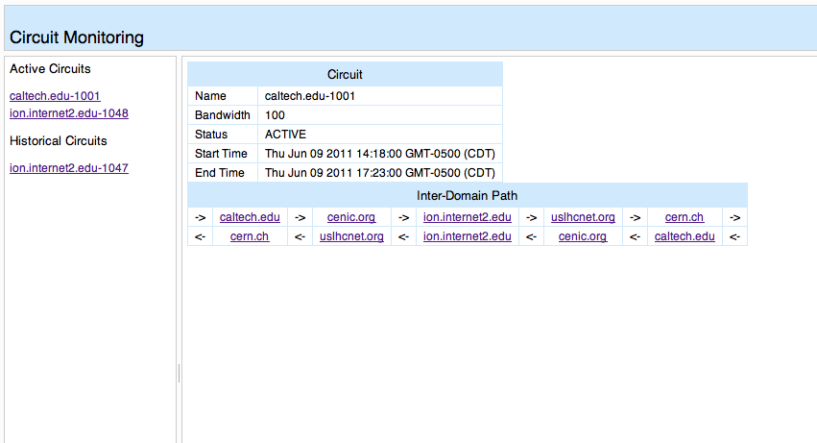
Web UI Client – Inter-Domain Path
<number> – 11/07/26, © 2011 Internet2
Notes:
The Web UI shows the inter-domain path as a list of domains. Since the Circuit Monitoring infrastructure supports asymmetric paths, both the forward and reverse paths are listed. These example instances show circuits from a test setup housed on ESnet’s OpenDevNet testbed.

Slide 19
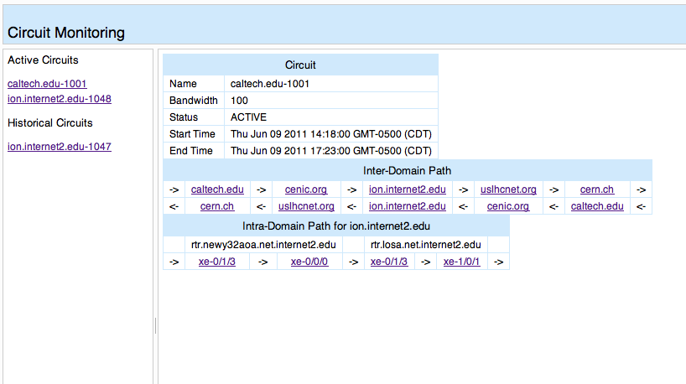
Web UI Client – Intra-Domain Path
<number> – 11/07/26, © 2011 Internet2
Notes:
Clicking on one of the Inter-Domain Path domains will load the Intra-Domain Path for that domain.

Slide 20
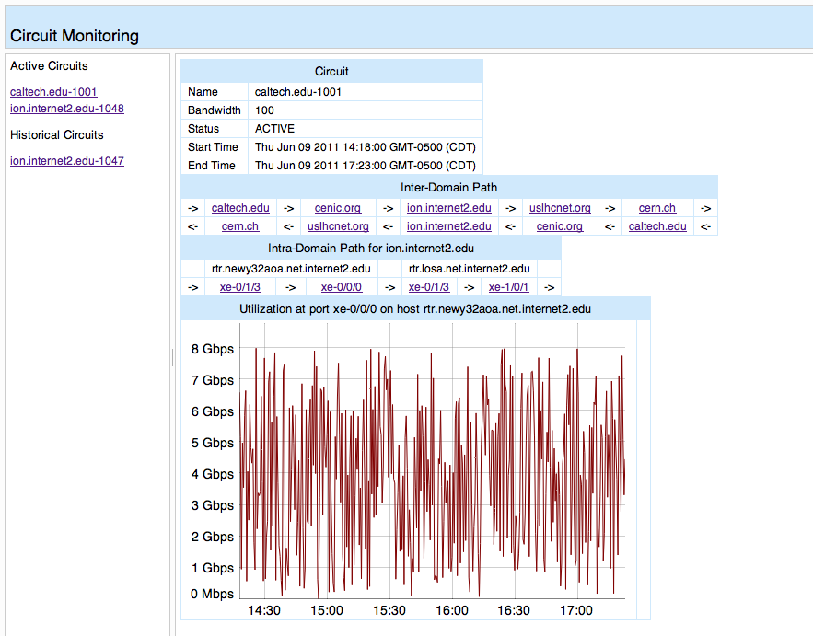
Web UI Client – Intra-Domain Path
<number> – 11/07/26, © 2011 Internet2
Notes:
Clicking on a port in the intradomain path will bring up the utilization of the circuit at that point

Slide 21
Web UI Client – Live Demo!
http://ndb1.internet2.edu/circuits/
<number> – 11/07/26, © 2011 Internet2
Notes:
Clicking on a port in the intradomain path will bring up the utilization of the circuit at that point

Slide 22
Circuit Monitoring
September 20th 2011, OGF 33: NML-WG
Jason Zurawski, Internet2 Research Liaison
For more information, visit http://psps.perfsonar.net
<number> – 11/07/26, © 2011 Internet2

