Slide 1

NML Progress
OGF 33, Lyon

Slide 2
OGF IPR Policies Apply
“I acknowledge that participation in this meeting is subject to the OGF Intellectual Property Policy.”
Intellectual Property Notices Note Well: All statements related to the activities of the OGF and addressed to the OGF are subject to all provisions of Appendix B of GFD-C.1, which grants to the OGF and its participants certain licenses and rights in such statements. Such statements include verbal statements in OGF meetings […]
Excerpt from Appendix B of GFD-C.1: ”Where the OGF knows of rights, or claimed rights, the OGF secretariat shall attempt to obtain from the claimant of such rights, a written assurance that upon approval by the GFSG of the relevant OGF document(s), any party will be able to obtain the right to implement, use and distribute the technology or works when implementing, using or distributing technology based upon the specific specification(s) under openly specified, reasonable, non-discriminatory terms. The working group or research group proposing the use of the technology with respect to which the proprietary rights are claimed may assist the OGF secretariat in this effort. The results of this procedure shall not affect advancement of document, except that the GFSG may defer approval where a delay may facilitate the obtaining of such assurances. The results will, however, be recorded by the OGF Secretariat, and made available. The GFSG may also direct that a summary of the results be included in any GFD published containing the specification.”
Notes:
IPR Notices Note Well for OGF meetings

Slide 3
OGF IPR Policies Apply
Some works (e.g., works of the U.S. government) are not subject to copyright. However, to the extent that the submission is or may be subject to copyright, the contributor, the organization he or she represents (if any), and the owners of any proprietary rights in the contribution grant an unlimited perpetual, non-exclusive, royalty-free, worldwide right and license to the Open Grid Forum under any copyrights in the contribution. This license includes the right to copy, publish, and distribute the contribution in any way and to prepare derivative works that are based on or incorporate all or part of the contribution, the license to such derivative works to be of the same scope as the license of the original contribution.
The contributor acknowledges that the Open Grid Forum has no duty to publish or otherwise use or disseminate any contribution.
The contributor grants permission to reference the name(s) and address(es) of the contributor(s) and of the organization(s) he or she represents (if any).
The contributor represents that contribution properly acknowledges major contributors.
The contributor, the organization (if any) he or she represents, and the owners of any proprietary rights in the contribution agree that no information in the contribution is confidential and that the Open Grid Forum and its affiliated organizations may freely disclose any information in the contribution.
The contributor represents that he or she has disclosed the existence of any proprietary or intellectual property rights in the contribution that are reasonably and personally known to the contributor. The contributor does not represent that he or she personally knows of all potentially pertinent proprietary and intellectual property rights owned or claimed by the organization he or she represents (if any) or by third parties.
The contributor represents that there are no limits to the contributor's ability to make the grants acknowledgments and agreements above that are reasonably and personally known to the contributor.
Notes:
IPR Notices Note Well for OGF meetings

Slide 4
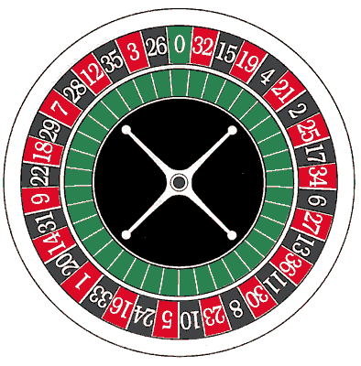
Notetaker

Slide 5
Agenda Session I
Agenda bashing
Jason Zurawski – Circuit Monitoring
Jeroen van der Ham – GEYSERS – NOVI – GLIF DTOX-TF
Jerry Sobiesky – NSI Topology requirements

Slide 6
Agenda Session II
Jeroen van der Ham – Port vs. Interface
Freek Dijkstra – URN:OGF:network Status and Proposal
Freek & Jeroen – Label Proposal
Status
XML syntax
RDF syntax
UML schema
Tasks Ahead (assignment of volunteers)

Slide 7
Agenda Session III
Break-Out session
Overflow
Further discussion
...

Slide 8
Tasks Ahead

Slide 9
Issue and Task Tracker
Proposal: Use Gridforge Tracker to keep track of tasks and use cases.

Slide 10
Tasks
Procedural
UML schema
Device / Node / Port
Link / Path / Segment
Network / Topology / Domain
Labels / Channels
Adaptation / Layer
Configuration / Cross-connect
Capabilities / Services
Visualization / Geo-data
Identifiers
XML syntax
RDF syntax

Slide 11
Open Issues
Currently: 19 open issues.
A selection:
artf6512: For adaptation, parallel compound relations: how to specify properties of these relations? (e.g. type of adaptation, or type of protection/link aggregation)
artf6507: Is the adaptation relation between links or between ports, or either?
artf6485: Synchronize UML diagram and Draft Document (e.g. Layer is only in the doc, while Bidirectional Port is only in the UML schema)
Notes:
Characteristic Information is defined in G.800

Slide 12
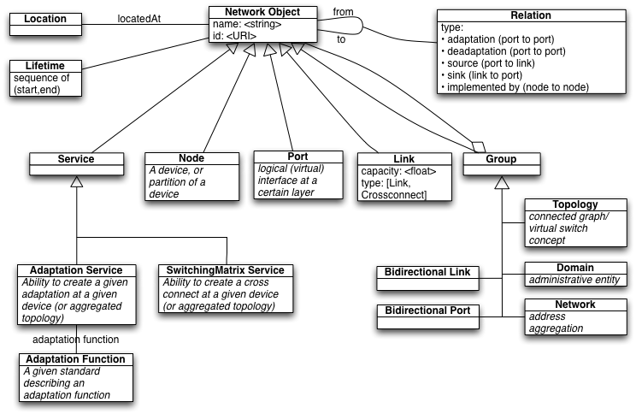
Current Schema (Oct 2010)

Slide 13
URN:OGF:network Identifiers

Slide 14
URN:OGF:network Status
Delegate urn:ogf to OGF (IANA registration)
IESG approved, IANA registered, RFC publication waiting for normative reference
OGF registry for subnamespaces
Create by Joel (www.ogf.org/urn)
OGF procedure to register subnamespaces
Draft in 60-day public comments since today
Registration of urn:ogf:network
Draft written

Slide 15

Thank you, reviewers!
Reviewers:
Wesley Eddy (IESG)
Brian Carpenter (IETF General Area Review Team)
Jeroen van der Ham (NML group member)
Russ Housley (IESG chair)
Peter Saint-Andre (IETF Applications Area Director, document shepherd)
Gunter Van de Velde (IETF participant)
Mykyta Yevstifeyev (IETF URN-NID workgroup)
IESG yea-nodders:
Jari Arkko (IESG)
Ron Bonica (IESG)
Stewart Bryant (IESG)
Gonzalo Camarillo (IESG)
Adrian Farrel (IESG)
Stephen Farrell (IESG)
Pete Resnick (IESG)
Dan Romascanu (IESG)
Robert Sparks (IESG)
Sean Turner (IESG)
Other helpers:
Richard Hughes-Jones (co-author)
Andre Mersky (setting up the OGF registry)
Joel Replogle (setting up the OGF registry)
Amanda Baber (IANA)
Cindy Morgan (IETF Secretariat)
Amy Vezza (IETF Secretariat)
Sandy Ginoza (RFC Editor team)

Slide 16
URN:OGF Volatility
URNs MUST be persistent
Never change during the lifetime of the identifier
Never be re-assigned to another resource
IESG concern:
"OGF" may change name
URN-NID concern:
domains may be re-assigned.
This brings a risk of re-assigning URNs
e.g. urn:ogf:network:surf.net:42
Solution: add year of assignment in URN
e.g. urn:ogf:network:2011:surf.net:42
or urn:ogf:network:surf.net:2011:42

Slide 17
Labels

Slide 18
Labels
Concept known in GMPLS, G.800, NDL, ...
e.g. "VLAN 412" or "34rd VC-4 in a STM-64" or "1554.48nm wavelength"
Has a value and a type
Used to distinguish channels in a link
May later be used for switching, but that is secondary
e.g. untagged VLANs are currently out of scope

