Slide 1

The Neutron Science
TeraGrid Gateway (NSTG) :
A Requirements Driven View
Presentation to Science Gateways Workshop at GGF14
J. W. Cobb and
Sudharshan Vazhkudai
June 28, 2005
Chicago, IL, USA

Slide 2
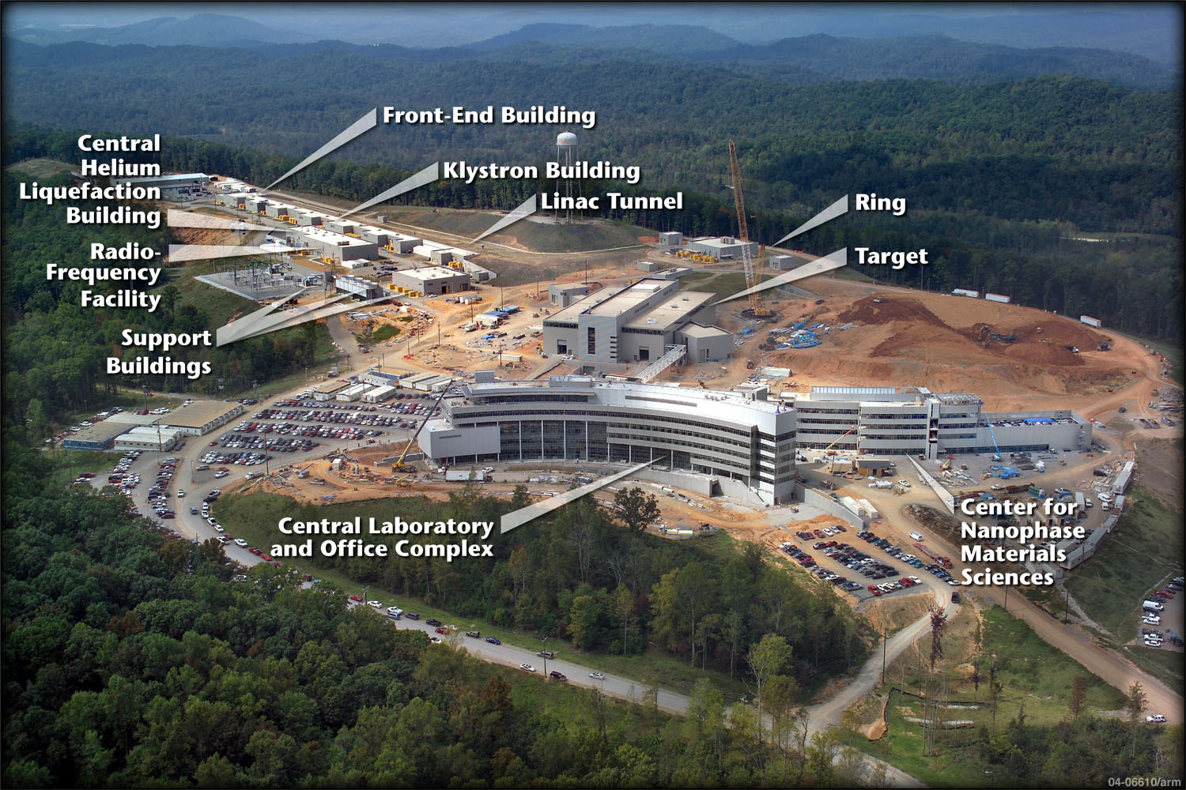
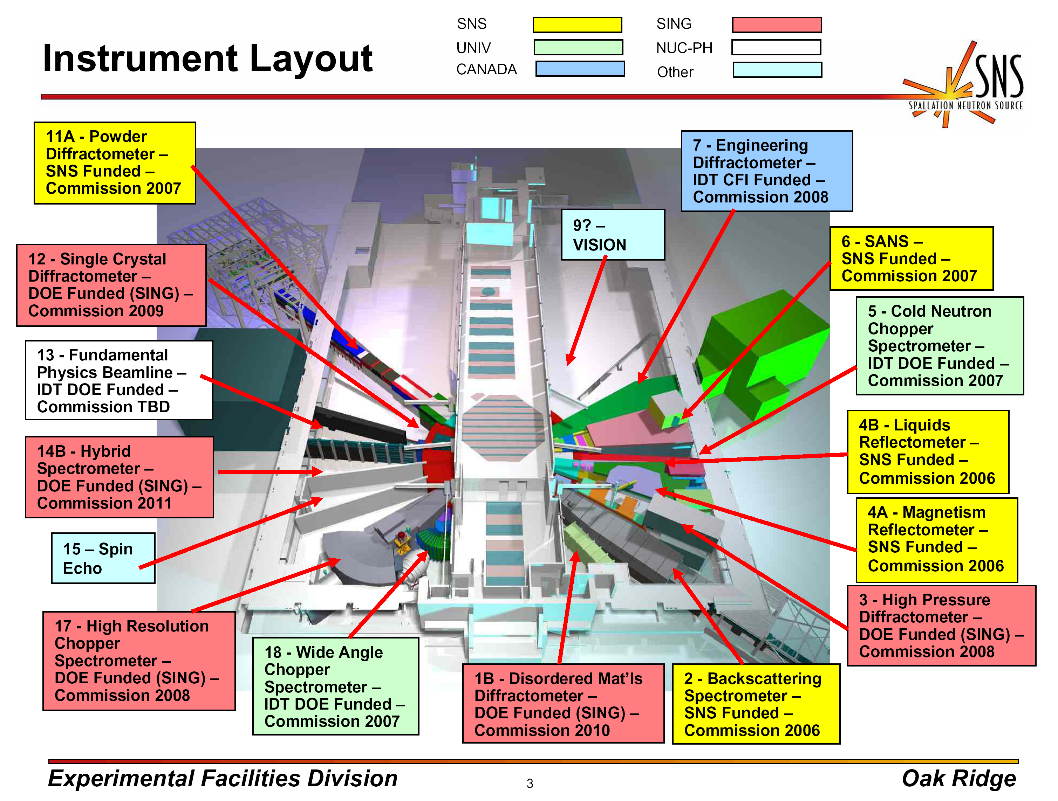
User Base: Neutron Science
About 3 dozen neutron scattering facilities world-wide.
Major next generation accelerator based source construction ongoing:
  J-Parc (Japan, ~2008)
  ISIS 2nd Target Station (U.K. 2007)
  Spallation Neutron Source SNS (US, 2006) A major NSTG focus
    1.4 MW proton beam on target
    1.4 G$US – TPC
    CD-4 (finish) 06/2005
    Project 92% complete (at April 05)
    > 7 Million man hours with only 2 LWC’s!
    17 Beamlines approved
    Power upgrades and 2nd target station proposals already at CD-0/1 stage
Today, we can permanently affect the development course of G$ facilities with 40 year lifetimes!

Slide 3
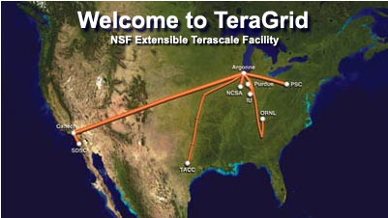
Science Gateway: NSTG
ETF/TeraGrid: 9 Resource Provider (RP)
Sites providing;
  > 50 TF of computing
  > 1.5 PB of storage
  Special resources (Viz, instruments, data collection, DB services, …)
  National (US) high bandwidth interconnection (10 gbps design min)
ETF dual goals: “Deep” and “Wide”
  Deep – more traditional HPC/HEC centers, updated for today.
  Wide – reach out to orders of magnitude more computational scientists who are not currently major HPC/HEC users, augmenting their scientific pursuits through judicious and intuitive use of computational resources – Science Gateways
ORNL RP narrowly focused on creating a bridge between ETF and neutron science, particularly SNS. – A Science Gateway

Slide 4
Neutron Science Community: Eliciting Requirements
“The Currency of Collaboration is Documentation” – Steve Miller
“Neutron science community interactions
  3 NeSSI Workshops (Neutron Science Software Initiatives)
    10/03: Oak Ridge
    10/04: Abingdon
    04/05: Santa Fe
  Continuing collaboration, especially strong with ISIS, J-PARC, NIST, ANL, and others
  Electronic collaboration archive
NSTG- UK eScience collaboration by virtue of SNS/ISIS collaboration and ETF/eScience collaboration.
Related DANSE collaborative SW effort (Caltech)
Somewhat related effort of NOBUGS conference series
SNS project planning
  Expect 2000 users/ yr
  Estimate 2008 Raw Data Rate: 100 TB in 2008. Cum. Raw data store by 2011: 1.2 PB
  Data Handling Group plans
    Phase 1 – Day-1 – April 30, 2006
    Phase 2 – First Users – September 30, 2006
    Phase 3 – General Users – June 1, 2007
    Phase 4 – Advanced functionality - TBD
Discussions with High Flux Isotope Reactor (HFIR) scientists at Oak Ridge. A large reactor-based source

Slide 5
Extracted Requirements - RAW
Support ~2000 users/yr. Moderately high fraction return year to year
Integrate data, proposal, sample environment and facility operations into a single data management system
Timeframe:
  Phase 1 – Support for Day-1 – April 30, 2006
  Phase 2 – Supporting First Users – September 30, 2006
  Phase 3 – Supporting General Users – June 1, 2007
  Phase 4 – Providing Advanced Functionality – TBD
Data rates: 1 TB/yr with av. Files size of 50MB
Need to provide an automatic data reduction pipeline from raw to reduced data. Pipeline must be verifiable.
Need to provide data access (raw and reduced) and make data analysis easier
Must integrate existing user and facility software
Neutron users intolerant of user-hostile/non-intuitive software
Neutron users expect interactive personal visualization to explore their data.

Slide 6
Extracted Requirements - Reduced
A portal is the good choice for user interaction with facility cyber-infrastructure.
Portal provides AAAA. Integrate (proxy) user credentials across multiple enterprise entities. AAAA must be unseen, unannoying, and unerring.
Incorporate contributed code with high QA and low lifecycle software cost.
Must address disconnected use case – the airplane trip
Credibility: The portal/gateway/grid approach is new to this community. We must prove it is more useful than “the old ways”. Note This implies we do not assume anything about infrastructure. We must justify each architecture decision – to the ultimate user community.

Slide 7
Extracted Requirements – Analyzed
AAAA and Data Management/Access are horizontally integrated issues. They pervade all access and use methods
NSTG portal is, at heart, data focused.
Portal provides execution environment for canned procedures/workflows.
CONTRADICTION: Need shared data collection access with integrity versus need for rich and open user application execution.
From NSTG developer’s view, “users” are neutron instrument scientists and expert users who “develop” tools for routine use and use by casual and novice users
Non-computational resources dwarf computational resources. Resource allocation and scheduling of Gateway resources must reflect this. Need “Holiday Inn” scheduler for comp. resources
See interface definition, next slide
Notes:
Sebstien for Nanohub: “ecure execution of untrusted code. “

Slide 8
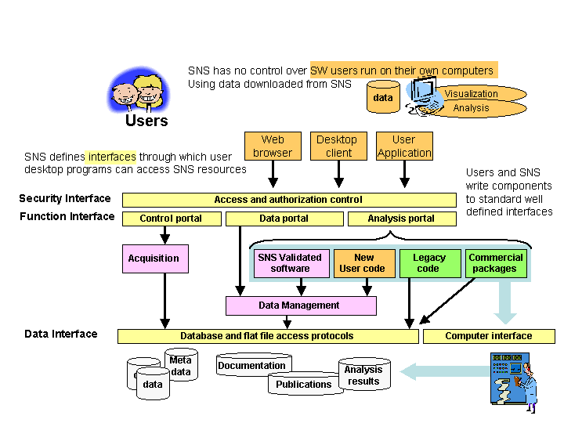
Gateway/Portal interface diagram
*Synthesis of discussion from NeSSI-1 workshop, courtesy of G. A. Geist

Slide 9
Prototype Deployment and Design Decisions (synoptic)
“… I wished to live deliberately, to front only the essential facts of life, and see if I could not learn what it had to teach, ...”
-Thoreau
Client access via (java enabled)
browser. Desktop client and
user application access not
until phase 4
Encapsulation of legacy (externally developed) reduction and analysis tools for execution
Data presentation through portal via (multiple) virtualization of physical storage
SRB is a candidate for part (or all) of data virtualization.
Notes:
I went to the woods because I wished to live deliberately, to front only the essential facts of life, and see if I could not learn what it had to teach, and not, when I came to die, discover that I had not lived ... I wanted to live deep and suck out all the marrow of life ...

Slide 10
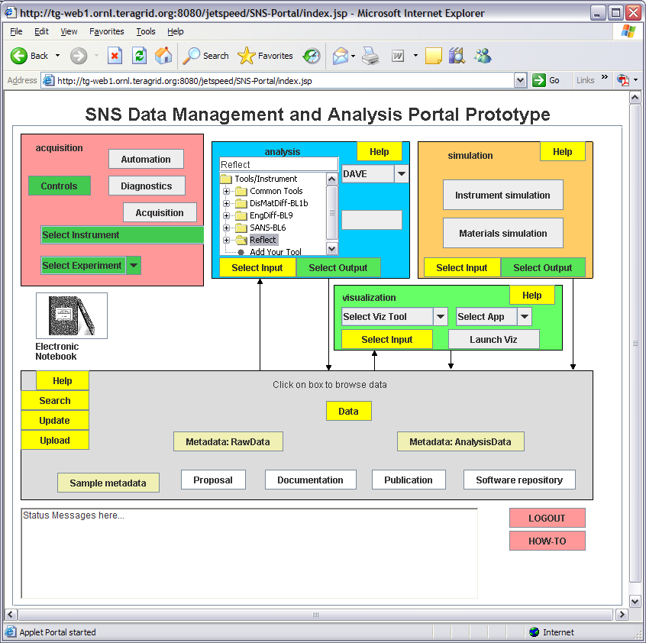
Prototype Portal Implementation

Slide 11
Where are we going?
(and why are we in a handbasket?)
AAAA – fish or cut bait soon
Integration of administrative domains
Data QA for promotion to facility archive?
(Slusers)
Tracking access control through community/dynamic accounts?
The Devil is in the details

Slide 12
Toward a Science Gateway Taxonomy
Main Focus
  Front a computational Grid
  Front application(s)
  Front a science community
  Bridge inter-grid connections
AAAA each is different
Data Services
  Facility collections
  User Workspaces
User Models
  Types
    1-1
    Proxies
    Impersonation
    Utility accounts
  Implications for AAAA
  Implications for other taxonomic features Workflow methods
Application execution
  Gateway provided
  User created
  Induction
  Virtualization
  Workflow needs
Relation to other interaction modes
  Legacy modes of operation
  Personal modes
  3rd party monolithic alternatives
  Disconnected use (portal on the plane)
Grid and Dist. computing technologies needed/used

Slide 13
Classification of NSTG
Caveat: Self-contradiction is a natural state of a collaboration.
Focus: Front a science community. Facility data storage. Application hosting.
AAAA: Proxy and impersonation. Single sign-on sought, but difficult. Gateway expected to map credentials across identity realms (ETF, ORNL, SNS, Proposal system,…)
Data: Primarily facility collections. Some request for user workspaces. Unclear on how to promote from one to the other.
Application Execution: Gateway provided. Possible induction (after QA) for user supplied. This choice is made by NSTG developers not users and is seen as required by AAAA issues. Users may later demand more flexibility. We are looking at virtualization and custom workflows as a possible way to accommodate.
Other modes: (preliminary)
  Legacy via application virtualization
  3rd party interaction via access to facility data management services
  Personal mode and disconnected mode – not implemented. Plan is to provide a personal Gateway that can run disconnected.
Technology choice: Design driven by users. NSTG developers try to focus on demand pull and refrain from technology push. Users are asking for grid technologies by function, just not name. SNS is focused on Day 1 operations.

Slide 14


Wrap Up
Acknowledgements: Contributions
  Contributions: I. S. Anderson, D. J. Ciarlette, T. H. Dunning, G. A. Geist, S. Miller, G. Pike, J. A. Rome, N. Vijayakumar, the entire TeraGrid team, and others
Acknowledgement: Support:
    Research sponsored by the U.S. National Science Foundation under interagency agreement DOE No. 0700-S664-A1, NSF Cooperative Agreement ACI-0352164 and Cooperative support agreement No. ACI-0338605, and executed under U.S. Department of Energy Contract No. DE-AC05-00OR22725 with UT-Battelle, LLC.
Administrivia:
  The submitted manuscript has been authored by a contractor of the U.S. Government under Contract No. DE-AC05-00OR22725. Accordingly, the U.S. Government retains a non-exclusive, royalty-free license to publish or reproduce the published form of this contribution, or allow others to do so, for U.S. Government purposes.
Questions/Discussion

Slide 15
Backup

Slide 16
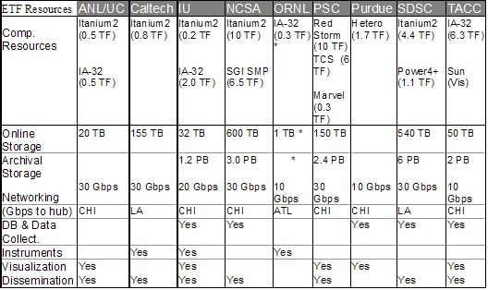
ETF/TeraGrid Resources

Slide 17
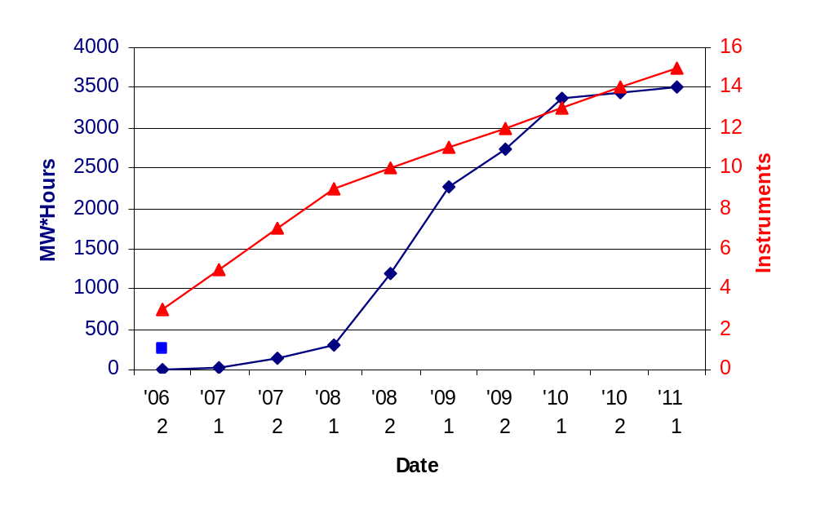
SNS Expected Facility Ramp-Up

Slide 18
SNS Data Handling and Analysis Plans
Phase 1 – Support for Day-1 – April 30, 2006
  provide tools – computer hardware and software – for initially working with experiment data
Phase 2 – Supporting First Users – September 30, 2006
  concentrates on building facility computing, networking, and data management infrastructure and integrating components with the portal developments into higher level user tools
Phase 3 – Supporting General Users – June 1, 2007
  enhance software usability and performance along with supporting additional instruments which come on-line
Phase 4 – Providing Advanced Functionality – TBD
  help expedite performing experiments via advanced computing or experiment protocols by integrating acquisition with analysis and simulation

Slide 19
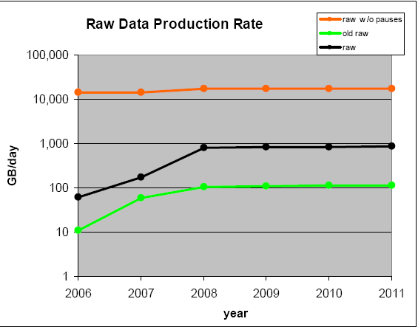
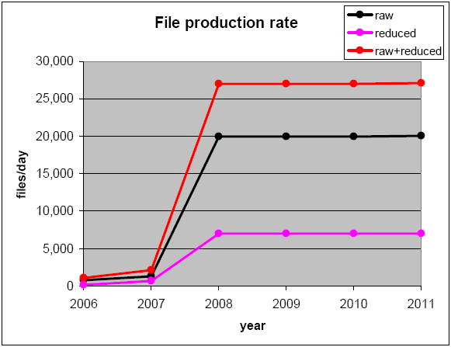
SNS Expected Raw Data Production
Data Production Rate
Files/Day

Slide 20
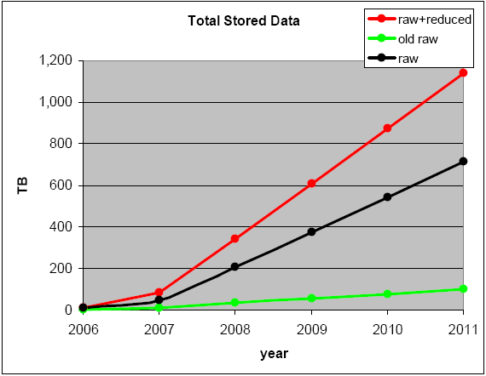
SNS Expected Raw Data Archive
Cumulative Raw Data Archive

