Slide 1

Building Portals to access Grid Middleware
National Technical University of Athens
Konstantinos Dolkas,
On behalf of Andreas Menychtas

Slide 2

GRIA Middleware
Grid Resources for Industrial Applications
A "B2B" application based on web services
End Users:
  Resources Suppliers
  People that need Resources
Auctioning Business Model

Slide 3
GRIA Technology
GRIA Services (Supplier Side)
  Tomcat/Axis Platform
  WS-Security
  Process-Based Access Control (PBAC)
GRIA Client
  Java API
    client side applications can be easily written and managed
GRIA Services
  Account Service
  Resource Allocation Service
  Data Storage Service
  Job Execution Service

Slide 4
GRIA Client
Command line Client
  Installation Problems
  Not user friendly
    End user is not a computer or grid professional
  Many mistakes occurred with typing the command line arguments and editing xml files
  Single User
GRIA Enterprise Client
  Portal version of the GRIA client
  Internal use

Slide 5
GRIA Enterprise Client
Portal version of the GRIA client
A client API Implementation
User Friendly
Single Installation / Centralized Access
Multi User Environment
Administration and management features

Slide 6
System Architecture
Tomcat Servlet Container
Modules:
  GRIA Client java classes (based on GRIA Client API)
  Java classes for user and application management (accounting, statistics)
  JSP pages which provide the user and administration interface

Slide 7
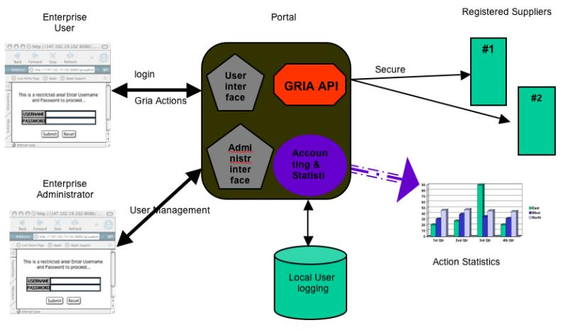
Portal Modules

Slide 8
Job Submission Procedure
Tender
Upload Data
Set Job
Check Job(s) Status
Download Data
Check Conversations

Slide 9
Tender
The job requirements are sent to the GRIA suppliers and the selection of the most suitable one for the specific job is being completed
Two steps procedure
  Requests Submission
  Allocation Confirmation in one or more suppliers
Tender Parameters
    Description of the new allocation
    Start and end date of the allocation
    Maximum number of data (in bytes) to be stored in the supplier
    Maximum number of data (in bytes) that will be uploaded and downloaded
    Maximum number of resources for each allocation
    Estimated workload in CPU seconds
    Minimum physical memory for job execution
    Minimum supplier performance (in GRIA standards) needed for the job
    Needed resources for each job
    Name of the service that the job will use to be executed
Scheduler (optional)

Slide 10
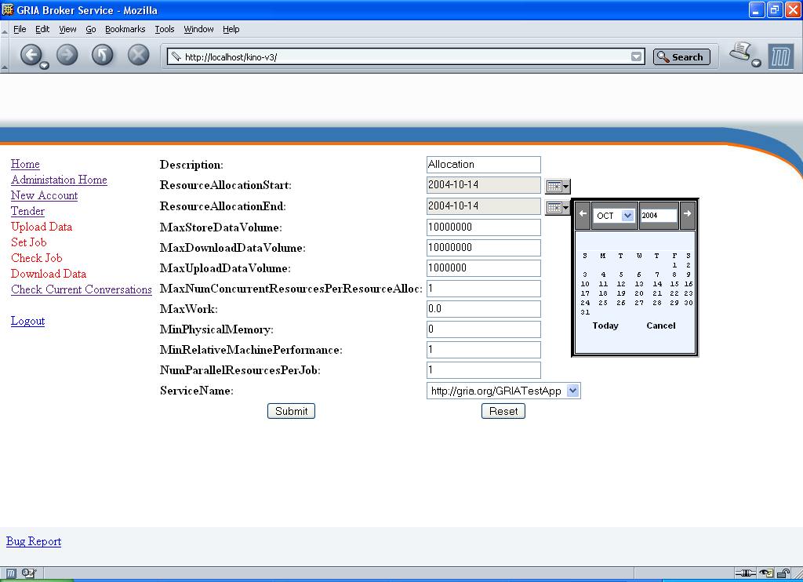
Tender

Slide 11
Upload Data
This action has to be performed after the tender process has been completed and an allocation conversation has been opened.
The user uploads the input file(s) of the job and selects in which allocation the data will be uploaded.
The data in the suppliers is represented as a data conversation.

Slide 12
Set Job
All the data have to be uploaded (input data may also be output data from previous job executions)
The user fills in a form with the job parameters:
  Description of the new job
  Maximum output data bytes
  Minimum physical memory needed for job execution
  Number of the processors needed for job execution
  Estimated CPU seconds of job execution
  Specific special arguments that may be needed for the job execution

Slide 13
Check Job(s) Status
Users can check the status of the job(s) sent for execution by browsing a table with all the active jobs (-conversations) and the status of them

Slide 14
Download Data
Portal users can download the output data of the submitted job

Slide 15
Check Conversations
Check the active conversations providing a list with all the conversations and their description
Conversations can be
  Accounts
  Allocations
  Data
  Job
Deletion of some conversations is also visible (for a specific group of users).

Slide 16
Added Functionality
User Management
System Control
Portal Statistics

Slide 17
User Management
User Management actors are the administrators
Actions
  Add new users
  Change their attributes
  Change their access level
  View the details of the user accounts

Slide 18
System Control
System Management actors are the administrators
Actions
  Open new accounts in GRIA suppliers
  Check their status
  Check their balance
  Delete them

Slide 19
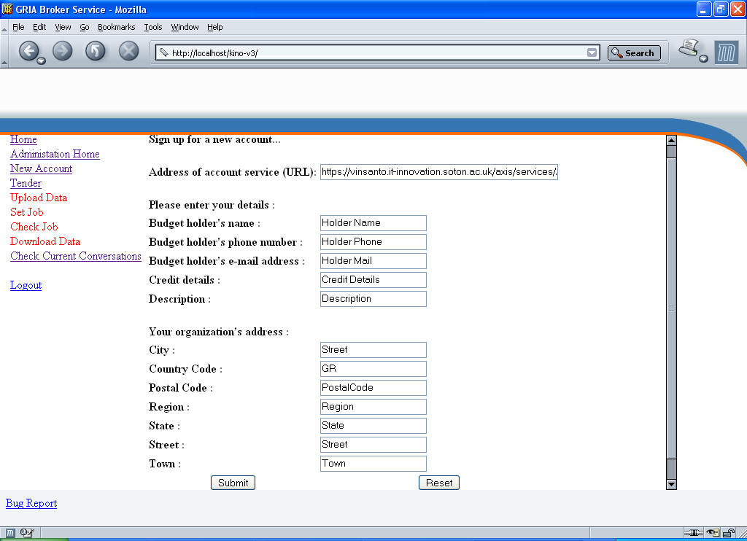
System Control

Slide 20
Statistics
Allows the presentation of the statistics for several time intervals, actions or users
Can be customized depending on the administrator’s preferences
monitoring information concerning:
  User’s actions and how they interact with the portal
    Which users submit jobs
    Which user accounts are inactive

Slide 21
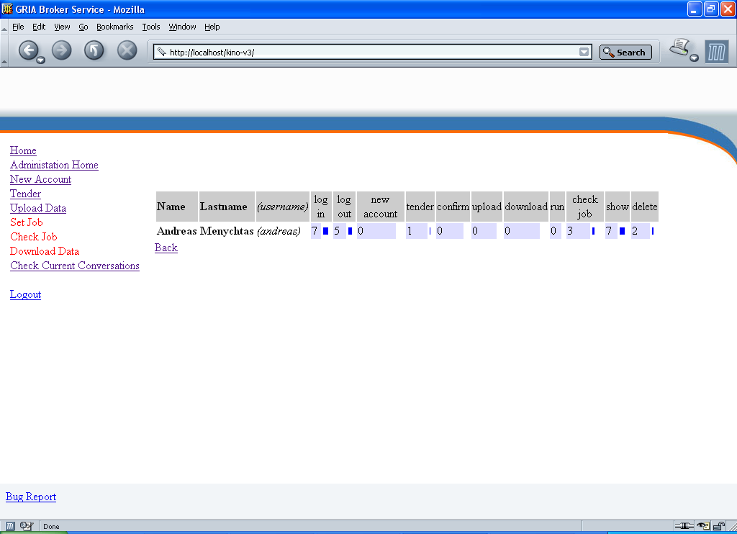
Statistics

Slide 22
Conclusions
User friendly
Performance
  The end user is only a few clicks away from the job submission
New useful tools, features
No Installation is Required
Presentation Layer unaffected by any Middleware Update/Changes
Platform independent
Easily extended

Slide 23
Future work
The migration of the portal from the tomcat servlet container to the GridSphere

